Slide 1
Instructions for Use of These Slides
The purpose of these slides is to serve as a resource that any radiation oncologist can use when speaking about the role of palliative radiation therapy for hospitalized patients.
The target audience could include residents/fellows, staff physicians or mid-level providers in the field of emergency medicine, internal medicine, palliative care and medical oncology. Any user is welcome to format the slides as needed to fit their target audience.
Please ask attendees to complete either the pre-test or post-test so that we can assess the effectiveness of the slides. If you make significant changes to the content of the slides for your presentation, we prefer that you use the pre-test only.
Pre-test link: https://redcap.link/inpatients-pre
Post-test link: https://redcap.link/inpatients1
Primary Author(s): Malcolm Mattes
Peer Reviewer(s): Bailey Nelson, Gabriel Peters, Mike Corradetti, Shunqing Zhang, J. Ben Wilkinson
Additional Support: ASTRO Communications Committee
Last updated in September 2022 – newer data may impact the accuracy of the content of these slides

Slide 2
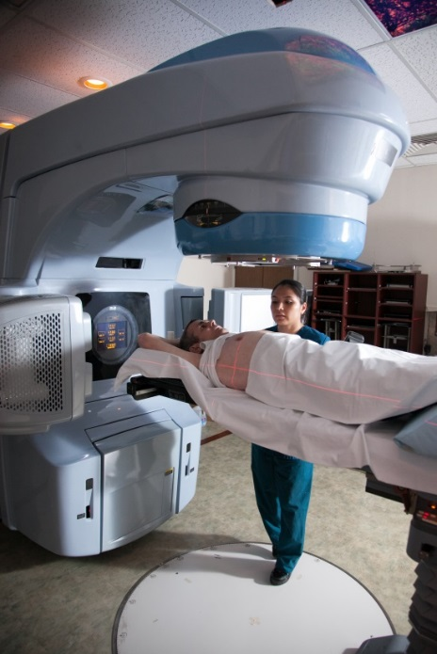
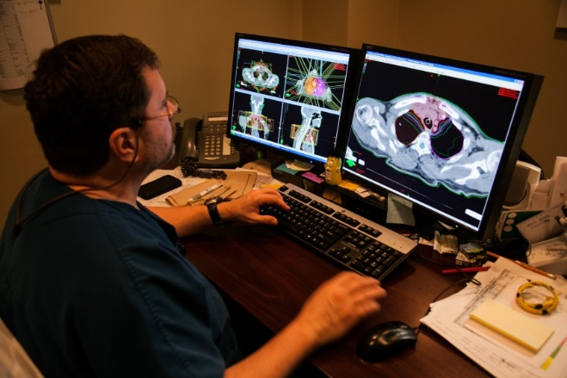
A Primer in Radiation Oncology for Hospitalized Patients

Slide 3
Learning Objectives
Learn fundamental principles of palliative radiation therapy.
Understand why all patients with cancer-induced symptoms should have a radiation oncology consultation concurrently with medical oncology and other organ-system specific specialists.

Slide 4
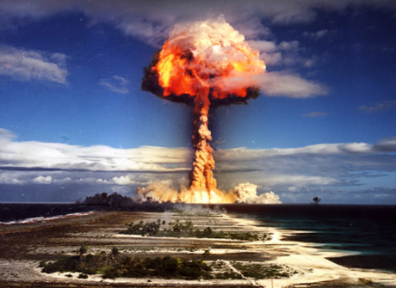
The word “radiation” might make you think…
The reality of medical use of radiation therapy is very different.
Notes:
Radiation therapy has led to many more lives saved than the combined lives lost from accidental or malicious use of radiation

Slide 5
Roles of Radiation Therapy in Cancer Care
Curative RT can be indicated before surgery, after surgery or instead of surgery.
Indications depend on the tumor type and stage.
Enables organ preservation.
Palliative RT in metastatic (incurable) patients is focused on alleviating symptoms and improving quality of life.
Two-thirds of patients with cancer receive radiation at some point in their treatment course.

Slide 6
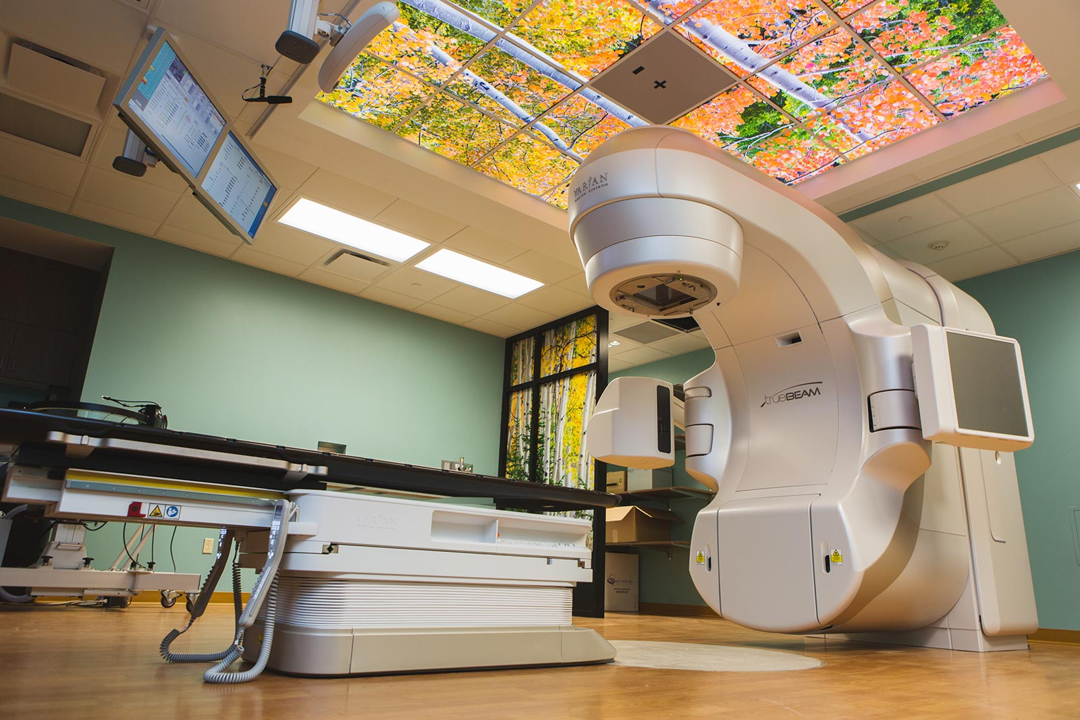
External Beam Radiation Therapy
A linear accelerator delivers high energy X-rays (photons) or electrons.
Non-invasive, painless.
Rapid treatment delivery in minutes.
Used in outpatients and inpatients.

Slide 7
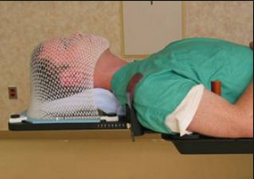
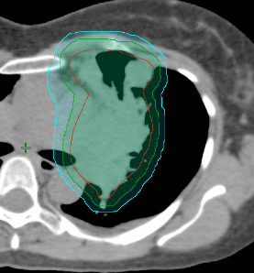
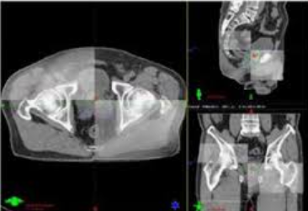
Radiation Therapy is Designed to be Precise
Immobilization devices are used to help patient be comfortable and make setup reproducible.
Image-guided treatment planning on a CT scan enables accurate delineation of the target and shaping of the dose to avoid normal structures.
Image-guided treatment delivery accounts for daily shifts in soft tissue anatomy or patient setup.

Slide 8
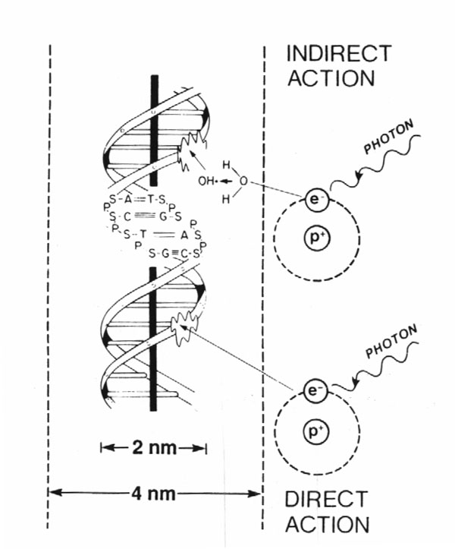
How Does Radiation Work?
80%
X-rays interact with water
radiolysis
free radicals
bind to and damage DNA
cell death
(by mitotic catastrophe)
20%
Cancer cells are more susceptible to RT
due to impaired DNA repair pathways.

Slide 9
Why do Patients with Cancer Come to the ED?
Symptoms!
From their cancer
From cancer treatments
In general, most patients with cancer who come through the ED or are admitted have advanced malignancies, and treatment goals are often palliative.

Slide 10
Why is Palliative RT Valuable?
External beam RT is non-invasive.
Most patients experience symptomatic relief.
Relatively low doses used compared to curative RT.
Usually with minimal short-term toxicity that is readily controlled with supportive medications.
Usually with no clinically significant long-term toxicity (brain RT is one notable exception).
If used appropriately, potential to prevent severe symptom crises.

Slide 11
Common Indications for Palliative RT
 | Examples | Time to Response
Bleeding | Bladder, GYN, lung, etc. | days
Obstruction | SVC, airway, esophagus, ureter, bile ducts | days - weeks
Pain | Bone mets, neuropathic pain | days - weeks
Neurologic Symptoms | Cord compression, brain mets | days - weeks
A general rule of thumb is that ~75% of patients who live long enough to respond to palliative RT will have improvement in their symptoms (though in practice, a number of factors can affect this rate).
Since time to response is not immediate, we can get ahead of issues (and avoid emergencies) with earlier consultations.

Slide 12
Differentiating Palliative RT Indications from Curative RT Toxicities
The same symptoms that radiation can effectively alleviate, it can also cause as late toxicity after curative treatment.
This does not mean that radiation will make a cancer-induced symptom worse.
Most tumors respond to RT.
By design, the incidence of severe late toxicities is generally low (<5%) for curative RT, and very low for palliative RT.
The risk:benefit ratio of palliative RT should always be carefully weighed, but generally favors treatment.
Notes:
Somehow the toxicities are remembered more

Slide 13
Triaging Inpatients
WARNING: This may be a fundamentally different approach than what you are accustomed to.

Slide 14
Understanding the Oncologic Specialties
There are 3 main types of oncologists.
Most of their knowledge of cancer is shared, however, the training for each is different, and there is no formal cross-training between specialties.
Each offers unique expertise and perspective to patient care.
For the most part, the treatment modalities complement each other.
Medical Oncology
Radiation Oncology
Surgical Oncology
+ Subspecialties
All are equal partners in cancer care.
Effective teamwork → higher quality, patient-centered care.

Slide 15
General Approach to Palliative/Supportive Care for Solid Tumors
All cancer symptoms exist on a spectrum.
Mild symptoms
Relatively controlled
Moderate symptoms
Impacting quality of life
Severe/life threatening symptoms or refractory to other treatments
Immediate relief needed
Systemic Therapy Alone
no local side effects, but response less likely and often delayed
+ Radiation Therapy
mild-mod potential for short- or long-term local side effects
+ Surgery/Invasive Procedure
higher potential for short- or long-term local side effects
Typically, when patients reach the ED or need inpatient care, it is because of moderate to severe symptoms. Radiation or an invasive procedure is usually indicated.
Notes:
Since these patients are incurable, before any intervention goals of care should always be evaluated and hospice considered, depending on patient’s values and wishes
Care of physical symptoms is often fragmented and inefficient due to sequential, rather than concurrent referrals to different types of physicians.

Slide 16
The Most Common (but Suboptimal) Care Path
Surgeon or other procedure-oriented specialist
often consulted first (single decision-maker model)
Three potential outcomes
Appropriate decision to proceed with invasive procedure
Decision not to proceed with procedure, but subsequent delay in referral to appropriate service
Inappropriate and overaggressive use of invasive procedures (often due to incomplete understanding of options)
Notes:
Its not anyone’s fault – deficiencies in cross-training and usually a lack of randomized evidence to guide management in palliative setting
Expedite treatment
Important in a symptomatic patient
RT treatment planning takes some time – better to start early
Greater likelihood patients will live long enough to benefit from palliative RT if initiated earlier in course

Slide 17
The Optimal Patient-Centered Care Path
Concurrent referral to surgical, medical and radiation oncology teams (multiple decision-maker model)
Expedited workup
Multidisciplinary discussion and consensus
Expedited initiation of appropriate treatment
More rapid hospital discharge (or avoid admission)
The Bottom Line: Doctors working collaboratively are more likely to take timely and appropriate actions.

Slide 18
Value of Multidisciplinary Inpatient Care that Includes Radiation Oncologists
Observational cohort study of 181 patients with painful bone metastases.
Compared inpatient outcomes before and after formation of a dedicated palliative rad onc consult service that worked closely with other specialties.
Results: The use of palliative rad onc consult service led to…
Shorter hospitalizations by an average of 8 days.
Cost savings of $20,719/patient/hospitalization.
35% increase in palliative care specialty utilization.

Slide 19
When to Consult Radiation Oncology?
Immediately upon diagnosis of any cancer-related symptom that may benefit from radiation, and concurrently with medical and surgical teams.
Common indications:
Brain mets
Bone mets (including spinal cord compression)
Bleeding
Obstruction of airway, esophagus or SVC

Slide 20
Common Pitfalls with Inpatient Radiation Oncology Consultations
Reliance on organ-system specific surgical (or other procedure-oriented) team to know when to consult radiation oncology.
Reliance on medical oncology team to know when to consult radiation oncology.
Waiting to consult until pathology is obtained.
Waiting to consult until patient is in so much discomfort that they cannot lie on our treatment table.
Not consulting radiation oncology when a radiation-induced toxicity is suspected.
Notes:
Consultation, simulation, and treatment planning can be occurring in the background while someone is waiting for a biopsy or pathology results (which can expedite overall patient care)

Slide 21
Is There Anyone Who Cannot be Treated?
Patients usually must be able to lie flat on treatment table.
Can be an issue if in significant pain; sometimes medical management of pain can overcome this issue.
Patients must be cooperative.
Can be an issue with altered mental status or children; can consider anesthesia support if indicated.
When treating brain or head/neck tumors, patients must wear a mask.
Can be an issue if claustrophobic; sometimes anxiolytic medications can overcome this issue.
Notes:
Some masks are now open (w/ surface imaging and/or can be made to be open around the eyes/nose to make the treatment more tolerable). A tip that could also be added to the notes section is that asking nursing to dose pain medication and 45 minutes before radiation therapy procedures can be helpful (less pain in transport / on sim or treatment table)

Slide 22
What About Patients Near the End of Life?
It is always better to give palliative RT while a patient has a long enough life expectancy to benefit from it.
There are some patients approaching the end of life who may benefit from a single fraction of palliative RT before hospice enrollment.
Need to consider patient’s life expectancy on hospice to determine if palliative RT right before enrollment is likely to benefit them.
Hospice services will generally (with some exceptions) not pay for radiation therapy, so better to do that single treatment before enrollment.
It is okay to discontinue a course of palliative RT for a patient to go on hospice, but the radiation oncologist should be involved in that decision.

Slide 23
Case Studies
Notes:
The following cases were written to highlight the importance of early multidisciplinary involvement of different types of cancer specialists, including radiation oncologists.

Slide 24
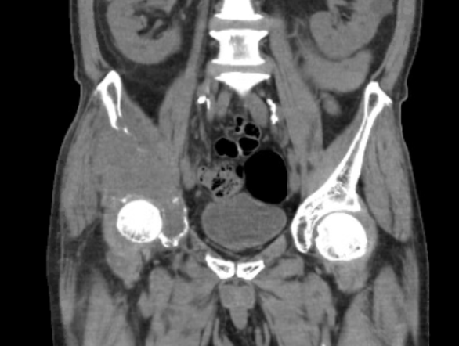
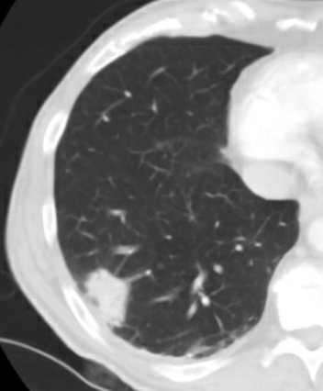
Case #1: Bone Metastasis
69M former smoker with no prior cancer history presents to ED with right hip pain and limp.
Who should you consult?
What should you do for his pain?
Notes:
Typically a case like this would be treated with palliative RT followed by systemic therapy, but radiation oncology needs to be consulted early on to help get on the same page with the rest of the team.
In practice, what actually happened with this patient is that rad onc was not consulted and orthopedics directed embolization, an aborted surgery, and then IR ablation, none of which helped the patient’s pain. After a delay, once radiation was started his pain gradually improved and he has been relatively pain free for the rest of his life until he ultimately died of progressive systemic disease 12 months later.

Slide 25
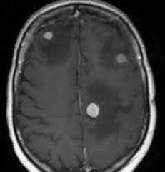
Case #2: Brain Metastasis
62M with a history of metastatic NSCLC currently on immunotherapy, who comes to the ED complaining of headache, nausea and vomiting. MRI brain shows three enhancing lesions with surrounding vasogenic edema.
​ Who should you consult?
What should you do for his symptoms?​
What are his treatment options? Would they differ if there are 15 lesions? Or a dominant 4cm lesion causing most of his symptoms?
Notes:
Neurosurgery, radiation oncology, and the patients medical oncologist should be consulted simultaneously. Important that they discuss optimal treatment approach in the context of his life expectancy.
Decadron will help with his symptoms.
Surgery will have little role given that there are multiple lesions and all are small. Hospital discharge with steroids and set up for outpatient stereotactic radiosurgery would be preferred given the limited number of small lesions. Whole brain radiation becomes the preferred option if more brain metastases are present, at the expense of toxicity. If a dominant lesion is present surgical resection would be useful for immediate symptom relief, even in some cases when multiple brain metastases are present.

Slide 26
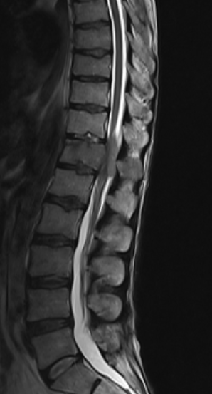
Case #3: Spinal Cord Compression
57F with known metastatic breast cancer presents to the ED with progressively worsening back pain over the past month and new left lower extremity weakness for the past two days.
Decadron is started empirically.
MRI of the full spine shows a L1 vertebral body metastasis with epidural compression.
Neurosurgery and radiation oncology are consulted. After discussion, a decision is made to proceed with surgical decompression.

Slide 27
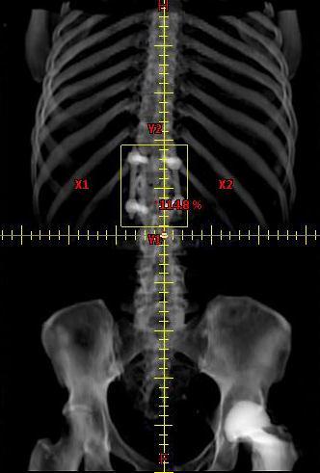
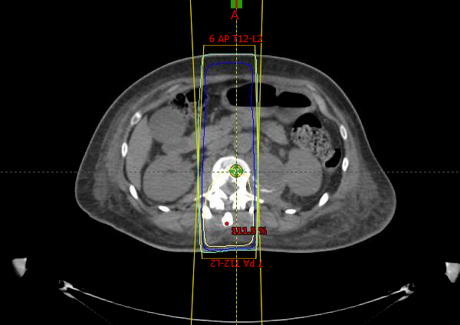
Case #3: Spinal Cord Compression
Radiation therapy is initiated on post-op day 10.
How would management change if this was multiple myeloma? Or lymphoma?
What if life expectancy was less than three months?
Notes:
Discuss how radiation or chemosensitive tumors do not need surgery. It would be wasting time to consult the surgeons first and delay consults to others. Some surgeons might even operate.

Slide 28
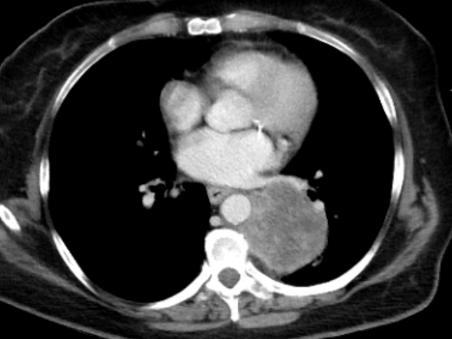
Case #4: Suboptimal Multidisciplinary Care
64F active smoker with HIV p/w perineal abscess.
Incidental finding on imaging of lung mass.
What should you do?

Slide 29
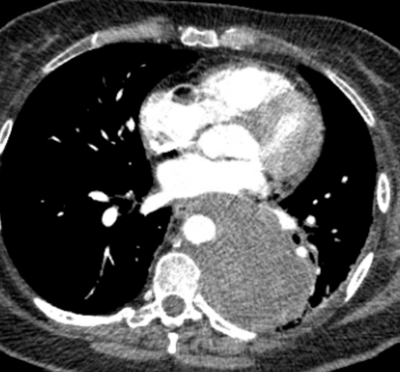
Case #4: Suboptimal Multidisciplinary Care
A multidisciplinary team of oncologists was not consulted and there was a six week delay in the patient’s care, when she returned to the ED with severe back pain and progressive disease on imaging.
Biopsy shows NSCLC.

Slide 30
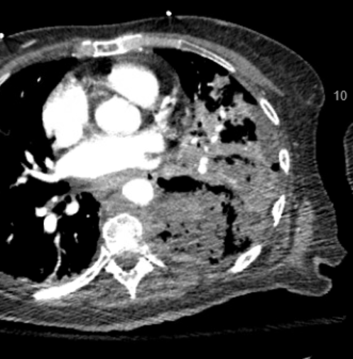
Case #4: Suboptimal Multidisciplinary Care
Radiation oncology was eventually consulted, and the patient started chemo-RT, with excellent response over first two weeks of treatment.
Unfortunately, regression of mass opened a fistula with bronchus or esophagus, and she died soon after.
She is unlikely to have had this complication if multidisciplinary referrals were initiated sooner.

Slide 31
Take Home Points
Radiation is a central treatment modality in alleviating symptoms from cancer, but it is underutilized, or often utilized too late to have maximal benefit.
Radiation oncologists are experts in multidisciplinary local symptom management and are the most knowledgeable physicians about RT indications and RT toxicity.
Any patient with cancer-induced symptoms should have a rad onc consultation concurrently with the rest of the multidisciplinary cancer team.
You can make a big difference in expediting care, shortening hospital stays, and most importantly, reducing patients’ suffering.
Trainees are welcome to come rotate with us in radiation oncology (even if just for a day) if interested so they can get a better sense of what we do.

Slide 32
Thank You!
Please take five minutes to answer the questions in this electronic survey to help consolidate what you learned.
https://redcap.link/inpatients1
Notes:
And to help us learn about how to improve the presentation in the future

