Slide 1
How to use this slide deck:
The following slides include various topics for you to tailor to the needs of your practice. Below are suggested sections based on your audience and intent of the presentation.
All:
ASTRO and APEx
Evaluation by APEx
Area of Additional Review
APEx Process
Improvement from Self-Assessment to Facility Results
ASTRO Support and Links
Administration:
Practice Types and Cost
Multi-facility Application Cost
Treatment Team:
Corrective Action Requirements
Notes:
Suggested Handouts for presentation:
APEx Standards List from webpage.

Slide 2
Transitioning to APEx® Accreditation

Slide 3
ASTRO and APEx

Slide 4
ASTRO is the leading medical society dedicated to radiation oncology, biology & physics.
A non-profit professional organization founded in 1958
Our Members
ASTRO’s nearly 10,000 members
include radiation oncologists, biologists,
medical physicists, dosimetrists,
radiation therapists, nurses, PAs,
administrators & industry representatives.
Our Mission
Advance the radiation oncology specialty:
Promote equitable, high-quality care for people with cancer
Cultivate & educate a diverse workforce
Foster research & innovation
Lead policy development & advocacy
Notes:
ASTRO, the premier radiation oncology society, developed APEx – Accreditation Program for Excellence®, a specialized accreditation program to meet the needs of modern radiation oncology practices. Before delving into the program details, we will examine feedback from other practices regarding the program.

Slide 5
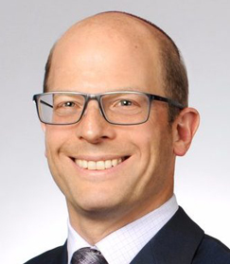
What Others Are Saying About APEx?
“[You] don’t know what you don’t know, and the accreditation process is a means for multiple stakeholders - physicians, physics, dosimetry, nursing, administration, and anyone else who is involved, to look at processes and approaches to how they’re doing things.”
Adam Dicker, MD, PhD, FASTRO, FASCO
Professor and Chairman, Department of Radiation Oncology – Sidney Kimmel Medical College
99% of evaluation survey respondents were satisfied or very satisfied with the overall APEx process.
“The process prompted us to … collaborate as a team to improve our workflows. It has been well worth the time and effort, and I feel it's been a very valuable process.”
– Program evaluation response
“I greatly appreciated the learning from this process and found the process inviting and more empowering than anything else.”
– Program evaluation response
“I feel that this was more in-depth than [another accrediting body], but that is to be expected as ASTRO is RO-focused, whereas [others have] many different branches.
I felt that our team learned a lot about ourselves, and we achieved all our accreditation goals. As a brand-new RO director (leading my first accreditation), I didn't realize the work needed to complete the process. In the end, it was great to see how our organization meets most of the APEx standards and I was thrilled when we gained full accreditation.”
Chris Channel, RT(T)
Director of Radiation & Imaging Services - Hematology-Oncology Associates of CNY

Slide 6
History of ASTRO and APEx Accreditation
2010
Target Safely Campaign launched by ASTRO
Pre-2015
Co-sponsored ACR’s accreditation
2015
First practice accredited by APEx
2019-2021
APEx recognized by NY and NJ
2021
ASTRO awarded contract to accredit Veterans Affairs radiation oncology practices
Notes:
The APEx timeline began with ASTRO co-sponsoring ACR's accreditation program until a critical NY Times article prompted ASTRO to reassess its approach. In 2010, ASTRO launched the Target Safely Campaign, which led to the creation of Safety is No Accident, Radiation Oncology Incident Learning System (or RO-ILS) and APEx. Since 2015, APEx has gained recognition and acceptance in all 50 states. In 2021, APEx was awarded the contract to accredit the 41 radiation oncology practices within the Veterans Health Administration. In 2023, ASTRO conducted a quality improvement review on APEx, explicitly updating the Evidence Indicators to align with current practices and design a better user experience for the future.

Slide 7
APEx Growth
Fastest growing radiation oncology accreditation program in the U.S. with 100% return rate for practices seeking reaccreditation.
“We liked APEx’s philosophy of teamwork to help patients.”
Srinivasan Senthamizhchelv, PhD, DABR
Director-Radiation Oncology & Lead Medical Physicist - CHI Memorial Radiation Oncology
* Through June 2023
Notes:
APEx has experienced consistent growth and is currently the fastest-growing radiation oncology accreditation program in the United States. Practices that have completed APEx accreditation have observed its benefits, leading practices to return for their reaccreditation cycles.

Slide 8
APEx Offers
Transparency during APEx evaluation, through:
Pre-application APEx Standards list.
Self-Assessment Guide to provide full program expectations.
One-on-one staff support.
Objective reviews by APEx Surveyors based on nationally recognized published guidance.
“We had a much better experience with APEx compared with [another accrediting body]. The APEx experience seemed more in-depth and involved. At the same time, our surveyors seemed more flexible and understood that each practice is different.”
– Program evaluation response
Notes:
ASTRO designed APEx to be transparent and provide feedback throughout the process. ASTRO staff is available to provide one-on-one staff support to practices, including scheduling team meetings to address any questions and review the accreditation process. Practices are evaluated on nationally recognized published guidance from organizations such as ASTRO, AAPM, AAMD, ASRT and ABR.

Slide 9
Evaluation Criteria of APEx

Slide 10
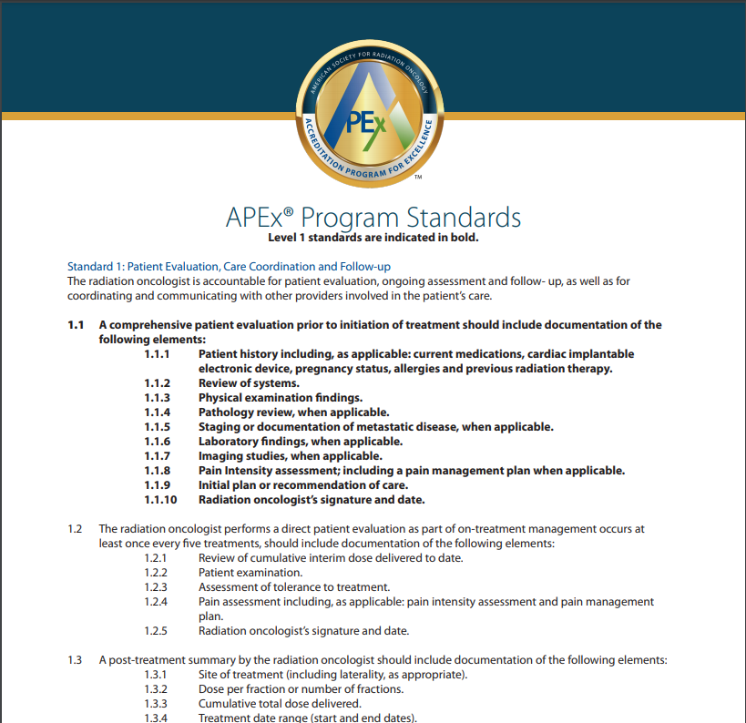
What Are APEx Practices Evaluated On?
APEx Standards – High-level overview
Self-Assessment Guide – Detailed guide
Notes:
If you have not already reviewed the APEx Standards document, please download a copy from the ASTRO webpages.
The APEx Standards document provides us with a high-level review of the Evidence Indicators that we will be evaluated on while seeking accreditation. Once we decide to pursue APEx and complete the application process, ASTRO will provide access to the Self-Assessment Guide, which includes details on the program requirements and how each Evidence Indicator is evaluated.

Slide 11
Benefits of the APEx Program
Developed by ASTRO for radiation oncology practices.
Team-based approach.
Feedback on compliance before the facility visit.
Increased team communication through documentation.
Focused on quality improvement.
Multiple user allowed per application.
Notes:
APEx was specifically created for radiation oncology practices, focusing on the entire teams’ role in continuous quality improvement. APEx provides multiple feedback points to the practice during the first phase of the program allowing for change before the surveyors evaluate our compliance during the facility visit. Once past the application phase of the program, we can add additional team members to the APEx Portal. This way, multiple team members can assist in adding information and completing it.

Slide 12
Focus on Quality Improvement
Notes:
APEx follows the quality mantra “if it isn’t documented, it isn’t done”, or you may have heard of it as “if it isn’t documented, it never happened”. Either way, getting into good habits and ensuring documentation of work and communication makes things efficient and become part of our routine practice. APEx follows a traditional plan-do-study-act quality improvement cycle , promoting the idea that we can evaluate our compliance with particular tasks, identify the best option or solution for our entire team, implement the plan, and monitor the outcome.

Slide 13
Areas of Additional Review in APEx

Slide 14
Unique Qualities of APEx
Culture of Safety
Clinical Safety
Clinical Communication
Information Systems and Support
Patient Education and Referral
Peer Review for all Disciplines
Notes:
APEx provides a comprehensive review of our practice, focusing on the entire team to ensure patients receive the highest quality of care. Assessment areas include reviewing patient care/safety, quality management, team training, treatment planning/delivery, equipment and data management, like other accrediting bodies. As a comprehensive program, APEx also evaluates several areas that other accreditation programs may not assess. Let’s review each of these in more detail.

Slide 15
Culture of Safety
A process for reporting all incidents, including near misses and patient events, focused on preventing future occurrences.
Developing a non-punitive culture that empowers staff and patients to speak up and ask questions.
A process for staff and patients to submit incidents anonymously.
Appointment of a radiation oncology department leader to oversee the submission, review and education on events and safety trends, including management of interdisciplinary radiation oncology safety meetings to provide ongoing education.
Reporting to a patient safety organization (PSO), like Clarity which supports ASTRO’s RO-ILS®, allowing your practice to see trends in patient events nationwide.
Notes:
A Culture of Safety is an open, non-punitive work environment with shared values, beliefs, and norms to build a learning healthcare system. Patient safety events in the radiation oncology department should be used as learning opportunities. Catching near misses before events reach the patient is the goal, but tracking near misses and patient events provides knowledge to mitigate future incidents.
RO-ILS is a patient safety initiative created by ASTRO and AAPM dedicated to reducing medical errors by providing a platform for reporting safety events in a secure and non-punitive environment. The program is free to enrolled U.S.-based practices. It gives access to a web-based portal for sending data to a federally listed PSO, thereby showing compliance with evidence indicator 7.5.1 and gaining legal protections as afforded by the Patient Safety and Quality Improvement Act.
Over the following few slides highlighting key APEx elements, including an example of a RO-ILS event submission showing why these areas of evaluation are essential.

Slide 16
Clinical Safety
Responding to patient falls, cardiac events, adverse drug reactions and being equipped to respond to equipment failure during treatment.
Facilitating transfers to emergency care during and after hours.
Cleaning radiation oncology-specific equipment (e.g., tables, custom and non-custom devices).
Providing safe staffing plans for absences and supervising non-board-certified team members assisting in the treatment procedure (e.g., students, medical physicist assistants, etc.).
Related RO-ILS Reported Event
Emergency whole brain treatment calculated by the radiation therapists. Second check performed by the physicist but not documented. Planning documents not approved by MD. Patient treated in QA mode. SOP was not followed, and many steps were not completed.
Notes:
The safety of our patients is the responsibility of every team member. Having documented emergency processes that our staff can be trained on and refer to allows staff to react faster and consistently when required. APEx requires policies to ensure safe staffing levels, plans for unplanned absences and cleaning of custom and non-custom devices in-between patients. While our practice may or may not treat on the weekends, it is crucial to have a process to treat patients on an emergency basis, so events like this RO-ILS example do not happen in our practice.

Slide 17
Clinical Communication
Documenting communication between the team.
Transmitting initial consultation and end-of-treatment notes to other providers and ensuring timely transfer of radiation therapy records upon request.
Verifying that the proper image set is transferred from simulation to the treatment planning system.
Verifying accurate transfer of patient information when using more than one information system.
Related RO-ILS Reported Event
The patient was scanned for DIBH. MD decided to plan on the free-breathing scan. Dosimetrist imported breath-hold scan for planning. The therapist noticed that the lung volumes were different on the third treatment. Documentation of DICOM transfer would mitigate the error.
Notes:
Communication plays a vital role in radiation therapy. Verbal communication, while fast, is unreliable and can be misunderstood. Documented communication is more reliable, saves time for staff and can be referred to as needed. APEx requires documented communication processes for staff working different hours (e.g., physicists working late into the evening to get a machine back in service for the morning therapists), documentation to providers outside the department for the continuation of patient care and review of proper DICOM image input to the treatment planning system. By verifying that the correct DICOM was transferred from CT simulation, the team can plan the treatment correctly and accurately following the intent of the radiation oncologist.

Slide 18
Information Systems and Support
Using individualized sign-ins with permissions based on job functions.
Implementing information system safety options (e.g., bolus acknowledgment, timestamp change requests, password-protected approvals, etc.).
Ensuring staff are trained on system upgrades and responding to requests for additional training to promote optimal utilization.
Related RO-ILS Reported Events
Practice acquired new auto-contouring software. Planner used software for SBRT lung plan, but a PTV-adjacent OAR had irregularities. Contouring error not discovered by planner nor during plan review. Error caught during chart rounds. Education before new technology commission helps staff become familiar with processes, workflows and potential dangers. Post go-live education allows real time experience and pitfalls to be accounted for.
Notes:
Radiation therapy is a technologically driven field and its importance is growing with new technologies. Information systems within the field require the same level of QA as any other aspect of radiation therapy. When staff are not properly trained on IT systems, it can lead to patient safety events not caught before it reaches the patient. Having full training to see when errors happen increases safety and reliability in our department .

Slide 19
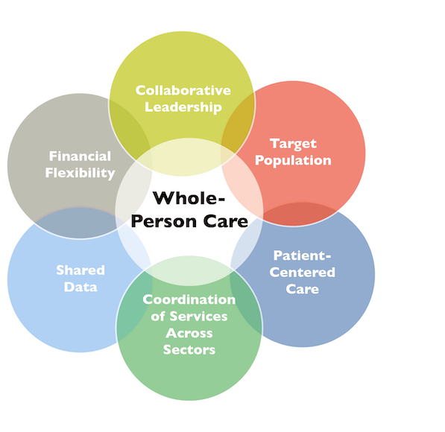
Patient Education and Referral
Providing patient education, including oral and written options in languages appropriate for your community.
Educating patients on the potential financial impact of treatment.
Referring patients to specialists outside of radiation oncology (e.g., speech therapy, pain management, etc.).
Accepting and addressing patients’ grievances outside of satisfaction surveys.
Notes:
Radiation therapy is just one branch of care for people with cancer. Patients need clear education and expectations as they navigate their own complex care. They also need access to other services that our practice may not provide. APEx ensures the implementation of processes to educate patients on financial implications of their treatment and provide them with educational materials that are accessible and tailored to their preferred written or communication style.

Slide 20
Peer Review
Multidisciplinary
Between specialties in oncology
Radiation oncology, medical oncology, surgical oncology
e.g., tumor boards
Interdisciplinary
Between professions in radiation oncology.
Radiation oncologists, medical physicists, therapists, dosimetrists, nurses.
e.g., chart rounds, safety meetings, huddles
Intradisciplinary
Between colleagues of the same profession.
Radiation oncologist-to-radiation oncologist, dosimetrist-to-dosimetrist, etc.
e.g., radiation therapist team meetings, alternating QA review
Notes:
Finally, peer review. APEx assesses various types of peer reviews. Multi-disciplinary peer review involves collaborating with other specialties, such as tumor boards. Interdisciplinary peer review encompasses team safety meetings, daily huddles, or chart rounds. The last aspect of peer review is intradisciplinary, which refers to peer-to-peer evaluation within your own profession (physicist-to-physicist, therapist-to-therapist, etc.). APEx evaluates all of these areas so our staff has access to several different learning environments and can continue to grow.

Slide 21
Practice Application Types and Cost

Slide 22
APEx meets the needs of all practice types.
APEx Accredited Practices as of July 2023
Notes:
As of 2023, over 400 practices are involved in APEx, with around 300 achieving accreditation and the rest working towards accreditation. APEx-accredited practices are located in 36 states and Washington, DC.
APEx has experienced consistent participant growth since its development and has successfully retained early adopters through the reaccreditation process. Most APEx practices are private or community-based, while one-third are academic or government facilities. This distribution aligns with ASTRO data on radiation oncology practices in the US, highlighting the program's applicability to practices of all types and settings. Over half of the participating practices apply for APEx as single applicants, and the remaining applicants represent multi-facility practices.

Slide 23
Accreditation Application Cost Main location with one satellite
Flexible accreditation cycles (3 or 4 years) with similar application fees as current accreditation.
Annual accreditation cost: approximately $3,200 regardless of cycle length or program.
3-year accreditation
4-year accreditation*
*ACR does not offer 4-year accreditation
Notes:
While the total fee for APEx accreditation may initially appear higher than other accrediting bodies, the annual costs are similar across the variety of accreditation options.

Slide 24
Multi-facility Application Costs

Slide 25
Sample Multi-facility Application
Facility 5
40 mi
120 mi
Facility 4
20 mi
5 mi
Facility 1
Facility 2
Facility 3
Notes:
However, APEx offers potential cost savings that are absent in other programs. Let's explore this further, focusing on a multi-facility application. As an example, this practice has five facilities seeking accreditation. On the next slide, we will look at the total cost for this application, considering the requirements and limitations of each program for both four-year and three-year accreditation cycles.

Slide 26
Application Comparisons Five locations seeking accreditation – 4-year accreditation
Application | Application
Location | APEx | ACRO | ACR
Facility 1 | $13,000 | $12,000 | N/A
Facility 2 | $4,000 | $4,500 | N/A
Facility 3 | $4,000 | $4,500 | N/A
Facility 4 | $4,000 | $12,000 | N/A
Facility 5 | $7,000* | $12,000 | N/A
 | $32,000 | $63,000 | N/A
APEx allows up to 10 satellites per application within 50 - 150 miles. An additional distance fee may be applied.
ACRO only allows two satellites within 50 miles per application.
ACR does not offer 4-year accreditation
* $3,000 distance fee included
Notes:
Only APEx and ACRO allow for four-year accreditation cycles. However, ACRO does not allow for more than two satellites per application and all facilities must be within 50 miles of the main location (facility 1). Therefore, practices seeking ACRO accreditation would need to have up to three separate applications, which increases the overall total cost.
APEx allows up to ten satellite locations which can be 50-150 miles from the main location (facility 1). Satellites outside 50 miles may require an additional distance fee of $3,000, which is up to ASTRO discretion when applied based on surveyor scheduling for the on-site facility visit. Even with the additional distance fee, you can see that APEx would only require a single application and would be almost half the cost of ACROs.

Slide 27
Application Comparisons Five locations seeking accreditation – 3-year accreditation
Application | Application
Location | APEx | ACRO | ACR
Facility 1 | $9,500 | $9,000 | $9,500
Facility 2 | $3,000 | $3,500 | $3,000
Facility 3 | $3,000 | $3,500 | $3,000
Facility 4 | $3,000 | $9,000 | $3,000
Facility 5 | $6,000* | $9,000 | $9,500
 | $24,500 | $34,000 | $28,000
APEx allows up to 10 satellites per application within 50 - 150 miles. An additional distance fee may be applied.
ACRO only allows two satellites within 50 miles per application.
ACR does not allow satellites outside one hour drive.
* $3,000 distance fee included
Notes:
All three programs offer a three-year accreditation option. However, as you can see, APEx is still the least expensive option for this multi-facility application due to the satellite restrictions of ACR and ACRO.

Slide 28
APEx Process

Slide 29
APEx Process
Notes:
There are four primary phases of APEx and therefore designed slightly differently than other accrediting bodies. These phases include the application, Self-Assessment, facility visit and determination.
The application phase is a straightforward input of data relevant to our facilities, such as the number of new patients seen in a year, treatment modalities offered, types of equipment, and physician list. The application also requires signed legal agreements and payment. During the application we can choose either a 3- or 4-year cycle.

Slide 30
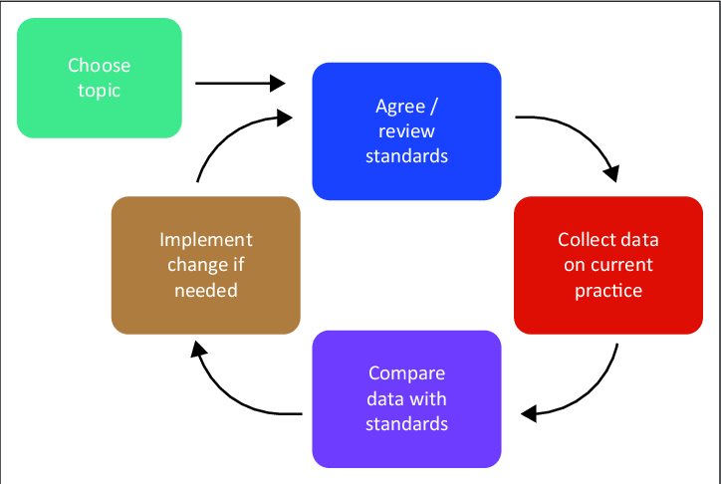
Self-Assessment
Choose section of APEx
Review the APEx Standards
Notes:
Once the application is complete, we will gain access to the Self-Assessment. This is a unique aspect of APEx and adds to the transparency of the program. The Self-Assessment is an internal review completed by us to see how our practice compares to the APEx Standards before surveyors evaluate us during the facility visit. Meaning that any deficiencies identified in the Self-Assessment can be addressed before the facility visit. The quality improvement nature of APEx is reiterated through the cyclical approach of the program. The Self-Assessment allows for multiple attempts in those cases where a particularly low score needs a reassessment once we’ve established the process change.

Slide 31
APEx Process – Self-Assessment
APEx
Self-Assessment
Medical Record Review
Document Upload
Interview Preparation
Application
Self-Assessment
Facility
Visit
Determination
Notes:
The Self-Assessment is broken into three main sections, Medical Record Review, Document Uploads, and Interview Preparation. Each section has a feedback report to help us identify areas where our practice is low performing or inconsistent. All assessment criteria are detailed in the Self-Assessment Guide and APEx Portal. For efficiency, ASTRO suggests that we complete the Document Upload section first, since it requires an external review, but all three sections can be completed simultaneously if we want. We choose the section, review the requirements in the Self-Assessment Guide, collect the data in the APEx Portal, and submit the section.

Slide 32
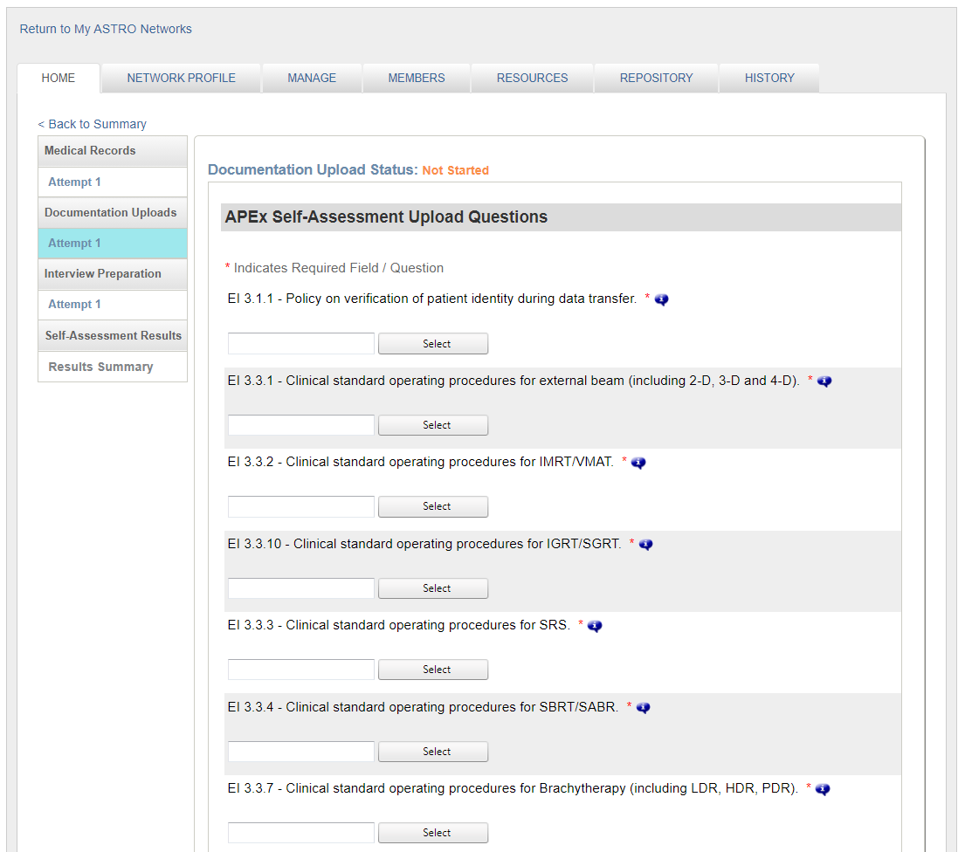
Self-Assessment – Document Upload
Policy, procedure and evidence of completed work are uploaded into the APEx Portal
Requirements based on application information
Application
Self-Assessment
Facility
Visit
Determination
Notes:
In the Document Upload section of the Self-Assessment, we must upload policies, procedures and other materials evidencing quality and safety processes. When reviewing the requirements, we should look at what we already have in place. Once we submit the section, there is a four to six external review, after which a feedback report identifies the extent to which we comply with evaluation criteria and highlights deficiencies that must be addressed before the facility visit.

Slide 33
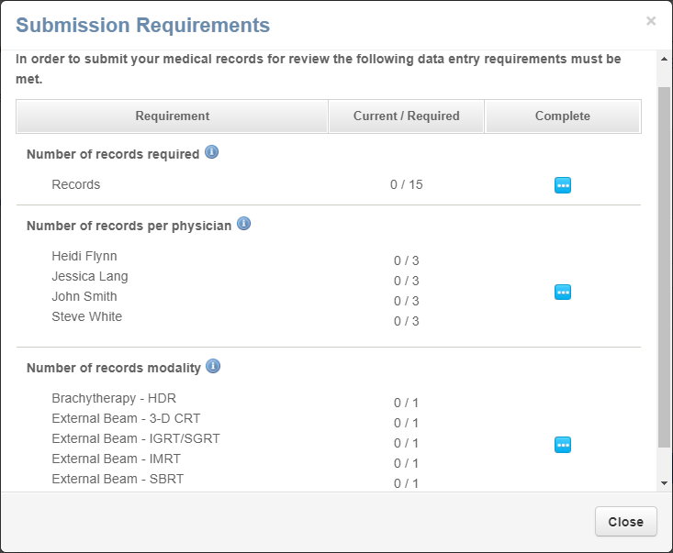
Self-Assessment – Medical Record Review
15-25 medical records reviewed internally for APEx compliance
Requirements based on application information
No PHI entered in the Portal
Application
Self-Assessment
Facility
Visit
Determination
Notes:
The next section of the Self-Assessment is the Medical Record Review. Patient information is never uploaded or entered into the APEx Portal. The questions that are asked are yes/no questions only. We will be required to answer these questions for 15-25 medical records. Each reviewed medical record must have a complete treatment course and a documented follow-up or reason for not following up in radiation oncology. The records must have completed treatment within the last 12 months and equally represent our physicians and treatment modalities at the practice. Each medical record takes roughly 45 minutes to complete.

Slide 34
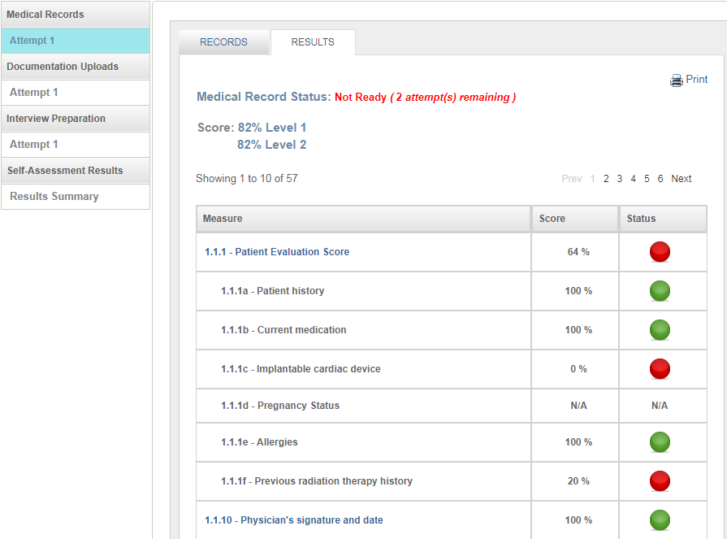
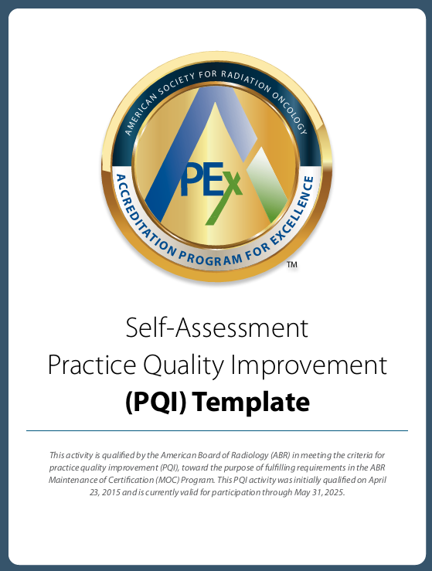
Self-Assessment – Feedback
Application
Self-Assessment
Facility
Visit
Determination
Example of Medical Record Review Feedback Report
Notes:
ASTRO believes that objective, timely feedback is an essential value-added aspect of APEx. This shows an example of the feedback reports from the Self-Assessment Medical Record Review section. APEx participants have indicated that this interim feedback report helps prioritize quality improvement activities at their practice. Additionally, the Self-Assessment is the first component of the Practice Quality Improvement (PQI) activity for radiation oncologist(s) and medical physicist(s) to fulfill Part IV, Evaluation of Performance in Practice for Maintenance of Certification (MOC) for the American Board of Radiology (ABR).
Any of our staff that wish to use the free APEx PQI Template will select a low-performing Evidence Indicator from the Self-Assessment, document the changes toward compliance and then use the results from the facility visit as a wrap-up to show how compliance has changed. The PQI is ours to use and does not need to be submitted to ASTRO.

Slide 35
APEx Process – Facility Visit
Dates
15 potential dates
80-120 days
Surveyors
Availability
Familiarity
Preparations
Materials
Teleconference with ASTRO staff
Distance
COI
“We could not have been more pleased with our surveyors on the facility visits. They were very thorough and provided great feedback. They were very professional and flexible.”
– Program evaluation response
Application
Self-Assessment
Facility
Visit
Determination
Notes:
Once the Self-Assessment has been satisfactorily completed, we will proceed to the facility visit. The facility visit typically occurs in a single day. It serves as an opportunity to showcase the excellent work we do and the changes that we have implemented after the Self-Assessment.
During this facility visit scheduling process, our practice will choose between in-person or virtual facility visit formats. We will then log in to the APEx Portal to select 15 potential dates at least 60 days in advance. ASTRO staff will review our selected dates and surveyor availability to ensure no conflicts before finalizing the facility visit date.
Both in-person and virtual facility visits involve a Medical Record Review, a Physicist Interview, and a Team Interview. The survey takes one full day to complete at the main facility.
For Multifacility practices: Satellites are evaluated for half a day. In a multi-facility practice like ours, ASTRO will pair satellites together (am and pm) and send additional surveyors so that all facility visits will occur on the same day.

Slide 36
APEx Process – Determination
77%
of APEx applicants receive full accreditation on the first attempt.
Application
Self-Assessment
Facility
Visit
Determination
Notes:
The APEx Surveyors will review our practice and enter the results into the APEx Portal. However, they will not provide feedback or a determination during the facility visit. The entered data is blinded by ASTRO staff and submitted to ASTRO’s Practice Accreditation Subcommittee for evaluation. The Practice Accreditation Subcommittee consists of board-certified radiation oncologists, medical physicists, dosimetrists, and radiation therapists who work full-time in radiation oncology. These professionals also volunteer as APEx Surveyors.
The subcommittee conducts an objective review and reaches a formal consensus vote to determine one of three possible outcomes: 1) full accreditation, 2) provisional accreditation, or 3) denial. Regardless of the determination, our practice will receive additional feedback reports to support our ongoing quality improvement efforts.
APEx practices have a very high success rate due to the feedback provided during the Self-Assessment and the opportunity to work on compliance before the surveyors’ visit. Approximately 77% are awarded full accreditation on the first attempt, while only 22% receive provisional accreditation. Continuing the idea of continuous improvement, facilities that receive a provisional accreditation have the opportunity to complete a targeted corrective action plan to reach full accreditation.

Slide 37
How Long Can It Take? Based on 2021-2023 median completion times.
Practice Driven
ASTRO Driven
 | Month 1 |  | Month 2 |  | Month 3 |  | Month 4 |  | Month 5 |  | Month 6 |  | Month 7 |  | Month 8 |  | Month 9
Application Phase
Self-Assessment: Document Upload
Self-Assessment: Document Review
Self-Assessment: Medical Records Review
Self-Assessment: Interview Preparation
Facility Visit Preparation Phase
Determination Phase
Payment Received
Self-Assessment Complete
Facility Visit Date
Notes:
This slide presents the median completion times for each phase based on practices going through APEx between 2021 and 2023. While the application information can be completed in a day, the processing time for legal agreements and payment can extend it to two months. Once ASTRO receives the payment notification, we are granted access to the Self-Assessment in the portal.
The most time-consuming process during the Self-Assessment is gathering, reviewing, or creating the documents to upload into the portal. The duration of this phase depends on the number of policies and procedures we have documented and any necessary edits based on the requirements. After submitting the documents, that the review process takes approximately four weeks to complete. During that review we can focus to the other two sections of the Self-Assessment. Each Medical Record Review takes about 45 minutes. If we complete one review a day, it can be finished in about a month. The Interview Preparation section takes about one hour and can be done any time during this period.
The facility visit scheduling process is collaborative between ASTRO and our practice. The facility visit occurs on a single day, and our determination will be provided within four weeks.

Slide 38
Improvements from Self-Assessment to Final Results

Slide 39
EI 2.1.3 – Verification of DICOM Transfer
Notes:
The following slides will show improvement for select Evidence Indicators from the Self-Assessment to the facility visit results. As you will see by the supplied data, the Self-Assessment feedback reports allowed practices to highlight low-performing EIs and implement a quality improvement project, reflected in the final results from the facility visits.
Importing the correct DICOM images into the treatment planning system is one of the essential building blocks of patient treatment planning, in addition to the actual collection of imaging and documentation of the treatment planning order. As we saw on the previous RO-ILS submission, a critical step could begin the treatment process on the wrong image set without having a documented process for the dosimetrist or other planning staff to verify that they have imported the correct scan. This is a critical clinical communication tool. It ensures that plans use the proper imaging or phase and is another step in verifying patient information. There was an average of 10% more compliance from the Self-Assessment to the results.

Slide 40
EI 9.3.1 – SOP on emergency radiation therapy treatment
Notes:
Add-on treatments or emergency planning occur in every radiation oncology practice, whether during regular treatment hours or when practices have on-call weekend hours. Expedited treatment plans can potentially increase safety events, which is why documented processes are so important. A specific standard operating procedure shows staff’s roles and responsibilities when deviating from a normal process. From the Self-Assessment to the final results, practices went from an average of 74% compliance to 100%.

Slide 41
EI 13.1 – Intradisciplinary peer review
Notes:
Shown here are the improvements practices have made for intradisciplinary peer review for medical physicists, radiation therapists and medical dosimetrists between the Self-Assessment and the facility visit. Most practices seeking APEx meet the radiation oncologists’ peer review though chart rounds or other similar activities, but struggle with opportunities for the other disciplines.
Peer review can be different for each practice based on the number of each profession or available opportunities. Peer review can be accomplished by holding regular meetings or bringing back information learned from conferences and training. However, intradisciplinary peer-to-peer review is not a QA check of what other staff members are doing within our practice. Intradisciplinary opportunities are meant to be a way for our staff to learn from each other or work together to be better at their profession. It subscribes to the idea that we can learn so much from others within our own profession.
Peer review acknowledges that within a team, we’re only as strong as our weakest team members. Success comes from the collective ability, not the performance of an individual.

Slide 42
Corrective Action Requirements

Slide 43
22%
of APEx applicants receive provisional accreditation and must submit a corrective action plan (CAP).
Provisional Accreditation provides feedback and extra time for practice improvement before potential full accreditation.
100% of provisionally accredited practices achieve full APEx accreditation after CAP submission.
Notes:
Provisional accreditation is an additional quality improvement process that enables practices to make compliance changes with guided instruction from ASTRO following the facility visit. During the provisional submission period, practices must submit a corrective action plan, attesting to future changes or providing additional documentation unavailable during the facility visit. The subcommittee reviews the plan and either accepts it or requests further information. Upon acceptance, the practice implements the plan during its accreditation cycle.
Based on recent APEx data, 22% of practices receive a provisional accreditation and must complete a corrective action plan. 67% of those plans are related to physicist processes or documentation. The following slide shows the specific Evidence Indicators within the physics section.

Slide 44
Physics Related Corrective Action Plans
Notes:
As seen on the previous slide, 73% of required corrective actions have some form of physics QA that does not meet the AAPM Task Group report standards, the framework used for the physics assessment in APEx. As you can see by this graph, 54% of the corrective action plans are related on Linac QA. The other Eis include brachytherapy QA, weekly chart checks, peer review for medical physicists and supervision requirements.

Slide 45
ASTRO Support and Helpful Links

Slide 46
ASTRO Supports Your Process
100%
Contact
APExSupport@astro.org
Satisfaction with ASTRO staff support throughout the process.
“ASTRO staff was able to break [APEx] down into recognizable portions instead of this mass of questions and requirements and policies.”
– Program evaluation response
Notes:
ASTRO has 100% customer satisfaction for its APEx customer support. ASTRO staff includes clinical personnel who can assist in understanding how to implement standards into daily clinical processes. Their staff provides support throughout the process, offering teleconferences at any time and will support our continued growth after accreditation is received.

Slide 47
What’s Next?
Schedule a one-on-one individualized meeting between your team and ASTRO staff.
Request a peer-to-peer conversation with someone who has already switched to APEx.
Start your practice’s APEx application.
Notes:
To determine if APEx accreditation is the right choice, we have three options: schedule a one-on-one interest meeting with ASTRO staff, have a peer-to-peer conversation with professionals who have switched to APEx or begin our APEx journey.

Slide 48
Helpful Links and Emails
APExSupport@astro.org
One-on-One Individualized Meeting: https://www.picktime.com/APExMeetings
Peer-to-Peer Conversation: Interest Form on ASTRO
Start an Application: www.astro.org/apex

