Slide 1
Instructions for Use of These Slides
The purpose of these slides is to serve as a resource that any radiation oncologist can use when speaking about the role of radiation therapy to treat breast cancer.
The target audience could include residents/fellows, staff physicians or mid-level providers in the field of Medical Oncology, General Surgery or Surgical Oncology. Any user is welcome to format the slides as needed to fit their target audience.
Please ask attendees to complete either the pre-test or post-test so that we can assess the effectiveness of the slides. If you make significant changes to the content of the slides for your presentation, we prefer that you use the pre-test only.
Pre-test link: https://redcap.link/breast_pre
Post-test link: https://redcap.link/breast_post
Primary Author(s): Cheryl Claunch, MD, PhD, Michelle Ludwig, MD, MPH, PhD, Malcolm Mattes, MD
Peer Reviewer(s): Jenna Kahn, MD, Kiri Cook, MD, Julia White, MD, Jolinta Lin, MD, Leah Katz, MD, MPH, Janice Lyons, MD
Additional Support: ASTRO communications committee
Last updated in April 2025 – newer data may impact the accuracy of the content of these slides.

Slide 2
Radiation Therapy as a Component of Multidisciplinary Breast Cancer Management

Slide 3
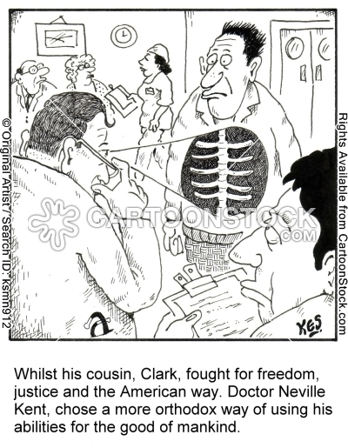
Learning Objectives
Understand basic principles of radiation therapy for breast cancer
Review how radiation therapy is integrated with surgery and systemic therapy in the management of breast cancer
Understand expected toxicity from radiation treatment and its management

Slide 4
Oncology Teamwork
Multidisciplinary Team
Radiation Oncology Team
Treatment Team
Radiation Oncologist
Medical Oncologist
Surgical Oncologist
Plastic Surgeon
Diagnostic Team
Pathologist
Radiologist
Medical Geneticist
Radiation Oncologist
Doctor specializing in the use of radiation therapy for malignant and benign conditions
Medical Physicist
Ensures the quality of radiation therapy treatment planning and delivery
Dosimetrist
Works with sophisticated computer software to generate radiation treatment plan based on parameters prescribed by the radiation oncologist
Radiation Therapist
Administers all radiation treatments
Radiation Oncology Nurse
Provides education, emotional support and tips for managing side effects

Slide 5
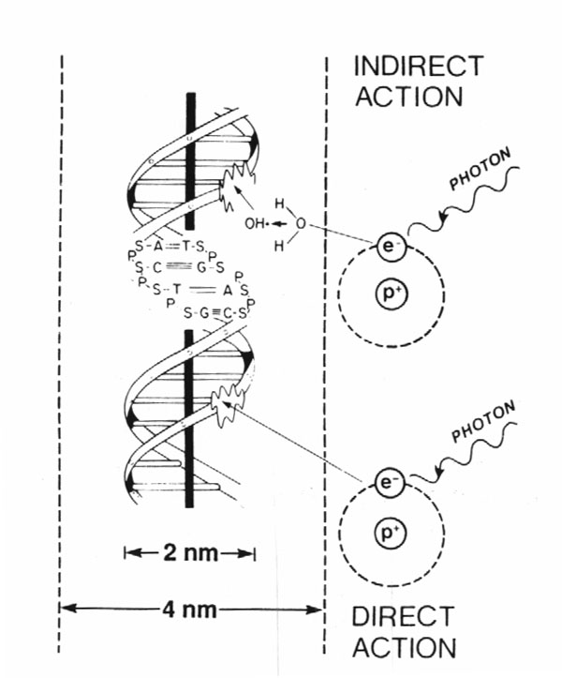
How Does Radiation Work?
X-rays interact with water
radiolysis
free radicals
bind to and damages DNA
mitotic catastrophe
cell death
80%
20%
Cancer cells are more susceptible to RT due to impaired DNA repair pathways

Slide 6
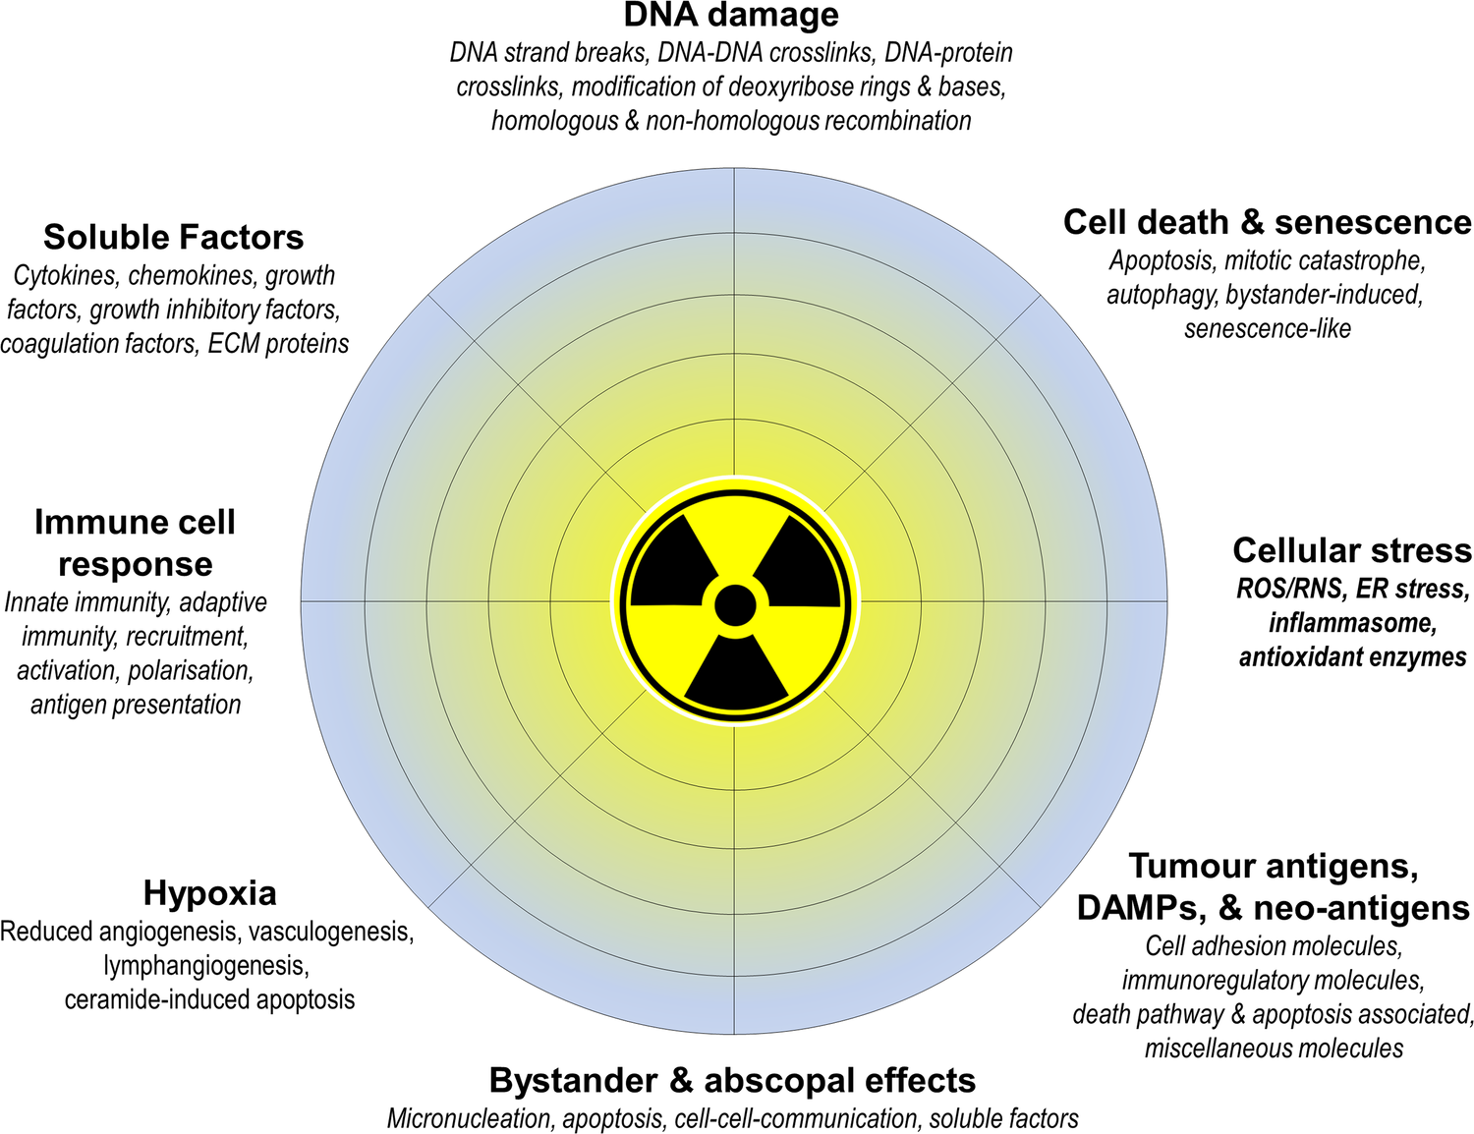
Radiation Impacts Cancer Cells by Many Mechanisms

Slide 7
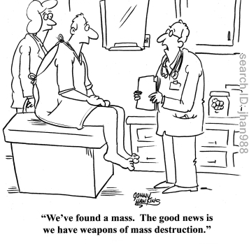
Types of Radiation Used to Treat Breast Cancer
X-rays (photons)
Protons
Electrons
Gamma rays (brachytherapy)

Slide 8
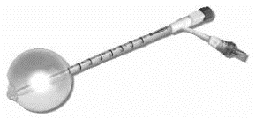
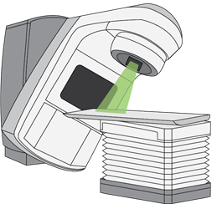
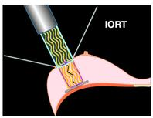
Techniques for Radiation Delivery
External Beam (EBRT)
3-D Conformal RT (3-D CRT)
Intensity Modulated RT (IMRT)
Volumetric Modulated Arc Therapy (VMAT)
Proton Beam Therapy (PBT)
Stereotactic Radiosurgery (SRS)
Stereotactic Body Radiotherapy (SBRT)
Brachytherapy (Internal)
Interstitial
Intracavitary
Intraoperative Radiotherapy (IORT)

Slide 9
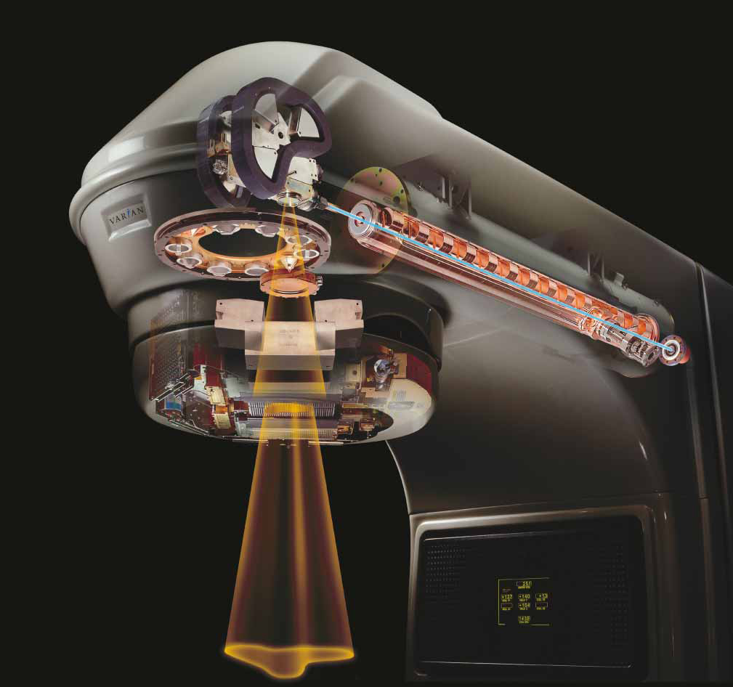
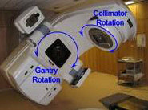
Anatomy of a Linear Accelerator
A linear accelerator delivers high energy X-rays (photons) or electrons
Non-invasive, painless
Rapid treatment delivery in minutes
Used in outpatients and inpatients
Notes:
Electricity powers electron gun, which generates high energy electrons, which are accelerated along waveguide, which strike a Tungsten target resulting in bremsstrahlung generating high energy photons (X-rays). These pass over a filter to generate uniform field, which is shaped by jaws and collimators, before finally entering patient
Briefly discuss how gantry and collimator rotation are used to angle fields in breast cancer tangents, and how the beam is shaped with MLCs to block dose to critical structures like heart or lungs or modulate the dose in an IMRT plan.

Slide 10
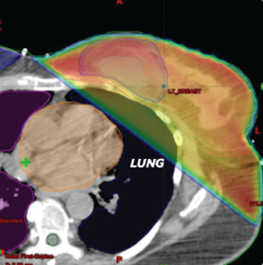
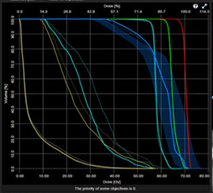
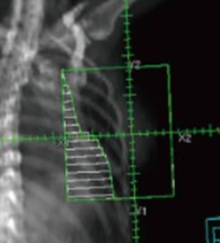
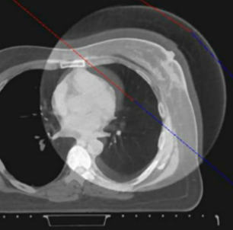
Radiation Therapy is Designed to be Precise
Immobilization device(s) created during CT simulation are used to facilitate patient comfort in treatment position, and make daily setup reproducible
CT-based treatment planning enables accurate delineation of the target and organs-at-risk (OARs) by the MD, allowing for individualized shaping (conforming) of the dose
Numerous contouring atlases available¹⁻³
Image-guided treatment delivery accounts for daily shifts in anatomy or patient setup
1. NRG Oncology, https://www.nrgoncology.org/ciro-breast; 2. Offersen et al, Radiother Oncol, 2015; 3. Kaidar-Person et al, Radiother Oncol, 2019
Notes:
Volumetric doses can be calculated on the CT scan.

Slide 11
Surface Guided Radiation Therapy (SGRT)
Uses patient’s external body surface to match setup before and during treatment
Eliminates the need for permanent tattoos on body
Reduces time required for daily positioning
May reduce need for additional X-ray image guidance
Reference surface (blue) with planning isocenter.
Live patient surface (green) captured by a camera system.
Reference and live surface are matched with a deformable algorithm and a couchshift with 6° of freedom is calculated to shift the live surface into the correct position.
Kügele, M, et al. (2019), J Appl Clin Med Phys, 20: 61-68.

Slide 12
Basic Radiation Treatment Planning Techniques

Slide 13
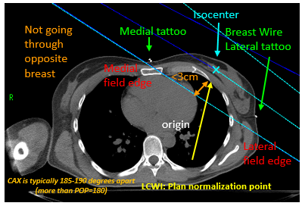
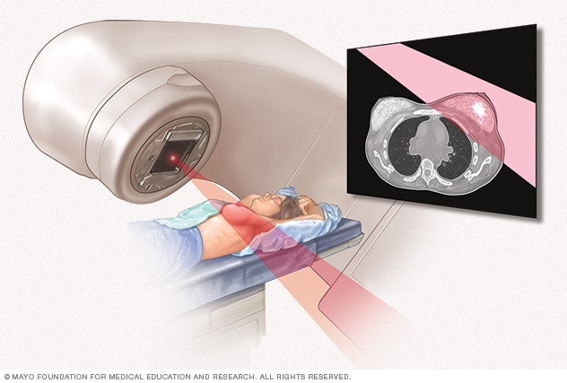
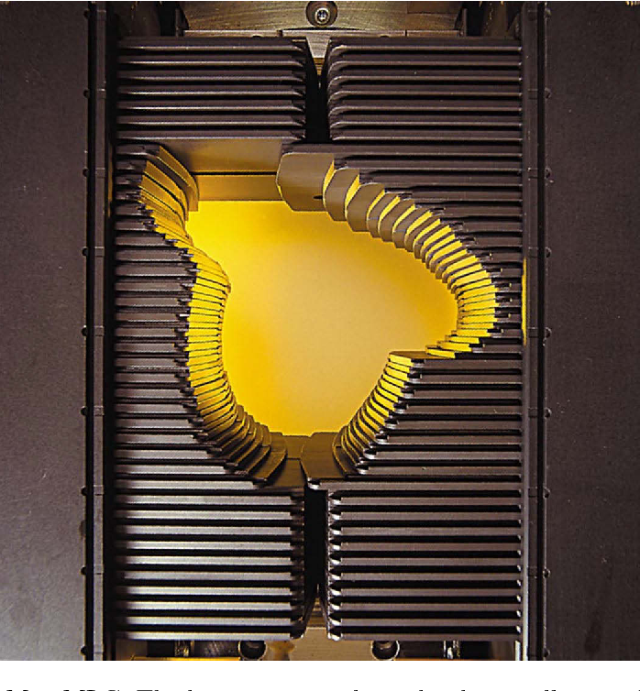
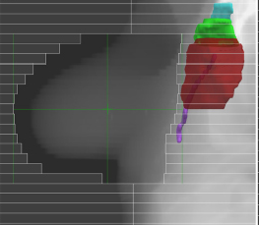
3D-Conformal Radiation Therapy (3DCRT)
Tangential fields (medial and lateral) are most commonly used to treat the breast
Gantry angle and MLCs are used to shape the field to minimize dose to underlying tissue

Slide 14
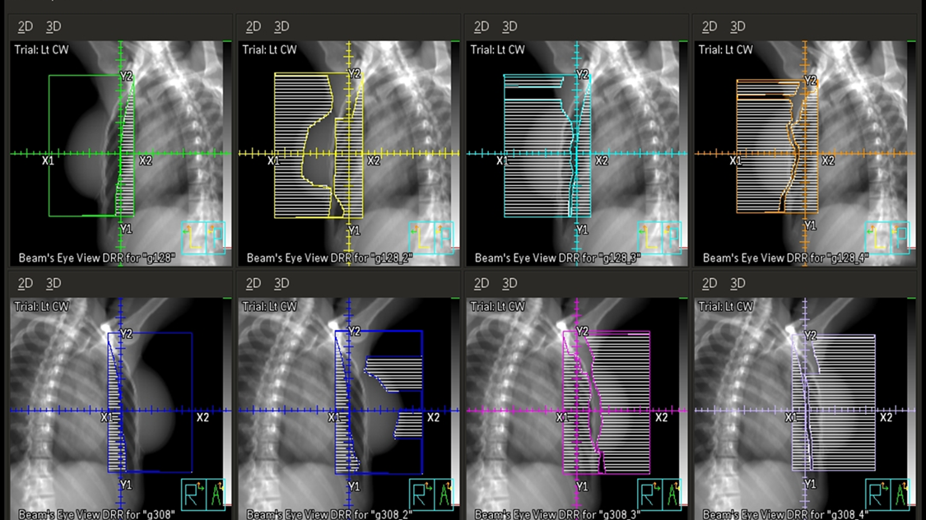
Field-In-Field Technique with 3-D CRT Planning
Extra smaller RT fields are added to the larger RT fields to minimize hot spots and create more homogeneous breast dose, which minimizes skin toxicity
https://pressbooks.uiowa.edu/radiationtherapy/chapter/overview-breast/

Slide 15
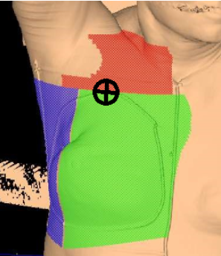
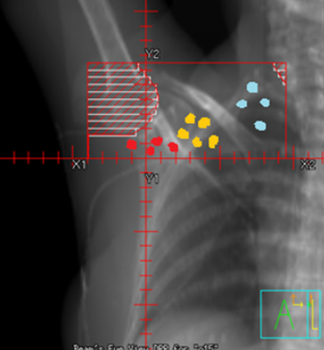
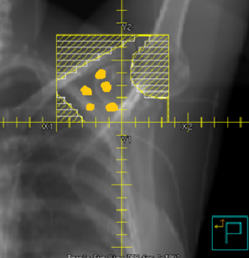
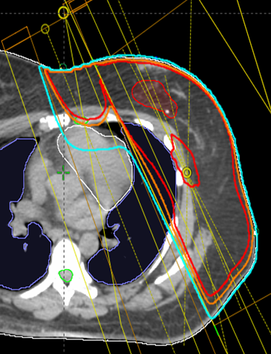
Regional Nodal Irradiation Using 3DCRT
To treat upper axillary and supraclavicular nodes, anterior and posterior fields are added above the tangents
Note: The tangent fields alone often cover the lower axilla
To treat internal mammary nodes, the medial tangent is widened, or matched with an electron field

Slide 16
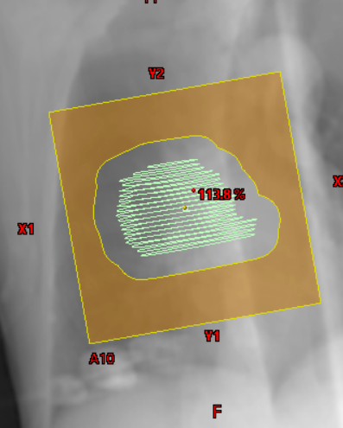
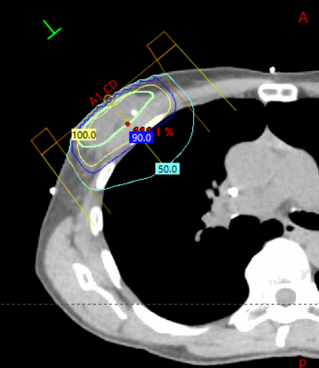
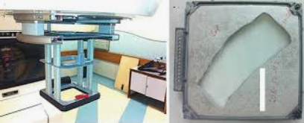
Boost of Tumor Bed or Scar
A radiation "boost" may be used to treat the tumor bed to a higher dose than the whole breast
Electrons are used for a more superficial tumor bed depth, whereas photons are used for a deeper tumor bed
The electron field is delivered using a personalized metal (Cerrobend) cutout placed in electron applicator

Slide 17
Advanced Radiation Techniques Sometimes Helpful to Reduce Dose to Normal Organs

Slide 18
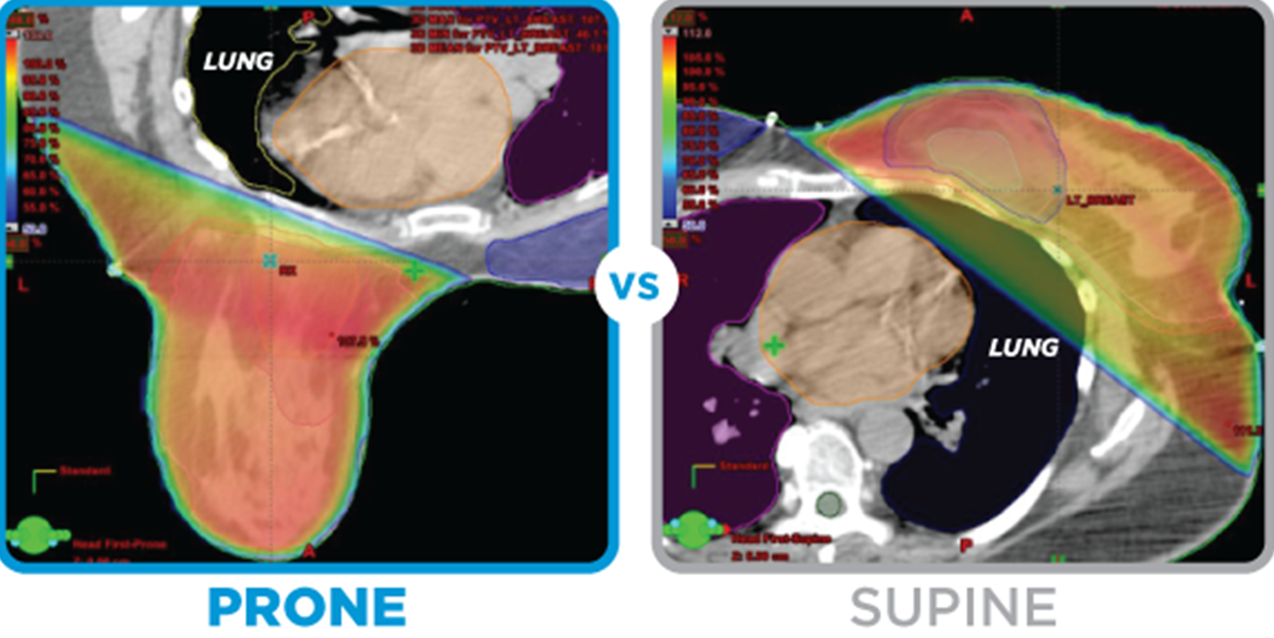
Prone vs. Supine Positioning
Prone position may help reduce lung and heart dose
Particularly useful for patients with larger breasts
May be suboptimal for some patients based on discomfort, tumor bed location, or if nodal RT needed

Slide 19
Deep Inspiratory Breath Hold (DIBH) Treatment
Can reduce dose to heart for left sided tumors
Relies on patient participation and good respiratory function

Slide 20
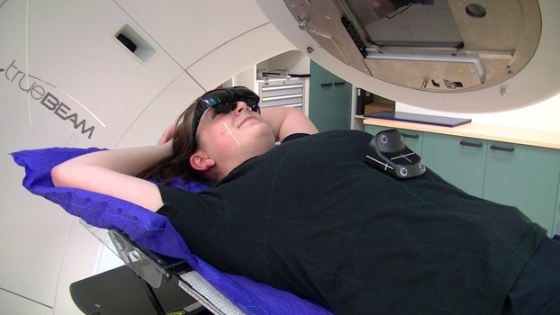
Real-Time Position Management (RPM) Setup for DIBH
Marker box positioned on xiphoid process
Visual feedback can be provided using modified video goggles
Dashed lines in RPM trace shows the upper and lower gating thresholds
J Med Radiat Sci. 2015 Mar;62(1):74-81.
Radiat Oncol. 2021; 16(49): 01777-7
Notes:
Ono, Y., Yoshimura, M., Ono, T. et al. Appropriate margin for planning target volume for breast radiotherapy during deep inspiration breath-hold by variance component analysis. Radiat Oncol 16, 49 (2021). https://doi.org/10.1186/s13014-021-01777-7

Slide 21
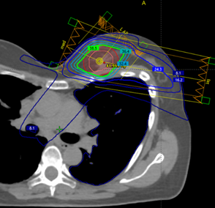
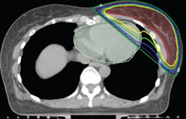
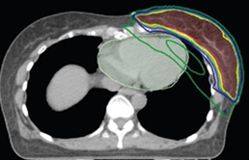
IMRT and VMAT
Delivers radiation from additional angles (or during rotation of gantry)
Modulates dose intensity around curved structures
Enables more conformal target coverage with prescription dose
Decreases higher dose (but may increase lower dose) to adjacent organs
IMRT
VMAT
3DCRT
IMRT reduces heart dose
Notes:
The middle right figure is a video showing MLC movement during VMAT
For the lower images, the yellow is 100% of prescription dose, which you are able to keep off the heart with the IMRT plan but not the 3D plan without sacrificing coverage.

Slide 22
Partial Breast Radiation Techniques

Slide 23
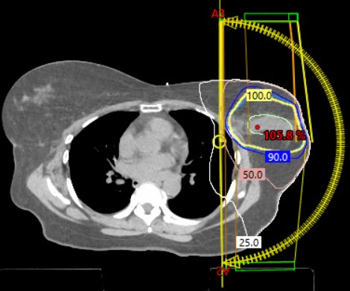
External Beam Partial Breast RT
Currently more common than brachytherapy or IORT
Target volume is typically ~2cm around the tumor bed
Treatment planning often uses 3DCRT or IMRT techniques
Typical dose using EBRT is 30 Gy in 5 fractions every other day

Slide 24
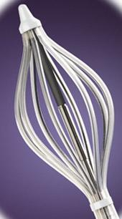
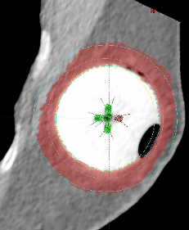
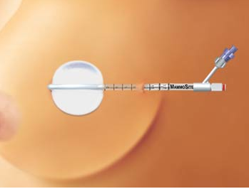
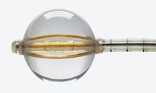
Intracavitary Brachytherapy
Fluid-filled balloon in lumpectomy cavity
Mammosite (single channel) requires at least 1 cm of tissue between the skin and the balloon surface, whereas SAVI (multichannel) does not have this requirement
Typical dose using brachy is 34Gy in 10 fractions twice daily (minimum 6 hours apart)
Notes:
Placement of catheter is under ultrasound guidance, outpt procedure

Slide 25
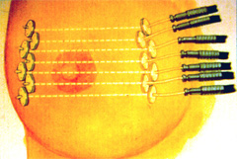
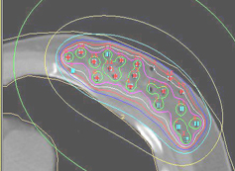
Interstitial Brachytherapy
Oldest breast brachytherapy technique
Used infrequently in contemporary practice

Slide 26
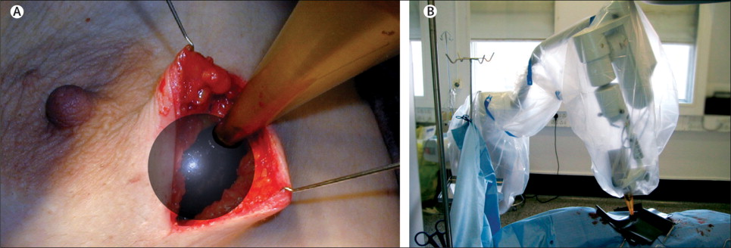
Intraoperative Radiation Therapy
Performed during surgery, immediately following lumpectomy and before incision is closed
Large dose of radiation focused directly on surgical site using electrons or low energy photons
Intended to be the only RT required - Generally reserved for early-stage disease with low recurrence risk
Requires special equipment – uncommon in most practices
Vaidya et al. Lancet. 2010; 376(9735), 91–102.
Notes:
(A) The applicator being placed in the tumor bed. (B) The x-ray source is delivered to the tumor bed by use of a surgical support stand. The sterile applicator is joined with a sterile drape that is used to cover the stand during treatment delivery.

Slide 27
Radiation Dosing for Breast Cancer
Gray (Gy) is the unit of RT dose
The absorption of 1 joule of radiation energy by 1 kilogram of matter
1 Gy = 100 centiGray (cGy)
The dose from 1 cGy roughly equals 1 CT scan
Adjuvant RT, Breast Conservation | Adjuvant RT, Post-Mastectomy | Palliative RT
45-50.4 Gy in 25-28 fractions 40-42.5 Gy in 15-16 fractions 26-30 Gy in 5 fractions | 45-50.4 Gy in 25-28 fractions 40-42.5 Gy in 15-16 fractions | 8 Gy in 1 fraction 20-30 Gy in 5-10 fractions 15-30 Gy in 1-5 fractions
Notes:
May emphasize that conventional fractionation should rarely be used for breast-only RT in contemporary practice.

Slide 28
Integration of Radiation with Surgery and Systemic Therapy

Slide 29
The Three Pillars of Oncologic Treatment
Surgery
Chemo
Radiation

Slide 30
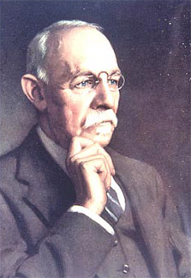
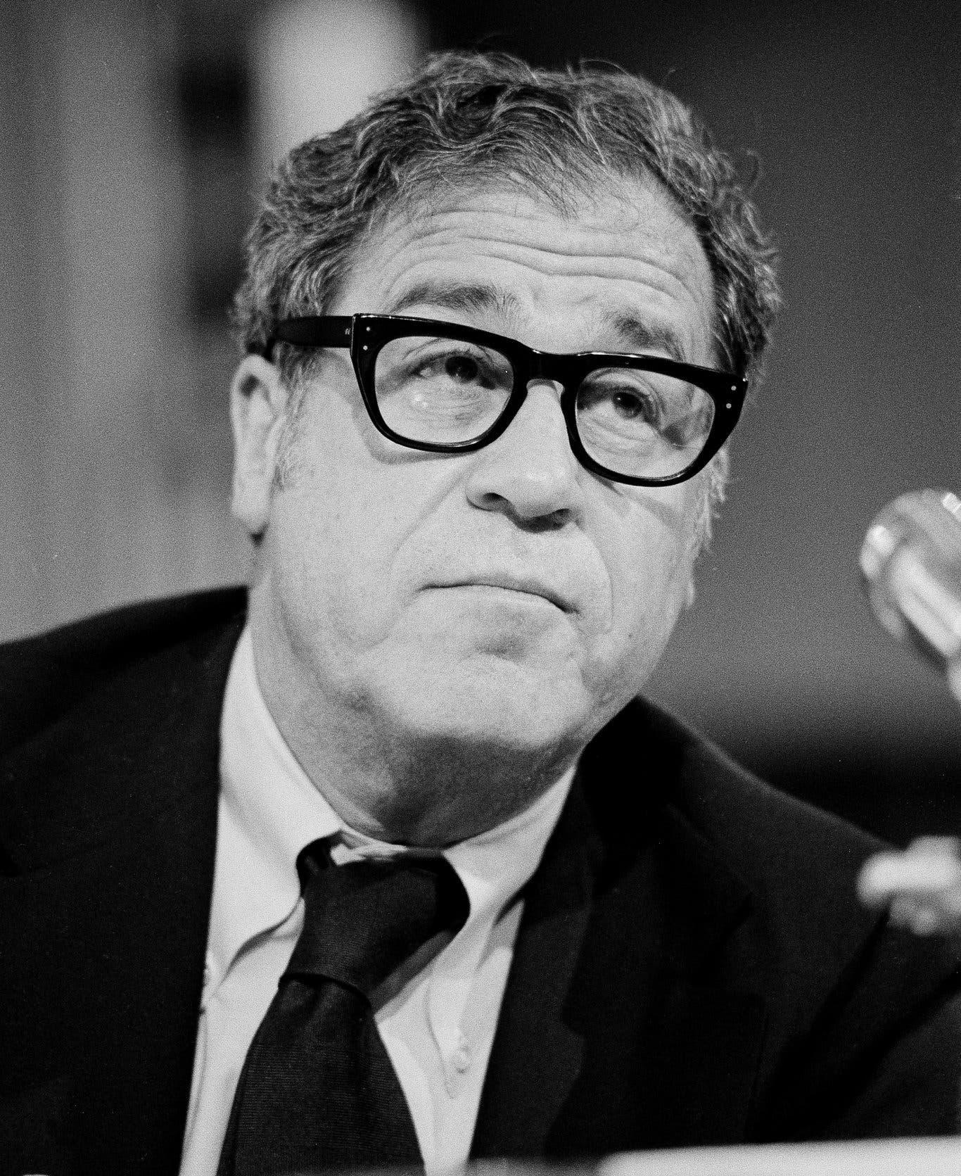
Surgical Evolution in Breast Cancer Treatment
Halstead
Fisher
Lumpectomy and radiotherapy has equivalent oncologic outcomes to mastectomy
Radical mastectomy as cure

Slide 31
Interplay of Surgery and Radiation
in Local Treatment
Mastectomy
Axillary node dissection
Lumpectomy
Sentinel node biopsy
Surgical Treatment
Radiotherapy Treatment
Breast radiotherapy
Nodal irradiation
Radiotherapy in combination with conservative surgery can have equal oncologic outcomes compared to radical surgery
Cosmetic and functional outcomes (e.g., lymphedema risk) often better with radiotherapy

Slide 32
Treatment Paradigm
Local treatment
Mastectomy 🡪 +/- RT
Lumpectomy (breast conserving surgery (BCS)) + RT
Systemic treatment
Chemotherapy
If needed, is delivered either neoadjuvantly or adjuvantly, but generally before RT
Hormonal therapy
Hormone receptor-positive cancers
Typically given adjuvantly

Slide 33
Sequencing of RT with Chemotherapy
When adjuvant chemotherapy is indicated, RT is commonly given afterwards
Uncommon exceptions include:
CMF (cyclophosphamide/methotrexate/fluorouracil)
Only standard adjuvant regimen that can be concurrent with RT (but rarely is)
Capecitabine (825mg BID only on radiation days)
Can be used as a radiosensitizer for gross disease that grew since surgery
Woodward, W. A., et al. IJROBP. 2017; 99(4), 777–783
Loap P, et al. JAMA Oncol. 2022; 8(12):1802–1808.
Corbin KS, et al. CTRO. 2020;24:99-101.
Notes:
May mention that giving RT after chemo avoids radiation recall phenomenon.

Slide 34
Sequencing of RT with Hormonal Therapy
Adjuvant hormonal therapy may be given concurrently with, or after, adjuvant RT
No apparent clinical impact on efficacy of RT (have been In vivo data suggesting tamoxifen mitigating effect of radiation)
Due to compounding side effects, initiating hormones after RT may be preferred
Woodward, W. A., et al. IJROBP. 2017; 99(4), 777–783
Loap P, et al. JAMA Oncol. 2022; 8(12):1802–1808.
Corbin KS, et al. CTRO. 2020;24:99-101.
Notes:
chemo for breast cancer is typically delivered before RT for breast cancer (i.e. radiation recall)

Slide 35
Sequencing of RT with Targeted Therapy
Herceptin (Trastuzumab) can be given concurrently
Kadcycla (ado-trastuzumab emtansine) may cause increased radiation dermatitis and pneumonitis. Timing of its initiation should be individualized based on disease burden.
Pembrolizumab can be given concurrently with RT, but have low threshold for stopping if patiet experiences toxicity.
KEYNOTE-522 included a mix of sequential vs. concurrent
Olaparib should only be given concurrently on a trial (e.g., RadioPARP)
Woodward, W. A., et al. IJROBP. 2017; 99(4), 777–783
Loap P, et al. JAMA Oncol. 2022; 8(12):1802–1808.
Corbin KS, et al. CTRO. 2020;24:99-101.
Notes:
NCCN guidelines.
https://pubmed.ncbi.nlm.nih.gov/28843370/
Woodward, W. A., et al. IJROBP. 2017; 99(4), 777–783. - capecirtabine
Loap P, et al. JAMA Oncol. 2022; 8(12):1802–1808. - olaparib
https://jamanetwork.com/journals/jamaoncology/article-abstract/2797849
Corbin KS, et al. CTRO. 2020;24:99-101.

Slide 36
Radiation Therapy for Ductal Carcinoma in Situ (DCIS)

Slide 37
Goals of RT in DCIS
Prevent local recurrence
Breast conservation
Avoid mastectomy
Minimize toxicity
Notes:
If the patient and physician view the individual risk as “low,” some patients may be treated by excision alone, particularly if they are ER-positive and will be receiving endocrine therapy.
Select patients with low-risk DCIS may be considered suitable for APBI/PBI if they meet all aspects of the definition of low-risk DCIS from the RTOG 9804 trial, including screen-detected DCIS, low to intermediate nuclear grade, tumor size ≤2.5 cm, and surgical resection with margins negative at >3 mm.

Slide 38
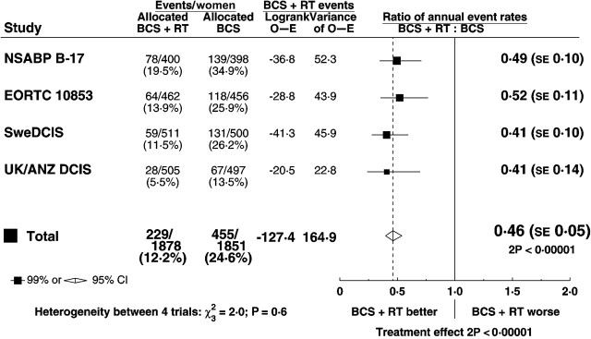
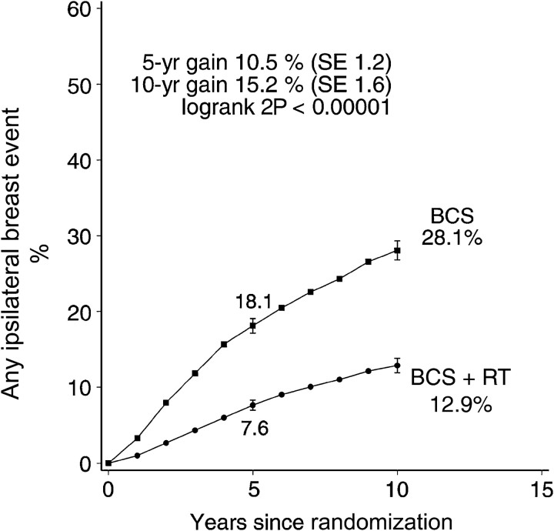
Seminal Trials of RT after BCS for DCIS
RT 🡪 ≈50% relative risk reduction and 15% absolute risk reduction in local recurrence
Approximately half of the recurrences are invasive and half are DCIS
EBCTG, JNCI Monogr 2010; 41:162-177
Notes:
Most patients did not receive tamoxifen

Slide 39
RT Options for DCIS (Tis N0 M0) Patients Who Undergo BCS
Whole breast RT +/- boost to tumor bed (Category 1)
Partial breast RT (If <2 cm, Grade 1-2, ER+)
No RT (Category 2B)

Slide 40
Risk Factors for Locoregional Recurrence in DCIS
Larger size (>2 cm)
Grade 3
Close (<2mm) or involved margins
Age <50 years
Palpable mass

Slide 41
Omission of RT for Low Risk DCIS
Rationale: RT reduces local recurrence, but likely does not change the odds of distant recurrence or decrease mortality
For low risk disease and widely negative margins, observation may be considered
ECOG 1594 & RTOG 9804 evaluated a “low risk” cohort of G1-2 tumors < 2.5cm in size with negative margins > 3mm (median tumor size 5-6mm)
12-15 year LR ~15% w/o RT
Whether these outcomes are low enough for observation should be viewed in the context of comorbidity, advanced age, hormone therapy use and patient preference
Generally speaking, low risk = G1-2, ER+, <2cm size, widely (-) margins

Slide 42
Gene Expression Assays for DCIS
Tools for identification of patients for whom post-lumpectomy RT may reasonably be omitted
Further validation is required before the multigene assay can become a standard part of clinical practice, but reasonable to incorporate in clinical decision making alongside known pathologic prognostic factors
Examples: Oncotype DX DCIS recurrence score and DCISionRT
Bremer, T, et al. Clin Cancer Res. 2018; 24 (23): 5895–5901.
Shah C, et al. Ann Surg Oncol. 2021 ;28(11):5974-5984.

Slide 43
Radiation Therapy for Invasive Breast Cancer

Slide 44
Why RT after BCS in Invasive Breast Cancer?
Breast conserving surgery (BCS) is for organ preservation
Up to 40% of women after surgical resection of gross tumor will have residual microscopic disease that can develop into recurrence.
The Holland study (1985) demonstrated that 43% of unifocal cancers in mastectomy specimens had tumor foci located >2 cm from the index lesion.
Holland, R., et. Al. Cancer, 1985; 56(5), 979–990.

Slide 45
Can RT be Omitted after Partial Mastectomy?
Trials Demonstrating Benefit of Radiation after BCS
≈66% relative risk and 25% absolute risk reduction in local recurrence with RT with long-term follow-up
The subgroup of patients > age 70 with small ER+ tumors generally have less benefit, so may consider omitting RT or HT
Study | f/u (yrs) | LR w/ RT (%) | LR w/o RT (%)
NSABP B-06 | 20 | 14.3 | 39.2
Veronesi et al | 10 | 5.8 | 23.5
Liljegren et al | 10 | 8.5 | 24.0
Clark et al | 7.6 | 11.3 | 35.2
Holli et al | 6.7 | 7.5 | 18.1
Renton et al | 6.1 | 13.0 | 35.0
Forrest et al | 5.7 | 5.8 | 24.5
Malmstrom et al | 5 | 4.4 | 13.3
Vinh-Hung et al. JNCI 2004;96:115-21

Slide 46
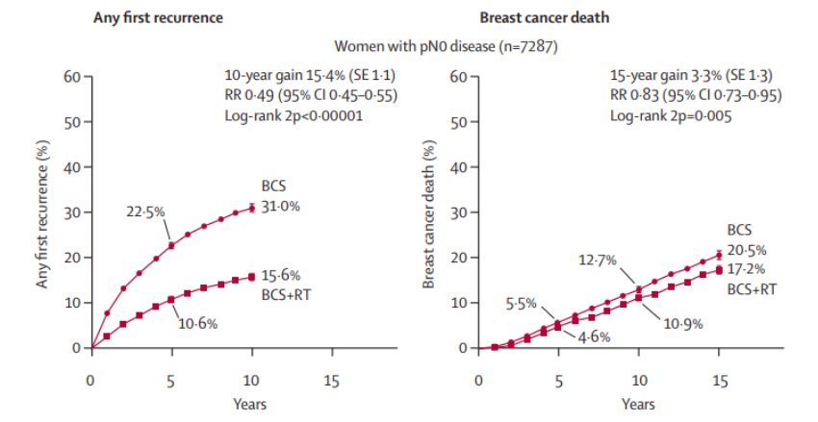
Does Improved Local Control Impact Survival?
Meta-analysis of Early Breast Cancer
15.4% improvement in LC at 10 years
3.3% improvement in OS at 15 years
EBCTCG. Lancet 2011;378:1707-16.
Notes:
Meta analysis of early breast cancer trials, Rad after BCS dropped the percentage of patient who developed any first recurrence at 10 years from 31 to 15.6% and decreased the rate of breast cancer deaths by 3.3% at 15 years.

Slide 47
Absolute Contraindications to
Breast Conserving Therapy
Diffuse or suspicious microcalcifications
Diffusely positive pathologic margins
Inflammatory breast cancer
Active pregnancy (unless RT can be delivered post-partum)
Homozygous (biallelic inactivation) for ATM mutation

Slide 48
Relative Contraindications to
Breast Conserving Therapy
Previous breast or chest RT
Ask your friendly radiation oncologist: Re-resection and reirradiation may be an alternative to mastectomy (RTOG 1014)
Active connective tissue disease (e.g., scleroderma, lupus)
Increased risk of late toxicity
Persistently positive margins despite multiple re-excisions
Known or suspected genetic predisposition to cancer (e.g., NF Type 1)
Notes:
Multicentric disease (tumors in more than one quadrant) that cannot be resected in a single incision was historically a contraindiciation, but not so much anymore since publication of ACOSOG Z11102.

Slide 49
Evolution of Dose-Fractionation for Whole Breast RT
Since their implementation, moderate hypofractionation and ultra-hypofractionation schemes have been shown to increase patient convenience, be safe and efficacious
Conventional Fractionation | Moderate Hypofractionation | Ultra- hypofractionation
45-50.4 Gy | 40-42.5 Gy | 26-28.5
25-28 treatments | 15-16 treatments | 5 treatments
~5 weeks | ~3 weeks | 1 week (or 1x/week for 5 weeks)
Moderate hypofx is safe for large breast size, age < 40, and collagen vascular disease (though unknown outcomes with ultra-hypofx)
Unknown outcomes for unusual histologies (neuroendocrine carcinoma or sarcoma)

Slide 50
Data for Moderate Hypofractionation after BCS
Similar or less normal tissue toxicity in hypofractionation vs. conventional fractionation arm
Shah, C, et al. JCO Oncol Pract. 2021; 7(12):697-706.
Notes:
Abbreviations: HWBI, hypofractionated whole breast irradiation; EORTC European Organisation for Research and Treatment of Cancer; F/U, follow-up; fx, fractions; NCI, National Cancer Institute; NSABP, National Surgical Adjuvant Breast and Bowel Project; OR, odds ratio; START, Standardisation of Breast Radiotherapy; SWBI, standard whole breast irradiation.

Slide 51
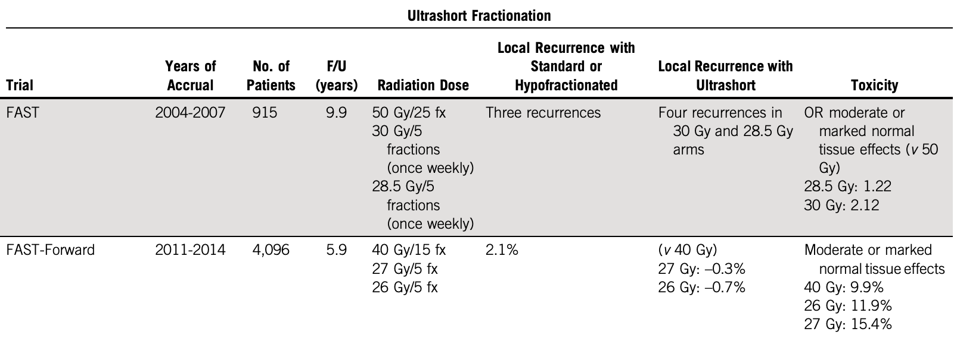
Data for Ultra-Hypofractionation after BCS
Shah, C, et al. JCO Oncol Pract. 2021; 7(12):697-706.
Murray Brunt A, Haviland JS, Wheatley DA, et al. Lancet. 2020;395(10237):1613-1626.
Notes:
UK FAST-Forward
26 Gy/5 fractions
Any age
Any stage if regional nodes do not require coverage
T1-3N0
cN0; pN0-1
No difference in ipsilateral breast cancer recurrence or cosmesis @ 5 year f/u

Slide 52
Partial Breast Irradiation (PBI)
Goals of Partial Breast Irradiation
Target areas with high risk of recurrence
Spare healthy breast tissue
Decrease treatment time
Suitable Candidates for Partial Breast Irradiation are women age ≥ 40 and with IDC or DCIS that is < 2cm, grade 1-2, ER+, and has negative LVSI, negative nodes, and negative margins
Partial Breast Irradiation is not recommended for (+) margins, (+) nodes, BRCA mutation, or age < 40
Shaitelman, et al. Pract Radiat Oncol. 2024.

Slide 53
Clinical Trials Evaluating Partial Breast Irradiation
RT Dosing
National Comprehensive Cancer Network. (2024). Breast cancer (version 2.2024).
Florence Trial results at 10-years
No difference between APBI vs. WBI at 10-years in:
ipsilateral breast tumor recurrence (IBTR)
locoregional recurrence
distant metastasis
breast cancer specific survival
overall survival (OS)
Notes:
National Comprehensive Cancer Network. (2024). Breast cancer (version 2.2024). Retrieved from https://www.nccn.org/professionals/physician_gls/pdf/breast.pdf

Slide 54
Re-irradiation after Ipsilateral Recurrence
NRG/RTOG 1014 Phase 2 Clinical Trial
A second breast conserving therapy was achievable in 90% of patients experiencing recurrence in ipsilateral breast after lumpectomy and whole breast radiation
Low risk of re-recurrence of cancer in the ipsilateral breast using adjuvant partial breast reirradiation
Effective alternative to mastectomy
Arthur DW, et al. JAMA Oncol. 2020;6(1):75–82.

Slide 55
Regional Nodal Irradiation (RNI) after Breast Conserving Surgery

Slide 56
Surgical Management after SLN Biopsy
Axillary LN dissection is NOT typically recommended for tumors that are cT1-3N0, with 1-2 pathologically positive SLNs, and post-op RT to the breast +/- regional nodes is planned
Note: standard breast tangents often cover lower axilla
If all of these criteria are met, the risk of nodal recurrence is low and the risk of lymphedema is substantially reduced by omitting ALND
ACOSOG Z0011 | IBTR | Nodal Recurrence | Lymphedema
BCS + ALND + RT | 6.2% (10-yr) | 0.5% (10-yr) | 13%
BCS + SLNB + RT | 5.3% (10-yr) | 1.5% (10-yr) | 2%
AMAROS | OS | Axillary Recurrence | Lymphedema
BCS + ALND + RT | 93% (5-yr) | 0.43% (5-yr) | 28%
BCS + SLNB + RT | 93% (5-yr) | 1.19% (5-yr) | 14%
Jagsi, R., et al. Journal of Clinical Oncology 32.32 (2014): 3600.
Giuliano, A. E., et al. JAMA 318.10 (2017): 918-926.
Galimberti, V., et al. The Lancet Oncology 14.4 (2013): 297-305.
Donker, M., et al. The Lancet Oncology 15.12 (2014): 1303-1310.
Notes:
Could bring up that some institutions raise the upper field edge to cover more of the axilla (though “high tangents” is not proven to have a benefit)

Slide 57
Whole-Breast RT + RNI after Partial Mastectomy
Indications:
> 1 macroscopically positive node
High-risk node-negative
pT3-4 primary tumor
pT2 with LVSI or grade 3 or ER-negative
cN+ s/p neoadjuvant chemotherapy
+/- pN1mi with other high-risk features
Relevant Trials
EORTC 22922
MA.20
Target volume typically includes infraclavicular, supraclavicular, and internal mammary nodes (+/- lower axillary nodes depending on surgical treatment of axilla)
MA.20 | DFS | OS | Lymphedema
BCT + RNI | 82% (10-yr) | 82.8% (10-yr) | 8.4%
BCT | 77% (10-yr) | 81.8% (10-yr) | 4.5%
Poortmans, Philip M., et al. NEJM 373.4 (2015): 317-327.
Whelan, Timothy J., et al. NEJM 373.4 (2015): 307-316.

Slide 58
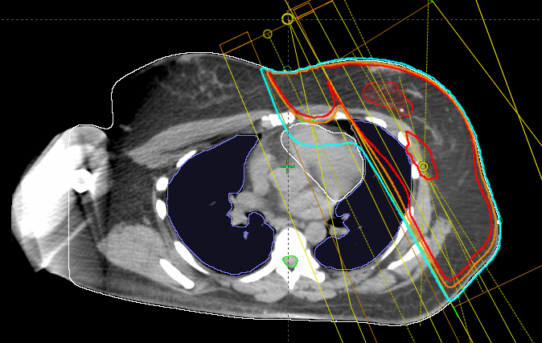
Addressing the Internal Mammary Nodes (IMNs)
Treating the IMNs is recommended for all patients undergoing RNI
For left sided tumors, particularly those in outer quadrant, meeting cardiac dose constraints may take priority over IMN coverage
Advanced treatment planning techniques or proton therapy may be required to optimize dosimetry
Notes:
Of note, if the IMNs were clinically positive, they must be treated to full dose.

Slide 59
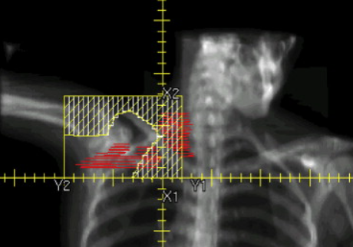
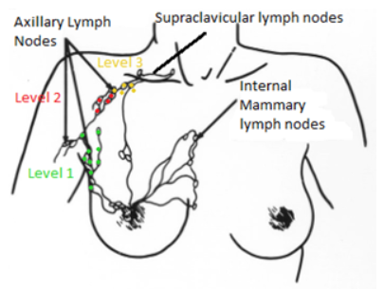
Omitting the Axilla
After ALND (not SLNB), the lower axilla can typically be omitted from RNI, whereas the “retained” portion of the axilla should be irradiated
Exceptions where the full axilla may be treated after ALND may include a high ratio of nodal involvement (e.g., > 20%) or extranodal extension
Notes:
https://pressbooks.uiowa.edu/radiationtherapy/chapter/overview-breast/

Slide 60
Post-Mastectomy Radiation

Slide 61
Indications for Post Mastectomy RT
Indications for PMRT if Up-Front Surgery:
Node-positive (1 or more nodes)
Positive margins, T4 disease
Select pT2-3N0 patients with other high-risk features (age < 50, LVSI, G3, or triple-negative)
+/- pN1mi with other high-risk features
Indications for PMRT if Neoadjuvant Chemo:
ypN1
Clinical Stage III (i.e., N2, T3N1, T4N0) pre-chemo
Clinical Stage II (i.e., N1, T2-3N0) with other high risk features or partial response to chemo
Notes:
Of note, use of RT for cN+ disease after pCR in the nodes after neoradjuvant chemotherapy is evolving and may be effected by publication of NSABP B-51.
We currently recommend RT for ANY positive nodes (many of these people think only 4 or more nodes have a benefit from PMRT).

Slide 62
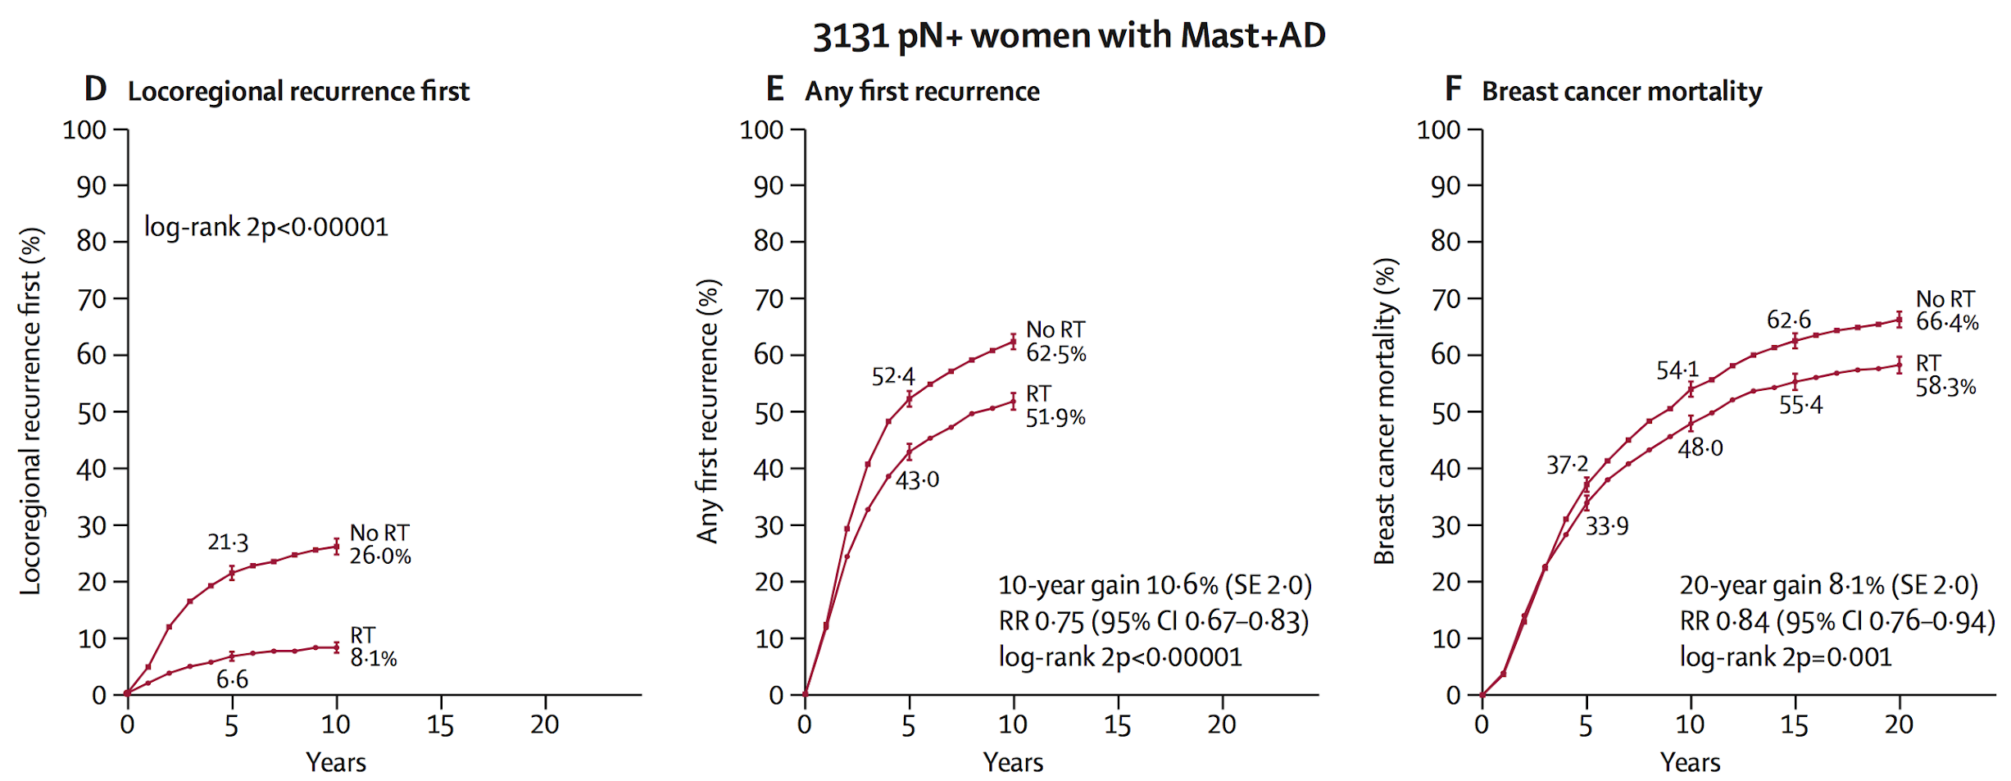
Evidence Supporting Post Mastectomy RT
Overgaard, Marie, et al. NEJM 337.14 (1997): 949-955.
Overgaard, Marie, et al. The Lancet 353.9165 (1999): 1641-1648.
McGale, P., et al. The Lancet 383.9935 (2014): 2127-2135.
Notes:
We recommend RT for ANY positive nodes (not just if 4 or more positive)

Slide 63
Mastectomy vs. BCS + RT
No difference in overall survival for total mastectomy vs. BCS + RT

Slide 64
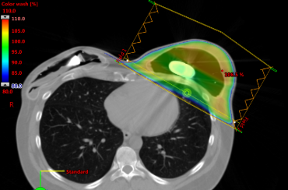
Implant Based Reconstruction and RT Considerations
RT boost typically not possible given rearrangement of breast tissue/skin
1 Stage: Direct to implant
Healing issues may occur and delay initiation of RT.
RT may be damaging to a permanent implant.
2 Stage: Tissue expander followed by permanent implant
Consult radiation oncology:
To determine if contralateral expander requires deflation.
When concern for close or positive deep margin - optimal expander placement may be impacted.
Optimal timing of reconstruction 4-5 months after RT completion to reduce short-term complications.
Kim, A., et al. Plastic and reconstructive surgery, (2022), 149(2).
Elver, A. et al. Journal of reconstructive microsurgery, 39(2), 111–119.

Slide 65
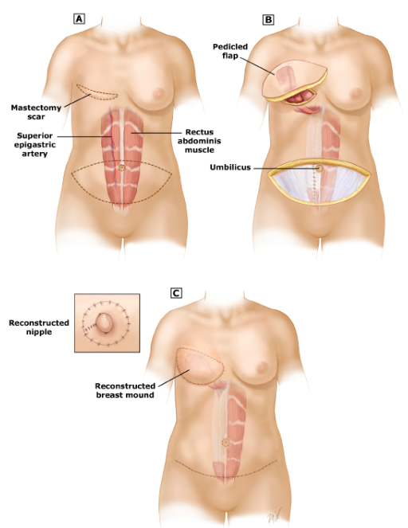
RT Considerations with Autologous Reconstruction
Consider delaying reconstruction until after RT is completed as RT to a flap may cause loss of cosmesis and/or fat necrosis
May be performed within 3 months without increased complications.
Kim, A., et al. Plastic and reconstructive surgery, (2022), 149(2).
Elver, A. et al. Journal of reconstructive microsurgery, 39(2), 111–119.

Slide 66
Radiation for Metastatic Breast Cancer

Slide 67
Palliative RT in Locally Advanced Breast Cancer
Useful to reduce pain, bleeding, discharge and offensive odor for ulcerating and/or fungating tumors
Common RT dose-fractionation schemes:
39 Gy in 13 fractions
35 Gy in 10 fractions
26 Gy to breast/32 Gy tumor boost in 5 fractions
Local control ≈75% and 50% at 6 and 12 months, respectively
Re-irradiation may be needed for symptom palliation
Figure 1. Ulcerating breast cancer before (A) and after (B) palliative RT
Figure 2. Fungating breast tumor before (A) and 4-months after RT (B).
Gao RW, et al. Cureus. 2017; 9(6):e1360.
Chatterjee S, et al. 2023; IJROBP, 116(5), 1033–1042.
Jacobson G, et al. Sci Rep. 2021;11(1):5282.
Hoeltgen L, et al. Technol Cancer Res Treat. 2023:15330338231164537

Slide 68
RT for Oligometastatic Breast Cancer
SABR-COMET
Phase II randomized clinical trial enrolled patients with a variety of cancers and ≤5 metastatic sites (n=99).
5-year overall survival (OS) improved in the SABR arm.
No difference in outcomes in the very small breast cancer subset (n = 18).
NRG-BR002
Phase II/III randomized clinical trial enrolled patients with oligometastatic breast cancer (N = 125), that had not progressed on initial systemic therapy within 12 months.
No statistically significant improvement in progression-free survival (PFS), OS, or new metastases rate.
Multiple trials around the world continue to evaluate the utility of SBRT in oligometastatic breast cancer.
NRG-BR002 – PFS
NRG-BR002 – Overall Survival
Palma DA, et al. J Clin Oncol 38:2830-2838, 2020
J Clin Oncol 40, 2022 (suppl 16; abstr 1007)

Slide 69
RT for Oligoprogressive Breast Cancer
CURB trial
Oligoprogressive disease treated with systemic therapy +/- SBRT
Included lung and breast cancer
Improved mPFS from 11 to 31 weeks
Benefit seen in lung, but not breast histologies
Notes:
In summary, even though there is not strong evidence to support consolidative therapy for oligometastatic breast cancer, it may be considered in select patients with otherwise good prognostic factors.
Also, We SHOULD offer SRS for brain metastases despite negative oligometastatic trials. CNS involvement was excluded in most oligometastatic trials.
Mashiach, et al. showed that patients with breast cancer with brain metastases can achieve long-term survival when treated with SRS.

Slide 70
What are the Side Effects?

Slide 71
Side Effects of Radiation Therapy
Side effects are generally limited to the area receiving radiation
Most damage occurs to rapidly dividing cells
Acute effects typically improve within 2 weeks after finishing radiation

Slide 72
Acute Toxicities of Breast RT
Fatigue
Breast pain/swelling
Gabapentin, NSAID’s
Radiation dermatitis
Aquaphor, mometasone (if mild)
Silvadene, minocycline/mupirocin (if severe)

Slide 73
Radiation Dermatitis
Grade 1 – Faint erythema and dry desquamation (*).
Very common (>75%)
Grade 2 – Moderate or brisk erythema; patchy moist desquamation (arrow) mostly confined to skin folds and creases.
Less common (10-15%)
Grade 3– Moist desquamation in areas other than skin folds and creases.
Uncommon (1-2%)
Risk of high grade dermatitis mainly among patients with locally advanced tumors involving skin who require bolus during RT in order to give full dose to skin.
Delishaj, et al. 2020; Radiation oncology journal, 38(4), 297-290.
https://www.cancernetwork.com/view/radiation-dermatitis-recognition-prevention-and-management

Slide 74
Late Toxicities of Breast RT
Skin hyperpigmentation, breast fibrosis or shrinkage
Vitamin E, pentoxifylline
Secondary cardiac events
Relative risk of heart disease and coronary events increases 4-7% for each 1 Gy in mean heart dose.
DIBH, smoking cessation, risk factor reduction
Radiation-induced pneumonitis
Occurs in 1-16% of breast cancer pts treated with RT (lower risk if breast-only, higher risk if RNI)
Prednisone 1 mg/kg x 1 month slow taper
Lymphedema
2-14% risk with BCS + SLNB + nodal RT
13-28% risk with BCS + ALND + nodal RT
Lymphedema precautions, sleeves, pump, PT
Secondary malignancy
Darby, et al. NEJM, (2013), 368:987-998.
McKenzie, et al. JMIRSI, (2022), 53(1), 167–174.
Giuliano, Armando E., et al. JAMA 318.10 (2017): 918-926.
Donker, Mila, et al. The Lancet Oncology 15.12 (2014): 1303-1310.

Slide 75
Breastfeeding After Radiation
Lactation is possible and safe after radiation.
Ipsilateral breast lactation present in at least 50% of women, but in reduced volume.
Breastfeeding in contralateral breast unaffected.
Leal et al., Expert Review Anticancer Therapy, 2013, 13(2)

Slide 76
Conclusions
RT improves local control and overall survival in the setting of breast conserving therapy
Technical advances have reduced acute and late radiation toxicities
Options for shorter courses of radiation than the historical standards are now more widely available for appropriately selected patients

