Slide 1
Radiation Therapy for Oligometastatic Non-Small Cell Lung Cancer:
An ASTRO/ESTRO Clinical Practice Guideline
Developed in collaboration with the European Society for Radiotherapy and Oncology
Endorsed by the Canadian Society of Radiation Oncology and the Royal Australian and New Zealand College of Radiologists

Slide 2
Citation
This slide set is adapted from the
ASTRO/ESTRO Radiation Therapy for Oligometastatic
Non-Small Cell Lung Cancer Guideline to be published in the May/June 2023 issue of Practical Radiation Oncology (PRO)
Web posted link: showPdf (practicalradonc.org)
The full-text guideline is also available on the ASTRO and ESTRO websites: www.astro.org, www.estro.org

Slide 3
Guideline Task Force
Co-Chairs
  Puneeth Iyengar, MD, PhD (ASTRO)
  Matthias Guckenberger, MD (ESTRO)
Members
  Sean All, MD
  Mark F. Berry, MD
  Thomas P. Boike, MD
  Anne-Marie C. Dingemans, MD, PhD
  Jill Feldman
  Daniel R. Gomez, MD
  Paul J. Hesketh, MD
  Salma K. Jabbour, MD
  Melenda Jeter, MD, MPH†
  Mirjana Josipovic, PhD
  Yolande Lievens, MD, PhD
  Fiona McDonald, MD
  Bradford A. Perez, MD
  Umberto Ricardi, MD
  Enrico Ruffini, MD
  Dirk De Ruysscher, MD, PhD
  Hina Saeed, MD
  Bryan J. Schneider, MD
  Suresh Senan, MRCP, FRCR, PhD
  Joachim Widder, MD, PhD
† The task force gratefully acknowledges the memory of Melenda Jeter, MD, MPH, who died during her participation in the development of this document but contributed immensely to our understanding of oligometastatic disease.

Slide 4
Task Force Composition
Radiation oncology from the U.S. and Europe
  Drawn from academic and private/community practices
  Includes a RO resident and a Guidelines Subcommittee liaison
Related specialties
  Medical oncology(ASCO)*
  Surgical oncology
  Thoracic surgery
  Medical physics
  Pulmonology
Patient representative
*Representatives nominated by specialty societies.

Slide 5
Introduction to Guideline
The use of definitive local therapy (radiation, surgery, etc.) is increasing in oligometastatic NSCLC with improving systemic therapy, more sensitive imaging and the emergence of SBRT.
The integration of definitive local and systemic therapies for oligometastatic NSCLC requires a true multidisciplinary approach – with input from medical oncologists, radiation oncologists, surgical oncologists, pulmonologists, radiologists, pathologists, etc.
Equally important are the viewpoints and therapy goals of the patients themselves and their families.
As is the case with any disruptive and innovative treatment paradigm, there is concern that widespread adoption precedes highest level of evidence with a firm understanding of the risks, benefits and overall impact of a therapeutic approach in each patient population.

Slide 6
Guideline Scope
The purpose of this document is to provide guidance regarding several key points in the utilization of local therapies as part of the overall management of oligometastatic NSCLC. Key highlights include:
1. Identification of appropriate advanced NSCLC patients for local therapy.
2. Selection criteria for use of distinct local therapy approaches.
3. Integration (sequencing and timing) of local therapy with systemic therapy administration.
4. Radiation-specific recommendations such as dose-fractionation regimens, planning and delivery techniques.
5. Role of local therapies at consolidation and progression.

Slide 7
Systematic Review
Ovid MEDLINE® search dates:
  January 2006 – February 2022 (RCTs, meta-analyses, retrospective and prospective studies)
  Outcomes: Overall survival, progression-free survival, local control, toxicity/QoL, distant metastasis-free survival, time to switch to next line systemic therapy
Inclusions: Adult patients age ≥18 years with (extracranial) oligometastatic NSCLC
Exclusions: Patients with diffusely metastatic disease, thoracic malignancies other than NSCLC, patients with contraindications for receiving local therapies
402 studies identified → 198 abstracts retrieved → 58 articles included and abstracted into evidence tables

Slide 8
Rating Strength of Recommendation
ASTRO’s recommendations are based on evaluation of multiple factors, including the quality of evidence (QoE) and panel consensus, which, among other considerations, inform the strength of recommendation. QoE is based on the body of evidence available for a particular key question and includes consideration of number of studies, study design, adequacy of sample sizes, consistency of findings across studies, and generalizability of samples, settings and treatments.
Strength of Recommendation | Definition | Overall QoE Grade | Recommendation Wording
Strong | Benefits clearly outweigh risks and burden, or risks and burden clearly outweigh benefits. All or almost all informed people would make the recommended choice. | Any (usually high, moderate, or expert opinion) | “Recommend/ Should”
Conditional | Benefits are finely balanced with risks and burden or appreciable uncertainty exists about the magnitude of benefits and risks. Most informed people would choose the recommended course of action, but a substantial number would not. A shared decision-making approach regarding patient values and preferences is particularly important. | Any (usually moderate, low, or expert opinion) | “Conditionally Recommend”
ASTRO Methodology Manual: https://www.astro.org/ASTRO/media/ASTRO/Patient%20Care%20and%20Research/PDFs/ASTRO_GuidelineMethodology.pdf

Slide 9
Rating Quality of Evidence
Overall QoE Grade | Type/Quality of Study | Evidence Interpretation
High | 2 or more well-conducted and highly generalizable RCTs or meta-analyses of such trials. | The true effect is very likely to lie close to the estimate of the effect based on the body of evidence.
Moderate | 1 well-conducted and highly generalizable RCT or a meta-analysis of such trials OR 2 or more RCTs with some weaknesses of procedure or generalizability OR 2 or more strong observational studies with consistent findings. | The true effect is likely to be close to the estimate of the effect based on the body of evidence, but it is possible that it is substantially different.
Low | 1 RCT with some weaknesses of procedure or generalizability OR 1 or more RCTs with serious deficiencies of procedure or generalizability or extremely small sample sizes OR 2 or more observational studies with inconsistent findings, small sample sizes, or other problems that potentially confound interpretation of data. | The true effect may be substantially different from the estimate of the effect. There is a risk that future research may significantly alter the estimate of the effect size or the interpretation of the results.
Expert Opinion† | Consensus of the panel based on clinical judgement and experience, due to absence of evidence or limitations in evidence. | Strong consensus (≥90%) of the panel guides the recommendation despite insufficient evidence to discern the true magnitude and direction of the net effect. Further research may better inform the topic.
Notes:
†A lower quality of evidence, including expert opinion, does not imply that the recommendation is conditional. Many important clinical questions addressed in guidelines do not lend themselves to clinical trials but there still may be consensus that the benefits of a treatment or test clearly outweigh its risks and burden.
Note: ASTRO’s methodology allows for use of implementation remarks meant to convey clinically practical information that may enhance the interpretation and application of the recommendation. While each recommendation is graded according to recommendation strength and QoE, these grades should not be assumed to extend to the implementation remarks.

Slide 10
Consensus Methodology
Modified Delphi approach.
Task force members rated their level of agreement for each recommendation via consensus survey.
  5-point Likert scale from “strongly disagree” to “strongly agree”
  Consensus defined using pre-specified threshold of ≥75% (≥90% for expert opinion recommendations) agreement
Recommendations for which consensus is not achieved are removed or are revised and resurveyed.
Recommendations achieving consensus but edited with substantive changes after the first round are also resurveyed.

Slide 11
KQ 1: What are the optimal patient/disease characteristics to select patients with oligometastatic NSCLC for definitive treatment combining systemic and local therapies?

Slide 12
KQ 1: Patient/disease characteristics for definitive systemic and local therapies
KQ1 Recommendations | Strength of Recommendation | Quality of Evidence
For patients with oligometastatic NSCLC, treatment decisions should be made using a patient-centered multidisciplinary team approach. | Strong | Expert Opinion
For patients with oligometastatic NSCLC, the integration of definitive local therapy is only recommended if technically feasible and clinically safe for all disease sites. | Strong | Moderate
For patients with oligometastatic NSCLC, a discussion of definitive local therapy as a component of multimodality treatment approach is recommended irrespective of presence of activating driver mutations. | Strong | Moderate
Abbreviations: KQ = key question; NSCLC = non-small cell lung cancer.

Slide 13
KQ 1: Patient/disease characteristics for definitive systemic and local therapies (con’t)
KQ1 Recommendations (continued) | Strength of Recommendation | Quality of Evidence
For oligometastatic NSCLC, definitive local therapy is recommended only for patients having up to 5 distant metastases, diagnosed with appropriate imaging. Implementation remark: Despite some prospective trials including patients with up to 5 extracranial metastases, most patients enrolled had 1-2 treated oligometastatic lesions, which should be factored into decision-making. | Strong | Moderate
For patients with synchronous oligometastatic NSCLC, definitive local therapy to all cancer sites in addition to standard of care systemic therapy is conditionally recommended. | Conditional | Moderate
For patients with metachronous oligorecurrent NSCLC, definitive local therapy to all oligorecurrent cancer sites in addition to standard of care systemic therapy is conditionally recommended. | Conditional | Low
Abbreviations: KQ = key question; NSCLC = non-small cell lung cancer.

Slide 14
KQ 1: Patient/disease characteristics for definitive systemic and local therapies (con’t)
KQ1 Recommendations (continued) | Strength of Recommendation | Quality of Evidence
For patients with induced oligopersistent NSCLC, definitive local therapy to all persistent cancer sites in addition to standard of care systemic therapy is conditionally recommended. | Conditional | Low
For patients with induced oligoprogressive NSCLC receiving systemic therapy, definitive local therapy to all progressive cancer sites is conditionally recommended while continuing the current line of systemic therapy. | Conditional | Expert Opinion
Abbreviations: KQ = key question; NSCLC = non-small cell lung cancer.

Slide 15
KQ 2: What are the selection criteria for choice of local treatment modality in the management of patients with oligometastatic NSCLC?

Slide 16
KQ 2: Local treatment modality selection criteria for oligometastatic NSCLC
KQ2 Recommendations | Strength of Recommendation | Quality of Evidence
For patients with oligometastatic NSCLC, a patient-centered multidisciplinary discussion of the most appropriate local treatment strategy of RT and/or surgery either alone or in combination are recommended. | Strong | Moderate
For patients with oligometastatic NSCLC, RT and/or surgery are recommended as definitive local treatment modalities for the locoregional primary and all oligometastases. | Strong | Moderate*
Abbreviations: KQ = key question; NSCLC = non-small cell lung cancer; RT = radiation therapy.
*The quality of evidence for RT and surgery as definitive local therapy differs, with implications for multidisciplinary decision-making as described in the narrative text.

Slide 17
KQ 2: Local treatment modality selection criteria for oligometastatic NSCLC (con’t)
KQ2 Recommendations (continued) | Strength of Recommendation | Quality of Evidence
For patients with oligometastatic NSCLC, highly conformal RT approaches and minimally invasive techniques for surgery are recommended to minimize morbidity. | Strong | Moderate
For patients with oligometastatic NSCLC, deciding between RT and surgery as the definitive local treatment modality should: Favor RT when multiple organ systems are being treated Favor RT when the clinical prioritization is to minimize breaks from systemic therapy Favor surgery when large tissue sampling is needed for molecular testing, to guide systemic therapy. | Strong | Expert Opinion
Abbreviations: KQ = key question; NSCLC = non-small cell lung cancer; RT = radiation therapy.

Slide 18
KQ 3: What are the appropriate sequencing and timing of systemic therapy and definitive local therapies for patients with oligometastatic NSCLC?

Slide 19
KQ 3: Sequencing and timing of treatment therapies for oligometastatic NSCLC
KQ3 Recommendations | Strength of Recommendation | Quality of Evidence
For patients with synchronous oligometastatic NSCLC, ≥3 months of systemic therapy is recommended prior to definitive local therapy. | Strong | Moderate
For patients with oligometastatic NSCLC, up-front definitive local treatment for symptomatic lesions should be prioritized. Implementation remark: Symptomatic disease sites (eg, brain metastases) are treated with up-front definitive local therapy. | Strong | Low
Abbreviations: KQ = key question; NSCLC = non-small cell lung cancer.

Slide 20
KQ 3: Sequencing and timing of treatment therapies for oligometastatic NSCLC (con’t)
KQ3 Recommendations (continued) | Strength of Recommendation | Quality of Evidence
For patients with synchronous oligometastatic NSCLC, the temporary pause of systemic therapy during definitive local therapy versus concomitant treatment should be discussed using a multidisciplinary team approach. | Strong | Expert Opinion
For patients with synchronous oligometastatic NSCLC, maintenance systemic therapy is conditionally recommended after completion of definitive local therapy. | Conditional | Low
Abbreviations: KQ = key question; NSCLC = non-small cell lung cancer.

Slide 21
KQ 4: What are the optimal dose-fractionation regimens, planning, and delivery technique of RT for patients with oligometastatic NSCLC?

Slide 22
KQ 4: RT dose-fractionation regimens, planning, delivery technique for oligometastatic NSCLC
KQ4 Recommendations | Strength of Recommendation | Quality of Evidence
For patients with oligometastatic NSCLC, appropriate staging with FDG PET, cranial MRI, and MRI in cases of suspect or proven spine or liver metastases are recommended. | Strong | High
For patients with oligometastatic NSCLC, individual assessment of respiratory motion for targets in the lungs and upper abdomen using 4-D CT, fluoroscopy, or MR-cine with appropriate motion compensation is recommended. | Strong | High
For patients with oligometastatic NSCLC, highly conformal RT using inverse dose planning, appropriate motion management strategies and image-guided RT delivery are recommended. | Strong | Moderate
Abbreviations: 4-D CT = 4-dimensional computed tomography; BED¹⁰ = biologically effective dose assuming an α/β = 10; FDG PET = fluorodeoxyglucose F-18 positron emission tomography; KQ = key question; MRI = magnetic resonance imaging; NSCLC = non-small cell lung cancer; RT = radiation therapy; SBRT = stereotactic body radiation therapy.

Slide 23
KQ 4: RT dose-fractionation regimens, planning, delivery technique for oligometastatic NSCLC (con’t)
KQ4 Recommendations (continued) | Strength of Recommendation | Quality of Evidence
For patients with oligometastatic NSCLC, a risk adapted approach using stereotactic RT (preferred), hypofractionated RT, or alternatively definitive chemoradiation based on the location and burden of disease is recommended. | Strong | High
For patients with oligometastatic NSCLC, definitive local RT should use doses and fractionations which achieve durable local control. Implementation remarks: Durable local control defined as minimum 85% local control at 2 years. Higher BED¹⁰ (typically >75 Gy) with SBRT alone is associated with optimal local control. Lower BED¹⁰ (50-75 Gy range) is associated with acceptable local control, typically in the setting of combination systemic therapy and SBRT. | Strong | High

Slide 24
KQ 5: After a definitive local therapy approach for oligometastatic NSCLC, what are the indications for additional local therapy upon disease progression?

Slide 25
KQ 5: Indications for additional local therapy on disease progression (after definitive local therapy approach)
KQ5 Recommendations | Strength of Recommendation | Quality of Evidence
In patients previously treated with definitive local therapy for oligometastatic NSCLC who subsequently develop widespread disease progression or recurrence, systemic therapy is recommended as the preferred treatment option. | Strong | Expert Opinion
In patients previously treated with definitive local therapy for oligometastatic NSCLC who subsequently develop repeat oligoprogression or recurrence, additional local therapy should be discussed using a multidisciplinary team approach. | Strong | Expert Opinion
Abbreviations: KQ = key question; NSCLC = non-small cell lung cancer.

Slide 26
KQ 5: Indications for additional local therapy on disease progression (after definitive local therapy approach) (con’t)
KQ5 Recommendations (continued) | Strength of Recommendation | Quality of Evidence
In patients previously treated with definitive local therapy for oligometastatic NSCLC who subsequently develop repeat oligoprogression or recurrence, local therapy is conditionally recommended. | Conditional | Low
In patients previously treated with definitive local therapy for oligometastatic NSCLC who subsequently develop repeat oligoprogression or recurrence at sites previously treated with local therapy, re-treatment is conditionally recommended if systemic treatment options are limited, and local therapy can be delivered with toxicity acceptable to the multidisciplinary team and patient. | Conditional | Expert Opinion
Abbreviations: KQ = key question; NSCLC = non-small cell lung cancer.

Slide 27
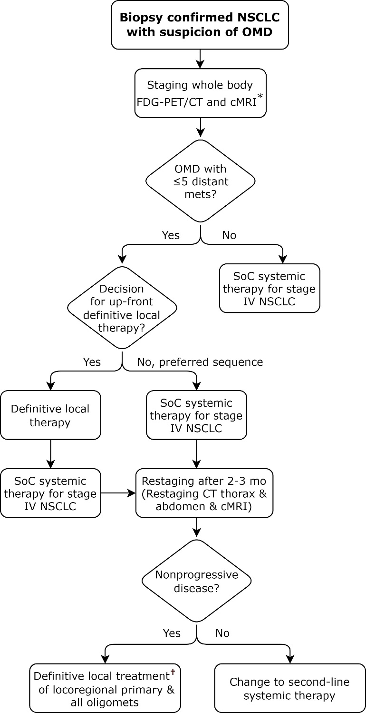
Figure 1. Diagnosis and sequencing of local and systemic treatment for synchronous oligometastatic NSCLC
* Additional imaging modalities that are reasonable to use in establishing an OMD state include: contrast-enhanced chest and upper abdomen CT scan, MRI, bone scan, or PET-MRI.
†Completion of definitive local treatment of all cancer sites if multimodality treatment was started with local treatment.
Abbreviations: cMRI = cranial magnetic resonance imaging; CT = computed tomography; FDG PET = fluorodeoxyglucose F-18 positron emission tomography; NSCLC = non-small cell lung cancer; OMD = oligometastatic disease; SoC = standard of care.

Slide 28
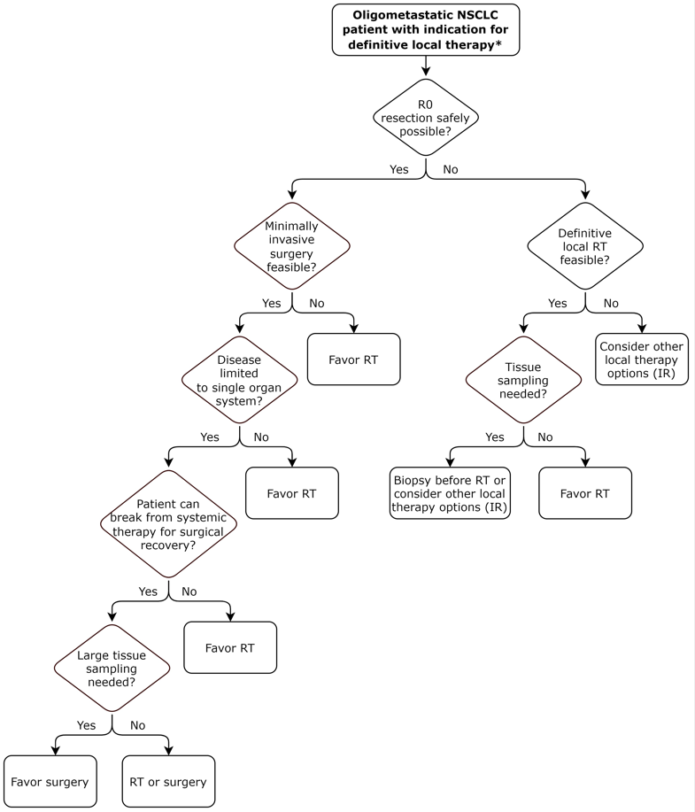
Figure 2. Multidisciplinary decision-making process of definitive RT and surgery for oligometastatic NSCLC
Abbreviations: IR = interventional radiology procedures; NSCLC = non-small cell lung cancer; RT = radiation therapy.
* The quality of evidence for RT and surgery as definitive local therapy differs, with implications for multidisciplinary decision-making as described in the narrative text for KQ2.

Slide 29
Key Takeaways
Despite a lack of randomized phase III trials, there has been increasing adoption and use of definitive local therapies in the management of oligometastatic NSCLC.
As we await these studies to better establish practice patterns, this document was created to provide consensus recommendations on optimal approaches in treating and managing this patient population.

Slide 30
Key Takeaways
Ultimately, a multidisciplinary approach with inclusion of patient preferences is key with suggestions provided by the guideline to support: selection of advanced NSCLC patients for definitive local therapy, timing of local therapy, type of local therapy, and integration of local therapy with systemic therapy among other considerations.

