Slide 1
External Beam Radiation Therapy for Primary Liver Cancers:
An ASTRO Clinical Practice Guideline
Developed in collaboration with the American Society for Clinical Oncology, American Society of Transplant Surgeons, and the Society of Surgical Oncology
Endorsed by the American Society of Transplant Surgeons, European Society for Radiotherapy and Oncology (other orgs TBD)

Slide 2
Citation
This slide set is adapted from the External Beam Radiation Therapy for Primary Liver Cancers Guideline to be published in the January/February 2022 issue of Practical Radiation Oncology (PRO)
Web posted link: https://www.practicalradonc.org/article/S1879-8500(21)00233-2/fulltext
The full-text guideline is also available on the ASTRO Web site: www.astro.org

Slide 3
Guideline Task Force
Chairs
  Higinia Cardenes, MD, PhD
  Smith Apisarnthanarax, MD
Members
  Aisling Barry, MD
  Minsong Cao, PhD
  Brian Czito, MD
  Ronald DeMatteo, MD
  Mary Drinane, MD
  Christopher L. Hallemeier, MD
  Eugene J. Koay, MD, PhD
  Foster Lasley, MD
  Jeffrey Meyer, MD, MS
  Dawn Owen, MD, PhD
  Jennifer Pursley, PhD
  Stephanie K. Schaub, MD
  Grace Smith, MD, PhD, MPH
  Neeta K. Venepalli, MD, MBA
  Gazi Zibari, MD

Slide 4
Task Force Composition
Radiation oncologist
  Drawn from academic, private and community practices
  Includes an RO resident and a member of the Guidelines Subcommittee
Related specialties
  Medical and surgical oncologists*
  Hepatologist
  Medical physicist
  Liver transplant surgeon*
  *Representatives nominated by specialty societies.

Slide 5
Introduction to Guideline
Primary liver cancers: Increasing incidence and mortality rates
  Hepatocellular carcinoma (HCC)
  Intrahepatic cholangiocarcinoma (IHC)
High complexity management
  Multidisclipinary approach
  Multiple treatment options
Evolving role of EBRT
  Better understanding of liver radiation biology
  Advances in imaging and RT delivery

Slide 6
Definitions
External Beam Radiation Therapy (EBRT)
Photon-based approaches and proton therapy
Moderate Hypofractionation
Fraction size 300-500 cGy; typically, 12-20 fractions
Ultrahypofractionation
Fraction size ≥500 cGy; typically, ≤10 fractions
SBRT/SABR* are specified as ultrahypofractionation delivered in ≤5 fractions
* Stereotactic body radiation therapy (SBRT) - Stereotactic ablative body radiation therapy (SABR)

Slide 7
Guideline Scope
Recommendations on use of EBRT for HCC (KQs 1-3) and IHC (KQs 4-5):
  Indications
  Outcomes
  Techniques / fractionations / dose constraints
Clinical settings:
  HCC
    Definitive / non-transplant setting: First line / consolidation / salvage
    Neoadjuvant setting: Preoperative / bridge to OLT
    Palliative
  IHC
    Unresectable: Consolidation after systemic therapy / EBRT alone
    Resectable: Adjuvant

Slide 8
Systematic Review
Ovid MEDLINE® search dates: 1/1/2000 – 2/25/2020
  Both MeSH terms and text words used
Outcomes: Local control, overall survival, disease-free survival, postop complications, toxicities
Inclusions: Age ≥18 years, diagnosis of HCC or non-metastatic IHC
Exclusions: Studies when EBRT was not part of the therapeutic approach; pre-clinical outcomes, non-English, case report, available in abstract only, based on SEER or NCDB databases, not relevant to KQs
1,078 references identified and titles screened
↓
837 abstracts screened
↓
92 articles included and abstracted into evidence tables

Slide 9
Rating Strength of Recommendation
ASTRO’s recommendations are based on evaluation of multiple factors including the quality of evidence (QoE), individual study quality, and panel consensus, all of which inform the strength of recommendation. QoE is based on the body of evidence available for a particular key question and includes consideration of number of studies, study design, adequacy of sample sizes, consistency of findings across studies, and generalizability of samples, settings, and treatments.
Strength of Recommendation | Definition | Overall QoE Grade | Recommendation Wording
Strong | Benefits clearly outweigh risks and burden, or risks and burden clearly outweigh benefits. All or almost all informed people would make the recommended choice. | Any (usually high, moderate, or expert opinion) | “Recommend/ Should”
Conditional | Benefits are finely balanced with risks and burden, or appreciable uncertainty exists about the magnitude of benefits and risks. Most informed people would choose the recommended course of action, but a substantial number would not. A shared decision-making approach regarding patient values and preferences is particularly important. | Any (usually moderate, low, or expert opinion) | “Conditionally Recommend”

Slide 10
Rating Quality of Evidence
Overall QoE Grade | Type/Quality of Study | Evidence Interpretation
High | 2 or more well-conducted and highly-generalizable RCTs or meta-analyses of such trials. | The true effect is very likely to lie close to the estimate of the effect based on the body of evidence.
Moderate | 1 well-conducted and highly-generalizable RCT or a meta-analysis of such trials OR 2 or more RCTs with some weaknesses of procedure or generalizability OR 2 or more strong observational studies with consistent findings. | The true effect is likely to be close to the estimate of the effect based on the body of evidence, but it is possible that it is substantially different.
Low | 1 RCT with some weaknesses of procedure or generalizability OR 1 or more RCTs with serious deficiencies of procedure or generalizability or extremely small sample sizes OR 2 or more observational studies with inconsistent findings, small sample sizes, or other problems that potentially confound interpretation of data. | The true effect may be substantially different from the estimate of the effect. There is a risk that future research may significantly alter the estimate of the effect size or the interpretation of the results.
Expert Opinion† | Consensus of the panel based on clinical judgement and experience, due to absence of evidence or limitations in evidence. | Strong consensus (≥90%) of the panel guides the recommendation despite insufficient evidence to discern the true magnitude and direction of the net effect. Further research may better inform the topic.
Notes:
†A lower quality of evidence, including expert opinion, does not imply that the recommendation is conditional. Many important clinical questions addressed in guidelines do not lend themselves to clinical trials but there still may be consensus that the benefits of a treatment or test clearly outweigh its risks and burden.

Slide 11
Consensus Methodology
Modified Delphi approach
Task force members rated their level of agreement for each recommendation via consensus survey
  5-point Likert scale from “strongly disagree” to “strongly agree”
  Consensus defined using pre-specified threshold of ≥75% (≥90% for expert opinion recommendations) agreement
Recommendations for which consensus not achieved were removed or revised and re-surveyed
Recommendations achieving consensus edited with substantive changes after the first round were also re-surveyed

Slide 12
KQ 1: What is the role of EBRT in the definitive/non-transplant and palliative settings in HCC?

Slide 13
KQ1: EBRT in the definitive/non-transplant and palliative settings in HCC
KQ1 Recommendations | Strength of Recommendation | Quality of Evidence
For patients with liver-confined HCC who are not candidates for curative options (surgery or thermal ablation), and for whom catheter-based therapies are being considered, EBRT is recommended as a potential first-line single therapy option. | Strong | Moderate
For patients with liver-confined multifocal and/or unresectable HCC, EBRT alone or sequenced with other catheter-based therapies* is conditionally recommended. | Conditional | Moderate
For patients with liver-confined HCC who had an incomplete response to thermal ablation or catheter-based therapies*, EBRT is recommended as a consolidative treatment option. | Strong | Moderate
*Caution should be used when recommending EBRT after TARE until more data are available.

Slide 14
KQ1: EBRT in the definitive/non-transplant and palliative settings in HCC
KQ1 Recommendations (continued) | Strength of Recommendation | Quality of Evidence
For patients with locally recurrent HCC after surgery, thermal ablation, or catheter-based therapies*, EBRT is recommended as a salvage treatment option. | Strong | Low
For patients with liver-confined HCC with macrovascular invasion, EBRT is conditionally recommended, alone or sequenced with systemic therapy or catheter-based therapies*. | Conditional | Moderate
For patients with liver-confined HCC with macrovascular invasion, EBRT is conditionally recommended, alone or sequenced with systemic therapy or catheter-based therapies*. | Conditional | Low (locally advanced HCC)
 |  | Expert opinion (metastatic HCC)
*Caution should be used when recommending EBRT after TARE until more data are available.

Slide 15
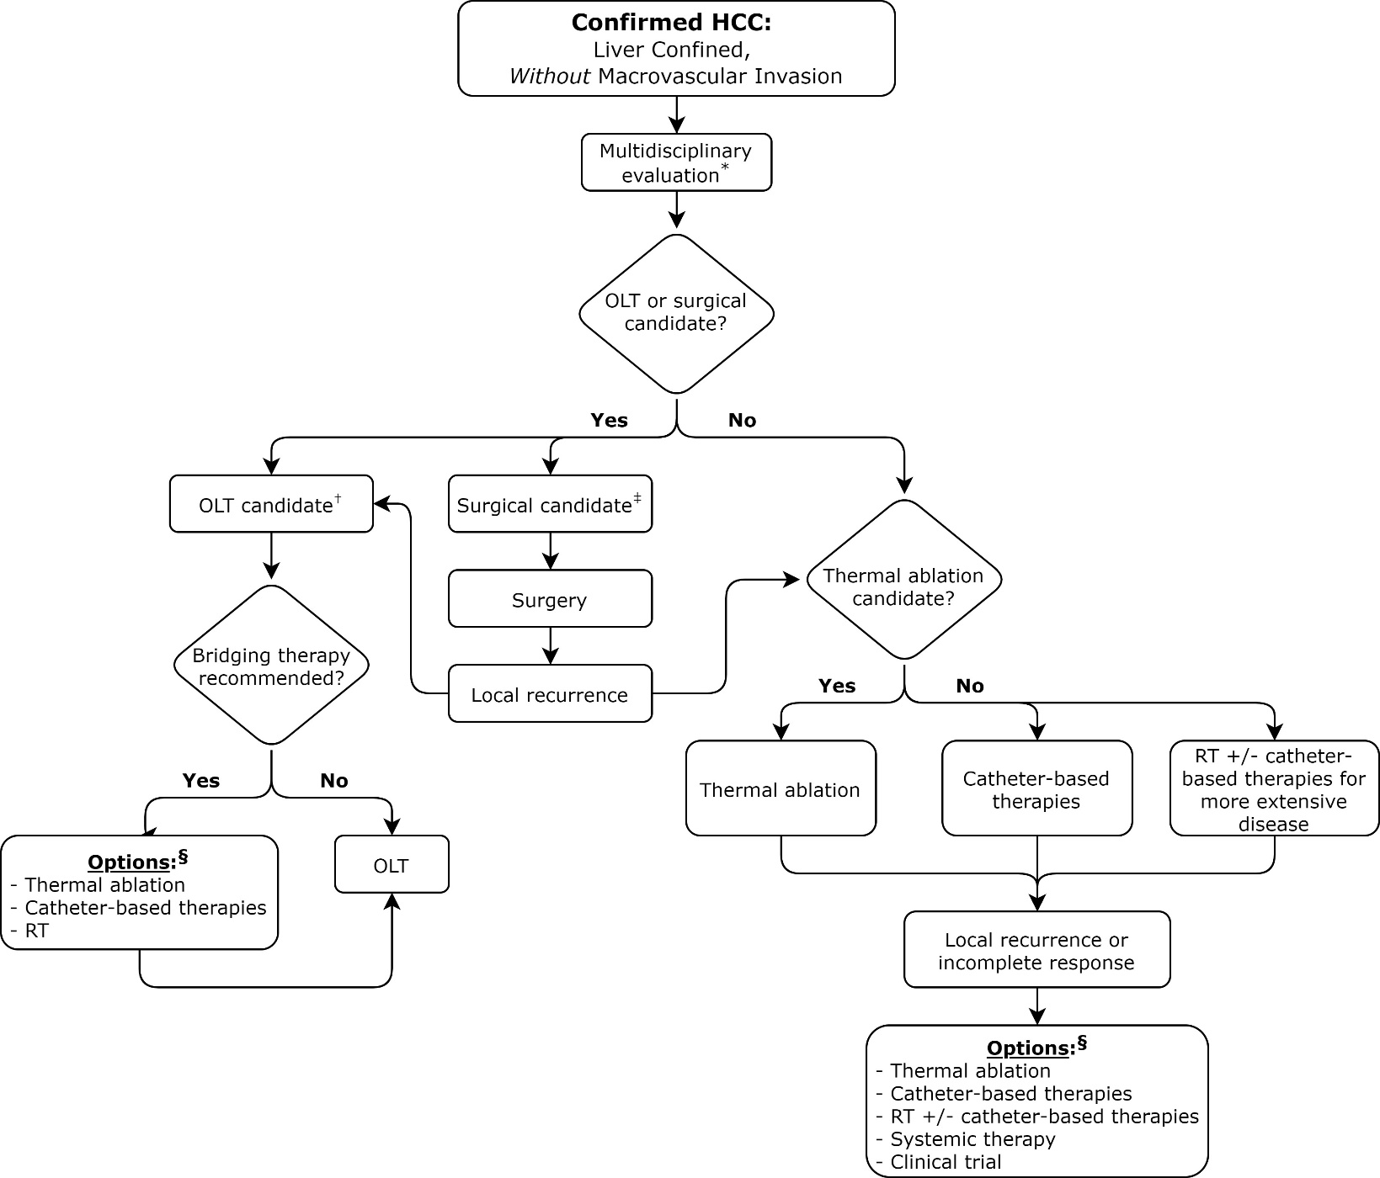
Figure 1.
HCC: Liver Confined, Without MVI
*Enrollment in a clinical trial should be prioritized if available.
†OLT candidate: UNOS criteria (solitary lesion 2-5 cm diameter or 2-3 lesions ≤3 cm each).
‡Surgical candidate: CP class A and selected CP class B (no portal hypertension, adequate location, preserved liver function).
§Order of listed options does not reflect a particular preference; decision is based on multidisciplinary evaluation.

Slide 16
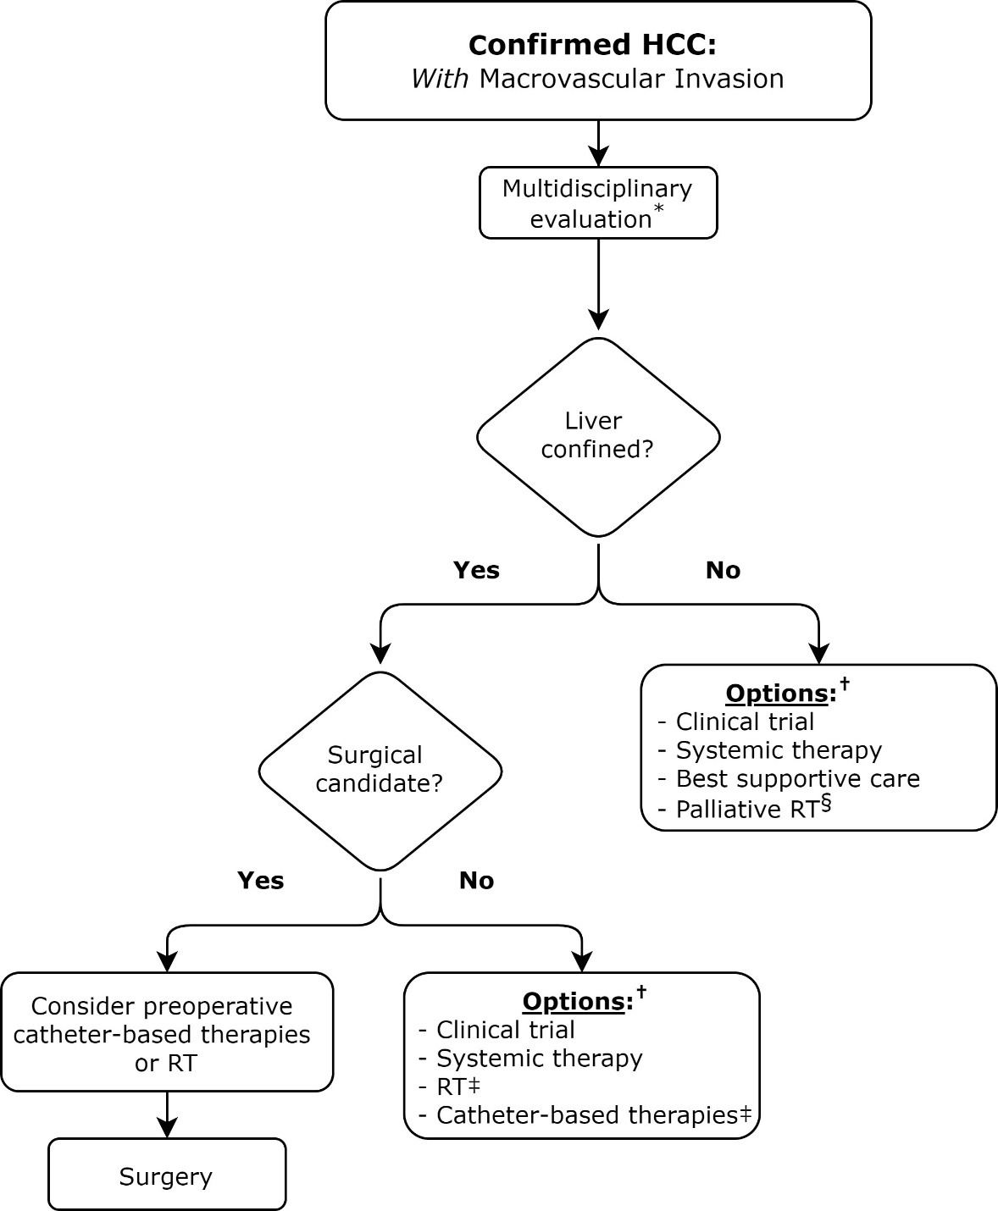
Figure 2.
HCC: Liver Confined, With MVI
*Enrollment in a clinical trial should be prioritized if available.
†Order of listed options does not reflect a particular preference; decision is based on multidisciplinary evaluation.
‡Consider alone or in sequential combination.
§To liver tumor(s) and/or large vessel tumor thrombus if symptomatic.

Slide 17
KQ 2: What is the role of EBRT in the neoadjuvant setting prior to surgical resection or OLT for HCC?

Slide 18
KQ2: Neoadjuvant EBRT prior to surgery or OLT for HCC
KQ2 Recommendations | Strength of Recommendation | Quality of Evidence
For patients with HCC who are potential candidates for OLT, ultra- or moderately hypofractionated EBRT is conditionally recommended as a bridge to transplant or as a downstaging intervention. | Conditional | Low
For patients with HCC with portal vein tumor thrombus that are potentially resectable, neoadjuvant EBRT is conditionally recommended. | Conditional | Low

Slide 19
KQ 3: In patients receiving EBRT for HCC, what are the preferred techniques, fractionation regimens, and recommended OAR dose constraints?

Slide 20
KQ3: EBRT technique and fractionation for HCC
KQ3 Recommendations | Strength of Recommendation | Quality of Evidence
For patients with liver-confined HCC, for whom EBRT is recommended, dose-escalated ultra- or moderately hypofractionated EBRT is recommended, with choice of regimen based on tumor location, underlying liver function, and available technology.* | Strong | Moderate
For patients with HCC with macrovascular invasion for whom EBRT is delivered in combination with other catheter-based therapies, moderately hypofractionated EBRT is conditionally recommended.* | Conditional | Moderate
For patients with HCC receiving dose-escalated ultra- or moderately hypofractionated EBRT, IMRT or proton therapy are recommended, with choice of regimen based on tumor location, underlying liver function, and available technology. | Strong | Moderate
*See recommended EBRT dose and fractionation table.

Slide 21
KQ3: EBRT technique and fractionation for HCC
KQ3 Recommendations (continued) | Strength of Recommendation | Quality of Evidence
For patients with HCC receiving dose-escalated ultra- or moderately hypofractionated EBRT, respiratory motion management and daily image guidance are recommended. | Strong | Low
For patients with HCC, radiation dose to the liver minus the gross tumor volume should be evaluated and minimized to reduce the risk of radiation-induced liver disease.* | Strong | Moderate
*See recommended dose constraints table.

Slide 22
Recommended EBRT doses and fractionation for HCC and IHC*
Fractionation regimen | Total dose/fractionation | BED₁₀
Ultrahypofractionation | Non-cirrhotic (primarily IHC): 4000-6000 cGy/3-5 fx** | 7200-18,000 cGy
 | CP class A: 4000-5000 cGy/3-5 fx | 7200-12,500 cGy
 | CP class B7: 3000-4000 cGy/5 fx | 4800-7200 cGy
 | 4000-5400 cGy/6 fx | 6700-10,300 cGy
 | 5000-6600 cGy/10 fx | 7500-11,000 cGy
Moderate hypofractionation | 4800 cGy/12 fx | 6720 cGy
 | 4500-6750 cGy/15 fx | 5900-9800 cGy
 | 6000 cGy/20 fx | 7800 cGy
 | 6600-7200 cGy/22 fx | 8600-9600 cGy
Standard fractionation | 5040 cGy/28 fx† | 5947 cGy
 | 6000 cGy/30 fx† | 7200 cGy
 | 7700 cGy/35 fx | 9400 cGy
*Bolded regimens are the most common prescriptions used, based on consensus of the task force. Dose constraints pertain to these most common dose-fractionations.
**Lower doses recommended for central lesions in which the maximum point dose to central bile duct(s) cannot be met.
†For IHC when combined with concurrent systemic therapy.

Slide 23
Recommended dose constraints for uninvolved liver and bowel structures*
OARs/ References | Ultrahypofx 3 fx | Ultrahypofx 5 fx | Moderate Hypofx 15 fx | Standard Fx ≥20 fx | Toxicity endpoint
Uninvolved liver, non-cirrhotic (MLD) | Mean <1200-1500 cGy ≥700 cc <1900 cGy | Mean <1500-1800 cGy ≥700 cc <2100 cGy | Mean <2400 cGy | Mean <3200 cGy | RILD
Uninvolved liver, CP class A (MLD) | Mean <1000-1200 cGy | Mean <1300-1500 cGy ≥700 cc <1500 cGy | Mean <2000 cGy | Mean <3000 cGy | CP increase >2 at 3 mo RILD
Uninvolved liver, (MLD) CP class B7 | N/R | Mean <800-1000 cGy ≥500 cc <1000 cGy | Mean <1600 cGy | Mean <2400 cGy | CP increase >2 at 3 mo RILD
*This table is a combination of evidence-based constraints and expert opinion; dose constraints are for the most common fractionations. It is meant as a starting point to keep the doses as low as possible to OARs, while still achieving a tumoricidal dose.
†CP class B patients are at very high risk of decompensation. The task force does not recommend 3 fraction SBRT; a 5 fraction SBRT regimen or hypofractionated approach to keep the MLD as low as possible is preferred.

Slide 24
Recommended dose constraints for uninvolved liver and bowel structures*
OARs/ References | Ultrahypofx 3 fx | Ultrahypofx 5 fx | Moderate Hypofx 15 fx | Standard Fx ≥20 fx | Toxicity endpoint
Central bile ducts | D0.03 cc <3570 cGy | D0.03 cc <4050 cGy | --- | --- | Stenosis
Stomach | D0.03 cc <2200 cGy D10 cc <1650 cGy | D0.03 cc <3200 cGy D10 cc <1800 cGy | D0.03 cc <4200 cGy | D0.03 cc <5400 cGy V45 Gy <33.3% V40 Gy <66.7% | Ulcer
Duodenum | D0.03 cc <2200 cGy D5 cc <1650 cGy | D0.03 cc <3200 cGy D5 cc <1800 cGy | D0.03 cc <4500 cGy | D0.03cc <5400 cGy | Ulcer
Small bowel | D0.03 cc <2500 cGy D5 cc <1800 cGy | D0.03 cc <3200 cGy D5 cc <1950 cGy | D0.03 cc <4500 cGy | D0.03cc <5400 cGy V45 Gy <195 cc | Ulcer
Large bowel | D0.03 cc <2800 cGy D20 cc <2400 cGy | D0.03 cc <3400 cGy D20 cc <2500 cGy | D0.03 cc <4500 cGy | D0.03cc <6000 cGy V55 Gy <5 cc V45 Gy <60 cc V35 Gy <150 cc V30 Gy <200 cc | Ulcer
*This table is a combination of evidence-based constraints and expert opinion; dose constraints are for the most common fractionations. It is meant as a starting point to keep the doses as low as possible to OARs, while still achieving a tumoricidal dose.
†CP class B patients are at very high risk of decompensation. The task force does not recommend 3 fraction SBRT; a 5 fraction SBRT regimen or hypofractionated approach to keep the MLD as low as possible is preferred.

Slide 25
KQ 4: What is the role of EBRT in the definitive and adjuvant setting in IHC?

Slide 26
KQ4: EBRT in the definitive and adjuvant setting in IHC
KQ4 Recommendations | Strength of Recommendation | Quality of Evidence
For patients with unresectable IHC, induction chemotherapy followed by consolidation with EBRT, alone or in combination with chemotherapy is recommended. Implementation remark: For patients who are not candidates for induction chemotherapy, EBRT alone or in combination with chemotherapy, should be considered. | Strong | Moderate
For patients with IHC who underwent curative surgical resection and have high-risk features, adjuvant EBRT with concurrent chemotherapy, alone or sequenced after systemic chemotherapy, is conditionally recommended. Implementation remark: High-risk clinical features include positive lymph nodes and/or R1 resection. | Conditional | Low

Slide 27
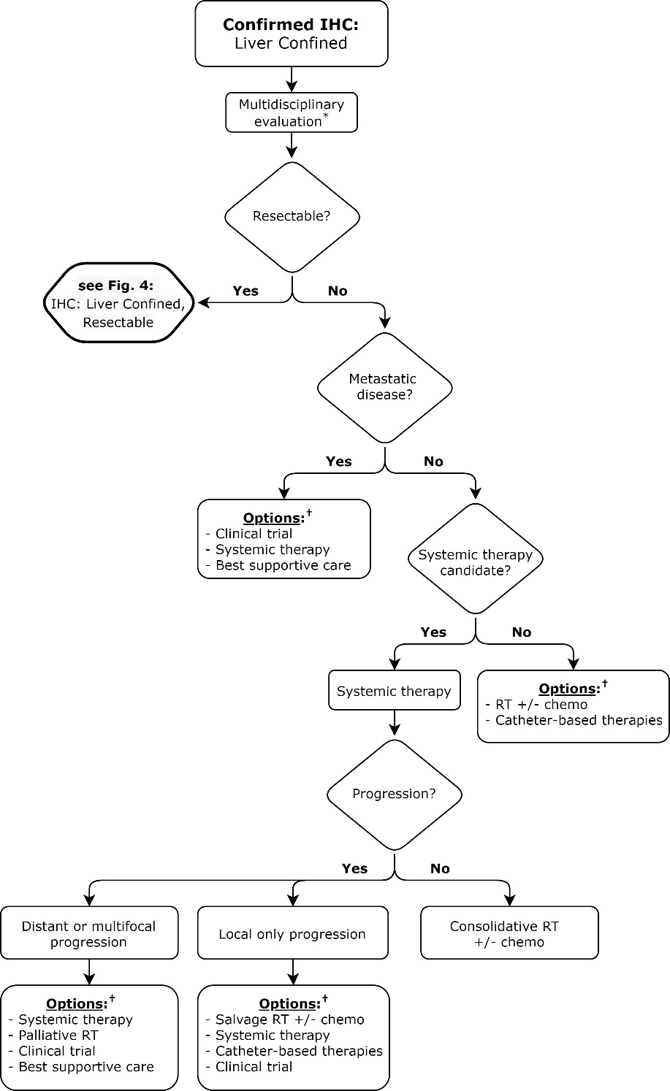
Figure 3.
IHC: Liver Confined, Unresectable
*Enrollment in a clinical trial should be prioritized if available.
†Order of listed options does not reflect a particular preference; decision is based on multidisciplinary evaluation.

Slide 28
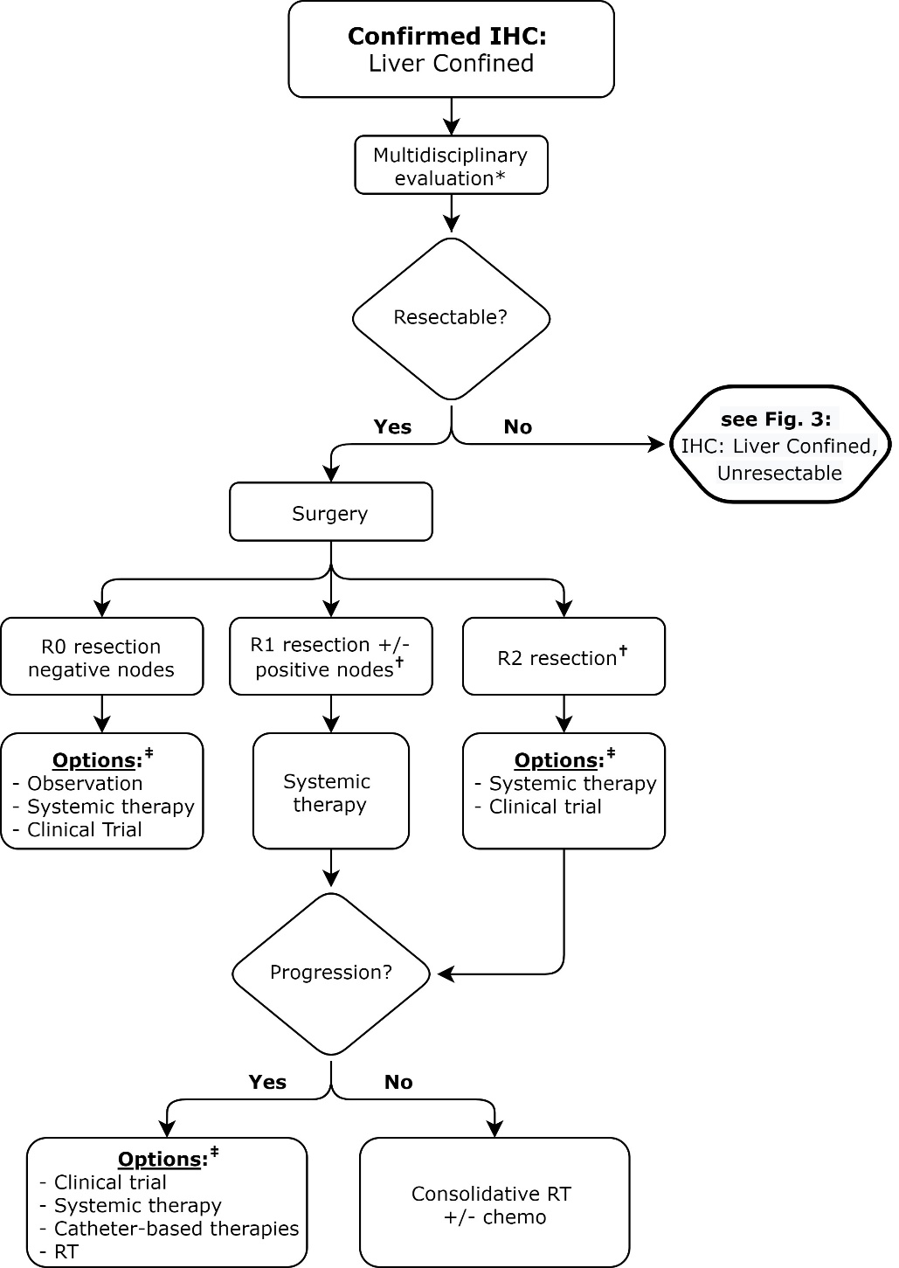
Figure 4.
IHC: Liver Confined, Resectable
*Enrollment in a clinical trial should be prioritized if available.
†Consider additional surgical resection when feasible prior to adjuvant therapy.
‡Order of listed options does not reflect a particular preference; decision is based on multidisciplinary evaluation.

Slide 29
KQ 5: In patients receiving EBRT for IHC, what are the preferred techniques, fractionation regimens, and recommended OAR dose constraints?

Slide 30
KQ5: EBRT technique and fractionation for IHC
KQ5 Recommendations | Strength of Recommendation | Quality of Evidence
For patients with unresectable IHC receiving EBRT, dose-escalated ultra- or moderately hypofractionated EBRT is conditionally recommended with fractionation based on tumor location, underlying liver function, and available technology.* Implementation remark: Concurrent systemic therapy should not be used with ultrahypofractionated EBRT. | Conditional | Low
For patients with resected IHC receiving postoperative EBRT, standard fractionation is conditionally recommended.* | Conditional | Low
*See recommended EBRT dose and fractionation table.

Slide 31
KQ5: EBRT technique and fractionation for IHC
KQ5 Recommendations (continued) | Strength of Recommendation | Quality of Evidence
For patients with unresectable IHC receiving dose-escalated ultra- or moderately hypofractionated EBRT, IMRT or proton therapy are conditionally recommended with choice of regimen based on tumor location, underlying liver function, and available technology. | Conditional | Low
For patients with IHC receiving dose-escalated ultra- or moderately hypofractionated EBRT, respiratory motion management and daily image guidance are recommended. | Strong | Low
For patients with IHC, radiation dose to the liver minus the gross tumor volume should be evaluated and minimized to reduce the risk of radiation-induced liver disease.* | Strong | Low
*See recommended dose constraints table.

Slide 32
Key Take Away Messages
Multidisciplinary assessment is key
Low-to-moderate quality evidence support consideration of EBRT for definitive, consolidative, salvage, and adjuvant therapy
  Strong recommendations:
    Potential first-line, consolidation after other LDTs and salvage option
  Conditional recommendations:
    Multi-focal disease, unresectable primary with/or macrovascular invasion
    Potential bridge to transplant and neoadjuvant therapy prior to surgical resections
    Palliative therapy: primary tumor, tumor thrombus
Dose-fractionation regimens, technique, and modality personalized
Moderate dose escalation with ultra- or moderate hypofractionation
Close attention to liver dose constraints

Slide 33
Future Directions
Recently published/completed/ongoing studies
  PBT vs thermal ablation RCT in HCC
  Consolidation EBRT after TAE/TACE RCT in HCC
  ABC-07: systemic therapy +/- EBRT in IHC
Additional areas of research needed:
  Optimal tumor dose, normal tissue constraints
  Consensus on radiological response, liver toxicity metrics
  Liver biomarkers
  Integration with systemic therapy
  MRI-guided EBRT
  Interplay with TARE and immunotherapy / targeted therapy

