Slide 1
Welcome

Slide 2
Disclosure
List your employer along with any potential conflicts of interest.
If you have none, please enter the following statement: “I have no conflicts of interest to disclose.”
Speakers are also required to disclose the following, if applicable, to the audience at the beginning of your presentation (in accordance with ACCME standards and Food and Drug Administration requirements):
Any vested interest or intention to discuss off-label and/or investigational use of pharmaceuticals or devices.
The existence of any financial or other relationship you have with the manufacturer(s) or any commercial product(s) or provider(s) of any commercial services discussed in an educational presentation IF your disclosure that is displayed on the disclosure slide is not current.

Slide 3
Learning Objectives
List two to three objectives that highlight the instructional content and/or expected learning outcomes of your presentation.
Describe what the learner is expected to do differently, keeping in mind your identified practice gaps, needs and expected results.
Examples of expected results include increasing knowledge/skills and, when appropriate, applying new strategies to make practice modifications.
Outcomes should be grounded in real expertise (what are the best performers deciding/doing?).
Address potential challenges/barriers to change during your talk and discuss potential solutions so that learners are better equipped to make changes in practice if needed.

Slide 6
Effective Educational Practices
Talk titles should inspire curiosity. If you update your talk title, please send it to ASTRO staff so they can update the program.
Consider making your talk case-based with decision points throughout. Use decision points as opportunities for attendees to take one minute and speak to one another about what they would do. People learn more when they collaborate.
Spend less time on slides and more time on discussion, questions and answers, and attendee engagement. Be sure you know when your session will be addressing Q&A.
Show how this education can help attendees make a meaningful, positive change in their day-to-day practice.

Slide 7
Conclusion/Summary – at the end of your talk
What are the main teaching points/takeaways from your talk?
If applicable, include key takeaways after each section of the talk so the audience can “digest” the material as the talk proceeds.
What changes and/or improvements in patient care should your audience make as a result of your presentation?
How should the audience incorporate information into their current practice?
How does your lecture improve their competency?
How does your lecture address potential challenges/barriers?

Slide 8
Widescreen Format
To take full advantage of the widescreen format, we recommend that you build or convert your presentation to 16:9.
If you would prefer to use your own PowerPoint template, you can change an existing 4:3 presentation into a 16:9 widescreen format.
For PowerPoint 2010 and 2007, on the "Design" tab, click on "Page Setup". In the drop-down box, select "On-Screen Show (16:9)" and click "OK."
If you are using Office 2003, click "File" and select "Page Setup" and then enter in "10" in the first field and "5.63" in the second field and click "OK."
If you make this change on an existing presentation, your slides will expand to the new size. If you have any videos or photos in an existing PowerPoint, they might need to be resized (so they do not appear stretched). Check animations to ensure the elements line up correctly.

Slide 9
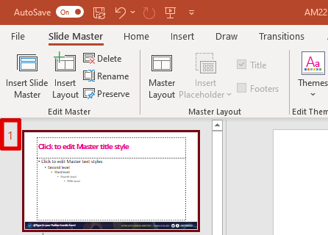
Adding your Twitter handle
To add your Twitter handle to the slides:
Click on View on the menu bar
Click on Slide Master
3. Make sure the first slide is selected
4. Click on the text box and type in your Twitter handle
5. Click on Close Master View on the top menu when finished

Slide 10
Want to remove the Twitter handle icon?
To remove the Twitter handle icon:
Click on View on the menu bar
Click on Slide Master
3. Make sure the first slide is selected
4. Click on the text box and delete the Twitter handle icon
5. Click on Close Master View on the top menu when finished

