Slide 1
Instructions for Use of These Slides
The purpose of these slides is to serve as a resource that any radiation oncologist can use when speaking about the role of radiation therapy to health care professionals involved in cancer rehabilitation (PT, OT, PM&R, etc)
Any user is welcome to format the slides as needed to fit their target audience.
Please ask attendees to complete either the pre-test or post-test so that we can assess the effectiveness of the slides. If you make significant changes to the content of the slides for your presentation, we prefer that you use the pre-test only.
Pre-test link: https://redcap.link/rehab_pre1
Post-test link: https://redcap.link/rehab_post1
Primary Author: Bailey Nelson, MD
Peer Reviewer(s): Maddie Duzyk, OTR/L; Ben Reader PT, DPT; Malcolm Mattes MD; Michael Corradetti, MD
Last updated in February 2022 – newer data may impact the accuracy of the content of these slides

Slide 2
Introduction to Radiation Therapy for Health Care Professionals Involved in Cancer Rehabilitation

Slide 3
Learning Objectives
Understand basic principles of radiotherapy
Identify radiotherapy side effects that can benefit from rehabilitation
Review work-up and treatment options for different types of radiation toxicity
Identify clinical situations where Radiation Oncology should be asked to see patient

Slide 4
Principles of Radiotherapy

Slide 5
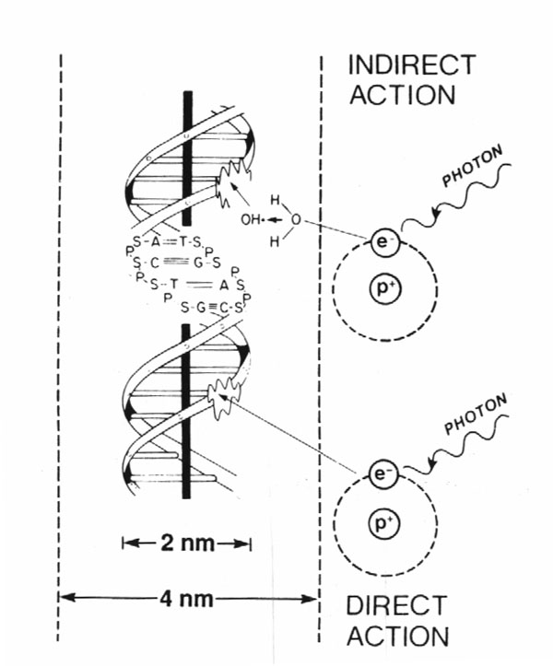
How Does Radiation Work?
80%
X-rays interact with water
radiolysis
free radicals
bind to and damage DNA
cell death
(by mitotic catastrophe)
20%
Cancer cells are more susceptible to RT
due to impaired DNA repair pathways

Slide 6
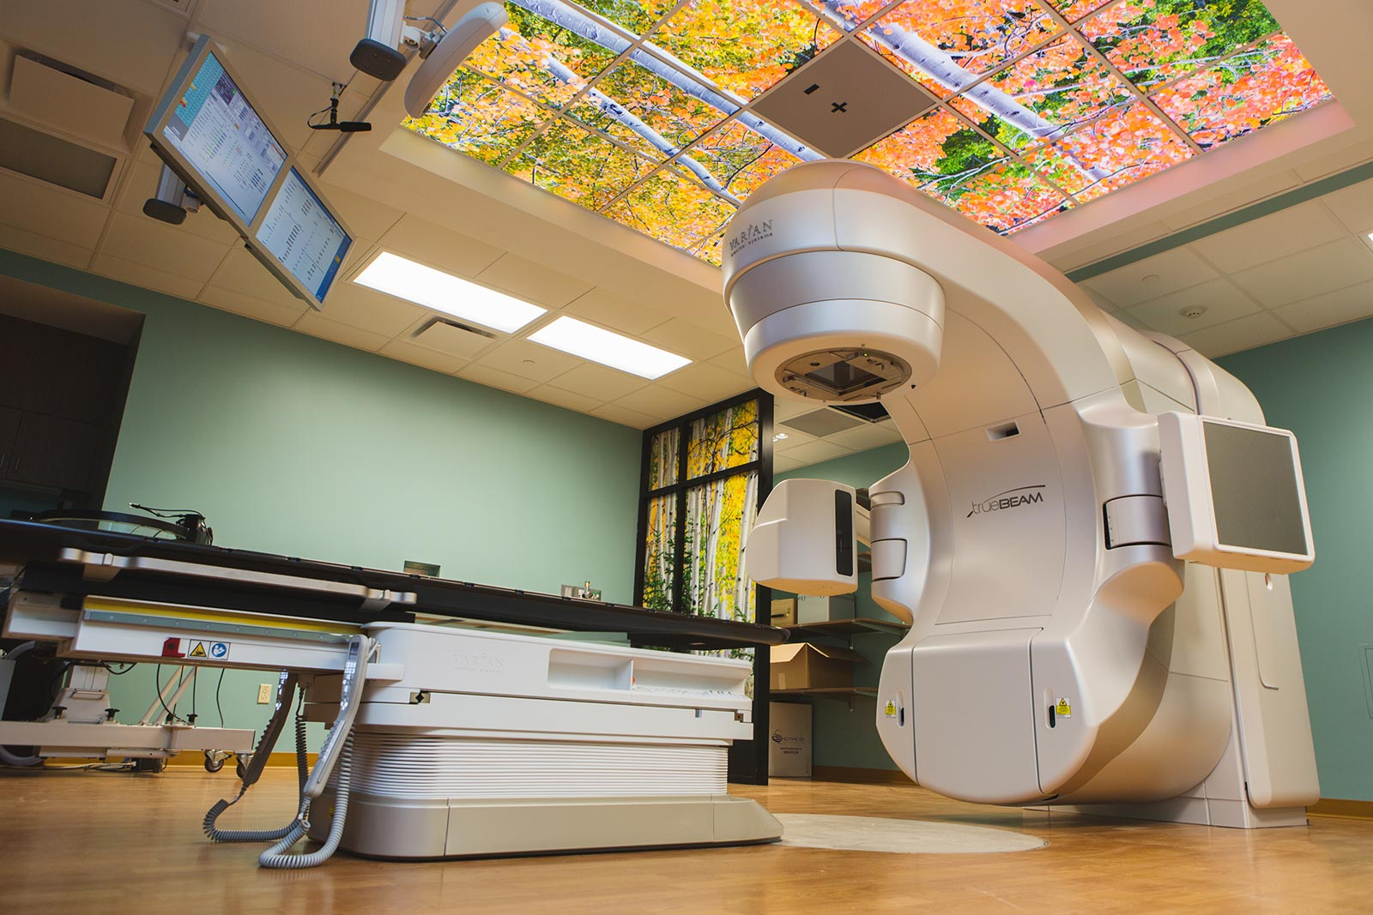
Approaches to Radiation Delivery
External Beam Radiation (majority)
Brachytherapy
Internally delivered radiation
Commonly used in gynecologic and
prostate cancers
Radiopharmaceuticals
Radioactive drugs used to treat
cancer

Slide 7
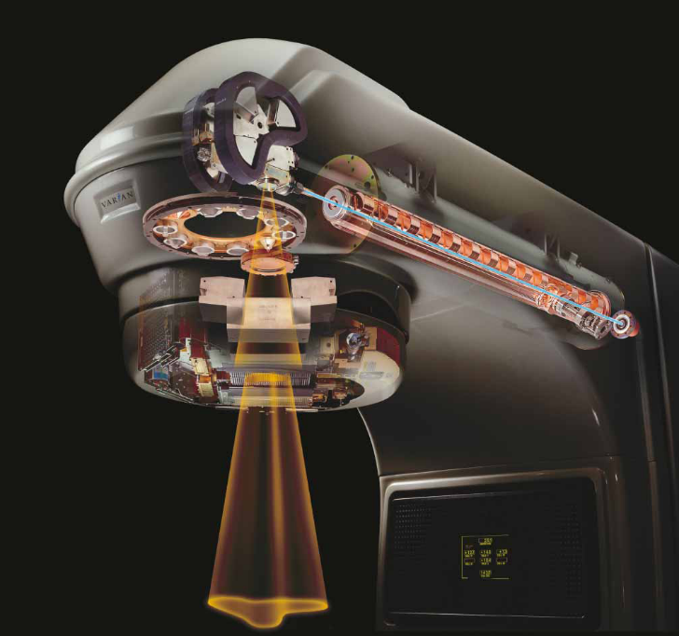
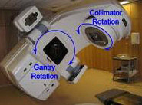
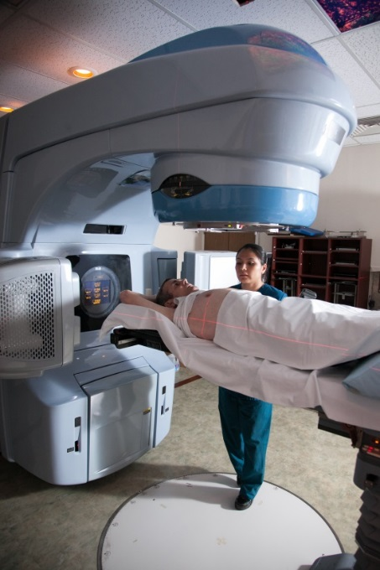
Linear Accelerator (Linac)
Delivers high energy X-rays (photons) or electrons
Non-invasive
Rapid treatment delivery, in minutes
Notes:
Explain how the machine actually works: Electricity → powers electron gun → generates high energy electrons → accelerated along waveguide → strike a Tungsten target → bremsstrahlung generates high energy photons (X-rays) → pass over a filter to generate uniform field → shaped by jaws and collimators → enter patient

Slide 8
Lymphedema

Slide 9
Lymphedema
Lymphatic system is responsible for filtering waste from the body and fighting infections
Lymph node dissection and radiation can both cause lymphedema
Most common in…
Sarcomas
Vulvar Cancer
Breast Cancer
Head & Neck Cancers
Blausen.com staff (2014). "Medical gallery of Blausen Medical 2014". WikiJournal of Medicine 1 (2). DOI:10.15347/wjm/2014.010. ISSN 2002-4436

Slide 10
Lymphedema
Lymphedema is a build-up of excess lymph in soft tissues
Surgery (~20-25% risk of lymphedema with ALND alone)
Removal of lymph nodes
Disruption of lymphatic channels
Radiation (~10% risk of lymphedema with axillary RT alone)
Scar tissue/fibrosis
Symptoms
Skin redness, differing sizes of extremities, tightness, heaviness/fullness, burning, itching, skin thickening
Lymphedema is typically not curable, but is manageable
Notes:
In the previous slide you mention several cancers with risk of lymphedema but here only talk about percentages for breast cancer. Since we try to avoid ALND in favor of sentinel LN biopsy, I am not sure these percentages are truly helpful.

Slide 11
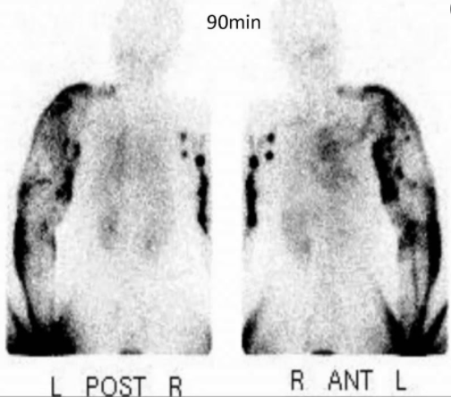
Lymphedema
Diagnosis
Comparing circumference with tape measure
Lymphoscintigraphy
Bioimpedance testing
Important to rule out cellulitis!
Associated with infectious symptoms
Fevers, chills, erythema, warmth
Notes:
Lymphoscintigraphy: a type of nuclear medicine imaging that provides images of the lymphatic system. Uses small amounts of radiotracers, which accumulate in regions of inflammation.
Bioimpedance testing: method for estimating body composition where a weak electric current flows through the body and the voltage is measured in order to calculated impedance (resistance) of the body

Slide 12
Cheng Lymphedema Grading
Grade | Symptoms | Circumferential Difference | Lymphoscintigraphy
0 | Reversible | <10% | Partial Occlusion
1 | Mild | 10-19% | Partial Occlusion
2 | Moderate | 20-29% | Total Occlusion
3 | Severe | 30-39% | Total Occlusion
4 | Very Severe | >40% | Total Occlusion

Slide 13
Lymphedema: Non-Invasive Treatments
Compression
Garments and bandaging
Devices: pneumatic pumps
Manual lymphatic drainage
Massage
Exercise
Flexibility and stretching
Progressive weight training
Aerobic exercise
British Journal of Community Nursing Vol 22 No 10 Chronic Oedema October 2017

Slide 14
Lymphedema: Invasive Treatments
Liposuction
Lymph node transfer
Debulking
Only used in severe cases
Lymphatic bypass procedure
Notes:
Lymphatic bypass surgery is sometimes called lymphovenous anastomosis surgery. Part of the lymphatic vessel that is not blocked is connected to a nearby vein. This allows the lymphatic fluid to get past the blockage and away from the affected limb. Typically performed by a vascular surgeon.
Liposuction is the treatment of choice for solid extremity lymphedema. The solid disease becomes prominent as the pathology progresses. Chronic lymphedema causes inflammation that can lead to excess fat growth in the affected limb. Liposuction is technically simple and minimally invasive. Removes fat only.
Lymph node transfer: involves moving lymph nodes with an intact blood supply to restore or augment lymphatic drainage. Typically performed by a surgical oncologist.
Debulking: removes damage skin and fat down to the muscle. Area of resurfaced with a skin graft. This is an extreme measure limited only for the most advanced cases of lymphedema.

Slide 15
Brachial Plexopathy

Slide 16
Brachial Plexopathy
Network of nerves that carry movement and sensory signals from hands and arms to spinal cord
Maximum point dose of radiation to brachial plexus is important
Serial structure
Higher risk with re-irradiation of regional lymph nodes and when gross disease is near plexus
1918 Edition of Gray's Anatomy

Slide 17
Radiation-Induced Brachial Plexopathy
Incidence ~1-2%
Typically, H&N, breast cancer, lung cancer patients
Risk increases if max dose > 60-66 Gy
Typical post-mastectomy radiation dose is 50 Gy unless gross disease
Progression of symptoms is delayed and gradual
Most commonly 1-5 years after RT
Symptoms
Numbness, paresthesia, dysesthesia, motor weakness
Typically, paresthesia → pain → weakness
Important for treating Radiation Oncologist to keep brachial plexus dose below tolerance, and clinically correlate symptoms with radiation plan
Important to rule out recurrent tumor
https://www.ncbi.nlm.nih.gov/pmc/articles/PMC7703345/#

Slide 18
Brachial Plexopathy
Differential
Disease progression!
Neuritis
Carpal Tunnel Syndrome
Cervical spine disease
Work-up
Physical examination
EMG
Nerve conduction studies
MRI
Notes:
EMG measures muscle response or electrical activity in response to a nerve’s stimulation of the muscle.

Slide 19
Brachial Plexopathy: Treatment
Non-invasive Treatment
Range of motion exercises
Stretching
Joint compression
Aquatic therapy
Invasive Treatment
Neurolysis
Nerve graft
Nerve transfer
*80-90% of patients see improvement, but it can take months to years.
Notes:
Neurolysis: frees up the nerve from scar tissue
Nerve graft: damaged part of the plexus is removed and replaced with sections of nerves taken from other parts of the body.
Nerve transfer: take less important nerve that’s still working and connects it to a nerve that’s more important but not working (“bypass”)
These procedures are performed by neurosurgeons.

Slide 20
fibrosis

Slide 21
Fibrosis
Swelling and inflammation caused by surgery and radiation can lead to scar tissue formation
Increased risk with increased radiation dose, larger treatment volume, larger dose/fraction, previous and/or concurrent treatments
Certain co-morbidities can worsen fibrosis
Diabetes
Connective tissue disorders
Circulatory disorders
Symptoms
Pain, decreased range of motion, tightness

Slide 22
Fibrosis in Sarcoma
Typically, the main treatment for sarcomas is surgery
Pre-op vs post-op radiotherapy can be given
Goal is to avoid amputation and preserve limb
Pre-op RT
Advantages: lower radiation dose, smaller treatment volume
Disadvantage: higher rate of wound complications
Worse in lower extremities vs upper extremities
Post-op RT
Associated with worse long-term fibrosis and decreased mobility

Slide 23
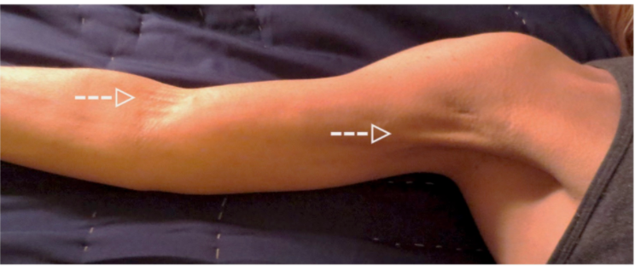
Cording
Axillary Web Syndrome aka “Cording”
Scarring of connective tissue under arm
The American Journal of Medicine, 2017

Slide 24
Cording: Treatment
OT/PT
Gradient Compression Bandaging
Myofascial Release
Medical Management
Anti-Inflammatory Medications
Collagenase Injections
Massage Therapy
Stretching
Fat Grafting
Notes:
Ann Plast Surg. 2016 May;76 Suppl 3:S227-31. doi: 10.1097/SAP.0000000000000767
Myofascial Release is a safe and effective hands-on technique that involves applying gentle sustained pressure into the myofascial connective tissue restrictions to eliminate pain and restore motion.
Fat grafting: the scar/cord is released and then a fat graft is harvested and injected into the area of scar release.
Collagenase (Xiaflex) can be injected to disrupt the cords.

Slide 25
Pelvic toxicity

Slide 26
Pelvic Floor Dysfunction
Radiation is used to treat many pelvic cancers
Anal, rectal, gynecologic, prostate, etc.
Changes in the pelvic floor musculature after RT are unclear, but RT can cause many pelvic floor dysfunctions
Urinary symptoms
Fecal symptoms
Dyspareunia
RT can also cause pelvic insufficiency fractures

Slide 27
Sexual Dysfunction
Dyspareunia
Women getting pelvic RT often receive high doses of radiation to the vagina
RT can cause vaginal stenosis, dryness, adhesions, telangiectasias and atrophy
Sometimes a vaginal dilator is inserted during radiation treatment to allow for maximum sparing of the genitalia
A vaginal dilator is typically recommended after RT
Use 3x weekly, a few minutes at a time, starting 1 month following RT

Slide 28
Urinary Incontinence
Need to identify type of incontinence
Stress
Most common after pelvic RT
Urge
Overflow
Functional
Mixed

Slide 29
Stress Urinary Incontinence
Incontinence with movement or activity (coughing, sneezing, lifting weight, etc.)
Important to rule-out infection
Treatment
Kegel exercises
Pelvic floor rehab
Medications: anticholinergics, etc.
Nerve stimulator
Surgery

Slide 30
Fecal Incontinence
Late side effect of RT
Result of muscle and sphincter damage
Radiation Oncologists aim to limit radiation dose to bowel to a known tolerance level
Treatment
Diet modification
Anti-diarrheal drugs, bulk fiber (psyllium)
Kegels
Biofeedback
Sacral nerve stimulator
Bowel training
Surgery: bowel diversion

Slide 31
Pelvic Insufficiency Fractures
Incidence of PIF after RT for gynecologic cancers is ~15%
Most common fracture sites
SI joint
Sacrum
Pubis
Median time to fracture is ~7-20 months after RT
Osteoporosis is a pre-disposing condition
Notes:
https://pubmed.ncbi.nlm.nih.gov/31580930/

Slide 32
Pelvic Insufficiency Fractures
Symptoms
Intractable pain that is exacerbated by weight bearing and relieved by rest
Presentation often in the absence of trauma
Work-up
Plain films
If negative and suspicion is high → MRI
Differential
Metastatic disease
Osteoarthritis
Trochanteric bursitis
Spinal stenosis
Disc herniation
Multiple Myeloma

Slide 33
Pelvic Insufficiency Fractures: Treatment
Evaluate for reversible secondary causes
Thyroid disease, Vitamin D deficiency, etc
Goals: minimize pain and optimize mobility
Anti-resorptive medications
Bisphosphonates
Calcitonin
Operative
Internal fixation
Sacroplasty
Notes:
https://www.ncbi.nlm.nih.gov/pmc/articles/PMC4252160/

Slide 34
Bone/spine disease and toxicity

Slide 35
Cord Compression
~10% of cancer patients develop cord compression
Symptoms: back pain, bowel/bladder dysfunction, saddle anesthesia, paralysis
Ability to ambulate before treatment is predictive of ability to ambulate after treatment
Workup: physical exam and MRI of brain/spine, biopsy (if no cancer history)
Treatment
Steroids first
Surgery typically preferred
Improves ambulation (vs RT)
Radiation can be given if surgery not recommended. It can also be given post-operatively.

Slide 36
Bone Metastases
RT can be used to treat painful bony disease in patients with metastatic cancer
Treatment is usually delivered in 1-10 treatments
Side effects are minimal. Pain flares are possible.
RT provides pain relief in 60-80% of patients with 1/3 of those patients having a complete response
Can take up to 1 month to have relief (typical time frame is 1-2 weeks after treatment)

Slide 37
Vertebral Body Fracture
Patients with metastatic disease can be treated with spine SBRT (high dose per fraction)
Risk of progressive vertebral body compression fracture: ~15%
Risk of new vertebral body compression fracture: ~15-20%
Spinal Instability Neoplastic Score (SINS)
Determine instability risk in patients with spinal neoplasia
Location, mechanical pain, type of lesion, spinal alignment, posterolateral involvement, vertebral body collapse
Notes:
https://www.thegreenjournal.com/article/S0167-8140(19)33072-5/fulltext
SINS calculator: https://qxmd.com/calculate/calculator_810/spinal-instability-neoplastic-score-sins

Slide 38
Vertebral Body Fracture
Symptoms
Severe pain
Increase of intensity when standing or walking
Decrease while lying on back
Decreased mobility
Deformity
Work-up
CT scan
MRI if concerned about spinal cord compression

Slide 39
Vertebral Body Fracture: Treatment
Vertebroplasty
Kyphoplasty
http://www.axis-hospital-croatia.com/surgical-procedures/kyphoplasty-and-vertebroplasty/
Notes:
Vertebroplasty: small amount of orthopedic cement is pushed through a needle into the vertebral body
Kyphoplasty: bone is drilled and a balloon is inserted. The space created by the balloon creates a cavity for the cement

Slide 40
Radionuclides
Helpful for select patients with diffuse painful metastases and have poor response to standard therapies
Commonly used radionuclides
Strontium-89
Samarium-153
Radium-223
Common adverse events
Myelosuppression
GI upset

Slide 41
Lung toxicity

Slide 42
Radiation-Induced Lung Injury
Radiation is an important treatment modality for lung cancer
Radiation can cause damage to normal lung tissue
Pneumonitis
Symptoms (timeline: 3 - 6 months after RT)
Low-grade fevers
Dry cough
Shortness of breath
Call Radiation Oncologist if suspicion is high for pneumonitis!
Fibrosis
Symptoms (timeline: 6 months - years after radiotherapy)
Shortness of breath
Decreased tolerance for physical activity

Slide 43
Pneumonitis
Risk depends on dose of radiation received by lung and receipt of systemic therapy (immunotherapy, chemotherapy)
Work-up
CT Chest
Inflammation that correlates with radiation plan
Treatment
Long steroid taper (months)
Supplemental oxygen if needed

Slide 44
Pulmonary Rehabilitation
Pulmonary rehab during, throughout and after treatment can improve exercise tolerance and quality of life
PR can decrease need for hospital visits
If patient is post-operative, likely need time to heal from surgery before starting program to avoid pain
Notes:
https://www.ncbi.nlm.nih.gov/pmc/articles/PMC8364991/

Slide 45
Take Home Points
Radiation can cause several chronic toxicities that can impact patients’ quality of life
For cancer survivors to have the best functional outcomes, oncologists and other health care professionals must work as a team
Please contact Radiation Oncology with any concerns about shared patients
New pain, worsening pain, new neurologic symptoms, etc.

