Slide 1
Instructions for Use of These Slides
The purpose of these slides is to serve as a resource that any radiation oncologist can use when speaking about the role of radiation therapy in treating prostate cancer.
The target audience could include residents/fellows, staff physicians, or mid-level providers in the fields of Urology and Medical Oncology.
However, any user is welcome to format the slides as needed to fit their target audience.
Please ask attendees to complete either the pre-test or post-test so that we can assess the effectiveness of the slides. If you make significant changes to the content of the slides for your presentation, we prefer that you use the pre-test only.
Pre-test link: https://is.gd/prostate_pre1
Post-test link: https://is.gd/prostate_post1
Primary Author(s): Malcolm Mattes
Peer Reviewer(s): Shauna Campbell, Edina Wang, Eric Gressen, J. Ben Wilkinson, Scott Morgan, Sabin B. Motwani, Kyle Stang
Additional Support: The ASTRO communications committee and ARRO communications subcommittee
Last updated in October 2020 – newer data may impact the accuracy of the content of these slides

Slide 2
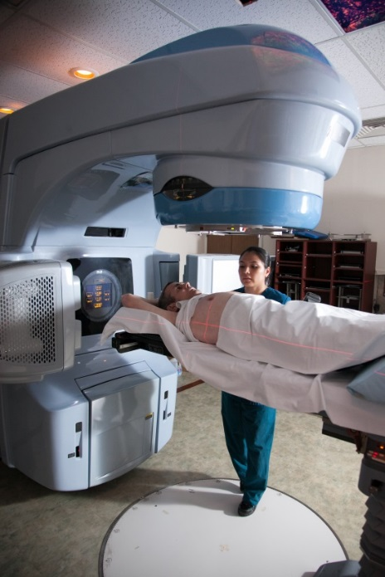
Radiation Therapy as a Component of Multidisciplinary Prostate Cancer Management

Slide 3
Learning Objectives
Understand the different ways in which radiation is used to treat prostate cancer
Compare each standard treatment modality (active surveillance, surgery and radiation therapy) for each prostate cancer risk group
Identify common toxicities from prostate radiation therapy and their optimal management
Review the role of hormonal therapy with radiation therapy
Understand indications for adjuvant or salvage radiation therapy after a prior radical prostatectomy
Discuss the emerging role of radiation therapy for oligometastatic prostate cancer

Slide 4
Radiation Therapy Concepts

Slide 5
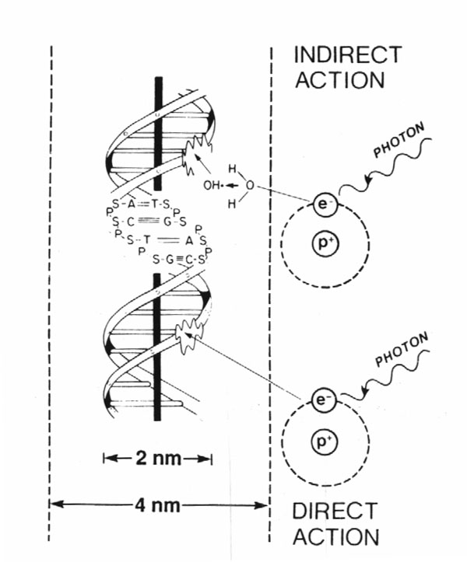
How Does Radiation Work?
80%
X-rays interact with water
radiolysis
free radicals
bind to and damages DNA
mitotic catastrophe
cell death
20%
Cancer cells are more susceptible to RT due to impaired DNA repair pathways

Slide 6
RT Terminology
RT is used to treat prostate cancer in the following ways:
Definitive RT directed at the prostate and seminal vesicles +/- regional lymph nodes, can be used instead of surgery as the primary curative treatment modality
Adjuvant RT directed at the prostate bed +/- regional lymph nodes can be used after radical prostatectomy in patients at high risk of recurrence, but undetectable PSA
Salvage RT directed at the prostate bed +/- regional lymph nodes can be used after radical prostatectomy in patients with clinical or biochemical evidence of recurrent/persistent disease
Palliative RT directed at a site of metastatic disease can be used for symptom relief (e.g., pain, hematuria, urinary obstruction)

Slide 7
Radiation Dosing
Gray (Gy) is the unit of RT dose
1 Gy = 100 centiGray (cGy)
The dose from 1 cGy roughly equals 1 CT scan
Dose prescription depends on:
Goal of treatment (curative > palliative)
Amount of disease (gross > microscopic)
RT sensitivity of tumor
RT sensitivity of surrounding normal tissue
Biologically Effective Dose (BED) depends not only on total dose, but how that dose is fractionated, and the tissue irradiated

Slide 8
Methods of RT Delivery
External Beam Radiation Therapy
Linear accelerator
Proton Therapy
Interstitial Brachytherapy
Permanent or Temporary Prostate Implant
Unsealed Source Brachytherapy
Radiopharmaceuticals (e.g., Radium-223)

Slide 9
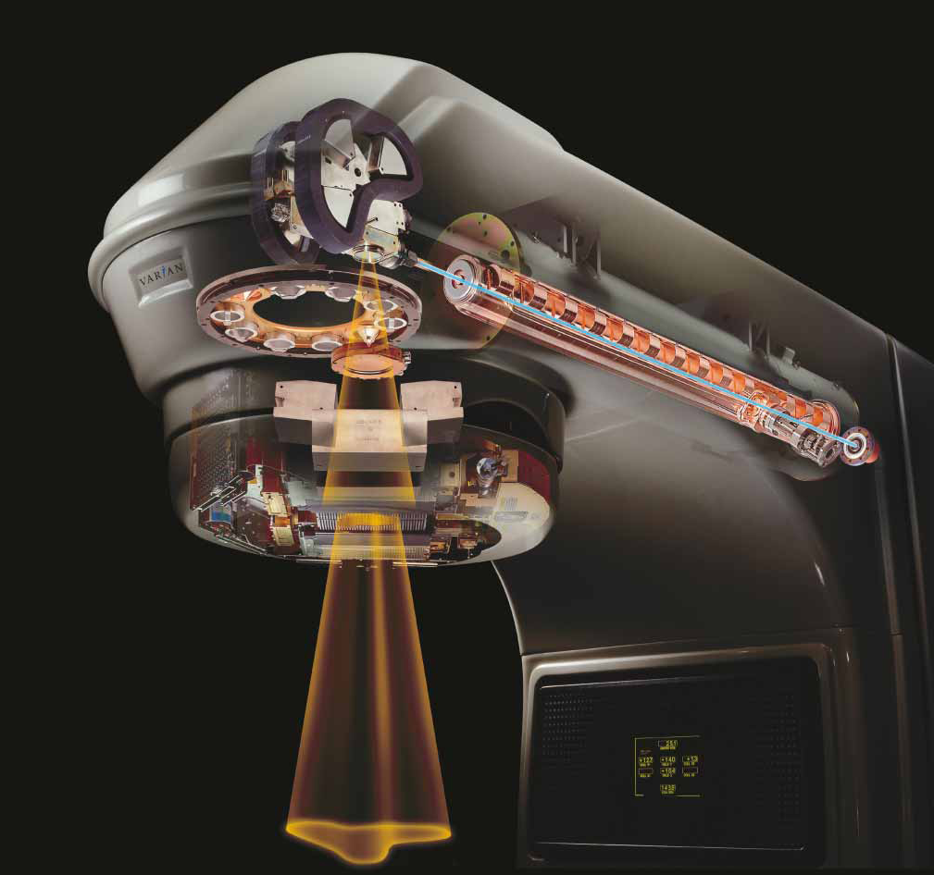
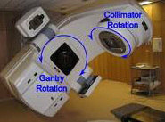
Method #1 of RT Delivery: External Beam
Linear accelerator (Linac)
Delivers high energy X-rays
Non-invasive
Notes:
Electricity → powers electron gun → generates high energy electrons → accelerated along waveguide → strike a Tungsten target → bremsstrahlung generates high energy photons (X-rays) → pass over a filter to generate uniform field → shaped by jaws and collimators → enter patient

Slide 10
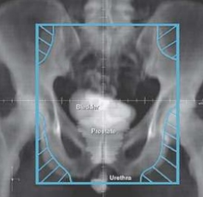
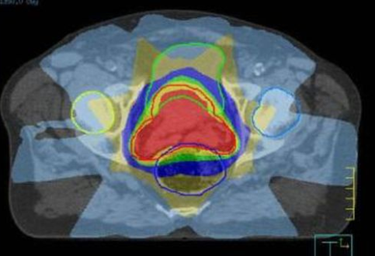
Evolution of External Beam Radiation Therapy
3-D treatment planning using CT scan
Enables more accurate tumor targeting
Can co-register MRI or PET with CT as indicated for more accurate target delineation

Slide 11
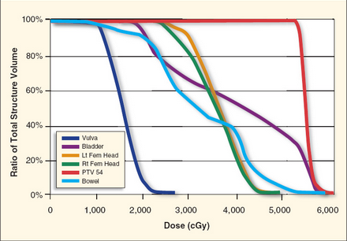
Evolution of External Beam Radiation Therapy
Use of sophisticated computer software to accurately calculate dose to tumor and organs at risk of toxicity
Enables assessment of “quality” of a RT plan (i.e., probability of cure or toxicity)
Dose-Volume Histogram relates irradiated dose to the volume of all contoured structures

Slide 12
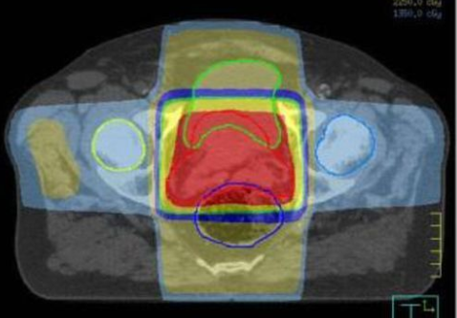
Evolution of External Beam Radiation Therapy
Use of dynamic MLCs to create irregular (non-uniform) radiation from each field and adjust the intensity around a curved target volume
Enables dose escalation or reduction in toxicity
3DCRT
IMRT

Slide 13
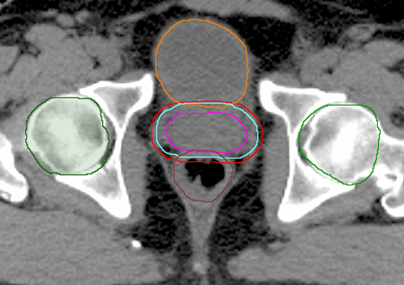
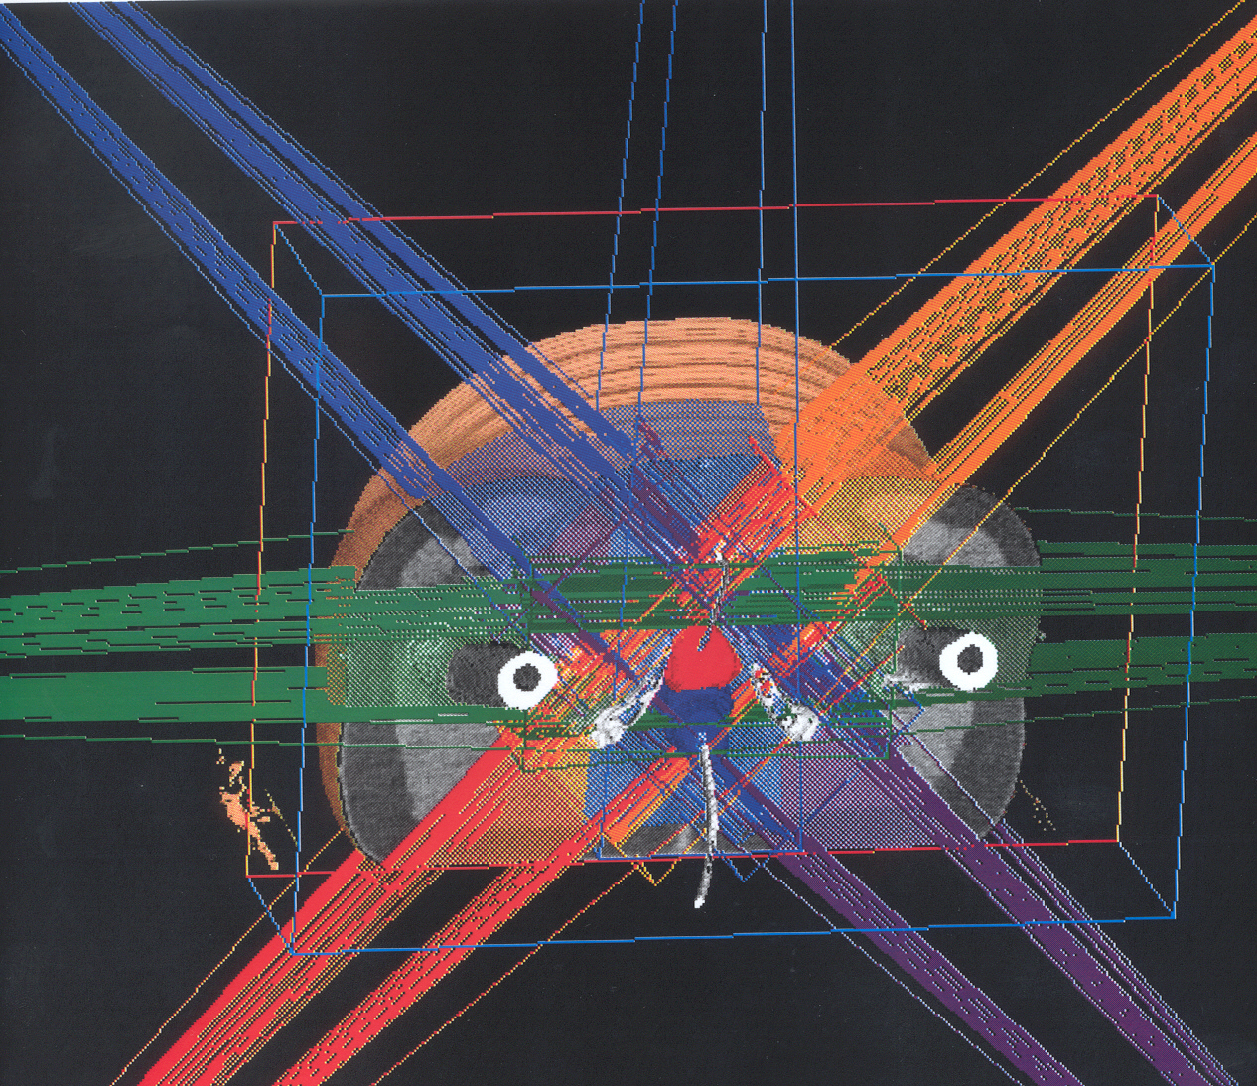
Prostate Cancer Intensity-Modulated Radiation Therapy (IMRT)
An advanced radiation treatment planning technique, and commonly used for prostate cancer
Target volume is contoured, with margin added to account for daily setup variation
Dosimetrist or physicist uses computer software to “optimize” plan based on planning objectives to conform to target while sparing other organs

Slide 14
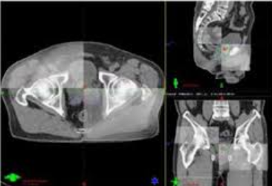
Evolution of External Beam Radiation Therapy
Daily image guidance to assess for shifts in soft tissue anatomy (e.g., bladder and rectum filling)
Enables reduced margin around the prostate → less risk of toxicity
Cone Beam CT

Slide 15
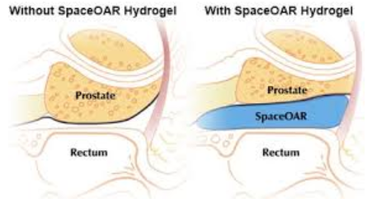
Evolution of External Beam Radiation Therapy
Implantable hydrogel spacer to physically separate rectum from prostate and decrease rectal dose
Cone Beam CT
Notes:
SpaceOAR is a commercial product made by Boston Scientific Group. Please keep in mind ASTRO does not endorse nor reject any specific commercial products.

Slide 16
Evolution of External Beam Radiation Therapy
In sum, these technological advances have enabled:
Dose escalation to increase RT cure rates
Hypofractionation to increase patient convenience
Conventional Fractionation | Moderate Hypofractionation | SBRT (“Ultrahypofractionation”)
78-81 Gy | 60-70 Gy | 36-40 Gy
39-45 fractions | 19-28 fractions | 5 fractions
8-9 weeks | 4-5.5 weeks | 1.5-2 weeks
Notes:
Hypofractionation is less (total) fractions and increase dose/fraction

Slide 17
Data for Moderate Hypofractionation
Several randomized trials demonstrated no difference in efficacy between conventional vs. moderate hypofractionation, with marginal difference in toxicity
Study | 'Longer Arm' | 'Shorter Arm' | Efficacy at 5 years | Late Toxicity | PROs
CHHiP | 74Gy/37Fx | 60Gy/20Fx | Similar | Similar | Similar
PROFIT | 78Gy/39Fx | 60Gy/20Fx | Similar | Similar | Similar
NRG 0415 | 73.8Gy/41Fx | 70Gy/28Fx | Similar | Small ↑ GU/GI | Not reported
HYPRO | 78Gy/39Fx | 64.6Gy/19Fx | Similar | ↑GU | Not reported

Slide 18
Data for Ultrahypofractionation
Long term Phase II data suggests comparable efficacy and toxicity to conventional fractionation. Data is maturing from the following randomized trials:
Scandinavian HYPO-RT-PC trial:
1200 men with intermediate or high-risk prostate cancer randomized to 78Gy/39Fx vs. 42.7Gy/7Fx
80% of pts treated with 3D-CRT
No difference in 5Y-bPFS (~84%).
SBRT → small ↑ Grade > 2 acute urinary toxicity (23→28%) and late urinary toxicity (2→6%), but no difference in late GI toxicity.
UK PACE-B trial (Brand, 2019):
874 men with low- or favorable intermediate-risk prostate cancer randomized to 78Gy/39Fx or 62Gy/20Fx vs. 36.25Gy/5Fx
All pts were treated with SBRT
Results: No significant difference in Grade > 2 acute GI toxicity (~11%) or GU toxicity (~25%).

Slide 19
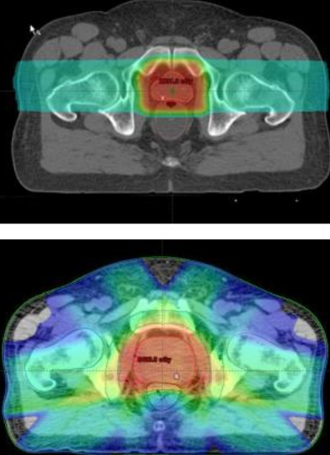
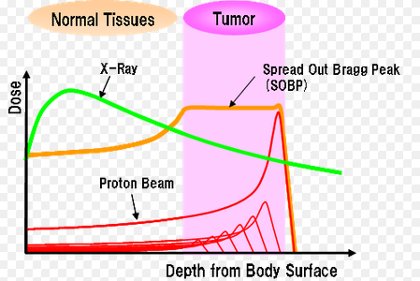
Proton Beam Therapy
Theoretical advantage over photon IMRT in dose distribution, since less "scatter" dose received by surrounding tissues
However, no published randomized trials comparing proton therapy to IMRT or brachy for prostate cancer (PARTIQoL trial is ongoing)
Major disadvantage of proton therapy is cost

Slide 20
Methods of RT Delivery
External Beam Radiation Therapy
Linear accelerator
Proton Therapy
Interstitial Brachytherapy
Permanent or Temporary Prostate Implant
Unsealed Source Brachytherapy
Radiopharmaceuticals (e.g., Xofigo)

Slide 21
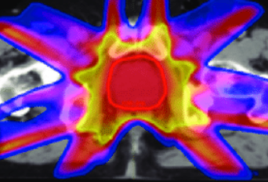
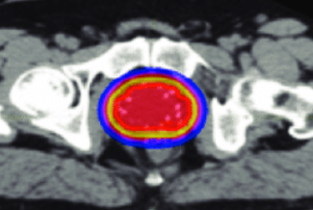
Method #2 of RT Delivery: Interstitial Brachytherapy
Radioactive sources are placed inside the prostate, either temporarily or permanently
Allows for greater dose escalation by sparing normal tissue
IMRT Brachytherapy

Slide 22
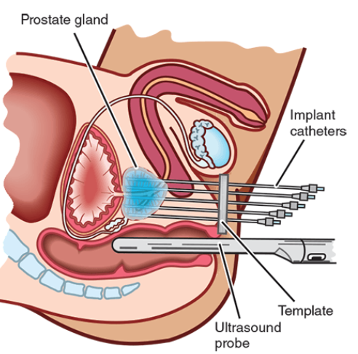
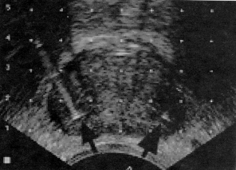
Implant Procedure
More invasive than external beam RT, but less than radical prostatectomy
Begins with placement of 14-20 needles/catheters under TRUS guidance.
Notes:
TRUS = trans rectal ultrasound

Slide 23
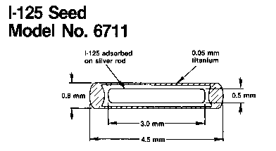
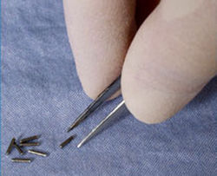
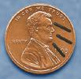
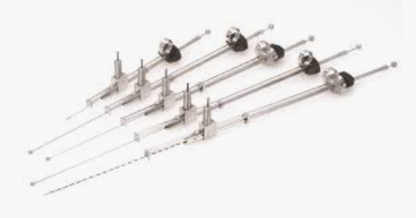
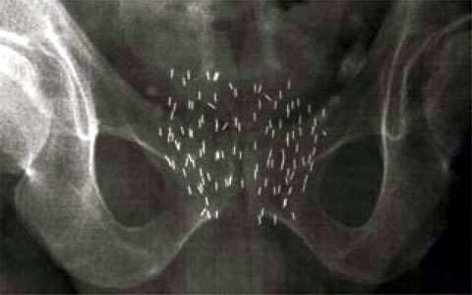
Low-Dose-Rate (LDR) Prostate Brachytherapy
Radioactive sources (“seeds”) are placed into specified positions through the needles (I-125, Pd-103, Cs-131)
Seeds remain in place permanently, though most of the radioactive dose is deposited over a few months

Slide 24
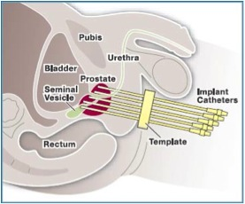
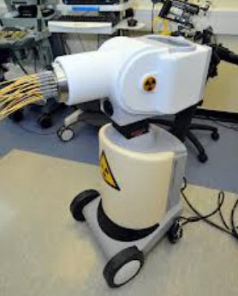
High-Dose-Rate (HDR) Prostate Brachytherapy
Each catheter is connected to an HDR Afterloader, and a single Ir-192 radioactive source on a wire travels within each catheter into specific positions, for specific periods of time
All catheters are removed after treatment

Slide 25
LDR vs. HDR
Advantages of LDR:
Single day catheter insertion for monotherapy
Shorter day for patient
Advantages of HDR:
Higher biologically effective dose
Less radiation safety hazard
Easier dose modulation

Slide 26
Brachytherapy is Not For Everyone
Increased risk of complications
Severe urinary frequency/obstructive symptoms (AUA score > 15)
Previous TURP → risk for incontinence
Gland size > 60cc
higher rate of acute urinary retention
Substantial median lobe hyperplasia
Active IBD involving the rectum
Best if asymptomatic (w/o need for Tx) for at least 6 months.
Prior pelvic radiotherapy
History of multiple pelvic surgeries
Severe diabetes with healing problems
Technical Difficulties that may → inadequate dose coverage
Previous TURP → risk for incontinence
Gland size > 60cc
Prominent median lobe
Severe pubic arch interference (can pre-plan with pubic arch template to assess)
Gross seminal vesicle involvement

Slide 27
Methods of RT Delivery
External Beam Radiation Therapy
Linear accelerator
Proton Therapy
Interstitial Brachytherapy
Permanent or Temporary Prostate Implant
Unsealed Source Brachytherapy
Radiopharmaceuticals (e.g., Radium-223)

Slide 28
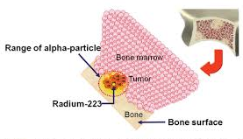
Method #3 of RT Delivery: Unsealed Sources
Radium-223 is an α-emitting, bone-seeking element administered IV
Less bone marrow suppression than β-emitters (e.g., Samarium-153)
Used in patients with CRPC and symptomatic bone metastases without other visceral metastases

Slide 29
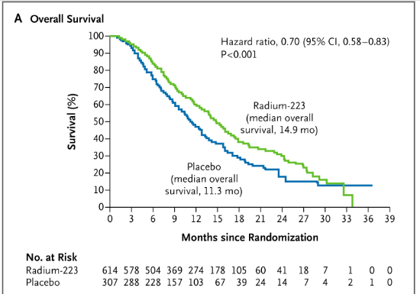
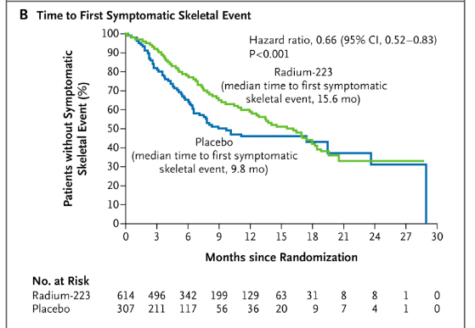
Radium-223
ALSYMPCA Trial (Parker, 2013)
922 men with CRPC & bone metastases who either failed or were ineligible for chemo.
Ra-223 (6 injections q4wks) vs. placebo
Ra-223 → ↑ median-OS (11→14mo), time to 1st skeletal event (8→14mo), & time to PSA progression
No difference in overall hematologic toxicity, but G3/4 Thrombocytopenia ↑ Ra-223 (6% vs 2%)
Mild G1/2 increase in diarrhea with Ra-223

Slide 30
Prostate Cancer Management

Slide 31
NCCN Risk Stratification
Commonly used tool to guide management decisions based on clinical parameters
Predicts pretreatment biochemical recurrence risk, but not optimized for risk of metastases or overall survival
 | Very Low | Low | Favorable Intermediate | Unfavorable Intermediate | High | Very High | Regional | Metastatic
Stage | T1c AND | T1-T2a AND | T2b-T2c OR | T2b-T2c OR | T3a OR | T3b-T4 OR | N1 | M1
Gleason | < 6 (G1) AND < 3 cores positive AND <50% cancer in each core AND PSA density <0.15 | < 6 (G1) | 3+4 (G2) AND <50% of cores positive | 3+4 (G2) AND >50% cores positive OR 4+3 (G3) | GS8 or GS4+5 | 1’ Gleason pattern 5 OR >4 (+) cores GS8-10 (G4-5)
PSA | AND < 10 | AND < 10 | OR 10-20 | OR 10-20 | OR > 20
nccn.org

Slide 32
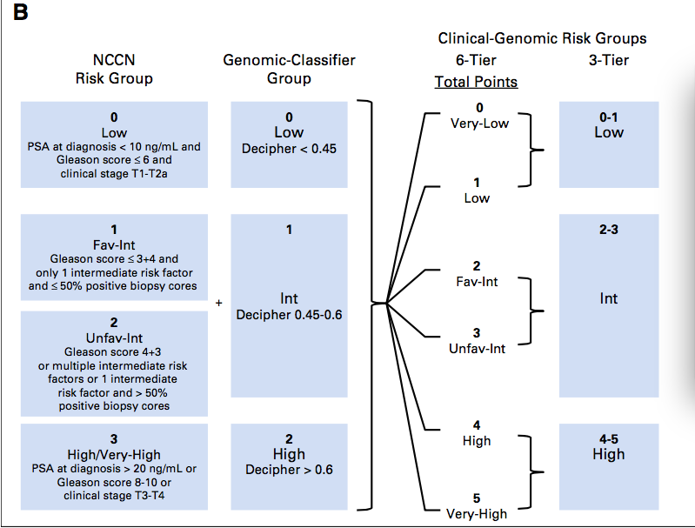
Integrating Genomic Information
Incorporation of both clinical and genomic classifiers can better stratify patients based on clinical outcomes (Spratt et al, JCO, 2018)

Slide 33
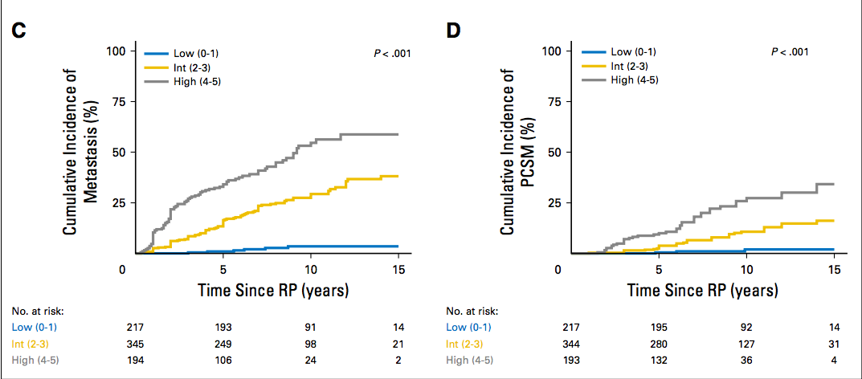
Integrating Genomic Information
NCCN Classification
Genomic Classification
Spratt et al, JCO, 2018

Slide 34
Molecular Biomarker Prognostic Assays for Prostate Cancer
Decipher (approx $5,150)
mRNA expression of 22 genes
Decision-aid post-biopsy for surveillance vs. treatment
Decision-aid post-RP for surveillance vs. RT
Oncotype Dx GPS (approx $4,520)
mRNA expression of 17 genes
Decision-aid post-biopsy to predict adverse pathologic features on RP
Decision-aid post-RP for surveillance vs. RT
Prolaris (approx $3,900)
mRNA expression for cell-cycle progression genes + clinical factors
Provides 10-year risk of DMs after definitive therapy
Provides disease-specific mortality under conservative management
ProMark Proteomic Prognostic Test (approx $3,900)
Expression of 8 proteins
Predicts likelihood of grade group > 2 or stage > T3b
Notes:
All are based on tumor pathology, unlike something like the 4Kscore which is a serum biomarker for the probability of high grade cancer.
Cost was not available on the website and was therefore obtained by contacting sales team or customer support for each company during the week of April 22, 2019. List prices do not necessarily reflect prices paid by Medicare or out of pocket by patients, or other discounted rates.

Slide 35
Overview of Treatment Options
Standard of Care Options:
Radical Prostatectomy (RP)
External Beam Radiotherapy (EBRT)
Brachytherapy (BT)
Active Surveillance (AS)
“Experimental Options”:
Cryotherapy
High-Intensity Focused Ultrasound (HIFU)
Transurethral Ultrasound Ablation (TULSA)
Focal Laser Ablation (FLA)

Slide 36
NCCN Management Guidelines
Very Low Risk:
Low Risk:
Life Expectancy | Treatment Options
< 10 years | Observation
10-20 years | Active Surveillance
> 20 years | Treat as Low Risk
Life Expectancy | Treatment Options
< 10 years | Observation
> 10 years | Active Surveillance (preferred) or External Beam RT or Brachytherapy or Radical Prostatectomy
Source: nccn.org

Slide 37
Active Surveillance
Rationale:
Avoid toxicity from overtreatment of relatively indolent cancers
General Approach:
PSA no more often than q6 months unless clinically indicated
DRE no more often than q12 months unless clinically indicated
Repeat Bx no more often than q12 months unless indicated
To r/o any high-grade disease missed on original Bx
Molecular and biomarker analysis of tumor can be considered for patients with low and favorable intermediate risk with life expectancy > 10 years considering AS
Consider mpMRI if anterior or more aggressive cancer is suspected when PSA increases, but repeat biopsy is negative
May switch to observation/watchful waiting if life expectancy becomes < 10 years. Patients on observation are only treated if symptoms develop or are imminent
Notes:
Specifics practices of active surveillance are practitioner dependent
mpMRI = multiparmetric MRI

Slide 38
Potential Disadvantages of Active Surveillance
Chance of missed opportunity for cure
Risk of progression and/or metastases
Subsequent treatment may be more intense with increased risk of side effects
Uncertain long-term natural history of prostate cancer
Potentially increased anxiety (many men eventually decide on treatment even in absence of progression)

Slide 39
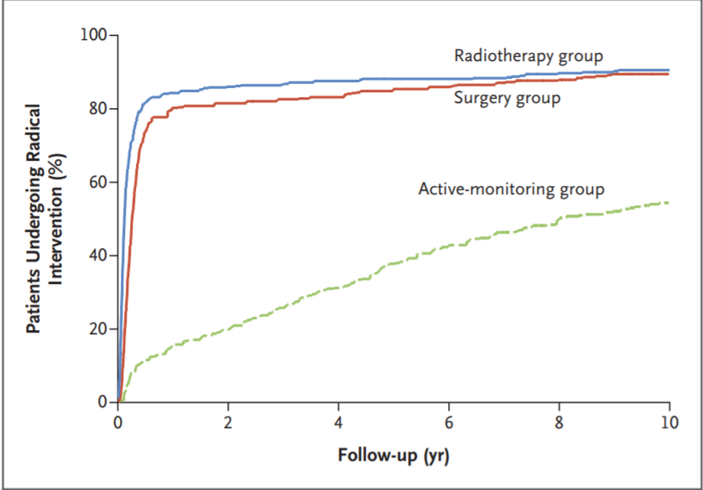
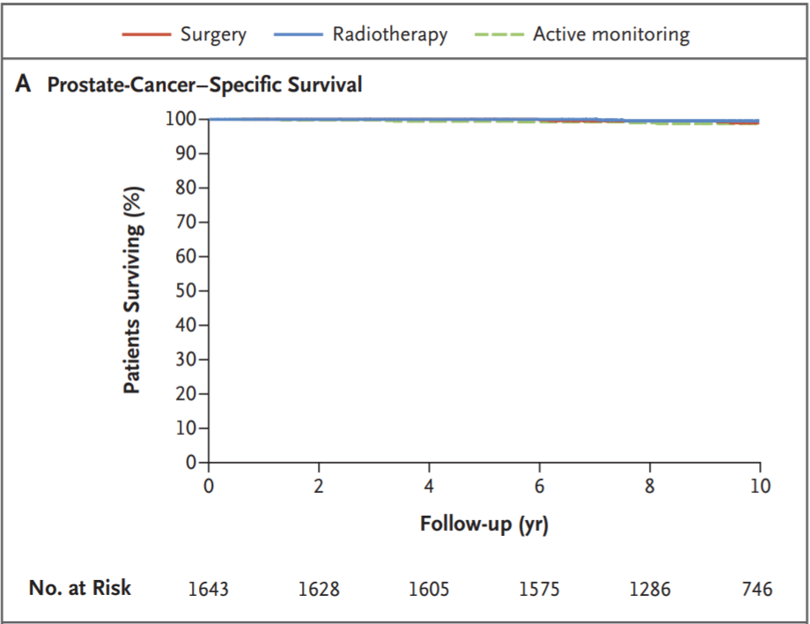
Outcomes from UK ProTECT Trial

Slide 40
NCCN Management Guidelines
Favorable Intermediate Risk:
Life Expectancy | Treatment Options
< 10 years | Observation (preferred) or EBRT or Brachytherapy (Note: RP is not an option)
> 10 years | Active Surveillance or EBRT or Brachytherapy or RP
Unfavorable Intermediate Risk:
Life Expectancy | Treatment Options
< 10 years | Observation (preferred) or EBRT + 4-6mo ADT or EBRT + BT Boost +/- 4-6mo ADT (Note: RP is not an option)
> 10 years | EBRT + 4-6mo ADT or EBRT + BT Boost +/- 4-6mo ADT or Radical Prostatectomy (Note: Active Surveillance is not an option)

Slide 41
NCCN Management Guidelines
High or Very High Risk:
Note: Docetaxel may be used for very high-risk patients
Regional Disease:
Life Expectancy | Treatment Options
< 5 years | Observation or ADT or EBRT
> 5 years | EBRT + 1.5-3 years ADT or EBRT + BT Boost + 1-3 yrs ADT or Radical Prostatectomy
Life Expectancy | Treatment Options
< 5 years (and asymptomatic) | ADT or Observation
> 5 years (or symptomatic) | EBRT + 2-3 years ADT (preferred) +/- Abiraterone

Slide 42
Surgery vs. Radiation
Radiation therapy is an option for essentially all patients regardless of NCCN risk group
Surgery and Radiation therapy are appropriate options for patients who have life expectancy of at least 10 years and have cancer confined to the prostate
Randomized evidence supports comparable cure rates for low-intermediate risk patients (ProTECT trial)
The treatment modality chosen depends more on potential for toxicity and patient preference
Lack of randomized evidence comparing modalities for high risk patients
Though surgery alone is usually insufficient in this setting due to risk of local recurrence or disseminated metastases

Slide 43
Surgery vs. Radiation
Ultimately, long term survival is expected for most patients, regardless of whether they are cured with up-front therapy or not
As such, long-term quality-of-life is a critical component of management decisions
All patients should be given the opportunity to see both a Urologist and Radiation Oncologist to help them reach a patient-centered decision

Slide 44
Potential Perioperative Complications from Surgery
Perioperative morbidity rates generally < 10%
Serious complications include myocardial infarction and thromboembolic, infectious, and neurologic events, but most complications are minor and resolve without sequelae
Perioperative mortality rates generally < 0.3%

Slide 45
Potential Acute Toxicity from External Beam RT
Acute toxicity is common but generally mild and easily managed with supportive medications
Cystitis or urethritis
Treatment = Cranberry juice, alpha-blockers (e.g., tamsulosin), tolterodine, phenazopyridine, NSAIDs
Proctitis
Treatment = diet, antidiarrheal agent or topical anti-inflammatory
Fatigue
Treatment = exercise

Slide 46
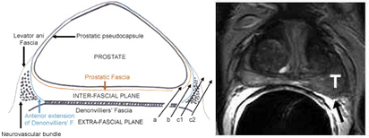
Long-Term Toxicity from Radical Prostatectomy
Erectile Dysfunction
Risk Factors |  |  | Probability of Functional Erection 2 Years After RP (according to Pre-Tx Sexual Function)
Patient Age | Pre-Tx PSA |  | < 25th Percentile | 25-75th Percentile | > 75th Percentile
50 | < 10 |  | 35% | 52% | 70%
 | > 10 |  | 18% | 32% | 50%
60 | < 10 |  | 23% | 38% | 57%
 | > 10 |  | 11% | 21% | 36%
70 | < 10 |  | 15% | 26% | 43%
 | > 10 |  | 7% | 13% | 24%
Alemozaffar et al, JAMA, 2011
Notes:
Prostate Cancer Outcomes and Satisfation with Treatment Data
Included mix of nerve sparing and non-nerve sparing prostatectomies

Slide 47
Long-Term Toxicity from Radical Prostatectomy
Urinary Incontinence
There is conflicting data on whether continuing recovery takes place beyond 2 years
 | @ 2mo | @ 12mo | @ 24mo
Lance, 2001 | 50% | 15% | 7%
Sanda, 2008 | 52% | 25% (5-10% mod-severe) | 7%
Resnick, 2013 |  |  | 10%

Slide 48
Potential Long-Term Toxicity from External Beam RT
Late toxicity is due to fibrosis, and is generally less reversible - severe (grade 3 or higher) toxicity in <5%
Rectal urgency
Treatment = fiber, cholestyramine
Rectal bleeding
Often self-limited and does not require an intervention
Treatment = sucralfate enema, steroid enema, argon plasma coagulation, Formalin solution
Minimize rectal trauma or biopsies due to risk of fistula formation
Erectile Dysfunction (also “dry” orgasm):
Higher risk if poor pre-treatment sexual function and ADT used
Treatment = PDE-5 inhibitors

Slide 49
Radiation-Induced Secondary Malignancy
Rarely develop after prostate RT (<1%)
Reason for low incidence:
Adults are less susceptible than children
Risk is highest 10-30 years post-treatment, and most prostate cancer patients are elderly men
In perspective:
Rate of RT-induced malignancy is similar to peri-operative mortality rates

Slide 50
Comparing Long-Term Toxicities of Surgery and RT
EBRT rarely causes incontinence, causes less ED within the first 5 years, but causes more long-term rectal toxicity (e.g., urgency, bleeding)
Brachytherapy generally causes less bowel toxicity and ED, but more long-term genitourinary toxicity (e.g. urethral stricture risk ~ 5-10%)
The Prostate Cancer Outcomes Study (Resnick, 2013):
 | Urinary Incontinence |  | Erectile Dysfunction |  | Bowel Urgency
 | RP | EBRT | RP | EBRT | RP | EBRT
2 years | 10% | 3%* | 80% | 60%* | 14% | 34%*
5 years | 13% | 4%* | 76% | 72%* | 16% | 31%*
15 years | 18% | 9% | 87% | 94% | 22% | 26%
* Statistically significant
Notes:
Part of the explanation for this data is that prostate cancer is largely a disease of older men, and these problems are common regardless of the treatment used.

Slide 51
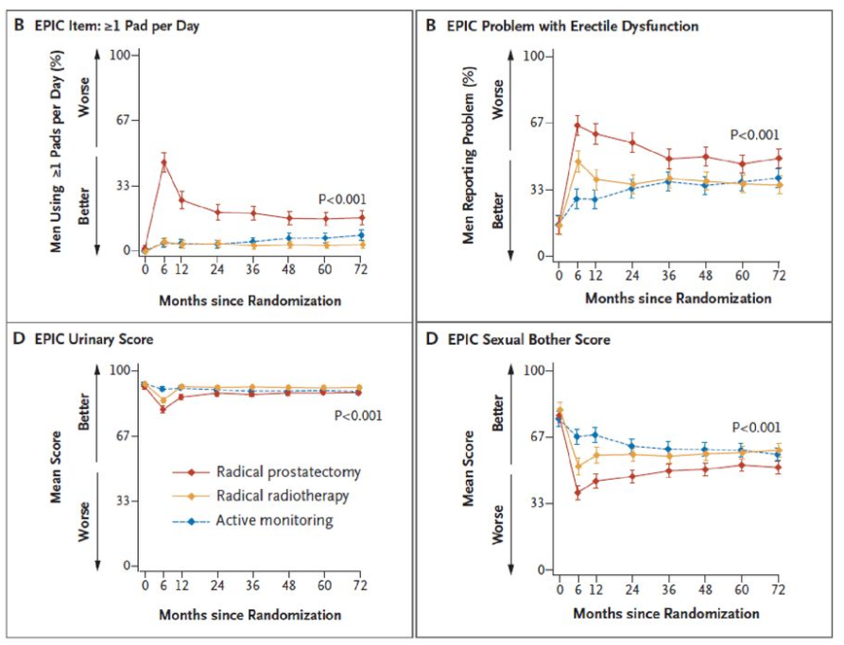
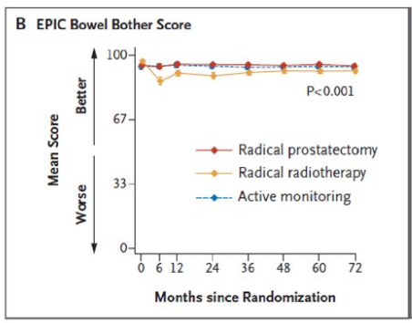
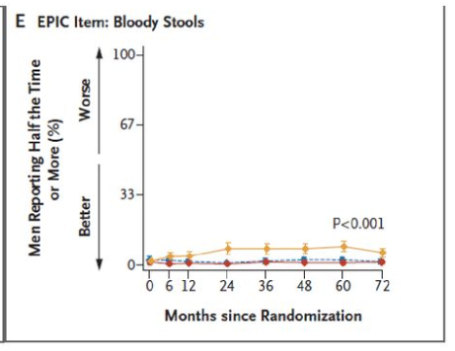
ProTECT Trial Patient Reported Outcomes

Slide 52
Why Consider EBRT + Brachytherapy?
EBRT can better cover periprostatic tissue, seminal vesicles and LNs, whereas brachytherapy enables a higher prostate dose
For higher risk patients, all of these areas may harbor malignant cells, and outcomes are improved with combined modality therapy
ASCENDE-RT Trial (Morris 2016):
398 men, unfav int & high risk, all received 12mo ADT
Randomized to 78/2Gy vs. 46/2+LDR
LDR → ↑ 7Y-bPFS (75→86%) but no difference in OS
Both int and high risk patients benefited
LDR → ↑ late GU toxicity (5→18%, mostly urethral strictures)
For lower risk patients, there is not the same benefit and still increased risk
RTOG 0232 (Prestidge 2016)
cT1-2b/GS6 and PSA10-20/GS7 and PSA <10 (low & favorable intermediate risk)
Randomized to LDR monotherapy vs. EBRT+LDR boost
No difference in 5Y-PFS (~85%), but combined modality therapy → ↑ G3 toxicity (7→12%, mostly GU)

Slide 53
Hormonal Therapy Helps RT Cure More Aggressive Tumors
Potential mechanisms by which ADT enhances effect of RT:
Tumor volume reduction → ↓ number of viable clonogens
Improved blood flow
Eradication of microscopic deposits outside irradiated target
Decreased androgen stimulation → downregulation of DNA repair and enhanced apoptosis
Studies of ADT + RT have generally used complete androgen blockade (for at least the first 4 months of Tx)
Whether the addition of the antiandrogen is necessary is not entirely clear
Use of ADT also impacts radiation toxicity:
Definite worsening of sexual function
Comparable late GU and GI toxicity
Notes:
ADT has not been shown to be beneficial in conjunction with surgery, suggesting synergism with RT in the irradiated areas, rather than simple controlling micrometastatic disease that is not irradiated.

Slide 54
Most Common Side Effects of ADT When Used with Definitive RT
Sexual dysfunction
GnRH agonists → loss of libido within the first several months → erectile dysfunction
Recovery may be delayed and incomplete
Vasomotor instability
Manifested by hot flashes and sleep problems
80% incidence
Treatment similar as in women: antidepressants (venlafaxine) , hormonal agents (medroxyprogesterone acetate), nonhormonal agents (gabapentin)

Slide 55
Most Common Side Effects of ADT When Used with Definitive RT
Fatigue or lack of energy
Severe in 14% of men after 3 months of ADT (independent of anemia or emotional cognitive issues)
Exercise is helpful for treating it
Loss of lean body mass, increased body fat, and ↓ muscle strength
Most of it occurs during the first 18 months of treatment
Treatment: encourage exercise

Slide 56
Less Common, but Potentially Life-Threatening, Side Effects of ADT When Used with Definitive RT
Cardiovascular and metabolic abnormalities
Statistically significant ↑ in CVD & Diabetes, but no significant ↑ in CV death
The potential benefits appear to outweigh the risks when ADT is indicated
Prevention: CV risk reduction measures
Pre-existing cardiovascular disease appears to modulate the risk of complications from ADT
Thromboembolic Events
In a meta-analysis (Nead, 2018), HR was 1.43 for M1 prostate cancer and 1.10 for localized prostate cancer

Slide 57
Other Side Effects of ADT
Anemia
Usually mild-moderate
Incidence 90% of men receiving long-term ADT
Osteoporosis
Longer therapy → higher risk of fracture
Fractures in up to 20% of men within five years of ADT
Prevention: Ca+Vit D + resistance exercises, smoking/alcohol cessation, bisphosphonates
Gynecomastia
Particularly prevalent with anti-androgen monotherapy
Often associated with breast tenderness as well
Prevention: tamoxifen, aromatase inhibitors, prophylactic breast RT (8Gy x1 or 3Gy x4-5, 70→30% incidence)
↓ body hair, smaller penile and/or testicular size, behavioral and neurologic effects

Slide 58
Current Guidelines For Use of ADT with Definitive RT
Low and Favorable Intermediate Risk Groups:
No role for ADT
Unfavorable Intermediate Risk Group:
Usually would use 4-6mo ADT with EBRT
High Risk and Regional Risk Groups:
Usually would use 18-36mo ADT with EBRT
Have the option of as little as 12mo ADT if using a brachytherapy boost
Duration of ADT is generally guided by disease characteristics, patient age, life expectancy, and comorbidities
For younger healthier patients, better to go with longer duration
Consider adding abiraterone for cN+ patients

Slide 59
Assessing for Recurrence
After Radical Prostatectomy:
PSA should rapidly decrease to undetectable (assuming negative margins)
AUA definition of biochemical failure: PSA >0.2 ng/ml
After External Beam RT and/or Brachytherapy:
More Gradual decline in PSA
Mean time to nadir is 18 months after EBRT alone
Biochemical Failure is defined as a rise of PSA 2 ng/mL above the nadir PSA
PSA "bounce" is a transient ↑ in PSA (usually 0.2-0.8 ng/mL) that does not signify a treatment failure. It is seen in ~25% of patients, a median of 12-18 months after RT

Slide 60
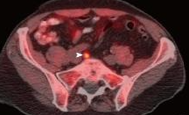
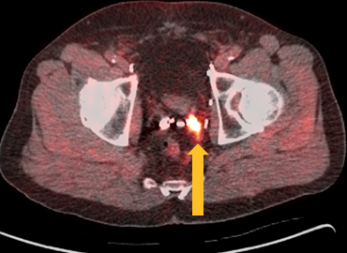
Advanced Imaging Techniques May Help Define Area of Recurrence
C-11 Choline and F-18 Fluciclovine PET are reported to have sensitivity and specificity of 80-95%, however:
limited sensitivity when PSA < 2 ng/mL
limited specificity when PSA <1 ng/mL, PSA velocity <1ng/mL/year, and PSA-DT > 3 months
Ga-68 PSMA PET has the best sensitivity at low PSA (sensitivity of ~50% when PSA is < 1, increases to > 70% when PSA>1, and up to 90% when PSA>2)

Slide 61
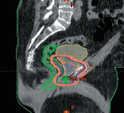
Adjuvant & Salvage RT After RP
Within 10 years of RP, 15-40% of patients will have PSA recurrence (40-70% if high risk features like ECE, SVI, or +margin)
RT directed at the prostate/SV bed + urethral anastomosis +/- pelvic nodes can still cure a high percentage of patients
“Adjuvant” describes RT for:
undetectable PSA but high-risk features
“Salvage” describes RT for:
persistently detectable post-op PSA or
initially undetectable PSA that rose at a later date or
palpable recurrence in prostatic fossa

Slide 62
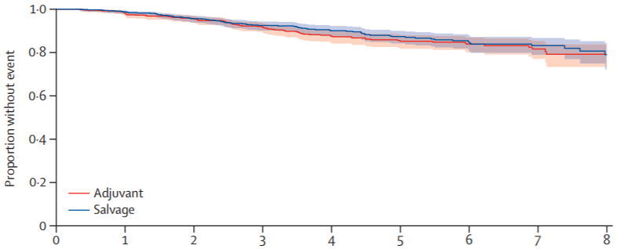
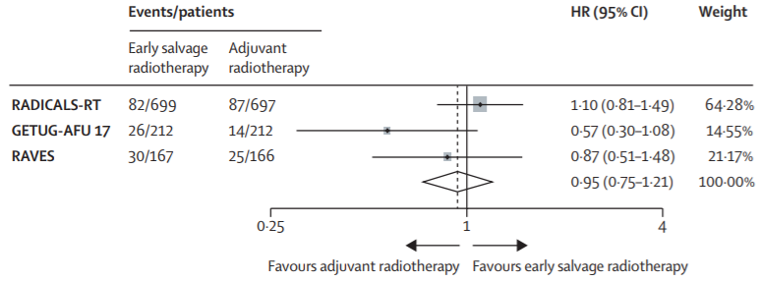
Adjuvant vs. Early Salvage RT
Three randomized trials (EORTC 22911, SWOG 8794, ARO 96-02) established a ~20% absolute benefit in bPFS from post-operative RT compared to observation.
Three recent randomized trials (RADICALS-RT, GETUG-AFU17, RAVES) demonstrated that early salvage RT has comparable efficacy to adjuvant RT, with decreased toxicity of early salvage RT since some patients will never recur or need RT
However, only 20% of men in the 3 trials had high risk of progression (pT3b, N1, GS8-10)
RADICALS-RT Trial, Parker et al, 2020
ARTISTIC Meta-Analysis, Vale et al, 2020

Slide 63
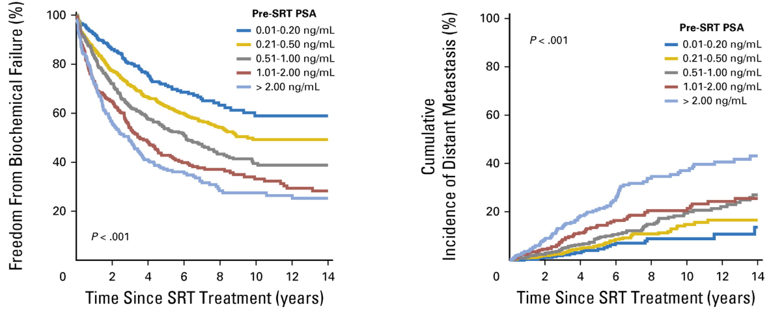
Predictive Factors for Effectiveness of Salvage RT
Lower PSA at time of salvage RT
Early referrals are important!
(Tendulkar 2016)
Notes:
retrospective analysis of 2460 patients treated at 10 tertiary care centers

Slide 64
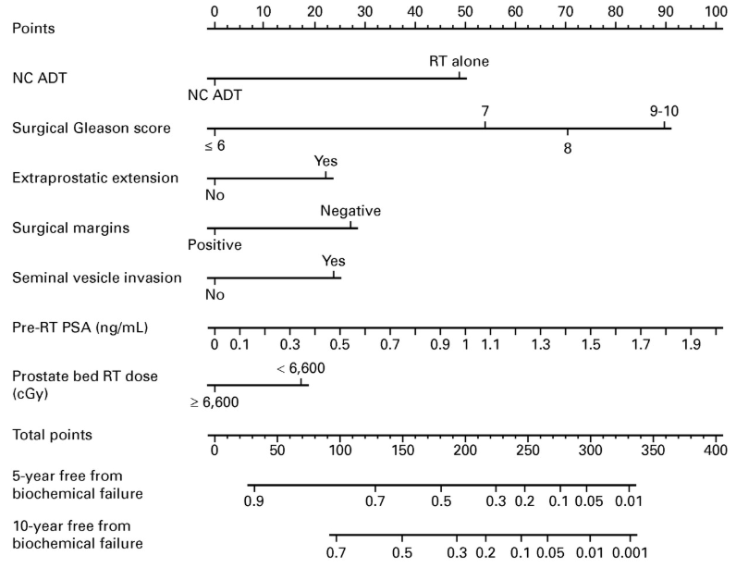
Predictive Nomogram for Effectiveness of Salvage RT
(Tendulkar 2016)
Notes:
retrospective analysis of 2460 patients treated at 10 tertiary care centers

Slide 65
Other Predictive Factors for Effectiveness of Salvage RT
PSA initially nadired at undetectable levels after RP before rising
Later rise in PSA after RP
Notes:
From prior studies

Slide 66
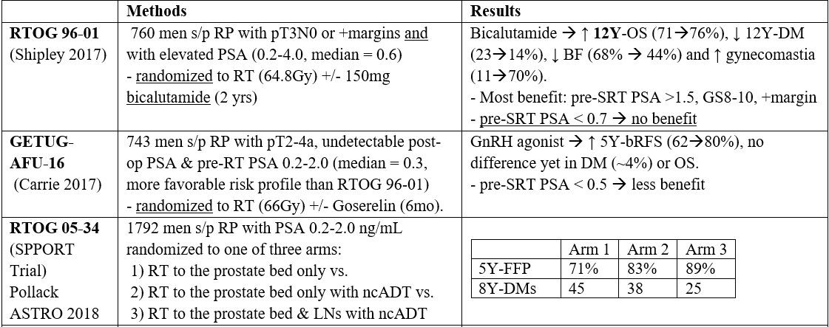
ADT with Salvage RT
Clearest benefit when pre-RT PSA > 0.6
May also be indicated for patients with pre-RT PSA < 0.6 if other high-risk features (GS>7, SVI, PSA never undetectable post-RP, high genomic recurrence score)

Slide 67
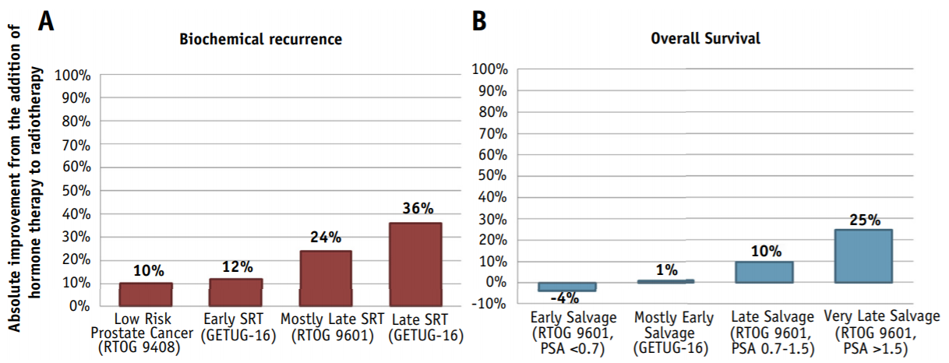
ADT With Salvage RT
Spratt 2018
Notes:
Keep in mind, data from RTOG 9601 was 2 years of 150mg bicalutamide monotherapy, which many providers may not use today in 2020.

Slide 68
Can Biochemical Failure After EBRT Be Salvaged?
Yes…but that doesn’t mean it is appropriate for most patients
Salvage local therapy may be considered if patient is healthy, has biopsy proven local recurrence, and has no evidence of distant metastases
Treatment Options:
Radical Prostatectomy – very high risk for urinary incontinence (worse than primary radical prostatectomy)
High risk also of rectal injury due to scarring from RT
Cryotherapy – urinary incontinence and erectile dysfunction is common
Brachytherapy – low rates of > G3 toxicity
Outcomes:
5Y-bDFS ~50% for each modality, based on relatively small published series

Slide 69
Radiation For Metastatic Prostate Cancer

Slide 70
NCCN Management Guidelines
Metastatic Disease:
Orchiectomy or ADT +/-
Docetaxel,
Abiraterone
Enzalutamide
Apalutamide
EBRT (but not RP) to the primary tumor may also be given for low volume castration-sensitive M1 disease

Slide 71
Data for Prostate-Directed RT For Oligometastatic Disease
STAMPEDE Trial (Parker 2018)
2061 men with newly diagnosed M1 prostate cancer randomized to systemic therapy +/- Prostate RT (55Gy/20fx daily or 36Gy/6fx weekly)
The metastatic burden was classified according to the definition used in the CHAARTED trial (high metastatic burden = four or more bone mets with one or more outside the vertebral bodies or pelvis, or visceral metastases, or both; all other assessable patients were considered to have low metastatic burden
For overall cohort, RT → ↑ FFS (HR 0.76) but not OS (HR 0.92)
5% G3 or higher acute toxicity and 4% G3 or higher late toxicity
For the subgroup with low metastatic burden, RT → ↑ FFS (HR 0.59) and OS (HS 0.68)
HORRAD trial (Boeve 2019)
432 men with primary bone M1 prostate cancer randomized to ADT +/- prostate RT (70Gy/35fx)
RT → No difference in median OS or TTP (trend towards improvement if < 5 mets)

Slide 72
Data for Metastasis Directed-RT For Oligometastatic Disease
ORIOLE Study (Phillips 2020)
54 men with recurrent, hormone-sensitive, oligometastatic prostate cancer (three or fewer lesions as determined by conventional imaging)
Randomized to observation (and no further treatment for six months) or SBRT to the metastatic sites outside of the prostate
SBRT → ↓ progression at 6 months (61→19%)
No G3 or higher toxicity
SABR-COMET Study (Palma 2019)
99 patients with variety of oligometastatic cancers with < 5 sites of disease, PR/SD on systemic therapy, randomized 1:2 to +/- SAbR (at ablative doses)
Most common histologies: breast, lung, colorectal, prostate
SAbR → ↑ M-PFS (6→12mo, p<0.001) & M-OS (28→41mo, p=0.09)
STOMP Study (Ost 2018)
62 men with biochemically, recurrent asymptomatic prostate cancer pts after primary PCa treatment with curative intent with 3 or fewer extracranial lesions determined by Choline PET-CT, and testosterone >50ng/mL
Randomized to surveillance or Metastasis directed therapy(MDT) (surgery or SBRT)
Median ADT-free survival was 13 months for the surveillance group and 21 months for the MDT group at 3 years follow-up
QOL similar in both arms at baseline and remained comparable at 3mo and 1yr follow-up

Slide 73
Data for Metastasis Directed-RT For Oligometastatic Disease
ORIOLE, SABR-COMET, and STOMP are all relatively small phase II Oligometastatic trials and that the results of Phase III trials (PLATON and PEACE-5) in this setting are awaited.

Slide 74
Palliative External Beam RT
Bone metastases
Pain
Spinal cord compression
Pathologic fractures
Urinary symptoms
Bleeding
Obstruction

Slide 75
The Future…A Few Examples of Active Clinical Trials in Prostate Cancer
Intact Prostate:
SBRT vs. hypofractionated IMRT for interm risk group (NRG-GU005)
PARP-inhibitor vs. placebo with IMRT for high risk group (NRG-GU007)
SBRT vs. surgery with toxicity/QOL primary endpoint (UK PACE-A)
SBRT vs. IMRT for variety of risk groups (UK PACE-B and C)
Post-prostatectomy:
Conventional vs. hypofractionated RT (NRG-GU003)
Apalutamide vs. placebo with salvage RT in patients with low PSA (NRG GU006)
Docetaxel vs. placebo with salvage RT for high risk patients (NRG GU002)
Abiraterone + Apalutamide with Salvage RT for node-positive patients (NRG-GU008)
Oligometastatic-Directed RT:
Standard systemic therapy vs Standard systemic therapy+local ablative therapy to all sites of disease in hormone sensitive prostate cancer (PLATON)
Metastasis-Directed Therapy(salvage LND or SBRT) + ADT vs Metastasis-Directed Therapy+Whole Pelvis Radiotherapy + ADT in Salvage Treatment of OligoRecurrent Nodal Prostate Cancer Metastases (PEACE V: STORM)

Slide 76
Take Home Points
Radiation therapy is a treatment option for all stages and risk groups of prostate cancer
All patients should be offered the opportunity to speak with a Urologist and Radiation Oncologist prior to pursuing definitive treatment of prostate cancer
ADT enhances the effects of radiation for more aggressive tumors
Early referral for salvage RT leads to better outcomes
RT has an emerging role in the management of oligometastatic prostate cancer

Slide 77
References
UptoDate: https://www.uptodate.com/home
NCCN: https://www.nccn.org/
Alemozaffar M, Regan MM, Cooperberg MR, et al. Prediction of erectile function following treatment for prostate cancer. JAMA. 2011 Sep 21;306(11):1205-14.
Bekelman JE, Rumble RB, Chen RC, et al. Clinically Localized Prostate Cancer: ASCO Clinical Practice Guideline Endorsement of an American Urological Association/American Society for Radiation Oncology/Society of Urologic Oncology Guideline. J Clin Oncol. 2018 Sep 5:JCO1800606.
Brand DH et al. Intensity-modulated fractionated radiotherapy versus stereotactic body radiotherapy for prostate cancer (PACE-B): acute toxicity findings from an international, randomised, open-label, phase 3, non-inferiority trial. Lancet Oncol. 2019;20(11):1531. Epub 2019 Sep 17.
Boevé LMS, Hulshof MCCM, Vis AN, et al. Effect on Survival of Androgen Deprivation Therapy Alone Compared to Androgen Deprivation Therapy Combined with Concurrent Radiation Therapy to the Prostate in Patients with Primary Bone Metastatic Prostate Cancer in a Prospective Randomised Clinical Trial: Data from the HORRAD Trial. Eur Urol. 2019 Mar;75(3):410-418.
Bolla M, van Poppel H, Tombal B, et al. Postoperative radiotherapy after radical prostatectomy for high-risk prostate cancer: long-term results of a randomised controlled trial (EORTC trial 22911). Lancet. 2012 Dec 8;380(9858):2018-27.
Hamdy FC, Donovan JL, Lane JA, et al. 10-Year Outcomes after Monitoring, Surgery, or Radiotherapy for Localized Prostate Cancer. N Engl J Med. 2016 Oct 13;375(15):1415-1424.
Kishan AU, et al. Long-term Outcomes of Stereotactic Body Radiotherapy for Low-Risk and Intermediate-Risk Prostate Cancer. JAMA Netw Open. 2019;2(2):e188006. Epub 2019 Feb 1.

Slide 78
References
Morris WJ, Tyldesley S, Rodda S, et al. Androgen Suppression Combined with Elective Nodal and Dose Escalated Radiation Therapy (the ASCENDE-RT Trial): An Analysis of Survival Endpoints for a Randomized Trial Comparing a Low-Dose-Rate Brachytherapy Boost to a Dose-Escalated External Beam Boost for High- and Intermediate-risk Prostate Cancer. Int J Radiat Oncol Biol Phys. 2017 Jun 1;98(2):275-285.
Nead KT et al. Association of Androgen Deprivation Therapy and Thromboembolic Events: A Systematic Review and Meta-analysis. Urology. 2018;114:155. Epub 2018 Jan 17.
Parker CC, James ND, Brawley CD, et al. Radiotherapy to the primary tumour for newly diagnosed, metastatic prostate cancer (STAMPEDE): a randomised controlled phase 3 trial. Lancet. 2018 Dec 1;392(10162):2353-2366.
Resnick MJ, Koyama T, Fan KH, et al. Long-term functional outcomes after treatment for localized prostate cancer. N Engl J Med. 2013 Jan 31;368(5):436-45.
Rodda S, Tyldesley S, Morris WJ, et al. ASCENDE-RT: An Analysis of Treatment-Related Morbidity for a Randomized Trial Comparing a Low-Dose-Rate Brachytherapy Boost with a Dose-Escalated External Beam Boost for High- and Intermediate-Risk Prostate Cancer. Int J Radiat Oncol Biol Phys. 2017 Jun 1;98(2):286-295.
Sanda MG, Dunn RL, Michalski J, et al. Quality of life and satisfaction with outcome among prostate-cancer survivors. N Engl J Med. 2008 Mar 20;358(12):1250-61.
Shipley WU, Seiferheld W, Lukka HR, et al. Radiation with or without Antiandrogen Therapy in Recurrent Prostate Cancer. N Engl J Med. 2017 Feb 2;376(5):417-428.
Spratt DE, Zhang J, Santiago-Jiménez M, et al. Development and Validation of a Novel Integrated Clinical-Genomic Risk Group Classification for Localized Prostate Cancer. J Clin Oncol. 2018 Feb 20;36(6):581-590.

Slide 79
References
Spratt DE. Evidence-based Risk Stratification to Guide Hormone Therapy Use With Salvage Radiation Therapy for Prostate Cancer. Int J Radiat Oncol Biol Phys. 2018;102(3):556-560.
Stephenson AJ, Scardino PT, Kattan MW, et al. Predicting the outcome of salvage radiation therapy for recurrent prostate cancer after radical prostatectomy. J Clin Oncol. 2007 May 20;25(15):2035-41.
Tendulkar RD et al. Contemporary Update of a Multi-Institutional Predictive Nomogram for Salvage Radiotherapy After Radical Prostatectomy. J Clin Oncol. 2016 Aug;
Thompson IM, Tangen CM, Paradelo J, et al. Adjuvant radiotherapy for pathological T3N0M0 prostate cancer significantly reduces risk of metastases and improves survival: long-term followup of a randomized clinical trial. J Urol.
2009 Mar;181(3):956-62.
Vale CL, Brihoum M, Chabaud S, et al. Adjuvant or salvage radiotherapy for the treatment of localised prostate cancer? A prospectively planned aggregate data meta-analysis (LBA48). Data presented at the 2019 European Society for Medical Oncology (ESMO) Congress, September 27, 2019, Barcelona, Spain.
Widmark A, Gunnlaugsson A, Beckman L, et al. Ultra-hypofractionated versus conventionally fractionated radiotherapy for prostate cancer: 5-year outcomes of the HYPO-RT-PC randomised, non-inferiority, phase 3 trial. Lancet. 2019 Aug 3;394(10196):385-395.
Wiegel T, Bartkowiak D, Bottke D, et al. Adjuvant radiotherapy versus wait-and-see after radical prostatectomy: 10-year follow-up of the ARO 96-02/AUO AP 09/95 trial. Eur Urol. 2014 Aug;66(2):243-50.

Slide 80
Supplementary Slides
The following slides were originally developed to be used in this presentation. However, they were ultimately excluded from it because their content is not as specific to the integration of radiation therapy into multidisciplinary management of prostate cancer.
We have included them below in case any individual who uses these slides would like to incorporate them into their presentation.

Slide 81
Anatomy
Most benign prostatic hypertrophy (BPH) arises from transitional zone
Causes obstructive urinary symptoms
75% of prostate cancer arises from peripheral zone (contains most of glandular tissue)
Usually asymptomatic and detected because of abnormal screening PSA

Slide 82
PSA Screening
Somewhat Controversial:
Clinical trials do not show a clear benefit
Lifetime risk of dying from prostate cancer has not changed after the advent of PSA screening
Potential Harms from PSA Screening:
High rate of false positives → unnecessary biopsies
Risks of biopsy: ↑ hospitalizations for complications in first 30 days (infection, bleeding, pain), anxiety
Risk of over-diagnosis: most men with screening detected prostate cancer have early stage disease, which may not ever become clinically significant, but will be offered aggressive treatment
Risks of therapy

Slide 83
PSA Screening Guidelines
Guidelines differ to some extent between countries & professional societies (AUA, ACS, USPTF, NCCN, etc)
Generally support shared decision-making based on patient’s individual risk factors.
Routine screening is NOT recommended
Shared decision-making begins with H&P including FH, meds, h/o prostate disease, race.

Slide 84
PSA Screening Guidelines
For patients age 45-75 who want PSA screening, consider biopsy if PSA > 3 or suspicious DRE
High risk patients (i.e. +FH or inherited mutations) should discuss screening by age 40
For patients age >75 who want PSA screening, consider biopsy for PSA > 4 or suspicious DRE
Generally stop screening if < 10 years life expectancy
In patients with elevated PSA, multiparametric MRI, as well as other serum biomarkers, can help define probability of high-risk cancer prior to biopsy (or after negative biopsy)
e.g., percent-free PSA <10%, PHI > 35, EPI score >15,6, 4Kscore)
Notes:
These are basically the NCCN recommendations

Slide 85
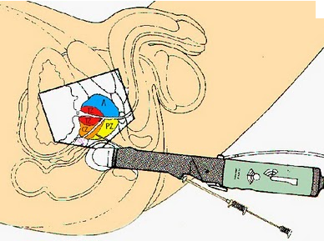
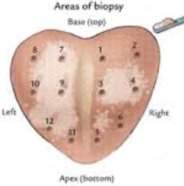
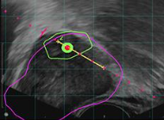
Prostate Biopsy
Systematic TRUS-guided vs. MRI-guided vs. both
PRECISION Study (Kasivisvanathan, NEJM, 2018)
500 men with elevated PSA and no prior Bx were randomized to MRI-guided vs. TRUS-guided (10-12 core) biopsy
If MRI negative, then biopsy was not offered
MRI spared 28% of patients a biopsy
MRI → increased clinically significant (GS > 7) cancer detection (26→38%)

Slide 86
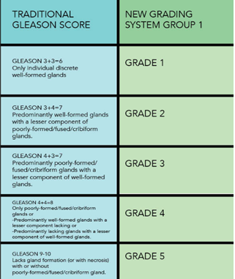
Prostate Cancer Grading
The new grading system adopted in 2014 provides more accurate risk stratification than the Gleason score

