Slide 1
Instructions for Use of These Slides
The purpose of these slides is to serve as a resource that any radiation oncologist can use when speaking about the role of radiation therapy in treating gynecologic malignancies.
The target audience is ob/gyn residents/gynecologic oncology fellows and gynecologic oncologists
  However, any user is welcome to format the slides as needed to fit your target audience.
Please ask attendees to complete either the pre-test or post-test so that we can assess the effectiveness of the slides. If you make significant changes to the content of the slides for your presentation, we prefer that you use the pre-test only.
  Pre-test link: https://is.gd/gyn_pre1
  Post-test link: https://is.gd/gyn_post1
Primary Authors: Jenna Kahn and Malcolm Mattes
Peer Reviewer(s): Jill Remick MD, Emma Fields MD, Shauna Campbell DO, Sabin Motwani MD, Shunqing Zhang, MD
Additional Support: The ASTRO communications committee and ARRO communications subcommittee
Last updated in July 2023 – newer data may impact the accuracy of the content of these slides.

Slide 2

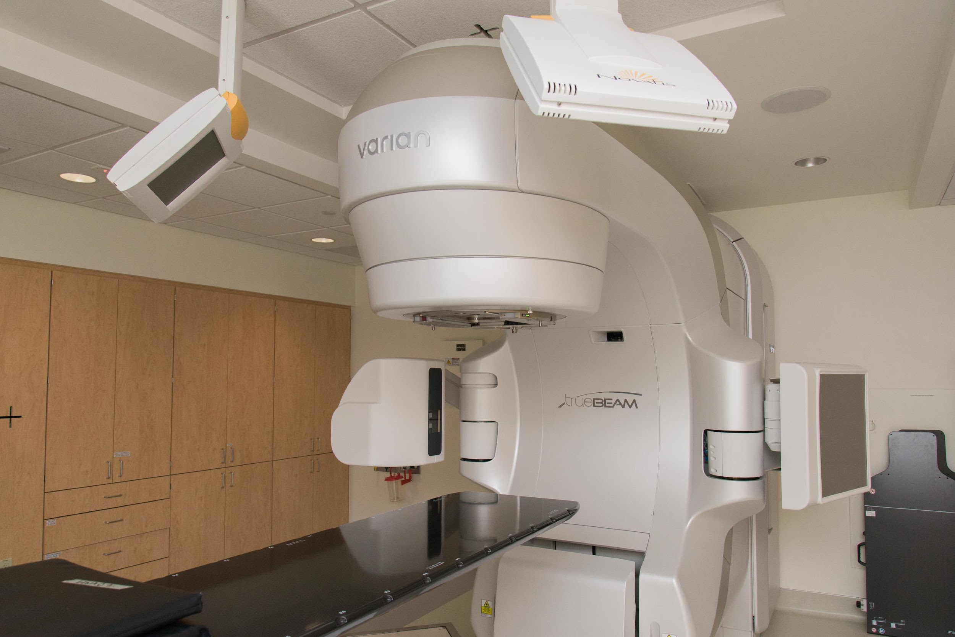

Introduction to Radiation Therapy for Gynecologic Malignancies

Slide 3
Learning Objectives
Understand the different radiation delivery techniques for women with gynecologic cancers
Review indications for radiation therapy in the curative and palliative settings

Slide 4
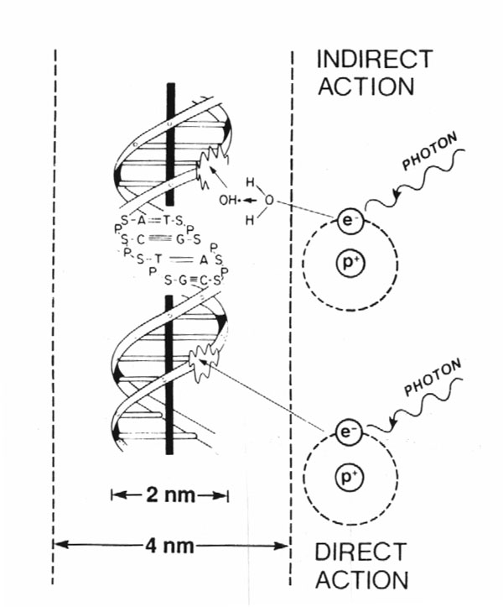
How Does Radiation Therapy (RT) Work?
80%
X-rays interact with water
radiolysis
free radicals
bind to and damages DNA
mitotic catastrophe
cell death
20%
Cancer cells are more susceptible to RT due to impaired DNA repair pathways

Slide 5
Radiation Dosing
Gray (Gy) is the unit of RT dose
  1 Gy = 100 centiGray (cGy)
  The dose from 1 cGy roughly equals 1 CT scan
Dose prescription depends on:
  Goal of treatment (curative > palliative)
  Amount of disease (gross > microscopic)
  RT sensitivity of tumor
  RT sensitivity of surrounding normal tissue
Biologically Effective Dose (BED) depends not only on total dose, but how that dose is fractionated, and the tissue irradiated
  Relevant to understanding EBRT vs. brachytherapy doses

Slide 6
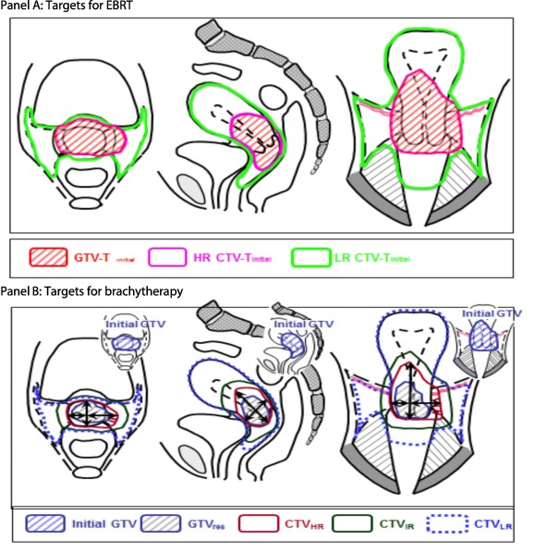
Radiation Delivery Techniques
External Beam Radiation Therapy (EBRT)
  3-Dimensional Conformal Radiation Therapy (3-D CRT)
  Intensity Modulated Radiation Therapy (IMRT)
  Image-Guided Radiation Therapy (IGRT)
  Stereotactic Body Radiation Therapy (SBRT)
Brachytherapy
  Intracavitary
  Interstitial

Slide 7
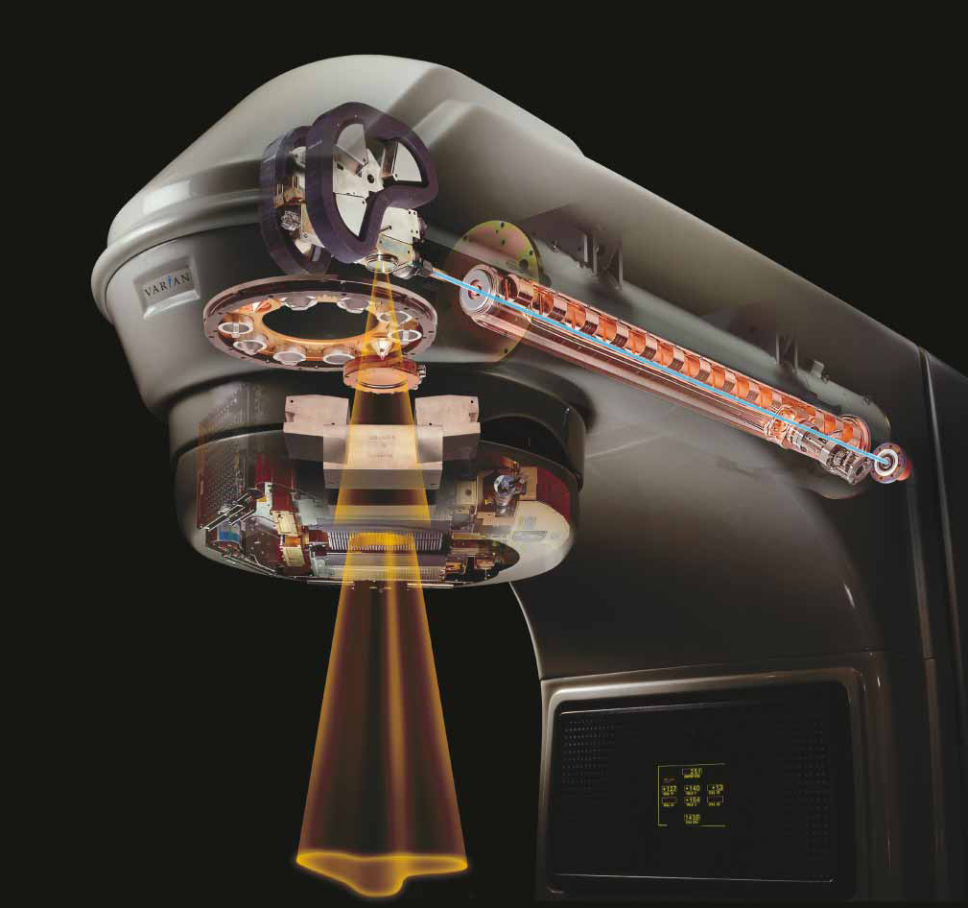
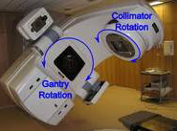
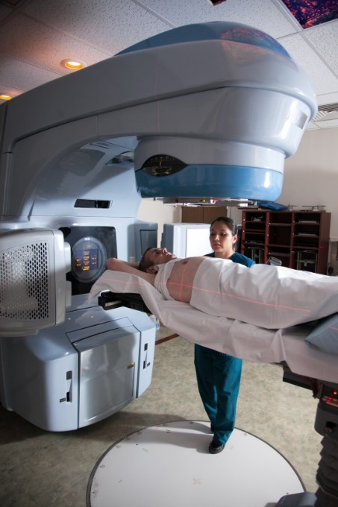
External Beam Radiation Therapy
Linear accelerator (Linac)
  Delivers high energy X-rays
  Non-invasive
  Rapid treatment delivery, in minutes
Notes:
Electricity → powers electron gun → generates high energy electrons → accelerated along waveguide → strike a Tungsten target → bremsstrahlung generates high energy photons (X-rays) → pass over a filter to generate uniform field → shaped by jaws and collimators → enter patient

Slide 8
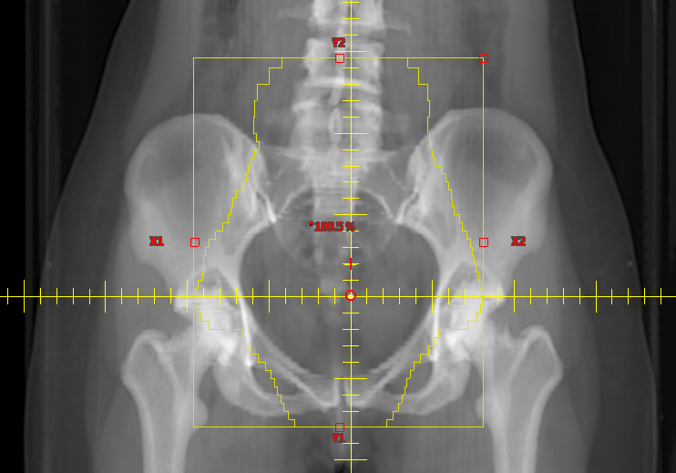
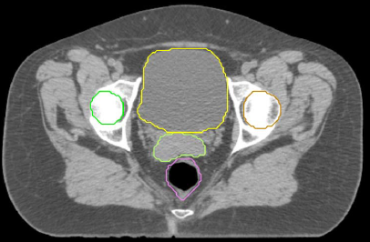
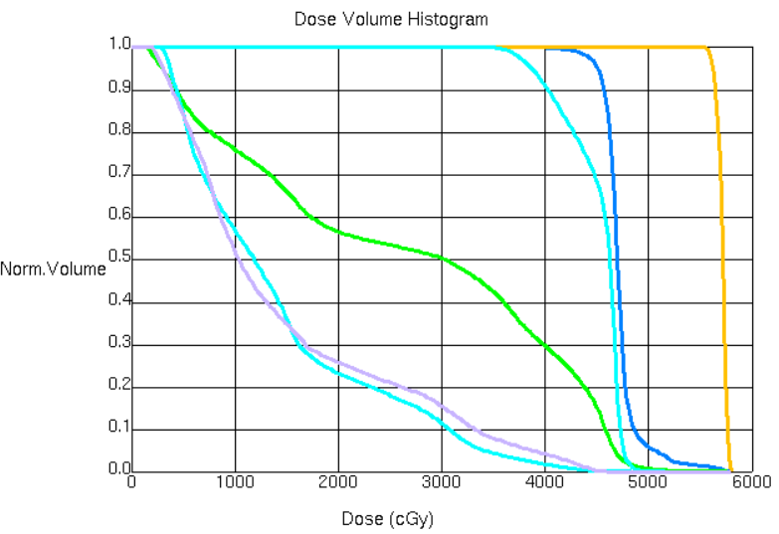
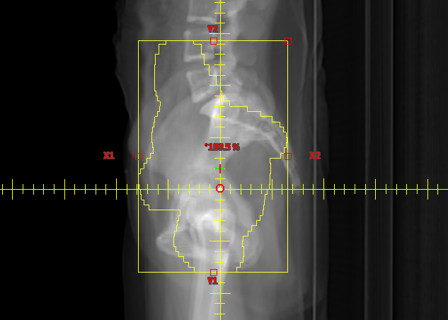
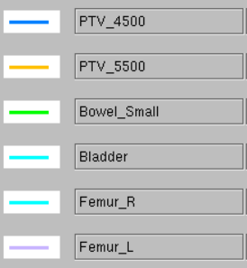
Evolution of External Beam Radiation Therapy
3-D treatment planning using CT scan enables:
1) More accurate delineation of target and normal structures
2) Accurate dose calculation to tumor and organs at risk of toxicity so the “quality” of the plan can be evaluated (i.e., probability of cure or toxicity)

Slide 9
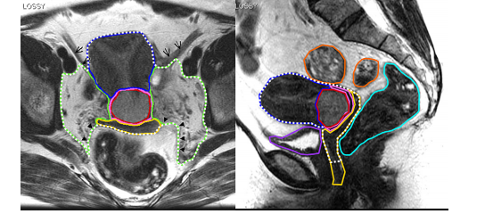
Evolution of External Beam Radiation Therapy
Can co-register (overlay) MRI or PET with CT for more accurate target delineation
Lim et al, 2009

Slide 10

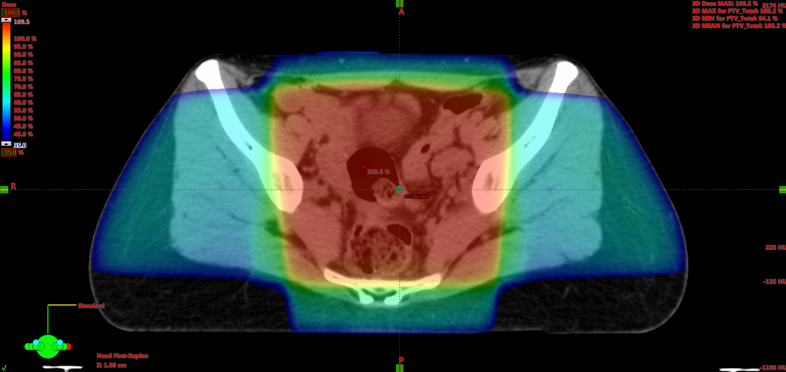
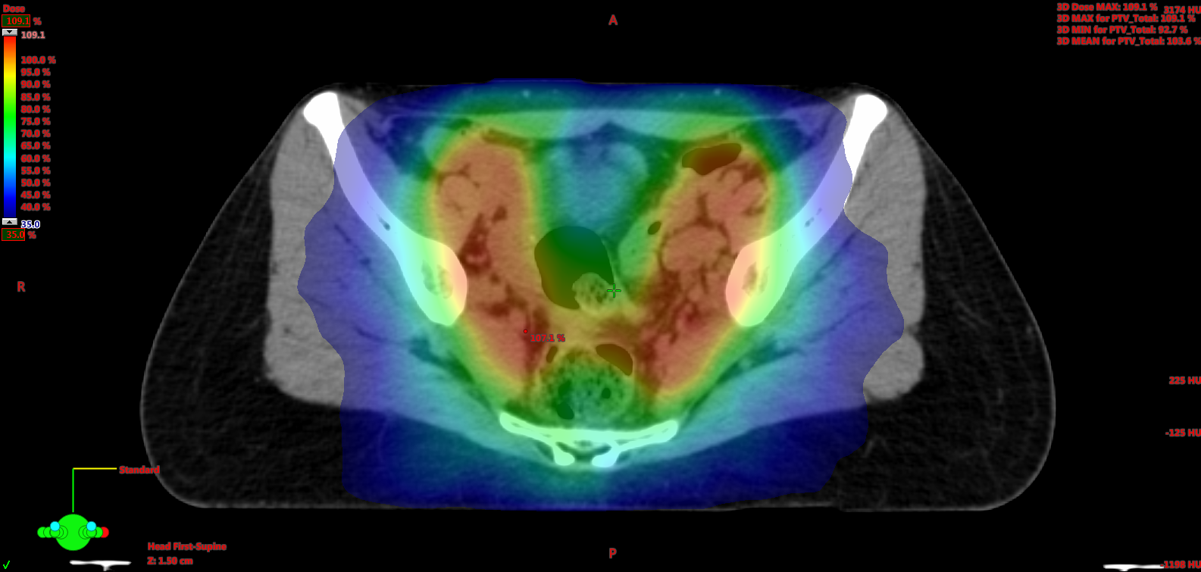
Evolution of External Beam Radiation Therapy
Use of dynamic MLCs to create irregular (non-uniform) radiation from each field and adjust the intensity around a curved target volume
Enables dose escalation or reduction in toxicity
3-D CRT
IMRT
Klopp et al, 2018

Slide 11
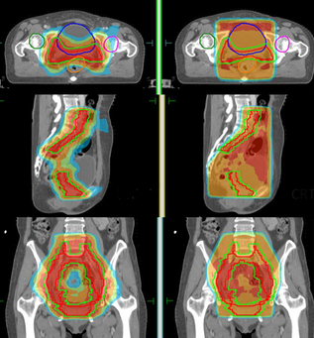
Intensity Modulated Radiation Therapy (IMRT)
IMRT is commonly used to treat GYN malignancies
Dosimetrist or physicist uses computer software to “optimize” plan based on planning objectives to conform to target while sparing other organs
From consult → RT start, the planning process typically takes 10-14 days
IMRT
3-D CRT
Deng et al, 2016

Slide 12
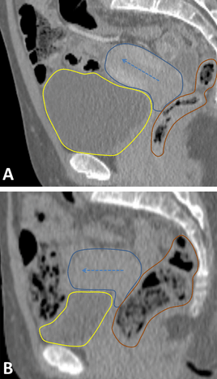
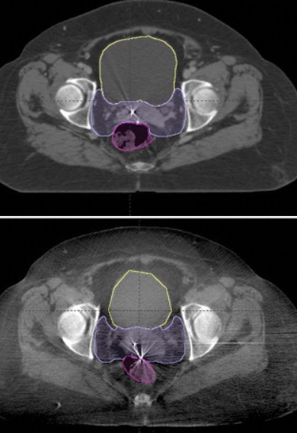
Managing Internal Organ Motion during Simulation and Treatment
Contour tumor position with empty and full bladder CTs, but treat with full bladder (to push bowel out of the way
Daily image guidance (e.g., CBCT) to assess for shifts in soft tissue anatomy enables margin reduction around tumor
Sun et al, 2016

Slide 13


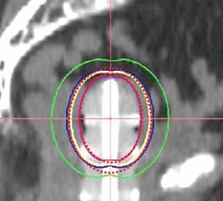
Brachytherapy
Radioactive sources temporarily placed inside or around a tumor
Allows for greater dose escalation by sparing normal tissue
Commonly used in definitive management of cervical cancer after EBRT to boost cervix/parametrium, and in the adjuvant management of uterine cancer to treat vaginal cuff

Slide 14
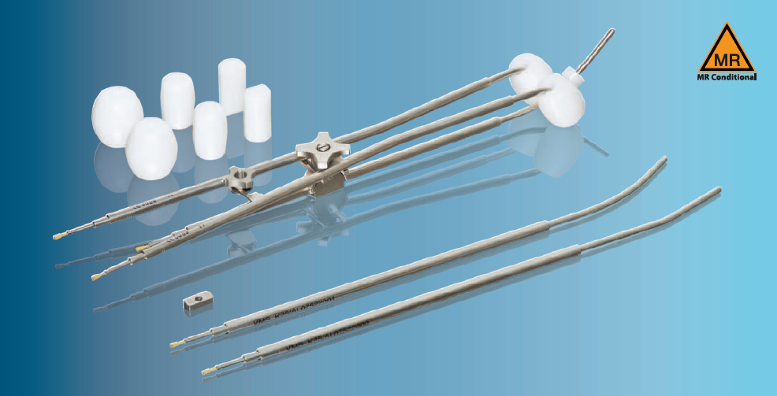
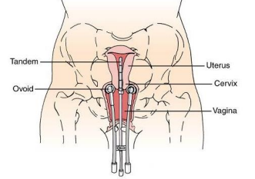
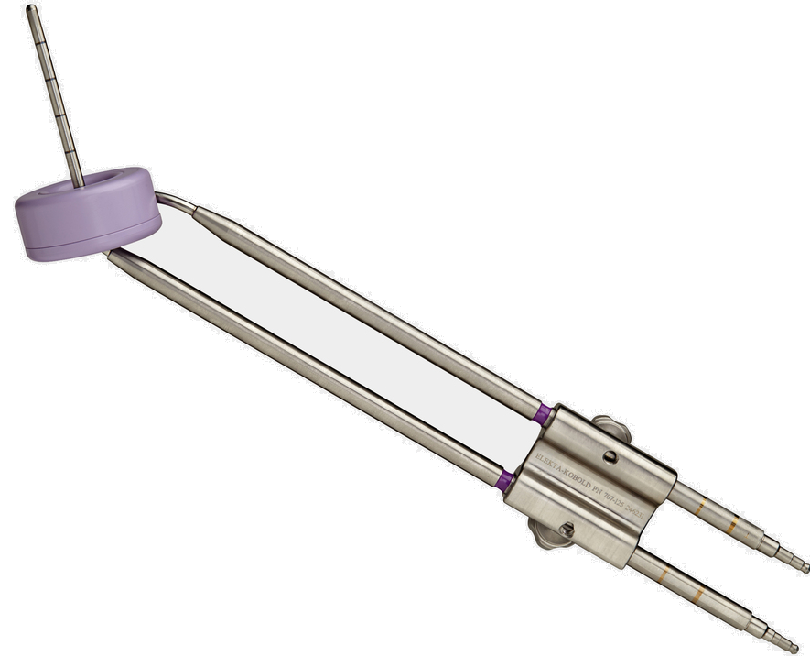
Brachytherapy Applicator Types for Cervical Cancer
Tandem and Ovoids
Tandem and Ring
Tandem and Cylinder
Tandem and Interstitial

Slide 15
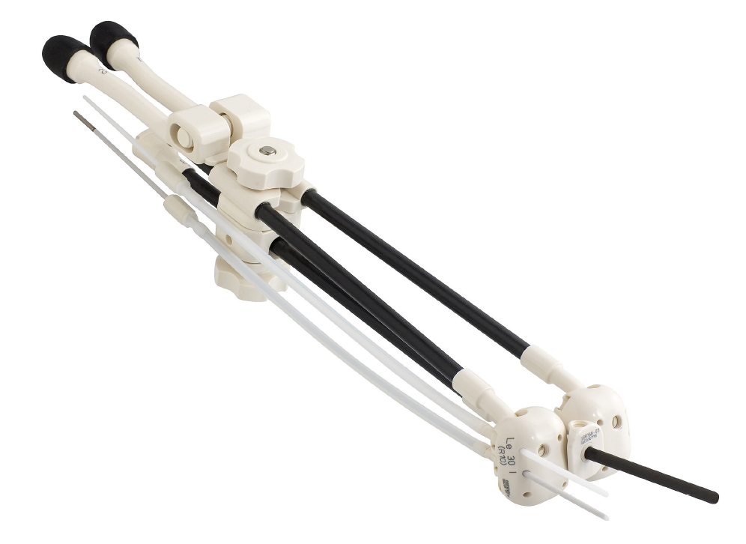
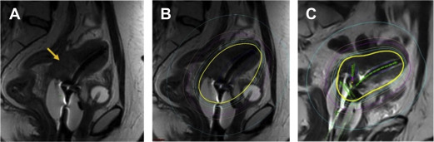
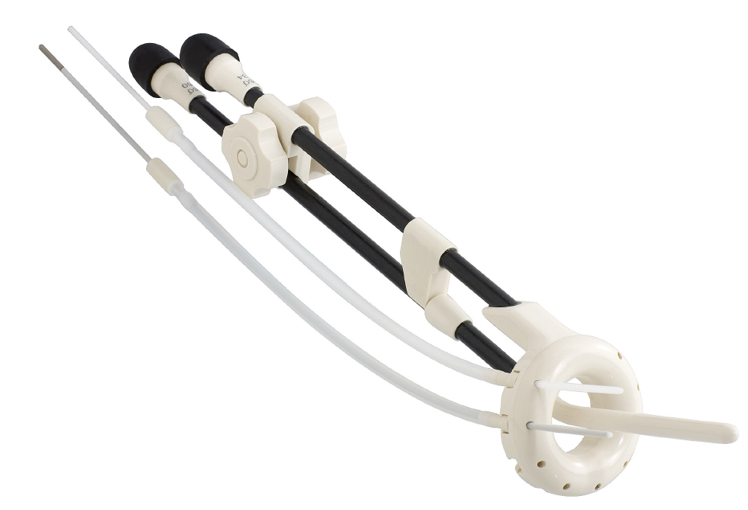
Hybrid Applicators with Interstitial Needles
Provide additional degree of freedom to adjust dose distribution around irregular or bulky tumors
Suneja and Viswanathan et al, 2020
Notes:
Utrecht applicator, Vienna Applicator – both made by Nucletron
Can add about 1cm of lateral coverage
Dose ~10% through the needles

Slide 16
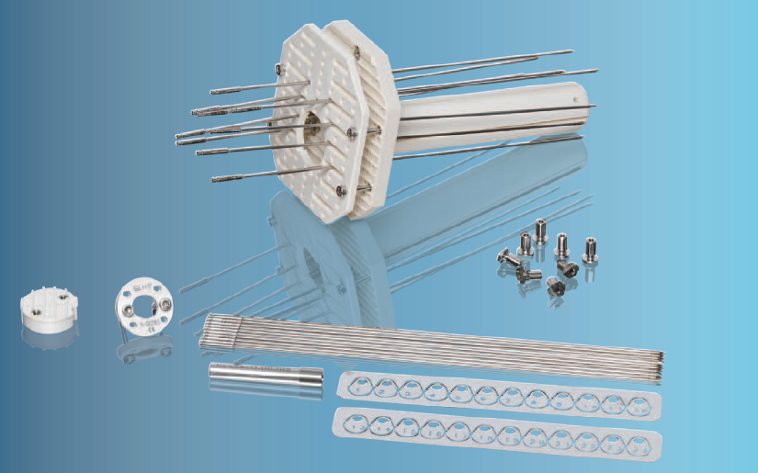
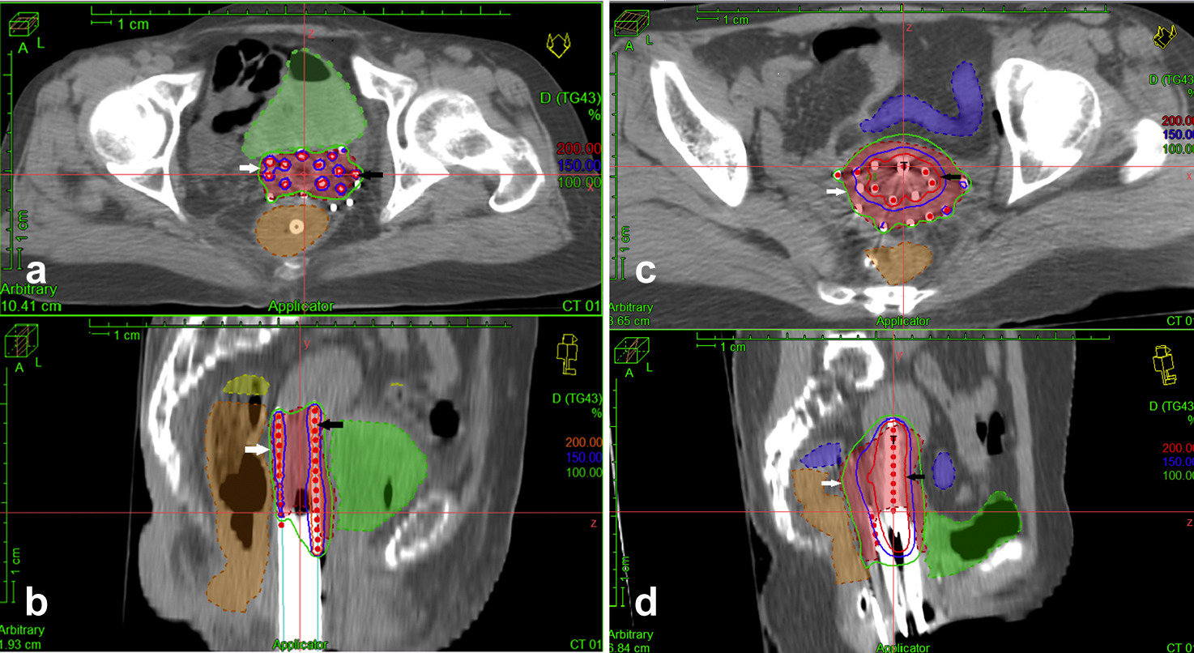
Interstitial Templates
Use for post hysterectomy, larger lesions or lower vaginal involvement
Tiwari et al, 2020

Slide 17
Brachytherapy Dose Rate
Low-Dose-Rate (LDR) Brachytherapy used to be most common
  Cs-137 manually placed within applicators in patient
  Long half life → deposits dose slowly → patient stays in bed, hospitalized, for 2-4 days
  Inconvenient and radiation safety risks
High-Dose-Rate (HDR) Brachytherapy has largely replaced LDR
  Applicators are placed in an operative room
  CT scan is used to delineate target volume and applicator position(s) and optimize treatment plan (easier dose modulation)
  Ir-192 remotely moved through applicators in a shielded room in radiation oncology department over 10-15 minutes (no radiation safety risk)
  Applicators are removed and patient typically goes home same day

Slide 18
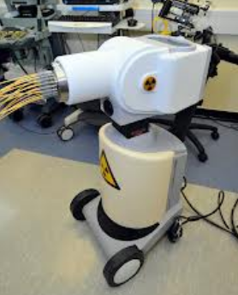
Remote Afterloader for HDR Brachytherapy
Each catheter/applicator is connected to a Remote Afterloader
A single Ir-192 radioactive source on a wire travels within each catheter into specific positions, for specific periods of time
All applicators are removed after treatment

Slide 19
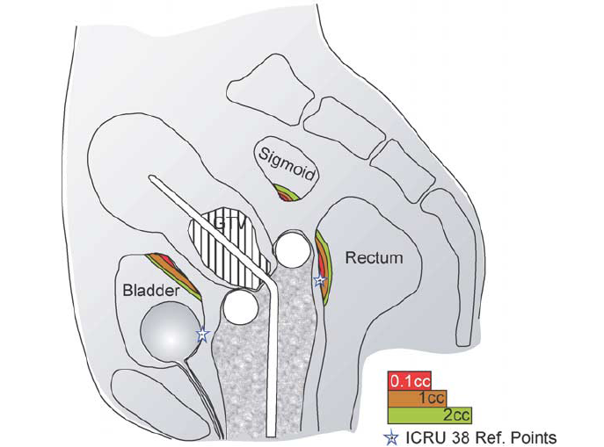
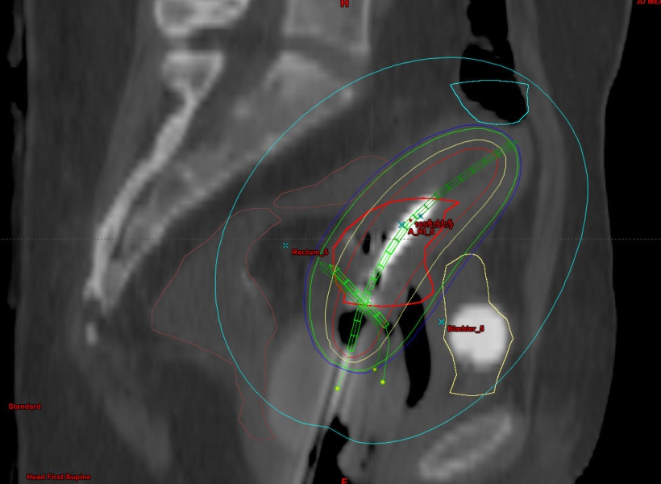
Brachytherapy Treatment Planning
Modern image guided volumetric planning uses a CT scan to optimize dose based on the contoured tumor (target) and nearby normal organs
Potter et al, 2006

Slide 20
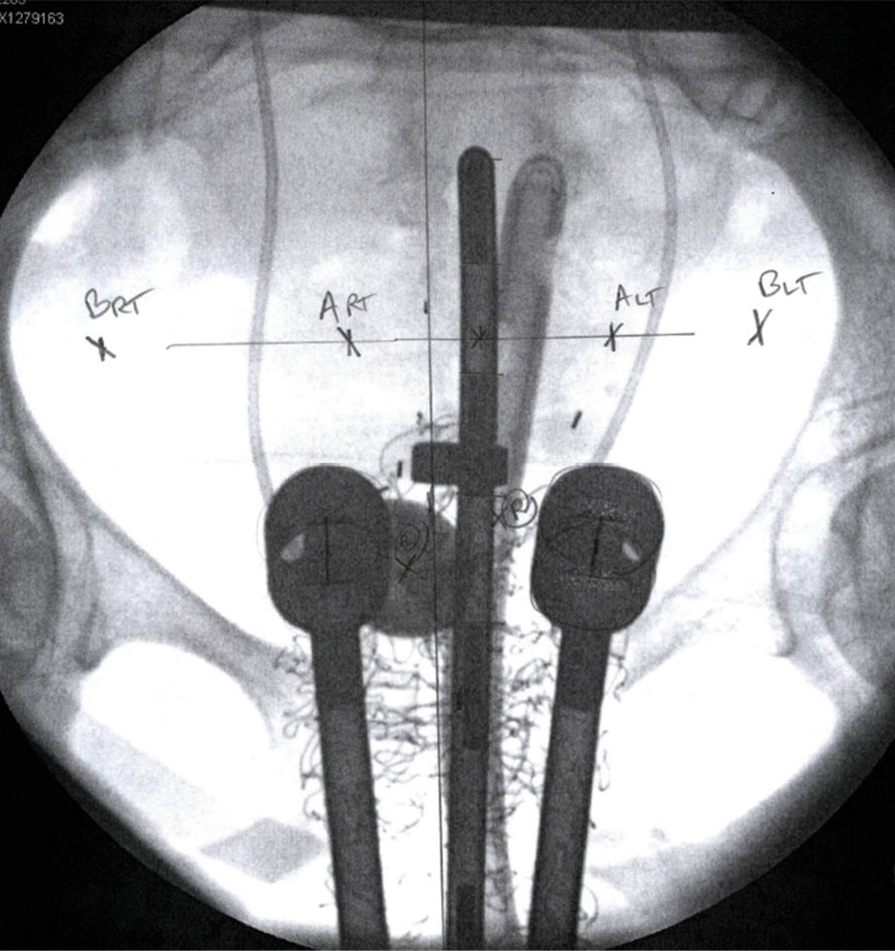
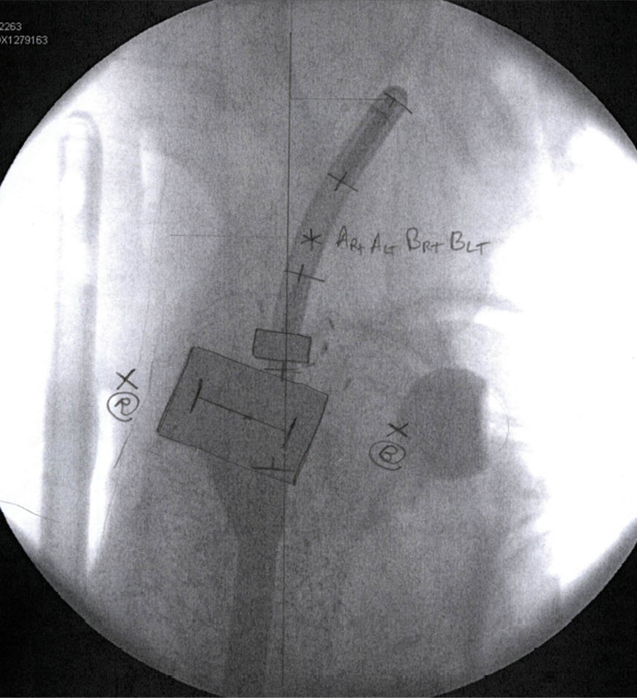
Brachytherapy Treatment Planning
Historically, treatment planning was based on 2-D X-rays, and dose was calculated based on reference points relative to the applicators or pelvic bones

Slide 21
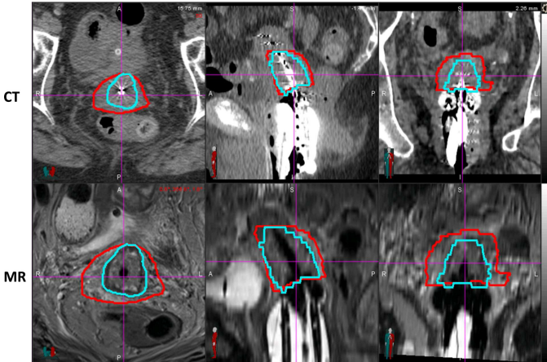
MRI Guided Brachytherapy
More accurate delineation of tumor extension
Visnawathan et al, 2014

Slide 22
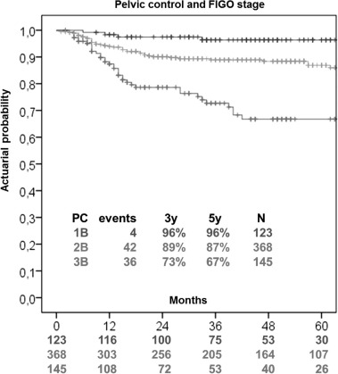
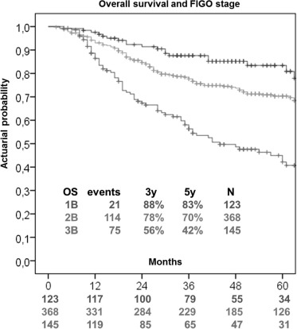
Clinical Outcomes of Image Guided Brachytherapy
Improves pelvic control and survival for patients with cervical cancer
Sturdza et al, 2016

Slide 23
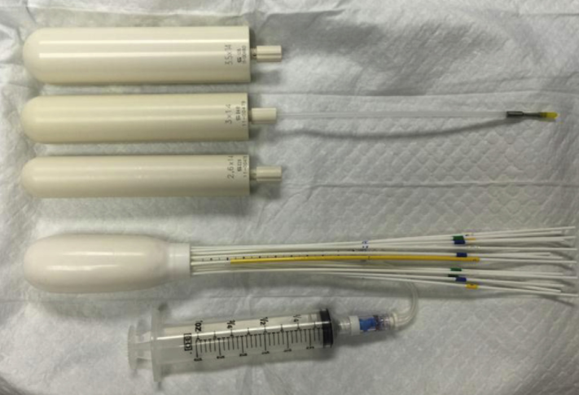
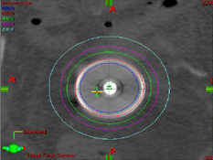
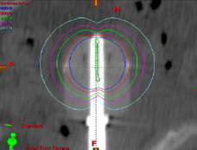
Vaginal Cylinder
Single channel cylinders come in several sizes
Multi-channel cylinders offer extra control of dose distribution

Slide 24
Integration of Radiation Therapy into Patient Care

Slide 25
Overview of Clinical Management of GYN Malignancies
Definitive RT (typically with concurrent chemo) is sometimes used instead of surgery as the primary curative modality
  Common in cervical cancer, vaginal cancer and some vulvar cancers
Adjuvant RT is sometimes used after a definitive surgical resection in patients at high risk of recurrence
  Common in uterine cancer, and some cervical and vulvar cancers
  Neoadjuvant RT is uncommon for GYN malignancies
Salvage RT is sometimes used for locoregional cancer recurrence after prior curative-intent therapy
Palliative RT can be directed at any site of symptomatic cancer for symptom relief (e.g., pain, bleeding, obstructive symptoms)

Slide 26
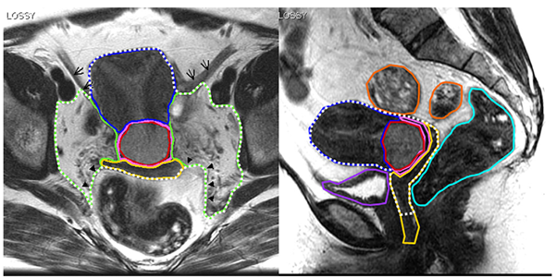
Cervical Cancer
Lim et al, 2009

Slide 27
Early-Stage Cervical Cancer
Stages IA1-2, IB1 are typically treated with up-front surgical resection
  Type of hysterectomy and extent of LND is stage dependent
Most recurrences after surgery alone are locoregional
  Post-operative pelvic external beam radiation therapy (EBRT) is indicated if patient has > 2 “Sedlis criteria” (correlates to recurrence risk up to 31%)

Slide 28
The Sedlis Criteria for Adjuvant EBRT
LVSI | Stromal Invasion | Tumor Size
Positive | Deep 1/3 | Any
Positive | Middle 1/3 | ≥ 2 cm
Positive | Superficial 1/3 | ≥ 5 cm
Negative | Deep or Middle 1/3 | ≥ 4 cm
Need 2 of 3: Positive LVSI, Middle 1/3, ≥ 4 cm
Sedlis et al, 1999

Slide 29
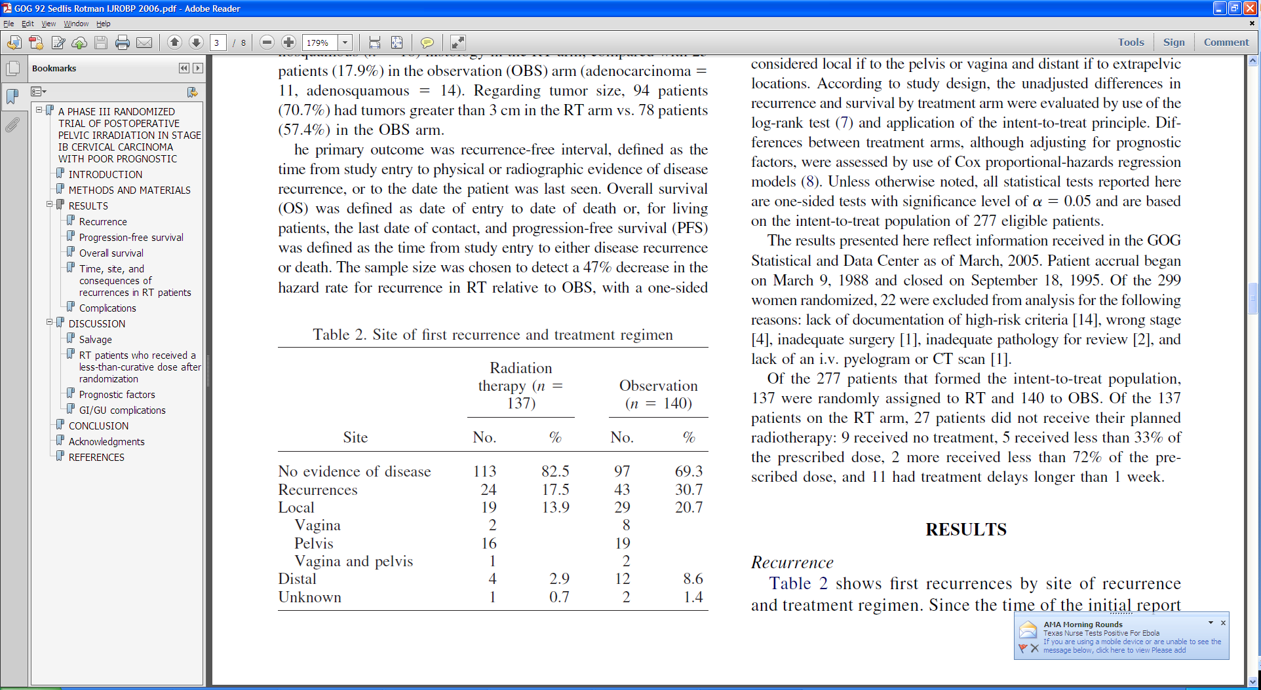
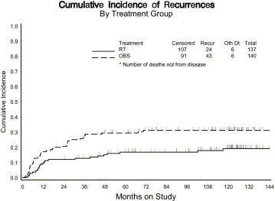
Evidence for Adjuvant Pelvic EBRT
GOG 92 randomized 277 patients who met the Sedlis criteria to post-op RT vs. observation
    RT → 46% relative reduction in pelvic recurrence
    RT → 30% relative reduction in risk of death (p=0.07)
Sedlis et al, 1999 and Rotman, et al, 2006
Notes:
GOG 92 (Sedlis 1999, Rotman 2006)
277 pts, IB s/p radical hysterectomy + LND (node negative) randomized to ± WPRT (46-50.4 Gy).
Inclusion criteria (intermediate risk features; 3Y-LR (31%) in GOG 49):
+CLS, deep 1/3 stromal invasion, any size
+CLS, middle 1/3 stromal invasion, size > 2cm
+CLS, superficial 1/3 stromal invasion, > 5 cm
–CLS, deep or middle 1/3 invasion, > 4 cm.
RT → ↓ 2Y-LRR (28→15%), ↑ 2Y-RFS (79→88%) and ↑ toxicity (2→6%).
Long-term f/u: RT → 44% ↓ recurrence and 42% ↑ PFS and trend towards 30% ↓ death (p=0.07)
Greater benefit of RT for AdenoCA and adenosquamous histologies (44→8% recurrence)
Leg lymphedema risk ~ 20%, but most are transient
Criticism: No brachy boost likely raised LRR rate

Slide 30
Adding Chemotherapy to Adjuvant EBRT
Indicated for patients with high-risk features (up to 40% pelvic recurrence rate)
The 3 P’s:
  Parametrium involvement (microscopic)
  Pelvic lymph node involvement
  Positive surgical margins
GOG 109 (Peters et al, 2000) demonstrated that adding chemo to RT → 10% absolute 4Y-OS benefit
Notes:
SWOG 8797 / GOG 109 / Intergroup 0107 / RTOG 9112 (Peters, 2000)
268 pts, clinical IA2-IIA s/p radical hysterectomy + LND with high risk features (positive pelvic lymph nodes, positive margins, or microscopic involvement of the parametrium) randomized to RT (49/1.7Gy) ± 4c q3week Cisplatin/5-FU (concurrent and adjuvant)
45/1.5Gy given to PALNs (+) common iliac LN.
No brachytherapy
Only 60% of patients received all 4 cycles of chemo (since had 5-FU in it)
Chemo → ↑ 4Y-OS (71→81%) & 4Y-PFS (63→80%) and ↓ LF (17→6%)
Smaller benefit for chemo if only 1 LN positive or tumor < 2cm
25% failure with 1 node & 35-55% failure with > 2 nodes
AdenoCA had worse prognosis than SCC with RT alone, but same prognosis with chemo-RT
Chemo → ↑ G4 toxicity (4→17%, mainly hematologic)

Slide 31
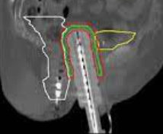
Adding Brachytherapy to Adjuvant EBRT
Vaginal cylinder indicated when high risk of local recurrence:
  Less than a radical hysterectomy
  Close or positive margin
  Large or deeply invasive tumor
  Parametrial or vaginal involvement
  Extensive LVSI
Notes:
In practice, adjuvant brachytherapy is indicated in many cases for which adjuvant EBRT is indicated for cervical cancer.

Slide 32
Definitive Chemo-RT for Cervical Cancer
Radical hysterectomy + adjuvant RT has high morbidity
When clinical staging suggests a high likelihood of the need for adjuvant RT after radical hysterectomy, definitive chemo-RT is preferred due to similar cure rate and reduced toxicity
As a threshold, most patients with a >4cm tumor confined to the cervix/uterus (or upper vagina) would meet criteria for adjuvant radiation
NCCN guidelines recommend definitive chemo-RT rather than radical hysterectomy for Stage IB3, IIA2, IIIA/B and IVA
  Also an option for Stage IB1-2, IA2 and IA1 with LVSI
Landoni et al, 1997
Notes:
Milan Trial (Landoni, 1997)
343 pts, IB-IIA (IB1 61%, IB2 27%, IIA 12%) randomized to radical hysterectomy vs. definitive RT
RT = 47Gy EBRT + LDRx1 → 76Gy to Point A
Adjuvant RT (50.4Gy) given in surgery arm if pathologically > Stage IIB, <3mm of uninvolved cervical stroma, positive margins, or positive LN(s)
Given to 63% of patients overall: 62/114 with Stage IB1 and 46/55 with Stage IB2
No difference in 5Y-OS (~88%) or DFS (~81%)
Surgery arm had ↑ G2-3 complications (12→28%)
Severe leg edema: surgery 0%, RT 1%, surgery + RT 9%
Subgroup Analysis: For AdenoCA, surgery → ↑5Y-OS (59→70%) and DFS (47→66%)
Conclusion: Surgery and RT are both acceptable, but favor RT whenever adjuvant RT is likely to be needed (e.g. bulky tumor) and possibly favor surgery for AdenoCA

Slide 33
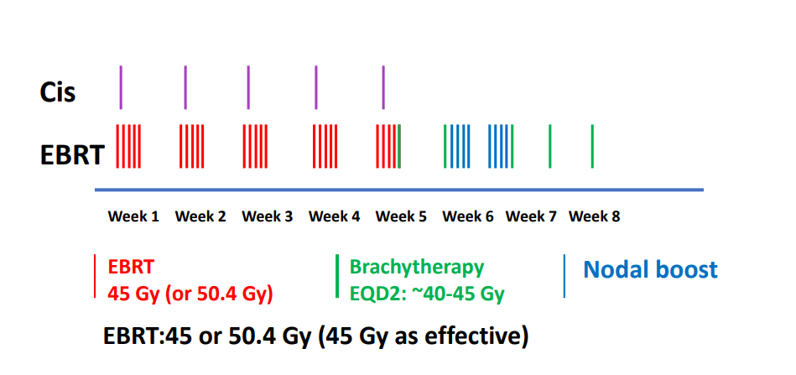
Definitive Chemo-RT Treatment Scheme
“Integrated boost” to involved nodes using IMRT also commonly used
Goal treatment time <56 days → improved local control

Slide 34
Use of Chemotherapy with Definitive RT
Addition of concurrent cisplatin-based chemo ↓ the risk of death by 30-50%¹⁻³
Several randomized trials used cisplatin/5-FU, however, weekly cisplatin is more common because better tolerated
The role of consolidation “outback” Cis/Gem substantially increases toxicity, and is not recommended⁴
  Carbotaxol is currently being evaluated in ANZGOG 0902 RTOG 1174
1. RTOG 90-01 (Morris et al, 1999, Eifel et al, 2004)
2. GOG 123 (Keys et al, 1999, Stehman et al, 2007)
3. Pearcey et al, 2002
4. Duenas-Gonzalez et al, 2011
Notes:
**RTOG 90-01 (Morris 1999, Eifel 2004)
403 pts, Stage IB2, IIA2, IIB-IVA, or LN+ (by staging lap or LAG) randomized to EFRT (45Gy) vs. WPRT (45Gy) + concurrent 3c Cisplatin/5-FU, followed by LDR brachy
Chemo → ↑ 5Y-DFS (40→67%, +25%) & OS (58→73%) & ↓ DMs (33→14%) & LRR (35→19%)
All stages benefitted (though greatest benefit in stages IB-IIB, likely because more advanced stages are more likely to be metastatic)
Nonsignificant increase in PALN failures w/o EFRT (4→8%)
No difference in late toxicity
**GOG 123 (Keys 1999, Stehman 2007)
369 pts, IB2 randomized to neoadjuvant RT (75Gy Pt A, WPRT+LDR brachy) ± weekly cisplatin → extrafascial hysterectomy (3-6 weeks after RT)
Chemo → ↑ 6Y-OS (64→78%) & DFS (60→71%) & LC (80%→90%) & pCR (41→52%)
50% lower relative risk of progression
**NCI Canada Study (Pearcey, 2002)
259 pts, IB-IVA or pelvic LN+ pathologically. Randomized to RT ± weekly cisplatin (40mg/m²) → brachy (LDR or HDR)
No difference in 5Y-OS (~60%)
Possible Reasons Why Negative:
Not as well powered as other trials, anemia higher in chemo arm, no surgical staging of PALNs, AdenoCA excluded, shorter average treatment duration in this trial than others (is chemo compensating for prolonged treatment in other trials?)
**Cochrane Meta-Analysis (2010)
15 trials, 3517 patients, locally advanced cervical CA, RT ± chemo.
Chemo → 8% ↑ 5Y-OS, 13% ↑ PFS, no difference in late toxicity
Greatest survival benefit from chemo in Stage IB-IIA

Slide 35
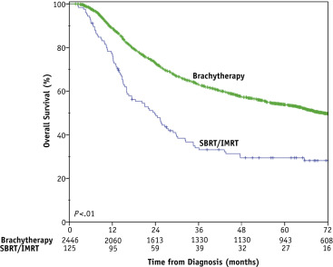
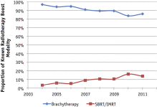
Brachytherapy is a Critical Part of
Definitive Management of Cervical Cancer
Declining utilization in recent years has correlated with reduced survival
Gill et al, 2014

Slide 36
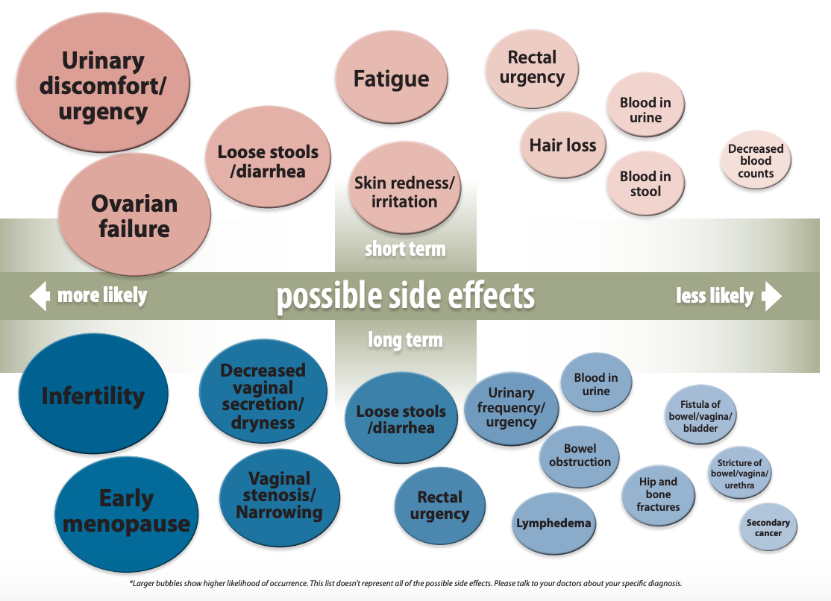
Radiation Therapy Side Effects
Vaginal stenosis can be prevented using vaginal dilator 15-20 minutes/day, at least twice per week
Apical vaginal ulceration or necrosis (~7%) treated with estrogen cream
Risk of G3+ (severe) long-term rectal, bladder or bowel toxicity is ~5%

Slide 37
Recurrences after Definitive Chemo-RT
If central disease → consider pelvic exenteration
  Radical hysterectomy or brachytherapy may be possible if lesion < 2cm
  Key selection factors to consider exenteration: no nodal or distant recurrence, excellent performance status, good social support, longer disease-free interval from initial treatment
If non-central disease (pelvic sidewall) → consider resection of tumor-directed RT or chemo/best supportive care
  Some patients with previously untreated PALN recurrence may be salvaged

Slide 38
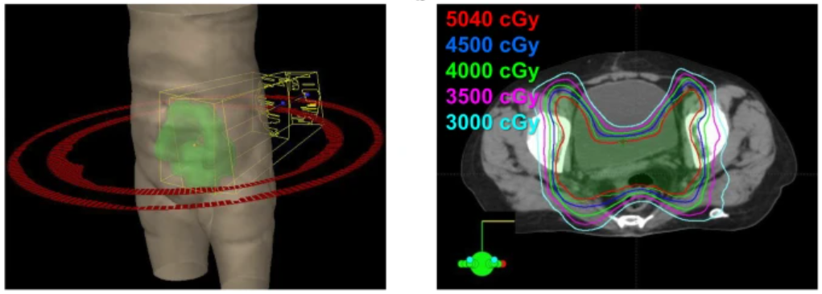
Uterine Cancer

Slide 39
Uterine Cancer Management
Most uterine cancer is treated with up-front surgery
Adjuvant radiation and/or chemotherapy are indicated for some patients based on pathologic stage, grade and other risk factors
If patient is not suitable for up-front surgery (medically inoperable or surgically unresectable) but not metastatic, pelvic EBRT +/- brachytherapy +/- systemic therapy should be considered

Slide 40
Risk Stratification for Adjuvant Therapy
Low Risk:
Endometrioid adenocarcinoma, grade 1-2, Stage IA no LVSI
No role for adjuvant treatment
Intermediate Risk:
Stage I-II (stratified into low or high intermediate risk primarily based on tumor grade, stage, presence of LVSI and patient age)
Risk of locoregional > distant recurrence, so RT > chemo
High Risk:
Endometrioid adenocarcinoma Stage III/IV or deeply invasive G3 (Stage IB or higher), or serous or clear cell histology of any stage
Higher risk of distant recurrence, so chemo is often indicated
Role of RT is dependent on other locoregional risk factors + use of chemo

Slide 41
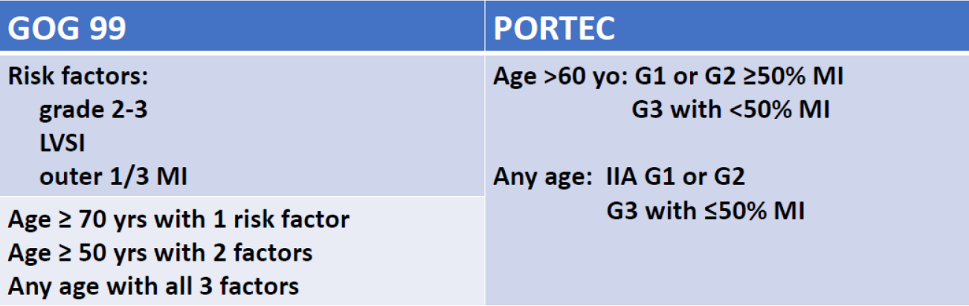
Definition of Low- vs. High-Intermediate Risk
For uterine confined disease, treat based on the presence of “high-intermediate” risk factors - definition varies in different studies

Slide 42
Key Studies for Intermediate Risk Uterine Cancer
GOG 99 and PORTEC-1 established that pelvic EBRT reduces locoregional recurrence from approximately 12-15% → 3-5%, with most of benefit in patients with high-intermediate risk features¹⁻²
    PORTEC-2 established comparable efficacy but less toxicity for brachytherapy compared to pelvic EBRT³
    GOG 249 established that chemotherapy has less of a role in high intermediate risk patients due to increased risk of acute toxicity compared to EBRT (64% vs. 11%) but no difference in recurrence-free or overall survival⁴
5-Year Outcomes | Locoregional Relapse | Vaginal Relapse | Pelvic Relapse | Distant Relapse | Overall Survival | Acute G1-2 Toxicity
Vaginal Brachy | 5.1% | 1.8% | 1.5% | 8.3% | 85% | 13%
Pelvic EBRT | 2.1% | 1.6% | 0.5% | 5.7% | 80% | 54%
p-value | NS | NS | NS | NS | NS | P < 0.05
1. Keys et al, 2004
2. Creutzberg et al, 2000
3. Nout, RA et al, 2010
4. Randall et al, 2019

Slide 43
LVSI: Substantial vs. Focal
Substantial LVSI > 4 foci
Risk factor for local and distant recurrence
Pooled analysis of PORTEC 1-2 studies
3-tiered system most prognostic for RR, DM and OS
Tier | 5-year risk of RR
No LVSI | 1.7%
Focal LVSI | 2.5%
Substantial LVSI (5%) (diffuse or multi-focal) | 15%
EBRT: 4%
VBT: 27%
Obs: 31%
Bosse et al. Eur J Cancer (2015)

Slide 44
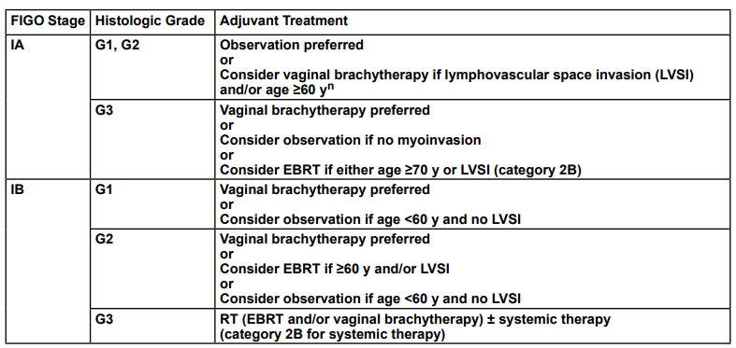
NCCN Adjuvant Therapy Guidelines for
Uterine-Confined Disease
Low Risk
High Int Risk
Intermediate Risk Factors: ≥ 60, focal LVSI
High Risk Factors: substantial LVSI, especially without nodal staging
Low Int Risk
High Risk
Notes:
Description of how to explain this slide:
The IA G1-2 patients are low risk and observation is preferred
- VBT should be considered if other risk factors
The IB G3 patients are high risk and RT +/- systemic therapy is preferred
All other patients are stratified into LIR and HIR based on stage, grade, LVSI and age.
- VBT is generally preferred for HIR and observation is considered for LIR
- EBRT is a consideration for IA G3 and IB G2

Slide 45
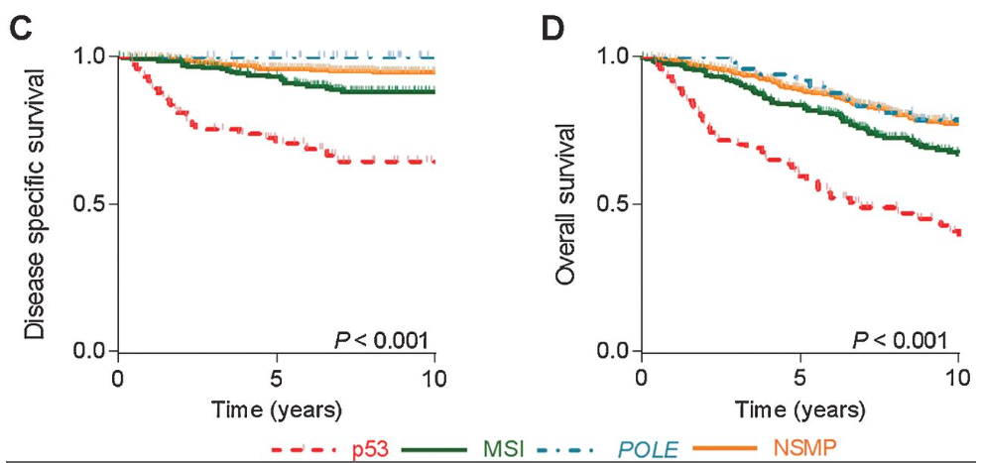
Molecular Subtype
4 molecular prognostic groupings:
BEST: POLE mutated
Copy number low (No specific profile)
MSI hypermutated (MMRd)
WORST: Copy number high/p53
Pooled analysis of PORTEC Patients:
Kandoth, et al, 2013
Stelloo et al. 2016

Slide 46
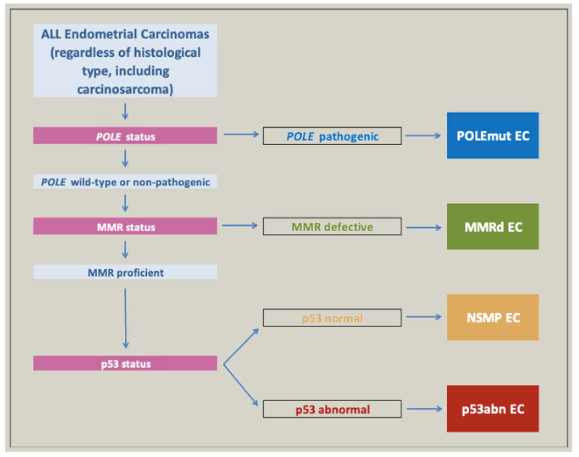
Molecular Subtyping Algorithm m<m
Masood m, Singh, N. Endometrial Carcinoma: changes to classification (WHO 2020). Diagnostic Histopathology. 2021
Masood et al, 2021
Notes:
Four non-overlapping categories that are recognized. Molecular categorization leads to better prediction of clinical outcomes than traditional morphology and histology factors.

Slide 47

PORTEC-2: 10 yr Update and Pathology and Molecular Analysis
High risk factors:
Substantial LVSI
p53-mutant and/or
L1CAM expression
Wortman et al, 2018

Slide 48
Adjuvant Therapy for High Risk Uterine Cancer
Approach depends on stage, histology and other risk factors
  Higher risk for distant mets → greater benefit of chemo
Clear cell or serous-histology, and stage IA without myometrial invasion
Clear cell or serous-histology, Stage IA or II with myometrial or cervical invasion
G3 endometrioid Adenocarcinoma, Stage IB or II
Stage III-IV of any histology
VBT or observation
EBRT or chemo, +/- VBT
*Chemo +/- VBT
*Use EBRT if not chemo candidate, or may favor EBRT over chemo for clear cell histology (data is limited)

Slide 49
Evolution of Treatment Paradigms for Advanced Endometrial Cancer
U.S. Standard of Care
European Standard of Care
Chemotherapy alone
GOG 122 Randall et al 2006
WPRT alone
Italian Study Maggi et al 2006
JGOG 2033 Susumu et al 2008
Regional Recurrence: 20%
Distant Recurrence: 25-30%

Slide 50
Evolution of Treatment Paradigms for Advanced Endometrial Cancer
GOG 258
PORTEC-3
Eligibility:
Stage III-IVA
Stage I-II serious or clear cell AND positive peritoneal histology (<5%)
≤ 2cm residual disease
s/p TAH/BSO, LND optional (94%)
Eligibility:
Stage IA G3 with LVSI; Stage IB G3
Stage II-IIIC EC
Stage IA-III serous or clear-cell histology (25%)
s/p TAH/BSO, LND optional (58%)
C-RT (n=370)
Cis-RT +/- VBT→Chemo (carbo/taxol x 4c)
C-RT (n=343)
Cis-RT +/- VBT→ Chemo (Carbo/taxol x 4c)
Arm 1: Experimental
Arm 2: Standard
Chemo alone (n=366)
Carbo/taxol x 6 c
RT alone (n=343)
EBRT 48.6 Gy +/- VBT

Slide 51
Key Studies for High Risk Uterine Cancer
PORTEC-3 showed that the addition concurrent+adjuvant chemo to pelvic EBRT improves 5Y-FFS (69→77%) and 5Y-OS (76→81%), at the expense of higher G3+ toxicity (13→61%)¹
  Most of OS benefit was for Stage III (69→79%) and serous tumors (53→71%)
GOG-258 showed that the addition of pelvic EBRT to chemotherapy made no difference on 5Y-RFS or 5Y-OS, but did decrease vaginal (7→2%) and nodal recurrences (20→11%). Long-term quality of life was slightly inferior with EBRT²
de Boer et al, 2019
Matei et al, 2019

Slide 52
Management of Locoregional Recurrences
If prior surgery alone → salvage EBRT +/- brachytherapy +/- systemic therapy
  Salvage RT for isolated vaginal recurrence has 5Y-OS 50-75%
If prior surgery+RT → consider surgical exploration and adjuvant reirradiation

Slide 53
Carcinosarcoma, Leiomyosarcoma, and Endometrial Stromal Sarcoma
EORTC 55874 showed that adjuvant pelvic EBRT decreases locoregional recurrence (41→20%), with no difference in OS
  Carcinosarcoma benefited more than leiomyosarcoma
Adjuvant EBRT and/or VBT should be considered based on risk for locoregional recurrence
Reed et al, 2008

Slide 54


Vulvar Cancer
Gaffney et al, 2016

Slide 55
Vulvar Cancer Management
Most vulvar cancer is managed with up-front surgery
Indications for adjuvant EBRT to the primary tumor bed:
Positive or close (<8mm) margin (when re-excision not feasible)
  Why 8mm? Optimal surgery should include a 1cm margin (frozen section), but cells shrink by ~20% in formalin, so 8mm is adequate margin on fixed specimen
T3 or N2-3 (somewhat debatable)
Some also treat if at least 2 risk factors, or 1 factor & LN+:
  Margin <8mm (most important), LVSI, thickness >5mm, infiltrative margin (as opposed to pushing margin)

Slide 56
Vulvar Cancer Management
Indications for adjuvant RT to groin and pelvic LNs
  At least 1 inguinal LN > 5mm (N1b-N3)
  +/- N0-N1a if only a small number of LNs sampled (exact number unclear, but some suggest ~5)
  Pelvic LND not indicated if patient receives adjuvant RT¹
Can consider only treating ipsilateral groin and pelvis if primary tumor is well lateralized and contralateral groin is pN-
Can consider omitting pelvic nodes if groin is pN0 but high-risk primary tumor (e.g. > 4cm, + margins, LVSI)
1. GOG 37 (Homesley et al, 1986, Kunos et al, 2009)

Slide 57
Up-Front Chemo-RT for Vulvar Cancer
  Neoadjuvant cisplatin-RT may be considered for patients who would require exenteration (anorectal, bladder, or bone involvement)
  GOG-205 (57.6Gy/32fx + cisplatin) → 64% cCR, 50% pCR¹
  GOG-279 (64Gy/32fx + weekly cisplatin/gemcitabine) → TBD
  Definitive cisplatin-RT may be considered for medically inoperable patients
1. Moore et al, 2012

Slide 58
Vaginal Cancer
Rare malignancy no randomized data to guide management
Most patients are treated with chemo-RT + brachytherapy boost (interstitial vs. cylinder, depending on response to EBRT and extent of disease)
Surgical excision only considered for Stage I disease, or as salvage for a recurrence after prior RT

Slide 59
Palliative Radiation Therapy for GYN Malignancies

Slide 60
Why Not Systemic Therapy Alone?
For any Stage IV cancers, systemic therapy is the primary palliative (and potentially life-prolonging) treatment modality
However, response rates to first line systemic therapy are generally <50% for most GYN malignancies (and even lower for 2nd/3rd line)
  Responses also usually not immediate after start of treatment
Unless patient’s symptoms are mild, generally need to address symptomatic sites of disease with a local therapy to improve quality of life in a patient population that will not be cured

Slide 61
What Does Palliative Radiation Offer?
External beam RT is non-invasive
  Brachytherapy is minimally invasive
Most patients experience symptomatic relief for a variety of tumor-induced symptoms (e.g., bleeding, obstruction, pain, neurologic)
Relatively low doses used (e.g., 30Gy/10fx, 20 Gy/5fx, 8 Gy/1fx)
  Usually with minimal short-term toxicity that is readily controlled with supportive medications
  Usually with no clinically significant long-term toxicity
  (brain RT is one notable exception)
  Reirradiation may be feasible in some patients
However, usually some delay in treatment effect (days – weeks)
  Hemostasis is fastest (usually within 72 hours of RT start)

Slide 62
General Approach to Palliative/Supportive Care
All cancer symptoms exist on a spectrum
Mild symptoms
Relatively controlled
Moderate symptoms
Impacting quality of life
Severe/life threatening symptoms or
Refractory to other treatments
Immediate relief needed
Systemic Therapy Alone
No local side effects
+ Radiation Therapy
Mild-mod potential for short or long term local side effects
+ Surgery/Invasive Procedure
Higher potential for short or long term local side effects
Since these patients are incurable, before any intervention, goals of care should always be evaluated and hospice considered, depending on patient’s values and wishes

Slide 63
Take-Home Points
Radiation therapy (external beam and brachytherapy) has a critical role in the curative management of gynecologic malignancies
Palliative radiation therapy can help alleviate symptoms and promote quality of life in patients with incurable cancer
Early referral to radiation oncology can help streamline care

Slide 64


Thank You!
https://is.gd/gyn_post1

