Slide 1
Instructions for
Use of These Slides
The purpose of these slides is to serve as a resource that any radiation oncologist can use when introducing medical students to a career in radiation oncology.
It was designed with an extracurricular “oncology interest group” seminar in mind, though portions could be used in other curricular contexts as well.
We would encourage tailoring these slides to your audience, and being flexible in your approach to meet the students’ needs.
Please encourage students attending your presentation to complete the following questionnaire afterwards so that we can improve outreach efforts in the future. It should take less than 5 minutes to complete. https://redcap.link/radiation
Primary Author: Malcolm Mattes
Peer Reviewers: Thomas Eichler, Neha Vapiwala, Curtiland Deville Jr, Trevor Royce, Daniel Golden, Shauna Campbell
Notes:
Note: The intended goal/tone is primarily to introduce the average student to basic principles of radiation oncology and multidisciplinary cancer care that are relevant to any field they choose to pursue, and secondarily to offer insight into a career in radiation oncology for those students who might be interested in pursuing it.

Slide 2
A Note on Content Related to the
Future of the Specialty (Slides 46-55)
This may be the most controversial section. The authors acknowledge that there are many opinions on the future of the radiation oncology profession and job market, and it is inherently challenging to predict the future.
The goal of these slides is to provide a transparent assessment of the situation so that students are informed in their decision making. However, we would encourage any individual who uses these slides to present the content that they personally feel is most appropriate.
We would suggest the following further reading about the radiation oncology job market if you would like to learn more:
https://doi.org/10.1016/j.ijrobp.2020.11.056
https://doi.org/10.1016/j.ijrobp.2020.12.024
https://doi.org/10.1016/j.ijrobp.2021.02.035
https://doi.org/10.1016/j.ijrobp.2016.05.029

Slide 3
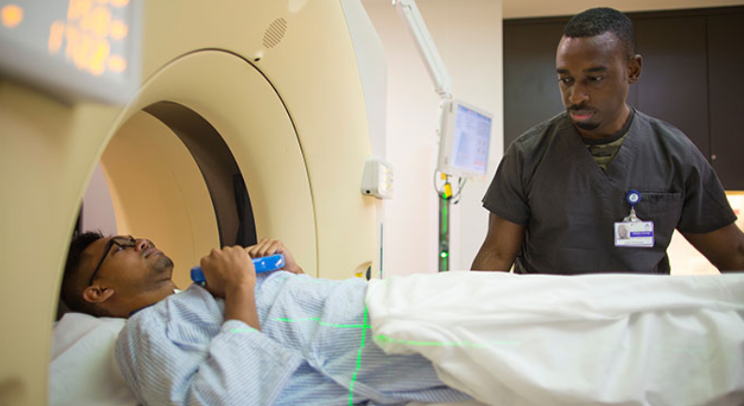
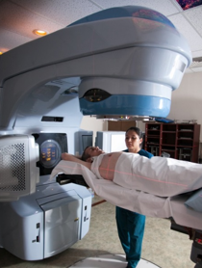
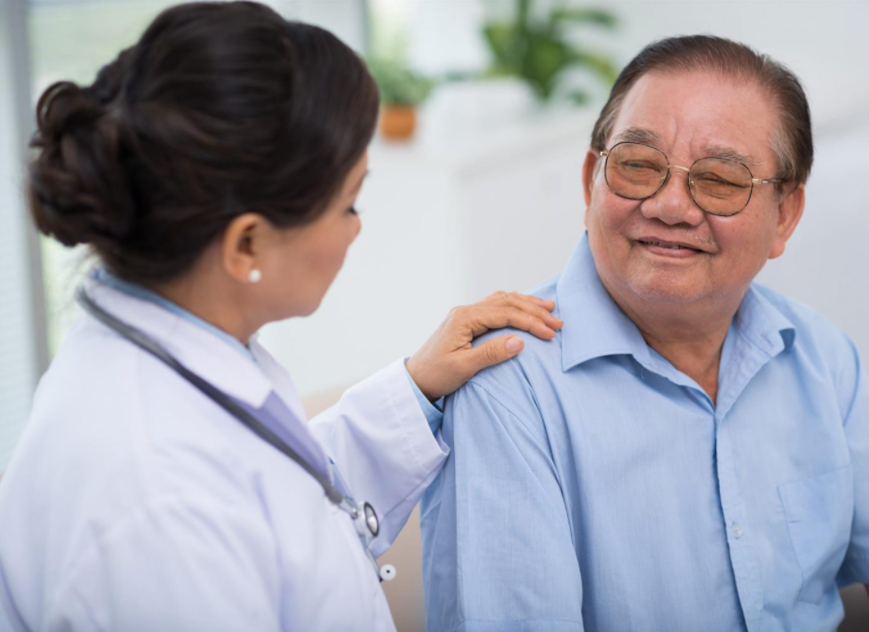
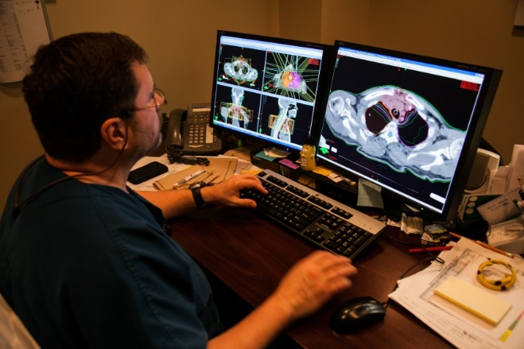
Introduction to
Radiation Oncology

Slide 4
Radiation Oncology Is A Small Field
Virtually no one envisions themself as a radiation oncologist when they apply to medical school; most people have never heard of it!
~950,000
US doctors
~5,000 US radiation oncologists (0.5%)
However, those who do get some exposure to the specialty tend to like it.

Slide 5
Objectives for Today
Learn how radiation therapy (RT) is incorporated into multidisciplinary cancer care
Understand basic principles of radiation oncology, applicable to any field you choose to pursue
Understand the pros and cons of a career in radiation oncology, and how to be a competitive applicant should you choose to pursue it

Slide 6
Opportunities to Get More Exposure to Radiation Oncology
Online Educational Resources
ROECSG- https://roecsg.org/introduction-to-radiation-oncology/
Free ASTRO Membership- https://www.astro.org/Membership
Mentorship
ARRO program- https://forms.gle/wjr5iY5E8nQD3Fgy6
ASTRO program- www.astro.org/mentormatch
Research Funding
Your own school’s MS1-2 summer research programs
ASTRO Minority Summer Fellowship Program
ACR Pipeline Initiative for the Enrichment of Radiology
ASCO Diversity Mentoring Program
RSNA Medical Student Research Grant
Notes:
There is a lot that cannot be covered today. More in-depth materials can be found through the Radiation Oncology Education Collaborative Study Group (ROECSG) website.
ASTRO- American Society for Radiation Oncology
ARRO- American Society for Residents in Radiation Oncology
ACR- American College of Radiology
ASCO- American Society of Clinical Oncology
RSNA- Radiologic Society of North America

Slide 7
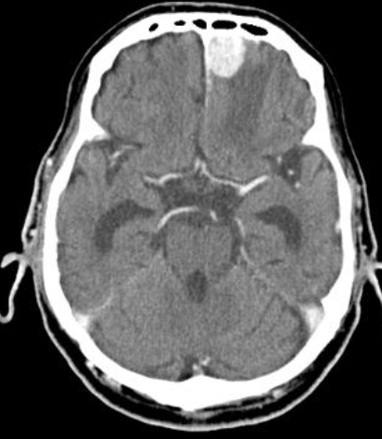
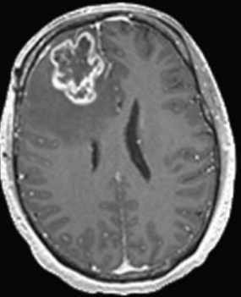
Defining “Oncology”
What is Oncology?
The study and treatment of tumors
What is a Tumor?
A swelling of a part of the body, generally without inflammation, caused by an abnormal growth of tissue, whether benign or malignant (cancer)
Grade 1 Meningioma
Grade 4 Glioblastoma

Slide 8
Defining “Oncologist”
There are 3 types of Oncologists
Surgical Oncologist
“The Army”
6+ years of training
subspecialty dependent
Only treat specific disease site
Medical Oncologist
“The Navy”
6 years training
- 3yr Int Med residency
- 3yr Hem/Onc fellowship
Trained to treat all disease sites
Radiation Oncologist
“The Air Force”
5 years training
- 1yr internship
- 4yr Rad Onc residency
Trained to treat all disease sites
All are equal partners in cancer care
All work together to manage patients
Notes:
If you think about how the modalities technically are administered, the military analogy makes some sense in the “fight” against cancer.

Slide 9
Defining the Treatment Modalities
Surgery is a local/regional therapy
Radiation is mainly used as a local/regional therapy
Sometimes it can be is systemic therapy (e.g. TBI/radioisotopes)
Chemotherapy is a systemic therapy
Though it can enhance local control when used with radiation
Chemo is primary treatment for hematologic malignancies
Since there is nothing local to cut out or irradiate
Surgery or radiation is primary treatment for solid malignancies
Unless they become metastatic (primarily a systemic issue)
Combinations of therapy are common for many cancers
Approximately ¹/₂ to ²/₃ of patients with cancer receive radiation at some point in their treatment course
Notes:
Toxicity is local too

Slide 10
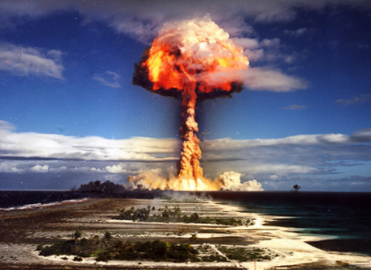
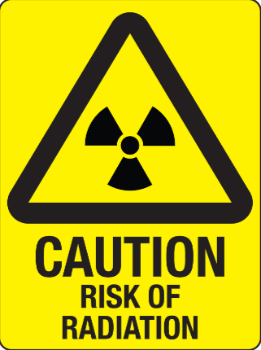
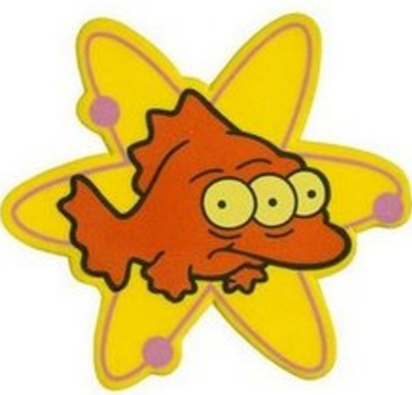
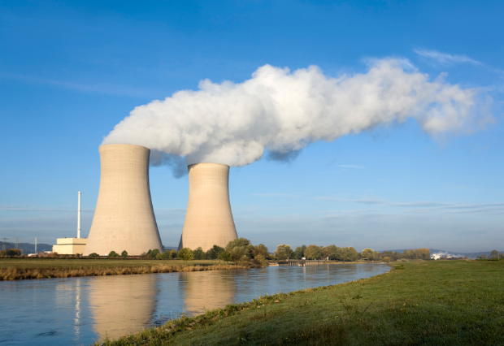
When people hear the word “radiation” they often think…
The reality of medical use of radiation therapy is very different

Slide 11
Indications for Radiation Therapy
Radiation is an important component of curative treatment either alone or in combination with surgery, chemotherapy, and immunotherapy
Radiation is a very effective palliative treatment of symptoms from advanced cancers that are no longer curable
Whether used for curative or palliative indications, radiation can provide quality-of-life benefits that may not be possible with the other modalities

Slide 12
Radiation Therapy as a Complement to Surgery
Adjuvant radiation can eradicate microscopic tumor cells in a post-op tumor bed or nodal region
Neoadjuvant radiation can downstage a tumor and make it more amenable to surgical resection
Examples include:
Breast cancer, soft tissue sarcoma, malignant gliomas, uterine cancer, rectal cancer, esophageal cancer
Notes:
Spend some time on this slide to describe how radiation is helpful in each clinical context. Students enjoy the clinical correlates and it will help capture their attention for the subsequent slides. For instance, for breast cancer it is important to go into the evolution of early stage breast cancer treatment from mastectomy to lumpectomy, and how it is really the use of radiation that enabled the less extensive and morbid surgery and improved quality of life for patients. A similar point can be made for an extremity sarcoma related to limb perseveration, and gliomas in terms of maximal safe resection and preservation of as much neurologic function as possible.

Slide 13
Definitive Radiation Therapy Instead of Surgery
In some cases, definitive RT is used instead of surgery with comparable probability of cure
Potential reasons include:
Not all tumors are surgically resectable
Not all patients are medically operable
Some cancer surgeries are very morbid
Organ preservation is desirable
Examples include:
Prostate, cervix, larynx, pharynx, anus, bladder, lung
Local consolidative therapy for oligometastatic cancer
Notes:
Again, really go into why a patient may undergo RT in each clinical scenario and what the quality-of-life benefits are in relation to a surgical approach.

Slide 14
Palliative RT for Incurable Patients
Pain
bone metastases
Neurologic Symptoms
spinal cord compression
brain metastases
Bleeding
bladder, cervix, lung
Obstruction
Superior vena cava, airway, esophagus, bile ducts

Slide 15
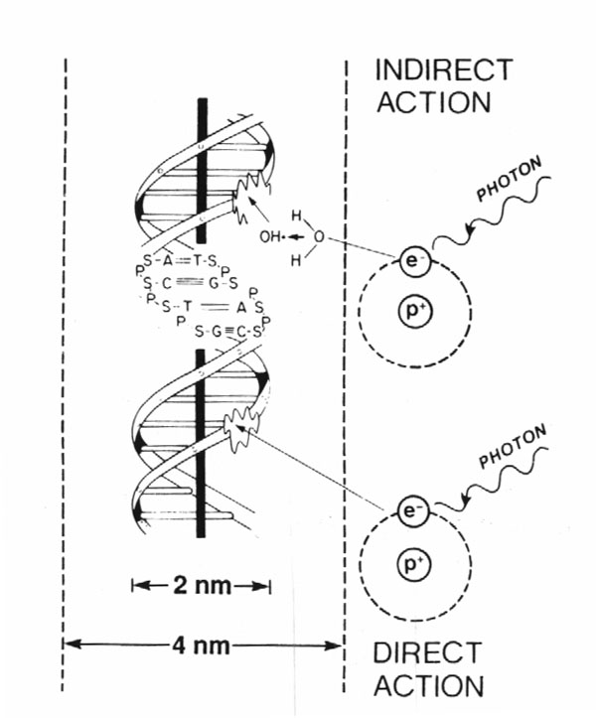
How Does Radiation Work?
80%
X-rays interact with water
radiolysis
free radicals
bind to and damage DNA
cell death
(by mitotic catastrophe)
20%
Cancer cells are more susceptible to RT
due to impaired DNA repair pathways

Slide 16
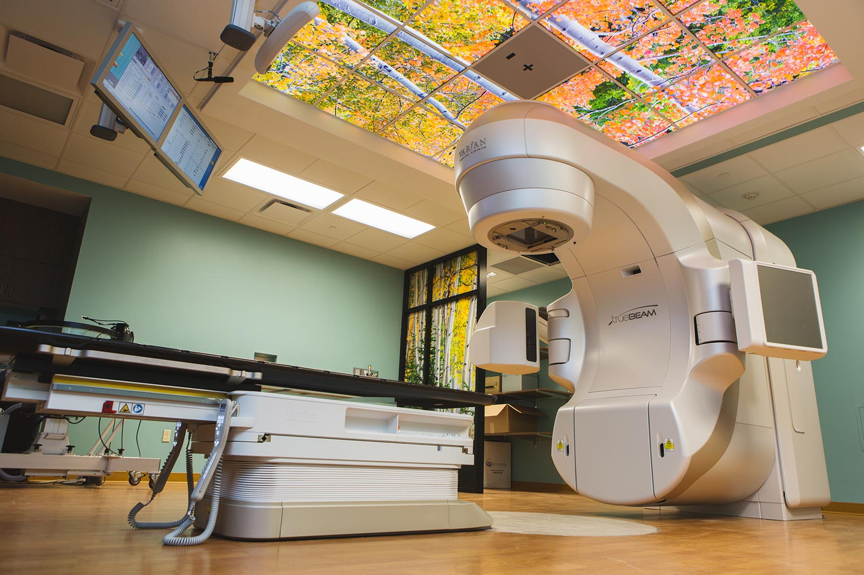
External Beam Radiation Therapy

Slide 17
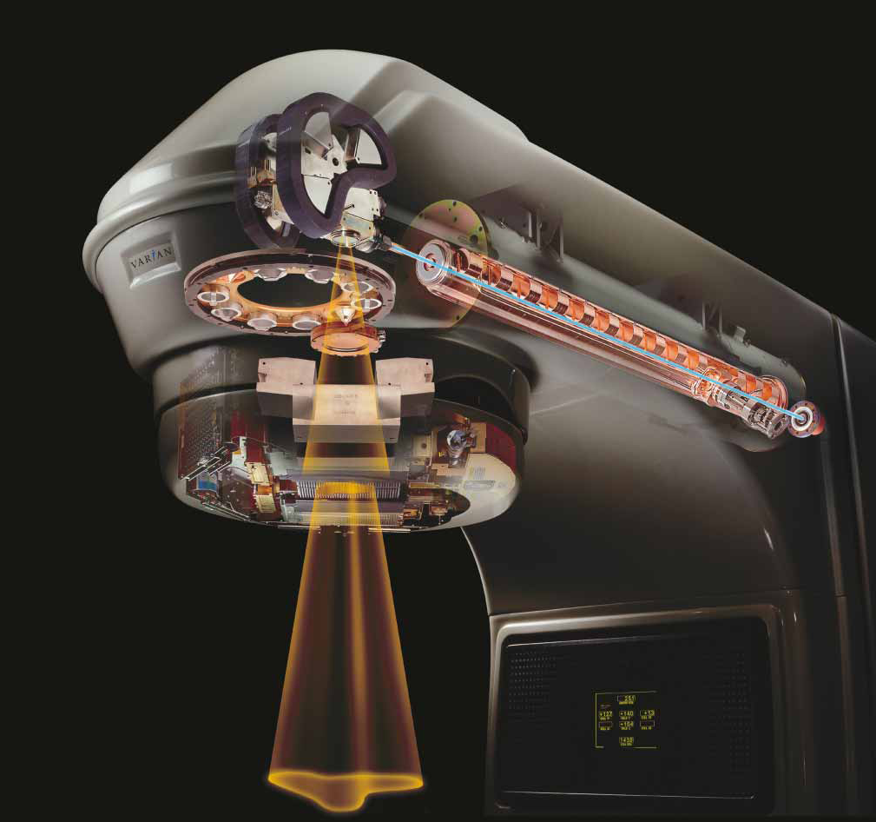
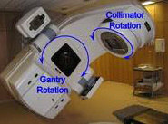
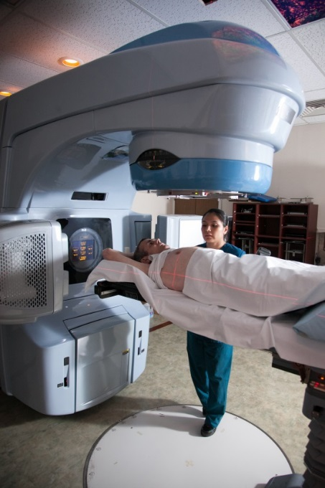
Linear Accelerator (Linac)
Delivers high energy X-rays (photons) or electrons
Non-invasive
Rapid treatment delivery, in minutes
Notes:
Explain how the machine actually works: Electricity → powers electron gun → generates high energy electrons → accelerated along waveguide → strike a Tungsten target → bremsstrahlung generates high energy photons (X-rays) → pass over a filter to generate uniform field → shaped by jaws and collimators → enter patient

Slide 18
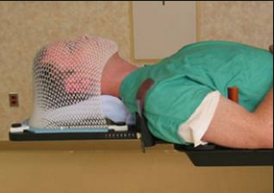
Simulation
Step 1: Position patient and design immobilization device
Goals = comfort and reproducibility
Alpha-cradle:
Foam ingredients mixed → exothermic reaction → foam rises to conform to patient
Aqua-plast:
Plastic “mesh” heated until soft → shaped to conform while warm → cools to rigid form

Slide 19
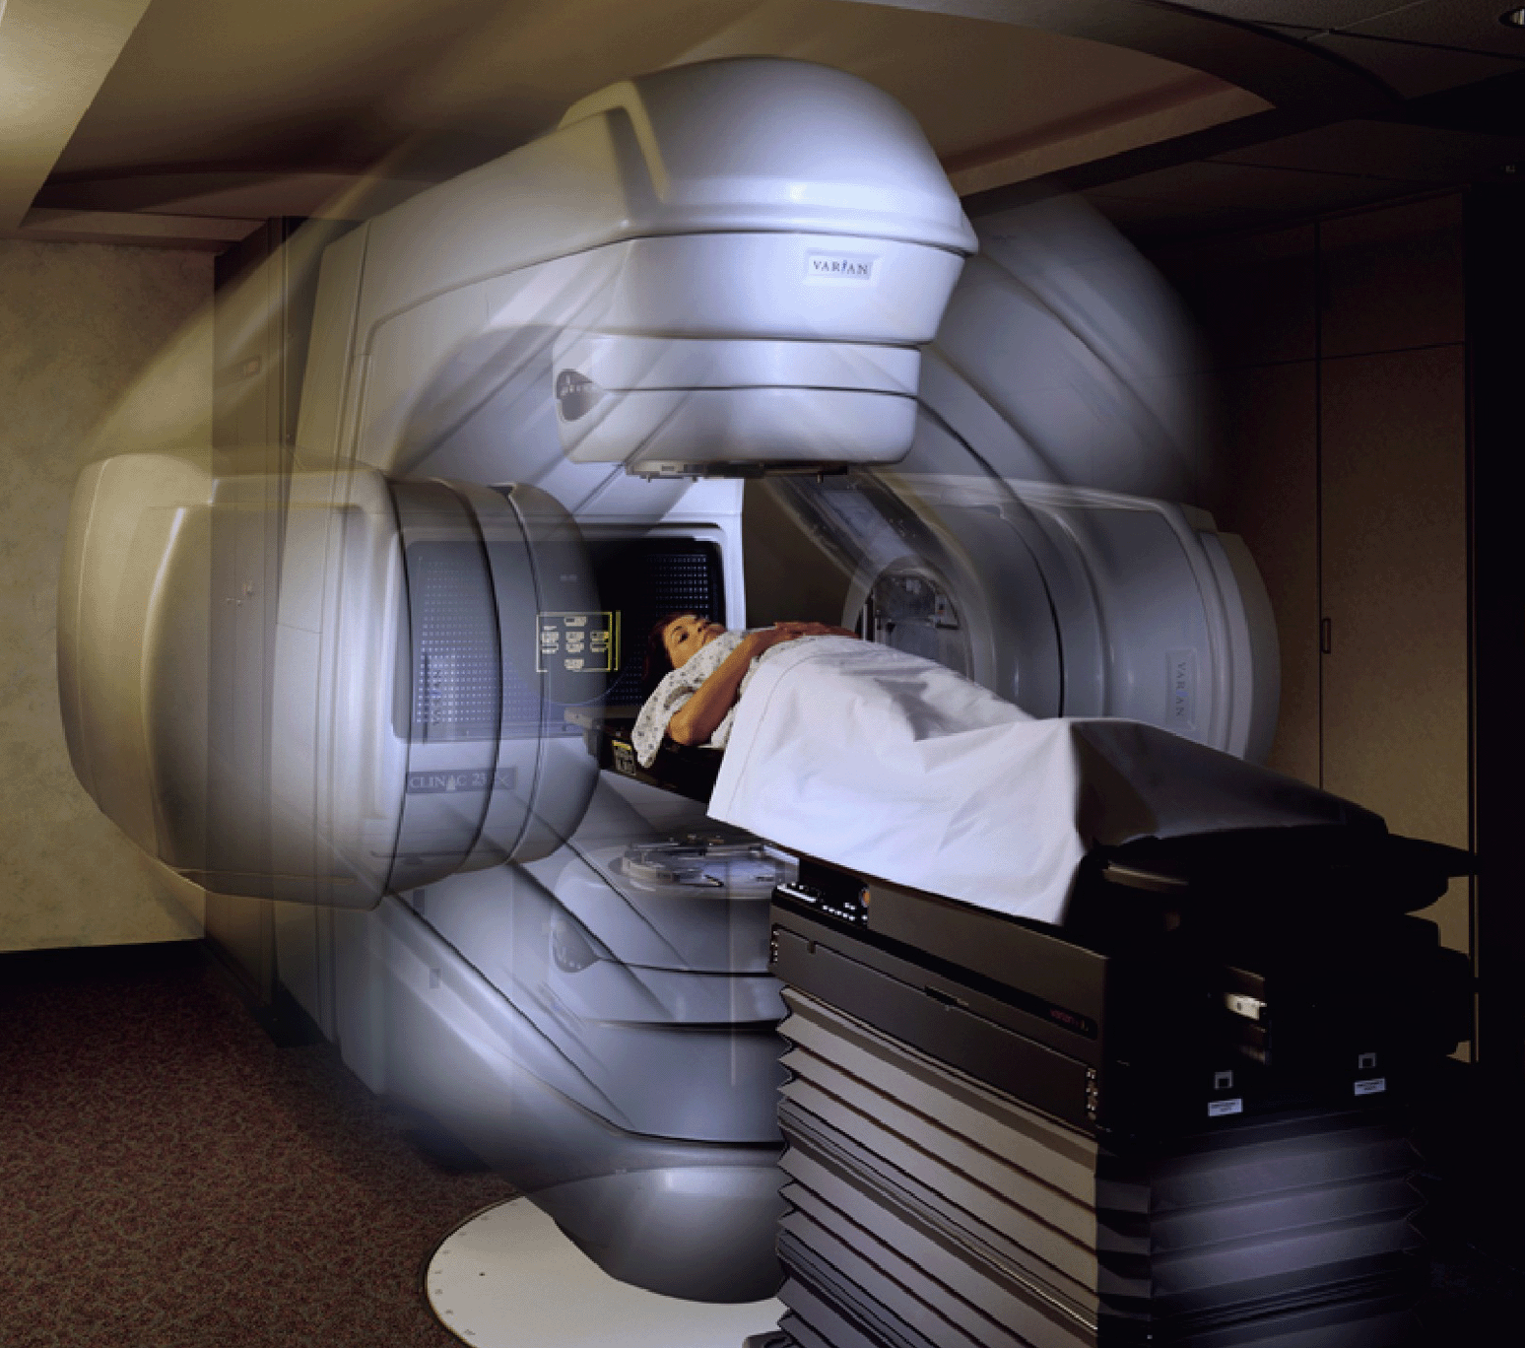
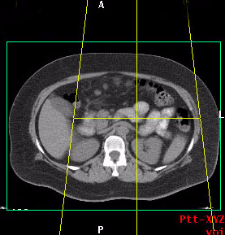
Simulation
Step 2: CT scan → tattoo/mark patient
Isocenter

Slide 20
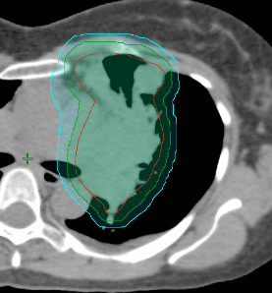
Target-Volume Delineation
Step 3: Draw the target(s) on the planning CT (+/- with image “fusion” with PET or MRI)
GTV (Gross Tumor Volume)
Visible disease
CTV (Clinical Target Volume)
GTV + margin for clinical uncertainty/microscopic spread
PTV (Planning Target Volume)
CTV + margin for physical uncertainties (e.g. positioning, respiratory motion)
PTV
CTV
GTV
Notes:
Not going to talk about ITV

Slide 21
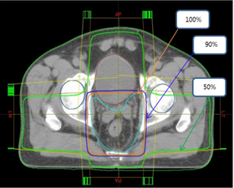
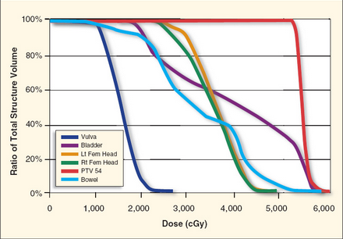
Generate a Treatment Plan
Step 4: Use sophisticated computer software to add RT field(s), and determine “quality” of plan by calculating dose to tumor and normal organs
Isodose Curve:
A line passing through points of equal dose
Dose-Volume Histogram: Relates RT dose to volume of all contoured structures

Slide 22
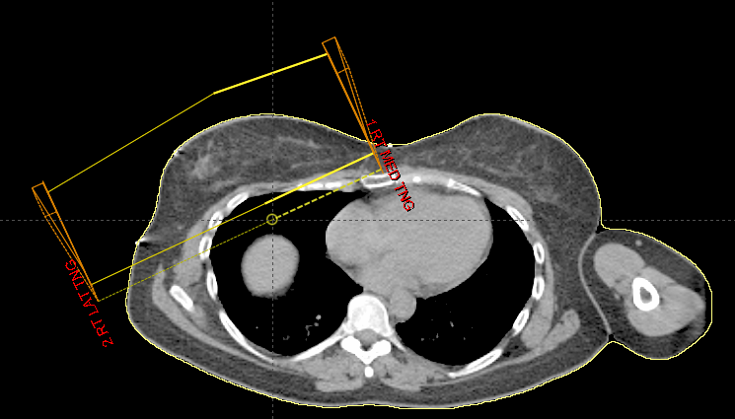
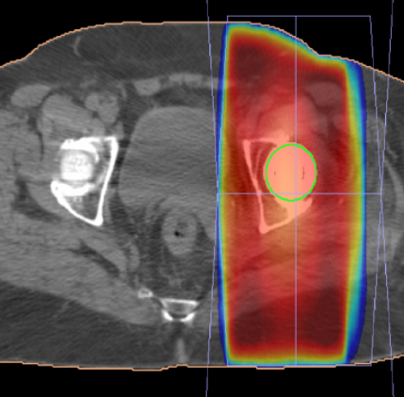
Sometimes a Simple Treatment Plan is Sufficient
Adjuvant RT for right sided breast cancer
Palliative treatment to most bone metastases

Slide 23
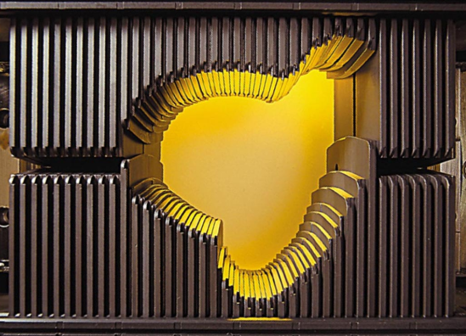
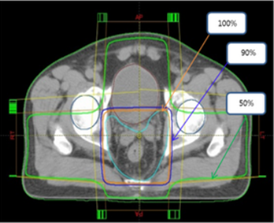
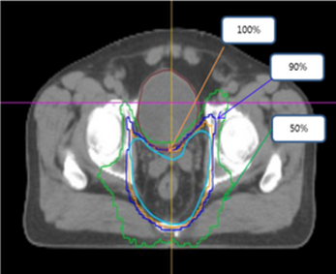
Sometimes a More Complex Intensity-Modulated Radiation Therapy (IMRT) Plan is Necessary
MLCs can dynamically modulate the dose intensity around a curved target volume
Enables dose escalation or reduction in toxicity
Valuable in curative and reirradiation settings
3DCRT
IMRT
Rectal Cancer

Slide 24
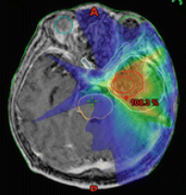
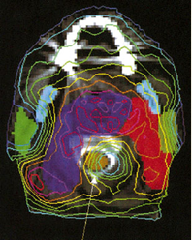
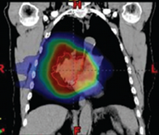
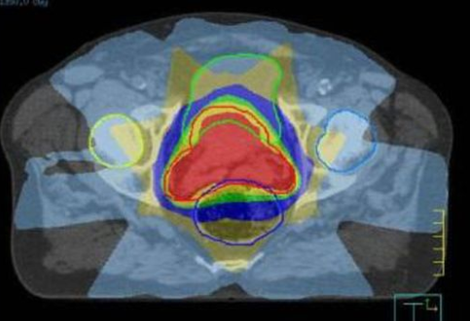
Other Examples of IMRT Treatment Planning
CNS Gliomas
H&N Cancer
Lung Cancer
Prostate Cancer
Notes:
For each, describe briefly the types of organs we are trying to avoid with the IMRT plan

Slide 25
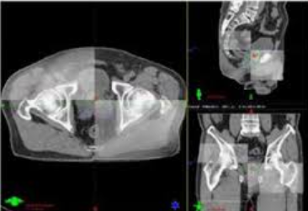
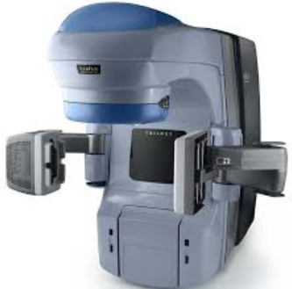
Image-Guided Treatment Delivery
Accounts for daily shifts in soft tissue anatomy or patient setup
Enables reduced margin around tumor → less risk of toxicity

Slide 26
Radiation Dosing
Gray (Gy) is the unit of RT dose
1 Gy = 100 centiGray (cGy)
The dose from 1 cGy roughly equals 1 CT scan
Dose prescription depends on:
Goal of treatment (curative > palliative)
Amount of disease (gross > microscopic)
RT sensitivity of tumor
RT sensitivity of surrounding normal tissue

Slide 27
The Total Dose is Delivered in a Series of Daily Fractions
Most patients receive multiple fractions during their treatment course
RT typically delivered once-daily, 5 days/week (30-45 min/visit)
Fractionation decreases risk of toxicity by allowing for DNA repair in normal tissue
The potency, or Biologically Effective Dose of a RT course depends not only on total dose, but how that dose if fractionated, and the tissue irradiated.

Slide 28
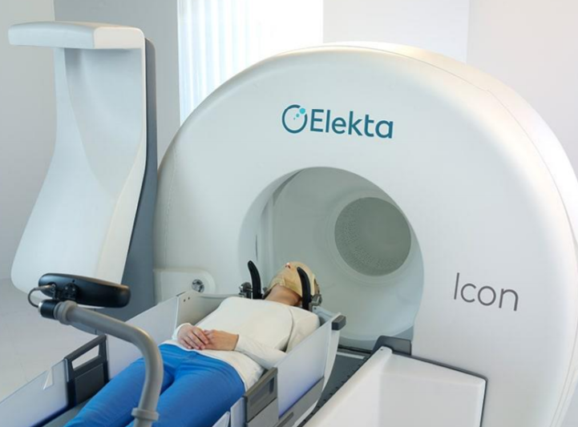
Stereotactic Radiosurgery

Slide 29
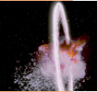
What is Stereotactic Radiosurgery?
Use of a high dose/fraction of RT in a very focused way
High probability of local control (>90%)
Can be done safely for well defined, small-medium sized targets, using our most advanced treatment technologies to deliver this very potent dose safely

Slide 30
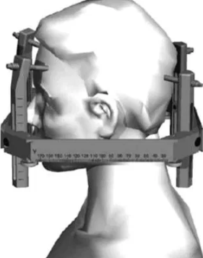
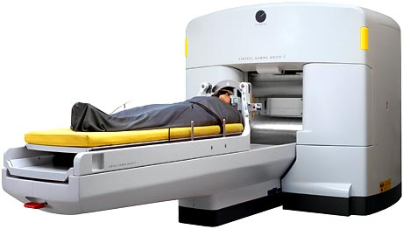
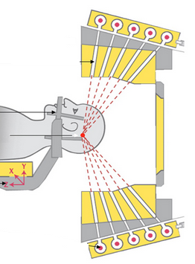
Special Stereotactic Radiosurgery Treatment Platforms
Gamma Knife
Head frame immobilization
192 Co-60 sources
Used to treat brain tumors with high precision

Slide 31
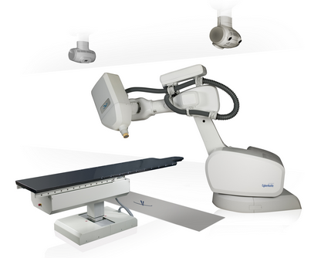
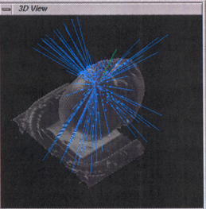
Special Stereotactic Radiosurgery Treatment Platforms
Cyber Knife
Robotic arm can treat tumors throughout body
High precision, but very long treatment times

Slide 32
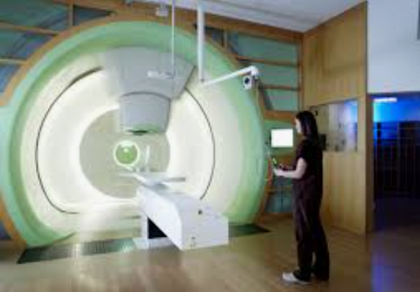
Proton Beam Therapy

Slide 33
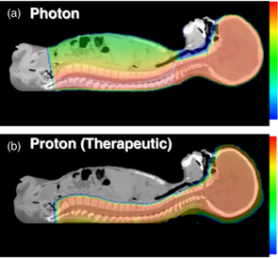
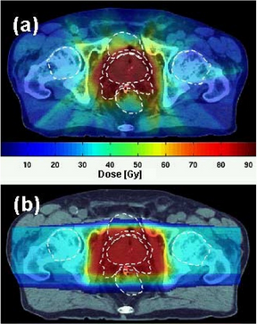
Proton Beam Therapy
Advantage over photon IMRT in dose distribution; less low-intermediate dose to surrounding tissues.
Reduces risk of long-term side effects in pediatric malignancies
Benefits under investigation in adult malignancies (where low dose may have less impact on toxicity)
Notes:
Major disadvantage of proton therapy is cost.

Slide 34
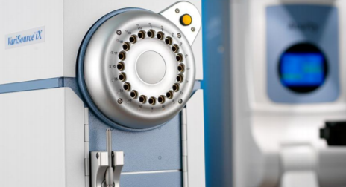
Brachytherapy

Slide 35
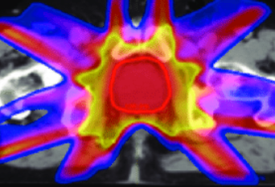
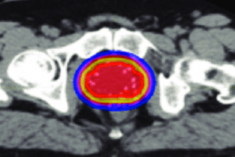
What is Brachytherapy?
“Short distance” therapy using radioactive implant
>100 years old, since radioactivity was discovered
Radioactive sources placed on or inside a tumor
Can be temporary or permanent implant
Allows ↑ dose escalation by sparing normal tissue
Prostate IMRT Prostate Brachytherapy

Slide 36
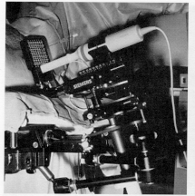
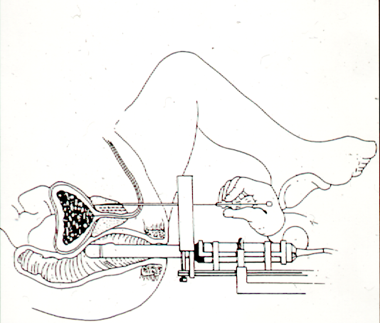
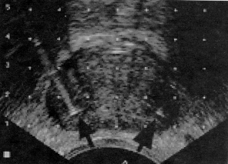
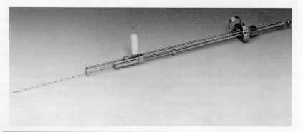
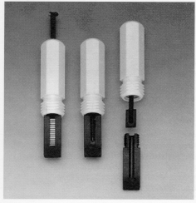
Example of a Prostate Seed Implant

Slide 37
Other Examples of Interstitial Brachytherapy

Slide 38
Examples of Intracavitary Brachytherapy

Slide 39
Choosing a Career in Radiation Oncology

Slide 40
Primary Care vs. Subspecializing
Cancer requires complex care by many physicians
PCPs are critical to prevention, screening, and initial symptom assessment
Specialists like gastroenterologists, pulmonologists, urologists, pathologists and radiologists are critical to diagnostic workup
Surgical, medical, & radiation oncologists are critical to treatment
There are pros and cons of all paths; we need diverse representation in all areas of medicine
Notes:
Oncologists are only as good as their patient’s presentation

Slide 41
Why Radiation Oncology?
The treatment modality itself is rewarding
You get to cure cancer every day!
When used for cure, RT is often oriented towards preserving normal function. When used for palliation, the risk:benefit ratio is often favorable
No radiation exposure for us
The patient interactions are rewarding
Although often confused with radiology, radiation oncologists see patients every day
Variety of patients; short & long-term relationships
Have plenty of time with each patient → meaningful & educational interactions
Treatment >>> Diagnosis (impacts conversations)
Notes:
The benefit:risk ratio comment is related to the fact that systemic therapies used for palliation typically have low response rates and can cause many toxicities, whereas most tumors are to some extent responsive to radiation, and palliative RT causes less toxicity.
Most of us have less radiation exposure than interventional radiology, invasive cardiology and other specialties. A select few radiation procedures do have some exposure, but it is extremely low

Slide 42
Why Radiation Oncology?
Cancer is intellectually stimulating
Treatment approaches evolve with time
There is much more to learn about cancer (lots of research funding and opportunity)
A somewhat “science-oriented” specialty
Lots of new, evolving technology
And exercising social responsibility to use it in a patient-centered way
Lots of procedure opportunities
If desired
Lifestyle
Outpatient hours, home call, few emergencies
Plenty of time to do research, teach, or enjoy life
Notes:
the physics is not more complicated than premed physics and we have great physicists that we work

Slide 43
Concerns With Radiation Oncology
Usually not first Oncologist a patient sees
Depend on referrals from surgical and medical oncology
Need to develop relationships with referring physicians, and educate them on the value of RT
Disadvantages of being in a smaller field
Minimal curricular attention in med school → RT is a relative unknown for most doctors
Risk for less political influence locally and nationally
Sacrifice some geographic flexibility in residency match and job market
Suboptimal Workforce Diversity
27% women, 9% under-represented minorities
This is a need, but also an opportunity if you want to help make a difference in addressing cancer health disparities through patient care and/or health policy.

Slide 44
Examples of Radiation Oncologists Addressing Health Disparities Locally
Develop departmental initiatives to create a more inclusive workplace or more patient-centered treatment approaches
Work with community partners and population scientists to improve cancer screening, education, survivorship care, etc
Join medical school or GME committees to teach about health equity, holistic review processes, or how race impacts patient care
Organize workshops or mentorship program for high school students
Notes:
Beginning: First, you have some choice in where you work, and what patient population and types of cancer you treat

Slide 45
Examples of Radiation Oncologists Addressing Health Disparities Nationally/Internationally
Join a cooperative group health equity committee to ensure equitable clinical trial design and access
Work with national specialty societies to develop relevant education and advocacy initiatives related to DEI
Work with International Atomic Energy Agency (IAEA) to build treatment facilities in countries with fewer resources
Notes:
End: The point is that even in small, highly specialized fields like radiation oncology, you can still do all of these things. If you want to get in touch with individuals doing this kind of work let me know and I can help connect you.

Slide 46
What About Job Security? How Does Radiation Therapy Fit Into the Future of Oncology? Understanding Concerns About the Radiation Oncology Job Market

Slide 47
Surgery: The “Historical Standard”
Surgery has evolved and improved over time...
but by nature it is limited by its invasiveness.
In all areas of medicine, there is a trend toward developing less invasive techniques and being more judicious with their application
Notes:
You may start with the disclaimer that this is your opinion on it, and certainly other opinions exist, but this is what makes sense to you.

Slide 48
Systemic Therapy and Radiation Have Great Potential
Both modalities have become more targeted in their approach. They are largely non-invasive, complimentary and synergistic.

Slide 49
Radiation and Systemic Therapy Will Continue to Improve
We will learn more about what drives tumor formation and growth
Systemic therapy has become increasingly targeted
More precisely tailor/individualize treatment to a patient’s specific tumor
Radiation physics will continue to develop
Delivery of RT more precisely with less side effects
Radiation biology will continue to develop
Better drugs to sensitize cancer cells to RT synergistically, or protect normal tissue from RT, optimize tumor kill

Slide 50
Will the Drugs Get So Effective That Radiation is Unnecessary?
Unlikely (at least not in the foreseeable future)
Targeted/biologic/systemic therapies are typically not curative
Tumors may temporarily stop growing, but the cancer cells eventually evolve and develop new mechanisms of growth and survival

Slide 51
What About Job Security? How Does Radiation Therapy Fit Into the Future of Oncology? Understanding Concerns About the Radiation Oncology Job Market

Slide 52
Is Securing a Rad Onc Residency Position Currently Competitive?
Yes, for the best residency programs
No, to match into any residency program
Mainly due to more available positions at present, and concern about job opportunities in certain geographic regions
Bates J et al, Pract Radiat Oncol, 2020
Notes:
There are certain disadvantages to being in a small field like radiation oncology
There will never be a need for lots of radiation oncologists everywhere
In any given year, some locations may not have any Rad Onc job openings
In more desirable locations, getting a job may be very competitive
The same principle holds for any small, specialized field; you potentially sacrifice some geographic flexibility in residency match and job market to do the job you enjoy

Slide 53
How is the Job Market Currently?
94% of graduating Rad Onc residents in 2020 participated in a job market survey
1 out of 179 residents did not report having a job offer at the time of the survey (May 2020)
No other information was provided by that individual, and their circumstances post-residency were not assessed.
Campbell S et al, ASTRO Annual Meeting, 2020
Notes:
Job openings do continuously become available during the year, and he/she may still have secured a job before graduation, or soon thereafter
Summary: based on the results of the job market survey we do not see signs of unemployment and reported satisfaction remains high.

Slide 54
What Does the Future Hold?
A variety of changing market forces impact supply and demand, for all medical fields
Demand for RT may be reduced by:
Technologic advances allowing for more efficient RT delivery in shorter courses
New systemic therapies or surgical techniques
Demand for RT may be increased by:
An aging population leads to more cancer
Expanding indications for RT to complement systemic therapy for metastatic disease
Expanding indications for definitive RT in the curative setting

Slide 55
Take-Home Points
Choose the field of medicine that intrinsically motivates you, and will provide you satisfaction
Radiation oncology remains a rewarding specialty despite concerns about the future job market
If living in a specific geographic area is very important to you, then small specialties like radiation oncology may be a more challenging choice to meet your goals
If you are flexible in where you live and work, the current Rad Onc job market is likely to support you

Slide 56
So Now You’re Potentially Interested in Radiation Oncology
How Do You Do It?

Slide 57
Know the Data: NRMP 2020
Becoming P/F to limit bias in its utilization
Skewed by % with a PhD. For MD’s, 1-2 publications is usually enough to match
Likely related to heavy weighting of research experiences
Notes:
May point out that these data will likely look “less competitive” in 2021 given decline in number of applicants

Slide 58
General Strategies to Be a More Competitive Applicant
Study Hard and Be Responsible
Grades and USMLE exams matter
Avoid disciplinary actions for academics or professionalism
Research
Clinical vs. basic science vs. health systems vs. health policy vs. cost effectiveness vs. education, etc
Think about what type of research you would realistically want to incorporate into your career.
Pick a good mentor that publishes frequently
Try to get a realistic sense for how long the project will take to complete and publish and your role in it (including authorship)
Start early
Letters of Recommendation
Be enthusiastic and proactive
Take on as many clinical responsibilities as possible
Be honest and humble when you don’t know something
Leadership/Volunteering & Networking
Notes:
These strategies are applicable to all fields, but historically things like research, board scores, grades, and letters of recommendation have been very important in radiation oncology.

Slide 59
Thank You!
Post-Presentation Questionnaire:
https://redcap.link/radiation
Online Educational Resources:
ROECSG- https://roecsg.org/introduction-to-radiation-oncology/
Free ASTRO Membership- https://www.astro.org/Membership
Mentorship:
ARRO program- https://forms.gle/wjr5iY5E8nQD3Fgy6
ASTRO program- www.astro.org/mentormatch
Notes:
Post-Presentation Questionnaire:
https://redcap.link/radiation
Other Educational Resources:
ROECSG Resources- https://roecsg.org/introduction-to-radiation-oncology/
Free ASTRO Membership- https://www.astro.org/Membership
ARRO Mentorship signup: https://forms.gle/wjr5iY5E8nQD3Fgy6
ASTRO mentorship signup: www.astro.org/mentormatch

