Slide 1
Instructions for Use of These Slides
The purpose of these slides is to serve as a resource that any radiation oncologist can use when speaking about the role of radiation therapy in treating bladder cancer.
The target audience is residents/fellows in the fields of urology and medical oncology.
However, any user is welcome to format the slides as needed to fit your target audience.
Please ask attendees to complete either the pre-test or post-test so that we can assess the effectiveness of the slides. If you make significant changes to the content of the slides for your presentation, we prefer that you use the pre-test only. Collected data is anonymous and will potentially be used for research purposes.
Post-test link: https://redcap.link/bladder_post1
Primary Author(s): Malcolm Mattes
Peer Reviewer(s): Noam VanderWalde, Jason Efstathiou, Scott Morgan
Additional Support: ASTRO communications committee
Last updated in December 2022– newer data may impact the accuracy of the content of these slides

Slide 2
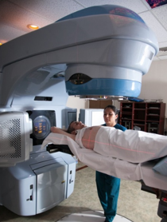
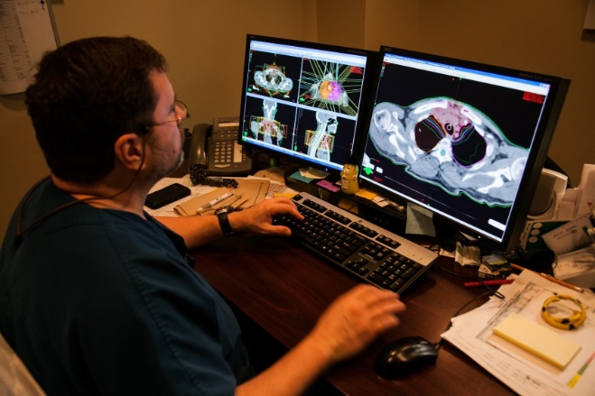
Radiation Therapy as a Component of Multidisciplinary Bladder Cancer Management

Slide 3
Learning Objectives
Understand basic principles of radiation therapy for bladder cancer
Review potential indications for radiation in the curative and palliative settings
Compare definitive surgical vs. radiation approaches for muscle-invasive bladder cancer in terms of toxicity and efficacy

Slide 4
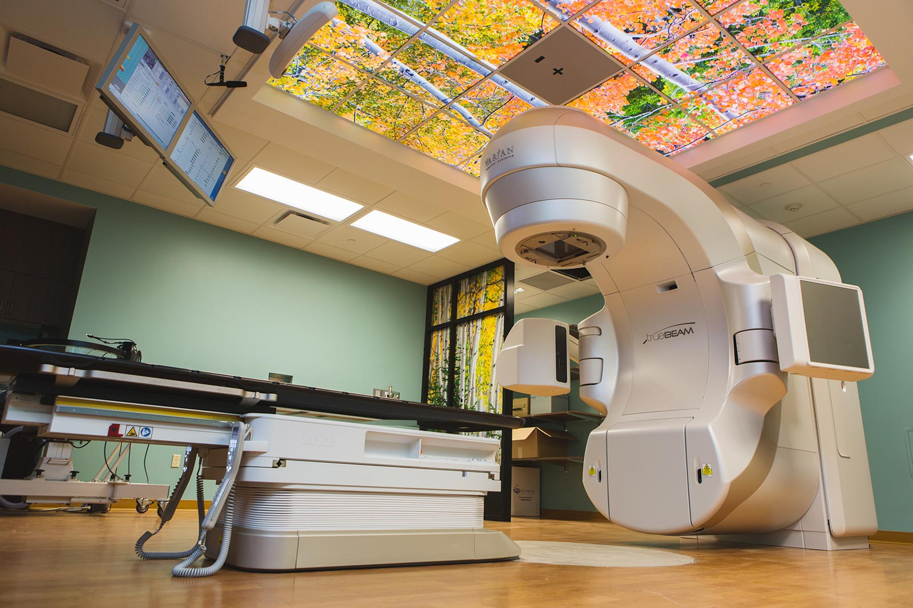
General Principles of Radiation Therapy

Slide 5
Indications for Radiation Therapy
Radiation is an important component of curative treatment either alone or in combination with surgery, chemotherapy, or immunotherapy
Radiation is a very effective palliative treatment of symptoms from advanced cancers that are no longer curable
Whether used for curative or palliative indications, radiation can provide quality-of-life benefits that may not be possible with the other modalities

Slide 6
Radiation Therapy as a Definitive Treatment Modality
Radiation is sometimes used as a complement to surgery to enhance locoregional control. In other cases, definitive RT is used instead of surgery when there is comparable probability of cure, and organ preservation has desirable quality-of-life outcomes.
Common examples include:
Prostate, bladder, cervix, larynx, pharynx, anus, lung
Local consolidative therapy for oligometastatic cancer

Slide 7
Palliative RT for Incurable Patients
Pain
bone metastases
Neurologic Symptoms
spinal cord compression
brain metastases
Bleeding
bladder, cervix, lung
Obstruction
Urethra, superior vena cava, airway, esophagus, bile ducts

Slide 8
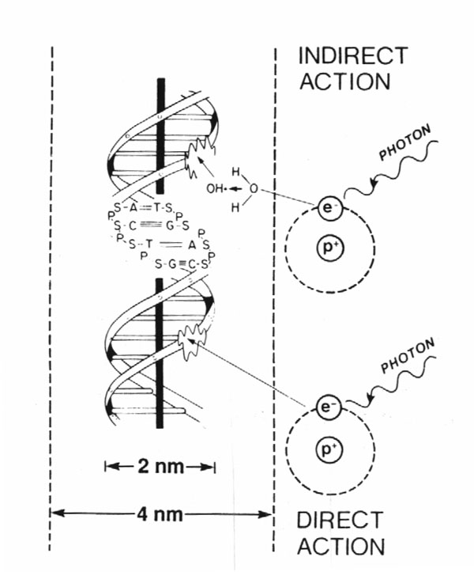
How Does Radiation Work?
80%
X-rays interact with water
radiolysis
free radicals
bind to and damages DNA
mitotic catastrophe
cell death
20%
Cancer cells are more susceptible to RT due to impaired DNA repair pathways

Slide 9
Radiation Dosing
Gray (Gy) is the unit of RT dose
1 Gy = 100 centiGray (cGy)
The dose from 1 cGy roughly equals 1 CT scan
Dose prescription depends on:
Goal of treatment (curative > palliative)
Amount of disease (gross > microscopic)
RT sensitivity of tumor
RT sensitivity of surrounding normal tissue

Slide 10
Biologically Effective Dose (BED)
Depends not only on total dose, but how that dose is fractionated, and the tissue irradiated
e.g., 55Gy/20 fractions vs. 60-66Gy/33-36 fractions
historically twice daily RT (hyperfractionation) was commonly used for bladder cancer, but once daily RT is more common now.

Slide 11
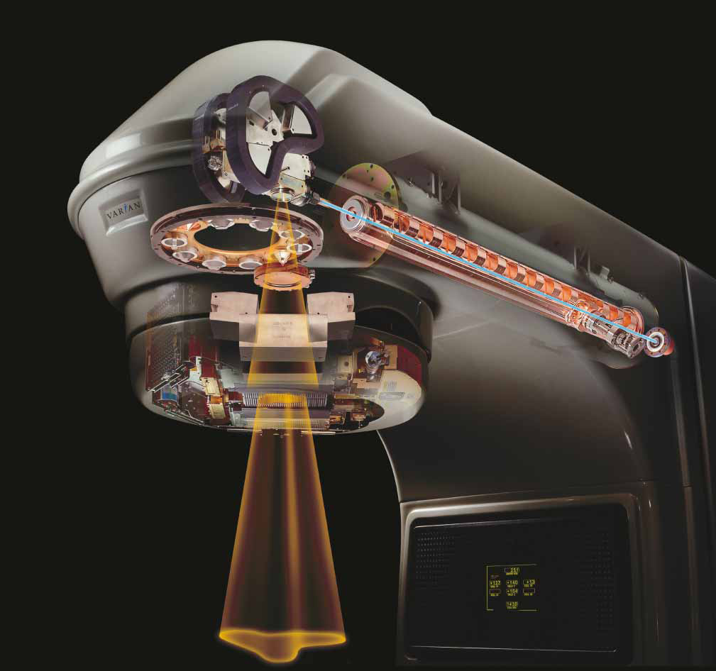
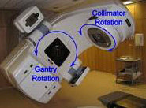
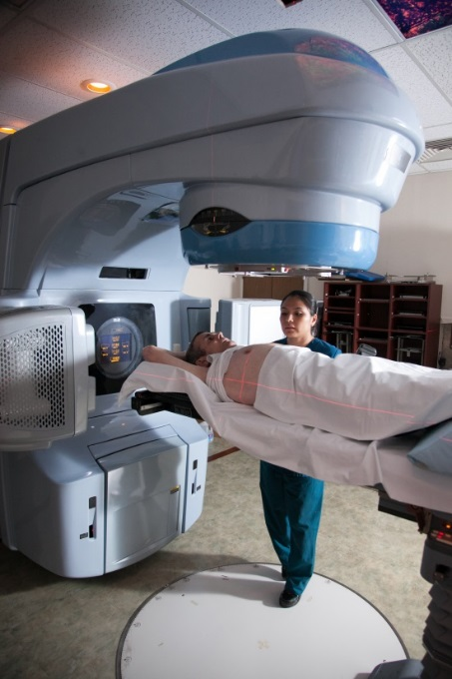
A Linear Accelerator Delivers External Beam Radiation Therapy
High energy X-rays (photons) or electrons
Non-invasive
Rapid treatment delivery, in minutes
Notes:
Electricity → powers electron gun → generates high energy electrons → accelerated along waveguide → strike a Tungsten target → bremsstrahlung generates high energy photons (X-rays) → pass over a filter to generate uniform field → shaped by jaws and collimators → enter patient

Slide 12
Techniques of Bladder Preservation with Definitive RT

Slide 13
RT Target Volumes
Different dose levels for gross vs. microscopic disease
Typically treat entire bladder (+/- elective pelvic nodes and prostate) to a moderate dose, and areas of gross disease in bladder or nodes to a high dose.
Sometimes uninvolved portions of the bladder may be spared from the full dose if tumor is more focal/localized
Based on CT, MRI, or bladder mapping at time of TURBT
When treating partial bladder, treat with bladder full to push bowel away and spare part of bladder. Otherwise, we treat with empty bladder to minimize target volume.

Slide 14
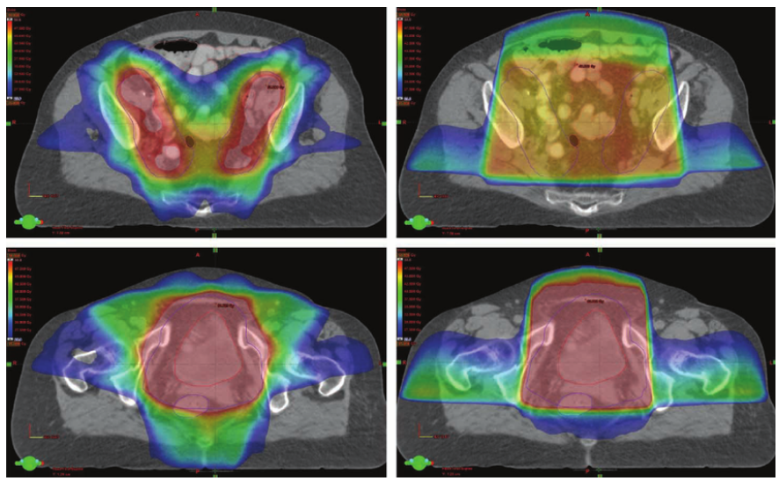
Treatment Planning Techniques
Intensity-modulated radiation therapy (IMRT) uses dynamic multi-leaf collimators (MLCs) to create irregular (non-uniform) radiation from each field to adjust the intensity around a curved target volume
IMRT
3-D CRT
Allows greater sparing of bowel and rectum
MLCs

Slide 15
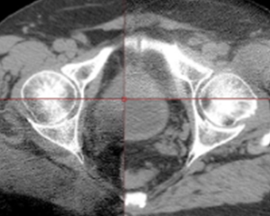
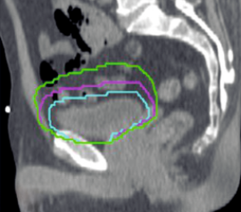
Image-Guided Radiation Delivery
Cone Beam CT
Ensures that bladder filling matches the treatment plan, so dose is delivered accurately
Enables reduced margin around the bladder tumor, so less risk of bowel toxicity
May facilitate adaptive treatment planning based on bladder filling at time of treatment

Slide 16
Maximal TURBT for Debulking
An essential component of bladder preservation that is highly correlated with complete response rate, and to a lesser extent disease-specific survival.
“Trimodality therapy” (TMT) = TURBT + Chemo-RT
Hydronephrosis is a poor prognostic factor for complete response to chemo-RT since it suggests an unfavorable location for a complete TURBT around the peri-ureteral orifice, or deep muscle invasion for which TURBT is inadequate
Typically wait ~ 4 weeks after maximal TURBT to start radiation, to allow for healing

Slide 17
Chemotherapy for Radiosensitization
Concurrent chemo with radiation improves CR rate, bladder preservation, and locoregional recurrence-free survival
Cisplatin alone or 5-FU/MMC are generally preferred
Low dose Gemcitabine is also an option
Doublet Cisplatin/5-FU or Cisplatin/Paclitaxel if using BID RT
Induction chemotherapy before chemo-RT does not have a clear benefit in node-negative muscle-invasive bladder cancer
Though it does have a role in some N2-3 bladder cancer patients

Slide 18
Patient Selection for Chemo-RT
Adverse prognostic factors for complete response to chemo-RT:
Hydronephrosis (especially mod – severe)
No maximal TURBT
T3b-4 (vs. T2-3a)
Extensive CIS
Tumor > 6cm or multifocal
High grade tumor in a diverticulum (maximal TURBT usually not possible)
SCC or AdenoCA (histologic variants of urothelial carcinoma are acceptable¹)
These are not absolute contraindications, but do suggest an inferior outcome
Adverse prognostic factors for good bladder function after chemo-RT:
Poor pre-treatment bladder function (distinguish from effect of the tumor)
Mid-treatment break to assess response is no longer commonly used
¹Krasnow et al Eur Urol 2017
Notes:
Note that these are not absolute contraindications

Slide 19
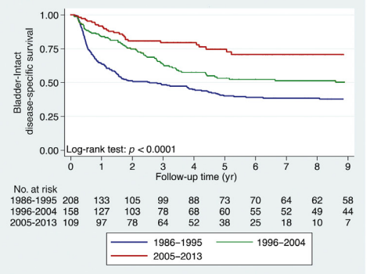
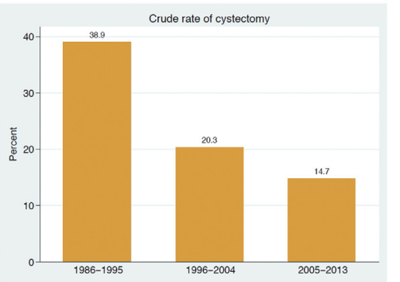
Outcomes of Definitive RT Over Time
Outcomes have improved over time with improved knowledge of appropriate patient selection, and advances in treatment technology and systemic therapy
Giacalone et al Eur Urol 2017
Notes:
Giacalone NJ, Shipley WU, Clayman RH, et al. Long-term Outcomes After Bladder-preserving Tri-modality Therapy for Patients with Muscle-invasive Bladder Cancer: An Updated Analysis of the Massachusetts General Hospital Experience. Eur Urol 2017; 71:952.

Slide 20
Summary of Outcomes of Definitive Chemo-RT
Highest level evidence comes from RTOG pooled analysis of 6 prospective trials, BC2001 trial, MGH experience, Erlangen experience
CR rate 70-85%
No difference in OS for the 10-15% of patients requiring salvage cystectomy
 | Muscle-Invasive Recurrences | Non-Muscle Invasive Recurrences | Distant Metastases | Disease-Specific Survival | Overall Survival | Intact Bladder if Alive
5-year | 13-16% | 26-31% | 31-32% | 56-71% | 48-57% | 71-80%
10-year | 14-18% | 26-36% | 35% | 42-65% | 31-39% | 70-75%
Rodel et al J Clin Oncol 2002
James et al N Engl J Med 2012
Mak et al J Clin Oncol 2014
Efstathiou et al J Clin Oncol 2009
Notes:
Mak, 2014

Slide 21
Comparing Outcomes for Definitive Surgery vs. Radiation

Slide 22
General Principles
Several factors can predict the likely effectiveness of chemo-RT
Understanding these factors is critical to an informed discussion with patients about relative efficacy of surgery vs. RT
Long-term quality-of-life after surgery or RT also varies based on a number of patient- and tumor-related factors
Independent of the risks and benefits of each modality, patients may have strong views about what treatment they prefer
A shared decision-making process that involves the patient and the urologist, radiation oncologist and medical oncologist is most likely to result in patient-centered care

Slide 23
Comparison of Efficacy
No completed randomized trials
5Y-OS is 50-60% for all comers with muscle-invasive bladder cancer in largest cystectomy and chemo-RT series.
Selection bias when comparing survival numbers from non-randomized cohorts of patients
Discordance between clinical (TURBT) staging and pathologic (radical cystectomy) staging.
Radiation patients tend to be older or have more comorbidities, but in modern studies may also be more highly selected based on probability of response.
Giacalone et al Eur Urol 2017
Notes:
Giacalone NJ, Shipley WU, Clayman RH, et al. Long-term Outcomes After Bladder-preserving Tri-modality Therapy for Patients with Muscle-invasive Bladder Cancer: An Updated Analysis of the Massachusetts General Hospital Experience. Eur Urol 2017; 71:952.

Slide 24
Comparison of Efficacy
Meta-analysis (Vashistha, 2016)
Included 8 studies evaluating 9554 patients
No difference in 5- or 10-year OS, DSS, PFS between modalities
Propensity score matched-cohort analysis (Kulkarni, 2017)
112 patients from Mount Sinai
No difference in 5Y-DSS (73% vs. 77%)
Vashistha et al Int J Radiat Oncol Biol Phys 2016
Kulkarni et al J Clin Oncol 2017
Notes:
Vashistha V, Wang H, Mazzone A, et al. Radical Cystectomy Compared to Combined Modality Treatment for Muscle-Invasive Bladder Cancer: A Systematic Review and Meta-Analysis. Int J Radiat Oncol Biol Phys 2017; 97:1002.
Kulkarni GS, Hermanns T, Wei Y, et al. Propensity Score Analysis of Radical Cystectomy Versus Bladder-Sparing Trimodal Therapy in the Setting of a Multidisciplinary Bladder Cancer Clinic. J Clin Oncol 2017; 35:2299.

Slide 25
Comparison of Efficacy
Multi-institutional propensity score matched-cohort analysis (Zlotta et al, GU ASCO 2022)
703 patients who would have been eligible for both RC or TMT
Matched based on age, sex, CIS, clinical T stage (cT2 vs. cT3-4), BMI, hydronephrosis, (neo)adjuvant chemotherapy, smoking history, PS
No significant difference in 5Y-DMFS (73% RC vs. 78% TMT, p=0.07), including in the subgroup of RC patients who received neoadjuvant chemotherapy (p=0.56).
Among TMT patients, no difference in 5Y-CSS for patients requiring salvage cystectomy compared to those not requiring salvage cystectomy.
Zlotta et al, GU ASCO 2022

Slide 26
Morbidity of Radical Cystectomy
Cystectomy Morbidity
Short-term complications in 30-60% (ileus, infection, bleeding, stones)
Serious complications in 3-5% (uretero-enteric anastomotic stricture, intestinal obstruction)
Perioperative mortality is 2-5% (1-2% for well selected younger patients)
Reconstruction Morbidity
Ileal conduit
50% have complications within 5 years and 95% by 15 years (problems with stoma, bowel complications, UTI, urolithiasis, deterioration of renal function)
Orthotopic Neobladder
~10% incontinence rate 1 year out
~10% risk complications over lifetime of patient
Liberman et al Urology 2011
Pieretti et al J Urol 2021
Notes:
Liberman D, Lughezzani G, Sun M, et al. Perioperative mortality is significantly greater in septuagenarian and octogenarian patients treated with radical cystectomy for urothelial carcinoma of the bladder. Urology 2011; 77:660.
Pieretti A, Krasnow R, Drumm M, et al. Complications and Outcomes of Salvage Cystectomy after Trimodality Therapy. J Urol 2021; 206:29.

Slide 27
Morbidity of Chemo-RT
Acute toxicity (from BC2001 randomized trial):
Mild toxicity is common, grade 3-4 toxicity in ~1/3 of patients
Cystitis or urethritis, proctitis, fatigue, diarrhea, hematologic
Late toxicity (from RTOG pooled analysis, median f/u 5.4 yrs):
6% grade 3 GU
2% grade 3 GI
no grade 4-5 GI or GU toxicity
<1% required cystectomy for treatment-related toxicity
Complications of salvage cystectomy after prior chemo-RT:
Comparable to up-front cystectomy
Post-op grade 3+ complications is 13-16% at 90 days, with 2% mortality rate
James et al N Engl J Med 2012 Mak et al J Clin Oncol 2014 Efstathiou et al J Clin Oncol 2009
Notes:
James ND, Hussain SA, Hall E, et al. Radiotherapy with or without chemotherapy in muscle-invasive bladder cancer. N Engl J Med 2012; 366:1477.
Mak RH, Hunt D, Shipley WU, et al. Long-term outcomes in patients with muscle-invasive bladder cancer after selective bladder-preserving combined-modality therapy: a pooled analysis of Radiation Therapy Oncology Group protocols 8802, 8903, 9506, 9706, 9906, and 0233. J Clin Oncol 2014; 32:3801.
Efstathiou JA, Bae K, Shipley WU, Kaufman DS, Hagan MP, Heney NM, Sandler HM.J Clin Oncol. Late pelvic toxicity after bladder-sparing therapy in patients with invasive bladder cancer: RTOG 89-03, 95-06, 97-06, 99-06. 2009 Sep 1;27(25):4055-61.

Slide 28
Radiation-Induced Secondary Malignancy
Rarely develop after bladder RT (<1%)
Reason for low incidence:
Adults are less susceptible than children
Risk is highest 10-30 years post-treatment, and most bladder cancer patients are elderly
In perspective:
Rate of RT-induced malignancy is lower than peri-operative mortality rates

Slide 29
Patient Reported QOL Comparison
MGH Experience (Mak, 2016):
226 patients with cT2-4 MIBC underwent definitive surgery vs. chemo-RT
Median time of questionnaire completion 9 years after RT and 7 years after surgery
Chemo-RT was associated with:
Better global QOL by 9.7 points (100 point scale, 10 point difference considered clinically meaningful)
Better sexual function and body image
No difference in urinary symptom score
Mak et al Int J Radiat Oncol Biol Phys 2016
Notes:
Mak KS, Smith AB, Eidelman A, et al. Quality of Life in Long-term Survivors of Muscle-Invasive Bladder Cancer. Int J Radiat Oncol Biol Phys 2016; 96:1028.

Slide 30
NCCN Guidelines for Curative Bladder Cancer Management

Slide 31
Stage II-IIIA (cT2-4a, N0-1), Cystectomy Candidates
Preferred options (both with category 1 evidence):
Neoadjuvant chemo, followed by radical cystectomy
Concurrent chemo-RT
If not a chemo candidate, surgery alone or radiation alone are options, though both have inferior outcomes.

Slide 32
Stage IIIB-IVa (cN2-3, M1a), Cystectomy Candidate
N2 = multiple pelvic nodes
N3 = common iliac nodes
M1a = lymph node beyond common iliacs
High risk of distant micrometastatic disease
Limiting morbidity from local therapy becomes increasingly important as probability of cure decreases
N2-3 Treatment options:
Systemic therapy → re-evaluate for surgery or chemo-RT
Chemo-RT
M1a Treatment = Systemic therapy → if complete response consider local therapy

Slide 33
Non-Cystectomy Candidates
Medical comorbidities or surgically inoperable (cT4b, pelvic or abdominal wall invasion)
Chemo-RT is preferred local therapy for muscle-invasive disease
Chemo-RT is also an option for patients with Ta, T1 (or Tis) refractory to intravesical therapy
Notes:
German retrospective series (Weiss, 2006, JCO)
141 pts, T1 with high risk feature (G3, CIS, multifocality, >5cm, multiple recurrences) underwent chemo-RT
88% CR rate, 5Y-tumor progression 19%, 5Y-DSS 82%, >80% of survivors preserved bladder, 70% were delighted or pleased with urinary function
RTOG 0926 was a Phase II study of patients with recurrent high-grade T1 NMIBC.
88% free from cystectomy at 3 years
Cumulative Incidence DM at 3 and 5 yrs: 12% and 20%

Slide 34
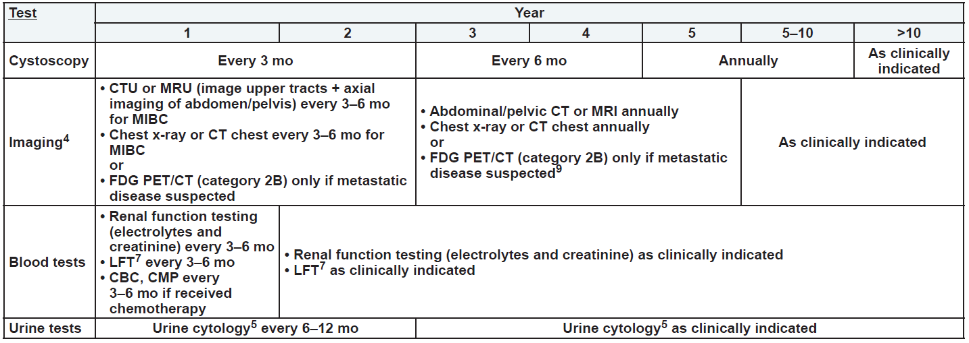
Surveillance After Bladder Preservation
Giving a partial course of chemo-RT to assess for response before boosting the bladder tumor is no longer recommended by NCCN
Notes:
Abbreviations:
CTU = Computed Tomography Urography
MRU = Magnetic Resonance Urography
FDG PET/CT = Fluorodeoxyglucose Positron Emission Tomography/Computed Tomography
MIBC = Muscle-Invasive Bladder Cancer
CBC = Complete Blood Count
CMP = Comprehensive Metabolic Panel
LFT = Liver Function Test

Slide 35
Residual or Recurrent Bladder Tumor After Chemo-RT
Treatment options include:
Intravesical therapy (for Ta, Tis, T1)
Salvage cystectomy
Systemic therapy

Slide 36
Post-Operative Radiation
Though there is less data available evaluating adjuvant RT, it should be considered after radical cystectomy with ileal conduit for:
Positive margins
pT3b-4
pN1-2
Extranodal extension
Target volume = areas at risk for microscopic disease (e.g. cystectomy bed, pelvic nodes)

Slide 37
Take Home Points
Definitive chemo-RT is a valid alternative to radical cystectomy in many patients with bladder cancer.
Patient selection is critical to optimizing the therapeutic ratio and adequately informing patients of their treatment options.
Multidisciplinary input can help promote patient-centered decision making.

Slide 38
References
Arslan B, Bozkurt IH, Yonguc T, et al. Clinical features and outcomes of nontransitional cell carcinomas of the urinary bladder: Analysis of 125 cases. Urol Ann 2015; 7:177.
Choudhury A, Porta N, Hall E, et al. Hypofractionated radiotherapy in locally advanced bladder cancer: an individual patient data meta-analysis of the BC2001 and BCON trials. Lancet Oncol 2021; 22:246.
Clayman RH, Shipley WU, Galland-Girodet S, et al. Outcomes of selective bladder preservation in the elderly treated with conservative surgery and chemoradiation. Int J Radiat Oncol Biol Phys 2013; 87:S83.
Efstathiou JA, Spiegel DY, Shipley WU, et al. Long-term outcomes of selective bladder preservation by combined-modality therapy for invasive bladder cancer: the MGH experience. Eur Urol 2012; 61:705.
Efstathiou JA, Bae K, Shipley WU, et al. Late pelvic toxicity after bladder-sparing therapy in patients with invasive bladder cancer: RTOG 89-03, 95-06, 97-06, 99-06. J Clin Oncol 2009; 27:4055.
Giacalone NJ, Shipley WU, Clayman RH, et al. Long-term Outcomes After Bladder-preserving Tri-modality Therapy for Patients with Muscle-invasive Bladder Cancer: An Updated Analysis of the Massachusetts General Hospital Experience. Eur Urol 2017; 71:952.
James ND, Hussain SA, Hall E, et al. Radiotherapy with or without chemotherapy in muscle-invasive bladder cancer. N Engl J Med 2012; 366:1477.
Krasnow RE, Drumm M, Roberts HJ, et al. Clinical Outcomes of Patients with Histologic Variants of Urothelial Cancer Treated with Trimodality Bladder-sparing Therapy. Eur Urol 2016.
Kulkarni GS, Hermanns T, Wei Y, et al. Propensity Score Analysis of Radical Cystectomy Versus Bladder-Sparing Trimodal Therapy in the Setting of a Multidisciplinary Bladder Cancer Clinic. J Clin Oncol 2017; 35:2299.
Liberman D, Lughezzani G, Sun M, et al. Perioperative mortality is significantly greater in septuagenarian and octogenarian patients treated with radical cystectomy for urothelial carcinoma of the bladder. Urology 2011; 77:660.
Mak RH, Hunt D, Shipley WU, et al. Long-term outcomes in patients with muscle-invasive bladder cancer after selective bladder-preserving combined-modality therapy: a pooled analysis of Radiation Therapy Oncology Group protocols 8802, 8903, 9506, 9706, 9906, and 0233. J Clin Oncol 2014; 32:3801.
Mak KS, Smith AB, Eidelman A, et al. Quality of Life in Long-term Survivors of Muscle-Invasive Bladder Cancer. Int J Radiat Oncol Biol Phys 2016; 96:1028.
Perdonà S, Autorino R, Damiano R, et al. Bladder-sparing, combined-modality approach for muscle-invasive bladder cancer: a multi-institutional, long-term experience. Cancer 2008; 112:75.
Pieretti A, Krasnow R, Drumm M, et al. Complications and Outcomes of Salvage Cystectomy after Trimodality Therapy. J Urol 2021; 206:29.
Rödel C, Grabenbauer GG, Kühn R, et al. Combined-modality treatment and selective organ preservation in invasive bladder cancer: long-term results. J Clin Oncol 2002; 20:3061.
Shipley WU, Winter KA, Kaufman DS, et al. Phase III trial of neoadjuvant chemotherapy in patients with invasive bladder cancer treated with selective bladder preservation by combined radiation therapy and chemotherapy: initial results of Radiation Therapy Oncology Group 89-03. J Clin Oncol 1998; 16:3576.
Vashistha V, Wang H, Mazzone A, et al. Radical Cystectomy Compared to Combined Modality Treatment for Muscle-Invasive Bladder Cancer: A Systematic Review and Meta-Analysis. Int J Radiat Oncol Biol Phys 2017; 97:1002.
Zapatero A, Martin de Vidales C, Arellano R, et al. Updated results of bladder-sparing trimodality approach for invasive bladder cancer. Urol Oncol 2010; 28:368.
Zietman AL, Sacco D, Skowronski U, et al. Organ conservation in invasive bladder cancer by transurethral resection, chemotherapy and radiation: results of a urodynamic and quality of life study on long-term survivors. J Urol 2003; 170:1772.

Slide 39
Thank You!

