Slide 1
Radiation Therapy for Endometrial Cancer: An ASTRO Clinical Practice Guideline Developed in collaboration with the American Brachytherapy Society, American Society of Clinical Oncology and the Society of Gynecologic Oncology Endorsed by the Canadian Society of Radiation Oncology, European Society for Radiotherapy and Oncology, and the Royal Australian and New Zealand College of Radiologists

Slide 2
Citation
This slide set is adapted from the Radiation Therapy for Endometrial Cancer Guideline to be published in the January/February 2023 issue of
Practical Radiation Oncology (PRO)
Web posted link:
(https://www.practicalradonc.org/article/S1879-8500(22)00273-9/fulltext)
The full-text guideline is also available on the ASTRO Web site: www.astro.org

Slide 3
Guideline Task Force
Chairs
Beth A. Erickson, MD
Matthew M. Harkenrider, MD
Members
Nadeem Abu-Rustum, MD
Kevin Albuquerque, MD
Kristin Bradley, MD
Ellen Dolinar
Corinne M. Doll, MD
Mohamed Elshaikh, MD
Melissa A. Frick, MD
Paola A. Gehrig, MD
Kathy Han, MD
Lara Hathout, MD
Ellen Jones, MD
Ann Klopp, MD, PHD
Firas Mourtada, PhD
Gita Suneja, MD
Alexi Wright, MD, MPH
Catheryn Yashar, MD

Slide 4
Guideline Task Force
Chairs
Beth A. Erickson, MD
Matthew M. Harkenrider, MD
Members
Nadeem Abu-Rustum, MD
Kevin Albuquerque, MD
Kristin Bradley, MD
Ellen Dolinar
Corinne M. Doll, MD
Mohamed Elshaikh, MD
Melissa A. Frick, MD
Paola A. Gehrig, MD
Kathy Han, MD
Lara Hathout, MD
Ellen Jones, MD
Ann Klopp, MD, PHD
Firas Mourtada, PhD
Gita Suneja, MD
Alexi Wright, MD, MPH
Catheryn Yashar, MD

Slide 5
Task Force Composition
Radiation oncology
Drawn from academic and private/community practices
Includes a RO resident and a member of the Guidelines Subcommittee
Related specialties
Medical (ASCO) and gynecological oncology (SGO)*
Medical physics
Patient representative
*Representatives nominated by specialty societies.

Slide 6
Introduction to Guideline
In 2014, ASTRO published a guideline on postoperative radiation therapy for endometrial cancer
Since then, several clinical trials were published across stages of endometrial cancer that impact the role of adjuvant therapy
Surgical lymph node staging for endometrial cancer patients has evolved away from lymphadenectomy towards sentinel lymph node mapping with pathologic ultrastaging
Molecular profiling of endometrial cancer is rapidly being utilized and demonstrates to be prognostic and likely predictive, yet the impact on use of adjuvant therapy at the present time remains investigational
With so many evolving topics that impact the use of adjuvant therapy in endometrial cancer, updating the guideline was justified and approved

Slide 7
Guideline Scope
The guideline is focused on the adjuvant management of endometrial cancer and emphasizes the evolving impact that uterine risk factors and disease stage (KQ1-4), surgical staging procedures (KQ5), and molecular tumor profiling (KQ6) have on adjuvant therapy.
It discusses the indications for adjuvant VBT, EBRT, and systemic therapy and includes sequencing of these therapies, and the impact that surgical nodal staging procedures and molecular tumor profiling decisions may have regarding adjuvant therapy.

Slide 8
Guideline Scope – Racial Disparities
Racial disparities in endometrial cancer are noted at all stages of diagnosis and treatment. Black patients:
have a higher incidence of high-risk histologies
are diagnosed at more advanced cancer stage
are less likely to receive timely surgery and adjuvant therapy
have poorer survival irrespective of stage or histology
Disparities are routinely multifactorial, but social determinants of health include:
insurance coverage
access to specialty care
financial toxicity
racism
Healthcare equality is paramount to improve receipt of standard of care therapy and patient outcomes, but the complexity of this topic and implementation of solutions is beyond the scope of this guideline.

Slide 9
Systematic Review
Ovid MEDLINE® search dates:
January 2000 – August 2021 (RCTs, meta-analyses, and prospective studies)
January 2015 – August 2021 (retrospective studies)
Outcomes: Endometrial carcinoma control, acute and late toxicity, quality of life
Inclusions: Age ≥18 years, nonmetastatic endometrial carcinoma (stage I-IVA)
Exclusions: metastatic disease; salvage therapy/reirradiation; lack of clinical outcomes, non-English, case report, not relevant to KQs
Retrospective studies were excluded for KQ1 (indications for adjuvant RT)
3414 studies identified → 578 abstracts retrieved → 196 articles included and abstracted into evidence tables

Slide 10
Rating Strength of Recommendation
ASTRO’s recommendations are based on evaluation of multiple factors including the quality of evidence (QoE) and panel consensus, which, among other considerations, inform the strength of recommendation. QoE is based on the body of evidence available for a particular key question and includes consideration of number of studies, study design, adequacy of sample sizes, consistency of findings across studies, and generalizability of samples, settings, and treatments.
Strength of Recommendation | Definition | Overall QoE Grade | Recommendation Wording
Strong | Benefits clearly outweigh risks and burden, or risks and burden clearly outweigh benefits. All or almost all informed people would make the recommended choice. | Any (usually high, moderate, or expert opinion) | “Recommend/ Should”
Conditional | Benefits are finely balanced with risks and burden or appreciable uncertainty exists about the magnitude of benefits and risks. Most informed people would choose the recommended course of action, but a substantial number would not. A shared decision-making approach regarding patient values and preferences is particularly important. | Any (usually moderate, low, or expert opinion) | “Conditionally Recommend”
ASTRO Methodology Manual: https://www.astro.org/ASTRO/media/ASTRO/Patient%20Care%20and%20Research/PDFs/ASTRO_GuidelineMethodology.pdf

Slide 11
Rating Quality of Evidence
Overall QoE Grade | Type/Quality of Study | Evidence Interpretation
High | 2 or more well-conducted and highly generalizable RCTs or meta-analyses of such trials. | The true effect is very likely to lie close to the estimate of the effect based on the body of evidence.
Moderate | 1 well-conducted and highly generalizable RCT or a meta-analysis of such trials OR 2 or more RCTs with some weaknesses of procedure or generalizability OR 2 or more strong observational studies with consistent findings. | The true effect is likely to be close to the estimate of the effect based on the body of evidence, but it is possible that it is substantially different.
Low | 1 RCT with some weaknesses of procedure or generalizability OR 1 or more RCTs with serious deficiencies of procedure or generalizability or extremely small sample sizes OR 2 or more observational studies with inconsistent findings, small sample sizes, or other problems that potentially confound interpretation of data. | The true effect may be substantially different from the estimate of the effect. There is a risk that future research may significantly alter the estimate of the effect size or the interpretation of the results.
Expert Opinion† | Consensus of the panel based on clinical judgement and experience, due to absence of evidence or limitations in evidence. | Strong consensus (≥90%) of the panel guides the recommendation despite insufficient evidence to discern the true magnitude and direction of the net effect. Further research may better inform the topic.
Notes:
†A lower quality of evidence, including expert opinion, does not imply that the recommendation is conditional. Many important clinical questions addressed in guidelines do not lend themselves to clinical trials but there still may be consensus that the benefits of a treatment or test clearly outweigh its risks and burden.
Note: ASTRO’s methodology allows for use of implementation remarks meant to convey clinically practical information that may enhance the interpretation and application of the recommendation. While each recommendation is graded according to recommendation strength and QoE, these grades should not be assumed to extend to the implementation remarks.

Slide 12
Consensus Methodology
Modified Delphi approach
Task force members rated their level of agreement for each recommendation via consensus survey
5-point Likert scale from “strongly disagree” to “strongly agree”
Consensus defined using pre-specified threshold of ≥75% (≥90% for expert opinion recommendations) agreement
Recommendations for which consensus is not achieved are removed or are revised and resurveyed.
Recommendations achieving consensus edited with substantive changes after the first round are also resurveyed.

Slide 13
KQ 1: What are the indications for adjuvant RT in patients with endometrial cancer?

Slide 14
KQ 1: Indications for adjuvant RT
KQ1 Recommendations | Strength of Recommendation | Quality of Evidence
For patients with FIGO stage IA, grade 1 or 2 endometrioid carcinoma without intermediate* or high-risk factors,† adjuvant RT is not recommended. | Strong | Moderate
For patients without high-risk factors† and with either FIGO stage IB, grade 1 or 2 endometrioid carcinoma or myoinvasive FIGO stage IA, grade 3 endometrioid carcinoma, vaginal brachytherapy is recommended. | Strong | Moderate
For patients with high-risk factors† and who have FIGO stage IB, grade 1 or 2 or myoinvasive FIGO stage IA, grade 3 endometrioid carcinoma, EBRT is conditionally recommended. | Conditional | Moderate
For patients with FIGO stage IB, grade 3 or FIGO stage II endometrioid carcinoma, EBRT is recommended. | Strong | High
* Intermediate-risk factors include age ≥60 years, focal LVSI.
† High-risk factors include substantial LVSI, especially without surgical nodal staging.

Slide 15
KQ 1: Indications for adjuvant RT
KQ1 Recommendations (continued) | Strength of Recommendation | Quality of Evidence
For patients with myoinvasive FIGO stage IA high-risk histology‡ endometrial carcinoma, vaginal brachytherapy with or without chemotherapy is conditionally recommended. | Conditional | Low
For patients with FIGO stage IB or II high-risk histology‡ endometrial carcinoma, EBRT with chemotherapy is conditionally recommended. | Conditional | Moderate
For patients with FIGO stage III or IVA endometrial carcinoma of any histology, EBRT with chemotherapy is conditionally recommended to decrease locoregional recurrence. | Conditional | Moderate
‡ High-risk histologies include serous carcinoma, clear cell carcinoma, carcinosarcoma, mixed histology carcinoma, dedifferentiated carcinoma, or undifferentiated carcinoma.

Slide 16
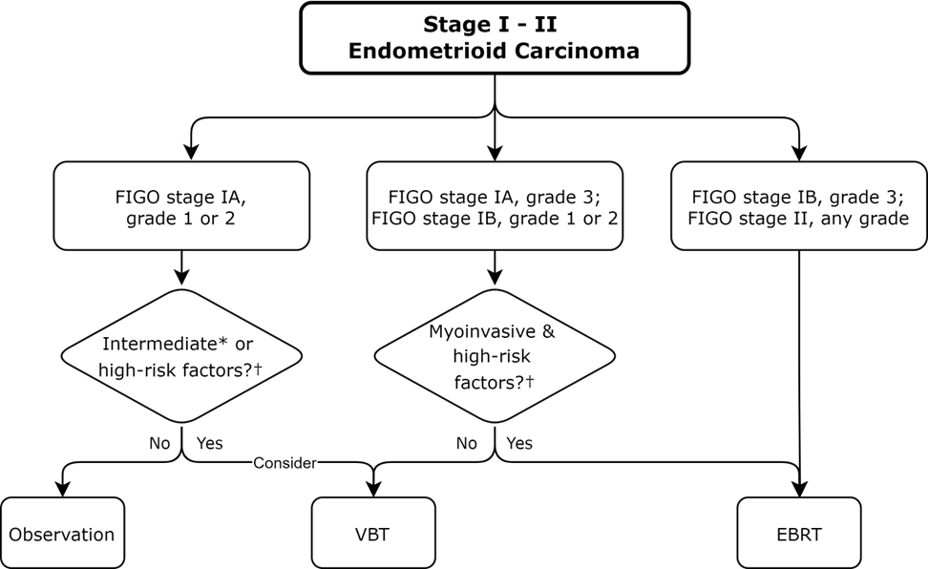
Figure 1. Stage I-II Endometroid Carcinoma
* Intermediate-risk factors include age ≥60 years and focal LVSI.
† High-risk factors include substantial LVSI, especially without surgical nodal staging.

Slide 17
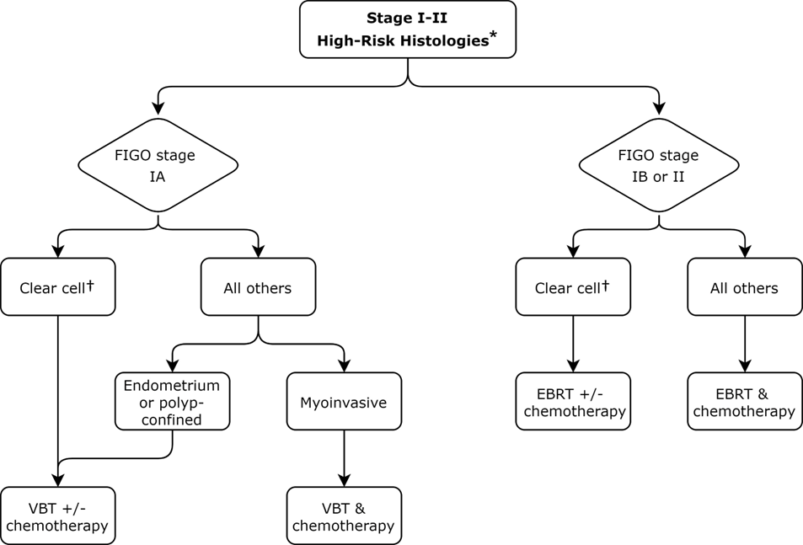
Figure 2. High-Risk Histologies
* Serous carcinoma, clear cell carcinoma, carcinosarcoma, mixed histology carcinoma, dedifferentiated or undifferentiated carcinoma.
† Molecular profiling may influence alternate treatment pathway selection.

Slide 18
KQ 2: What are the appropriate techniques, target volumes, dose-fractionation regimens, and normal tissue constraints for patients receiving adjuvant RT for endometrial cancer?

Slide 19
KQ 2: RT Techniques, target volumes, dose-fractionation regimens, and normal tissue constraints
KQ2 Recommendations | Strength of Recommendation | Quality of Evidence
For patients with endometrial carcinoma undergoing adjuvant EBRT, IMRT is recommended to reduce acute and late toxicity. | Strong | Moderate
For patients with endometrial carcinoma undergoing adjuvant EBRT using IMRT, a vaginal ITV is recommended for treatment planning with daily IGRT for treatment verification. | Strong | Moderate
For patients with endometrial carcinoma undergoing adjuvant EBRT, a dose of 4500-5040 cGy at 180-200 cGy per fraction is recommended. | Strong | Moderate

Slide 20
KQ 2: RT Techniques, target volumes, dose-fractionation regimens, and normal tissue constraints
KQ2 Recommendations (continued) | Strength of Recommendation | Quality of Evidence
For patients with endometrial carcinoma undergoing adjuvant vaginal brachytherapy alone, treating the proximal third to half of the vagina (typically 3-5 cm) is recommended. | Strong | Moderate
For patients with endometrial carcinoma with cervical stromal involvement and/or close or positive vaginal margins, postoperative vaginal brachytherapy as a boost after EBRT is conditionally recommended. | Conditional | Expert Opinion

Slide 21
Table 5. TIME-C planning aims for adjuvant treatment of endometrial cancer
Organ at risk | Ideal dose limit | Variance allowed
Bowel Space | Up to 30% receives 4000 cGy | No more than 70% receives 4000 cGy
Rectum | Up to 80% receives 4000 cGy | <100% receives 4000 cGy
Bladder | Up to 35% receives 4500 cGy | No more than 70% receives 4500 cGy
Bone Marrow | Up to 37% receives 4000 cGy Up to 90% receives 1000 cGy | No more than 60% receives 4000 cGy No more than 90% receives 2500 cGy
Abbreviations: IMRT = intensity modulated radiation therapy; TIME-C = RTOG 1203, Standard vs. IMRT Pelvic Radiation for Post-Operative Treatment of Endometrial and Cervical Cancer.
Planning aims used in RTOG 1203 (TIME-C) trial protocol.⁵⁴

Slide 22
KQ 3: What are the indications for systemic therapy in patients with nonmetastatic endometrial cancer?

Slide 23
KQ 3: Indications for systemic therapy
KQ3 Recommendations | Strength of Recommendation | Quality of Evidence
For patients with FIGO stage I-II endometroid adenocarcinoma, systemic therapy is not recommended. | Strong | High
For patients with myoinvasive FIGO stage I-II endometrial cancer with high-risk histologies,* systemic therapy is conditionally recommended. | Conditional | Moderate
For patients with FIGO stage III-IVA endometrial cancer of any histology, adjuvant systemic therapy is recommended. | Strong | High
* High-risk histologies include serous carcinoma, clear cell carcinoma, carcinosarcoma, mixed histology carcinoma, dedifferentiated or undifferentiated carcinoma.

Slide 24
KQ 4: What is the appropriate sequencing of systemic therapy with RT in patients with endometrial cancer?

Slide 25
KQ 4: Sequencing of systemic therapy with RT
KQ4 Recommendations | Strength of Recommendation | Quality of Evidence
For patients with FIGO stage III-IVA endometrial cancer receiving RT, EBRT with concurrent chemotherapy followed by adjuvant chemotherapy is conditionally recommended. | Conditional | Moderate
For patients with FIGO stage III-IVA endometrial cancer receiving RT, sequential chemotherapy followed by RT is conditionally recommended. | Conditional | Expert Opinion
For patients with FIGO stage I-II endometrial cancer with high-risk histologies* receiving EBRT and chemotherapy, either sequential or concurrent treatment is recommended. | Strong | Moderate
For patients with endometrial cancer receiving vaginal brachytherapy and chemotherapy, either sequential or concurrent treatment is recommended. Implementation remark: It is preferrable not to administer brachytherapy on the same day as chemotherapy. | Strong | Expert Opinion
* High-risk histologies include serous carcinoma, clear cell carcinoma, carcinosarcoma, mixed histology carcinoma, dedifferentiated or undifferentiated carcinoma.

Slide 26
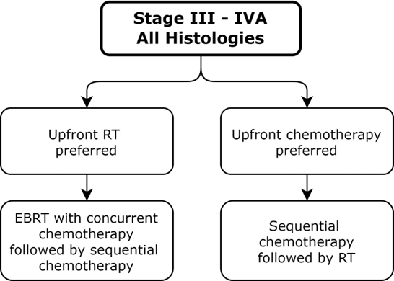
Figure 3. Stage III-IVA Endometroid Carcinoma

Slide 27
KQ 5: How should the performance of, and type of, lymph node assessment influence adjuvant RT decisions in patients with endometrial cancer?

Slide 28
KQ 5: Adjuvant RT decisions based on lymph node assessment
KQ5 Recommendations | Strength of Recommendation | Quality of Evidence
For patients with endometrial cancer, use of bilateral sentinel lymph node mapping is recommended over standard pelvic lymphadenectomy, to accurately detect subclinical nodal metastases, decrease morbidity, and guide selection of adjuvant therapy. | Strong | Moderate
For patients who have undergone hysterectomy and no pelvic nodal assessment, surgical restaging or pelvic RT is conditionally recommended for any myoinvasion with LVSI or deep myoinvasion. | Conditional | Expert Opinion
For patients who have undergone hysterectomy and pelvic nodal assessment with isolated tumor cells present, it is conditionally recommended that uterine risk factors be used to guide adjuvant therapy. | Conditional | Low
For patients who have undergone hysterectomy and pelvic nodal assessment with nodal micrometastases or macrometastases (FIGO stage IIIC), adjuvant therapy is recommended. | Strong | High

Slide 29
KQ 6: How should molecular markers influence adjuvant RT and systemic therapy decisions in patients with nonmetastatic endometrial cancer?

Slide 30
KQ 6: Molecular marker influence on adjuvant RT and systemic therapy decisions
KQ6 Recommendations | Strength of Recommendation | Quality of Evidence
For patients with endometrial cancer considering adjuvant therapy, molecular testing is recommended. Implementation remarks: Immunohistochemistry is needed to assess for mutations in mismatch repair and TP53 genes POLE sequencing can be used to identify hypermutated tumors | Strong | Moderate
For patients with myoinvasive FIGO stage IA-IIIC2 TP53 mutated endometrial cancer, chemotherapy and RT are conditionally recommended. | Conditional | Low
For patients with FIGO stage IB-IIIC2 mismatch repair deficiency endometrial cancer, RT without chemotherapy is conditionally recommended. | Conditional | Low
For patients with FIGO stage IB-IIIC2 POLE mutant tumors, RT without chemotherapy is conditionally recommended. | Conditional | Low

Slide 31
Key Take Away Messages
The choice of EBRT versus VBT in FIGO stage I endometrial cancer should depend on the performance and method of lymph node assessment and the uterine risk factors including the degree of LVSI and histology, and patient age.
EBRT decreases the risk of locoregional recurrence, especially in patients with FIGO stage I disease with high-risk features or high-risk histologies, FIGO stage II disease, and FIGO stage III-IVA disease.
When EBRT is indicated, the use of IMRT is associated with improved patient-reported outcomes and acute and late toxicity. Creation of a vaginal ITV with daily image-guidance ensures accurate daily treatment delivery.

Slide 32
Key Take Away Messages
Systemic chemotherapy should be effectively sequenced with radiation therapy in patients with high-risk histologies of all stages and in FIGO stage III-IVA disease of all histologies to decrease distant and locoregional recurrence, respectively.
SLN mapping with pathologic ultrastaging improves the accuracy of surgical staging and results in less morbidity than pelvic lymphadenectomy. Adjuvant therapy should be recommended based on the clinical and uterine risk factors, performance of a nodal assessment, and results of that nodal assessment.
For patients with endometrial cancer considering adjuvant therapy, molecular profiling is recommended and may be used to guide adjuvant therapy.

