Slide 1
Radiation Therapy for Cervical Cancer: An ASTRO Clinical Practice Guideline Developed in collaboration with the American Brachytherapy Society, American Society of Clinical Oncology and the Society of Gynecologic Oncology Endorsed by the American Brachytherapy Society (ABS), Canadian Association of Radiation Oncology (CARO), European Society of Radiotherapy (ESTRO), Royal Australian and New Zealand College of Radiologists (RANZCR), and the Society of Gynecologic Oncology (SGO)

Slide 2
Citation
This slide set is adapted from the
Radiation Therapy for Cervical Cancer Guideline.
E-Published in May 2020: https://doi.org/10.1016/j.prro.2020.04.002
Print Publishing in the July/August 2020 issue of
Practical Radiation Oncology (PRO)

Slide 3
Guideline Task Force
Chairs
Akila N. Viswanathan, MD, MPH
Junzo Chino, MD
Members
Christina M. Annunziata, MD, PhD
Sushil Beriwal, MD, MBA
Lisa Bradfield
Beth A. Erickson, MD
Emma C. Fields, MD
KathrynJane Fitch, PhD
Matthew M. Harkenrider, MD
Christine H. Holschneider, MD
Mitchell Kamrava, MD
Eric Leung, MD
Lilie L. Lin, MD
Jyoti S. Mayadev, MD
Marc Morcos, MS
Chika Nwachukwu, MD, PhD
Daniel Petereit, MD

Slide 4
Task Force Composition
Radiation oncology
Drawn from academic practice and private or community practice
Include a RO resident and a member of the Guidelines Subcommittee
Related specialties/disciplines
Radiation oncology
Gynecologic oncology
Medical oncology
Medical physicist
Non-RO physicians are nominated by their respective societies
Patient representative

Slide 5
Introduction to Guideline
Despite advances in screening and prevention, cervical cancer remains a significant source of morbidity and mortality worldwide
Effective treatment is often challenging due to local spread within the pelvis, in close proximity to critical normal tissues
Recent advances offer opportunities to improve clinical results
Surgical technique
External radiation therapy (RT)
Brachytherapy
Chemotherapy
ASTRO commissioned this guideline to examine the evidence, and make recommendations for 5 key clinical questions (KQ)

Slide 6
Guideline Scope
Curative management of invasive carcinomas of the uterine cervix
Squamous cell carcinomas
Adenocarcinomas
Focus on management with RT and its indications, techniques, and outcomes.
Additionally covers therapies that modify the efficacy of RT when used concurrently or in sequence (eg, CT and/or surgery).

Slide 7
Systematic Review
Ovid MEDLINE® - Search time period 1/1993 – 12/2018
MeSH terms and text words used, supplemented with hand searches
Outcomes: Overall and disease-free survival; local and regional control; toxicity; and quality of life (endpoint depending on KQ)
Inclusion: Adult women with cervical cancer
- Minimum study patient numbers varied by KQ and type of study (see full guideline for details)
Exclusions:
Metastatic and recurrent disease
Preclinical/non-human studies
studies available in abstract only
health economics or cost analysis studies
review articles, and comments or editorials
Literature search started with 2032 citations → 596 abstracts retrieved → 164 articles included and abstracted into evidence tables

Slide 8
Rating Strength of Recommendation
ASTRO’s recommendations are based on evaluation of multiple factors including the quality of evidence (QoE), individual study quality, and panel consensus, all of which inform the strength of recommendation. QoE is based on the body of evidence available for a particular key question and includes consideration of number of studies, study design, adequacy of sample sizes, consistency of findings across studies, and generalizability of samples, settings, and treatments.
Strength of Recommendation | Definition | Overall QoE Grade | Recommendation Wording
Strong | Benefits clearly outweigh risks and burden, or risks and burden clearly outweigh benefits. All or almost all informed people would make the recommended choice. | Any (usually high, moderate, or expert opinion) | “Recommend/ Should”
Conditional | Benefits are finely balanced with risks and burden or appreciable uncertainty exists about the magnitude of benefits and risks. Most informed people would choose the recommended course of action, but a substantial number would not. A shared decision-making approach regarding patient values and preferences is particularly important. | Any (usually moderate, low, or expert opinion) | “Conditionally Recommend”

Slide 9
Rating Quality of Evidence
Overall QoE Grade | Type/Quality of Study | Evidence Interpretation
High | 2 or more well-conducted and highly generalizable RCTs or meta-analyses of such trials. | The true effect is very likely to lie close to the estimate of the effect based on the body of evidence.
Moderate | 1 well-conducted and highly generalizable RCT or a meta-analysis of such trials OR 2 or more RCTs with some weaknesses of procedure or generalizability OR 2 or more strong observational studies with consistent findings. | The true effect is likely to be close to the estimate of the effect based on the body of evidence, but it is possible that it is substantially different.
Low | 1 RCT with some weaknesses of procedure or generalizability OR 1 or more RCTs with serious deficiencies of procedure or generalizability or extremely small sample sizes OR 2 or more observational studies with inconsistent findings, small sample sizes, or other problems that potentially confound interpretation of data. | The true effect may be substantially different from the estimate of the effect. There is a risk that future research may significantly alter the estimate of the effect size or the interpretation of the results.
Expert Opinion† | Consensus of the panel based on clinical judgment and experience, due to absence of evidence or limitations in evidence. | Strong consensus (≥90%) of the panel guides the recommendation despite insufficient evidence to discern the true magnitude and direction of the net effect. Further research may better inform the topic.
Notes:
†A lower quality of evidence, including expert opinion, does not imply that the recommendation is conditional. Many important clinical questions addressed in guidelines do not lend themselves to clinical trials but there still may be consensus that the benefits of a treatment or test clearly outweigh its risks and burden.

Slide 10
Consensus Methodology
Modified Delphi approach
Task force members rated their agreement with each recommendation using an online consensus survey
5-point Likert scale from “strongly disagree” to “strongly agree”
Consensus defined using pre-specified threshold of ≥75% (≥90% for expert opinion recommendations) agreement
Recommendations for which consensus is not achieved are removed or are revised and re-surveyed.
Recommendations achieving consensus edited with substantive changes after peer and public review are also re-surveyed.

Slide 11
KQ 1: Following primary surgery for cervical cancer, when is it appropriate to deliver postoperative RT with or without systemic therapy?

Slide 12
KQ 1: Following primary surgery for cervical cancer, when is it appropriate to deliver postoperative RT with or without systemic therapy?
KQ1 Recommendations | Strength of Recommendation | Quality of Evidence
1. For women undergoing surgery for cervical cancer who have high surgicopathologic risk factors, adjuvant EBRT and concurrent platinum-based chemotherapy is recommended. Implementation Remark: High-risk factors include positive margin(s) or positive lymph node(s) or extension into the parametrial tissue. | Strong | High

Slide 13
KQ 1: Following primary surgery for cervical cancer, when is it appropriate to deliver postoperative RT with or without systemic therapy?
KQ1 Recommendations | Strength of Recommendation | Quality of Evidence
2. For women with cervical cancer and intermediate-risk factors, adjuvant EBRT is recommended to decrease locoregional recurrence. Implementation remark: Intermediate-risk factors include*: LVSI plus deep one-third cervical stromal invasion with any tumor size LVSI plus middle one-third stromal invasion and tumor size ≥2 cm LVSI plus superficial one-third stromal invasion and tumor size ≥5 cm No LVSI but deep or middle one-third stromal invasion plus tumor size ≥4 cm * The original GOG 92 protocol estimated tumor size based on palpation, however, estimation based on pathologic and/or MRI findings are an acceptable substitute. | Strong | High

Slide 14
KQ 2: When is it appropriate to deliver definitive RT with and without systemic therapy? When is it appropriate to perform a hysterectomy after RT for cervical cancer?

Slide 15
KQ 2: When is it appropriate to deliver definitive RT with and without systemic therapy? When is it appropriate to perform a hysterectomy after RT for cervical cancer?
KQ2 Recommendations | Strength of Recommendation | Quality of Evidence
1. For women with FIGO stage IB3-IVA* squamous cell or adenocarcinoma of the cervix, RT with concurrent platinum-based chemotherapy is recommended for definitive treatment. Implementation remark: Recommended dose for cisplatin is 40 mg/m² weekly for 5 to 6 cycles. | Strong | High
* Stage IIA1 cancers may be managed with radical hysterectomy in well-selected (eg, non-bulky, with limited vaginal involvement) cases.

Slide 16
KQ 2: When is it appropriate to deliver definitive RT with and without systemic therapy? When is it appropriate to perform a hysterectomy after RT for cervical cancer?
KQ2 Recommendations | Strength of Recommendation | Quality of Evidence
2. For women with FIGO stage IB3-IVA cervical cancer, a planned adjuvant hysterectomy after RT or chemoradiation is not recommended.† | Strong | High
3. In women with FIGO stage IA1-IB2 that are deemed medically inoperable, RT with or without chemotherapy is conditionally recommended. | Conditional | Expert Opinion
† In the setting of biopsy-proven gross residual disease after point-A based dose specification for brachytherapy, surgery may be an option.

Slide 17
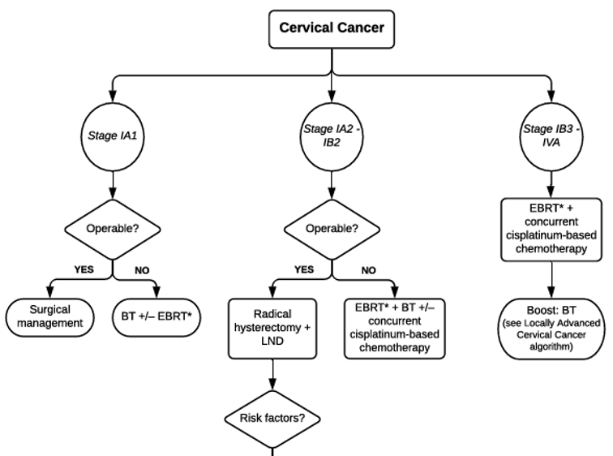
Cervical cancer algorithm

Slide 18
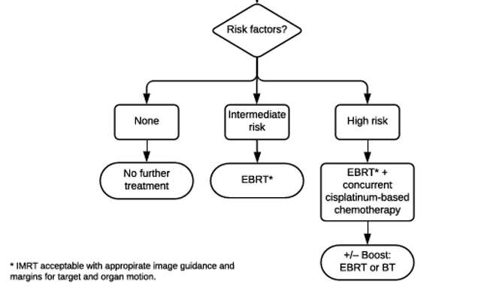
Cervical cancer algorithm (con’t)

Slide 19
KQ 3: For patients receiving definitive or postoperative RT for cervical cancer, when is it appropriate to deliver intensity-modulated radiation therapy (IMRT)?

Slide 20
KQ 3: For patients receiving definitive or postoperative RT for cervical cancer, when is it appropriate to deliver IMRT?
KQ3 Recommendations | Strength of Recommendation | Quality of Evidence
In women with cervical cancer treated with postoperative RT with or without chemotherapy, IMRT is recommended to decrease acute and chronic toxicity. | Strong | Moderate (acute)
 |  | Low (chronic)
2. In women with cervical cancer treated with definitive RT with or without chemotherapy, IMRT is conditionally recommended to decrease acute and chronic toxicity. | Conditional | Moderate (acute)
 |  | Moderate (chronic)

Slide 21
KQ 4: For patients receiving definitive or postoperative RT for cervical cancer, when is brachytherapy indicated?

Slide 22
KQ 4: For patients receiving definitive or postoperative RT for cervical cancer, when is brachytherapy indicated?
KQ4 Recommendations | Strength of Recommendation | Quality of Evidence
For women receiving definitive RT for intact cervical cancer, brachytherapy is recommended. | Strong | Moderate
For women with cervical cancer receiving postoperative whole pelvis radiation, a brachytherapy boost is conditionally recommended in the presence of positive margin(s). Implementation remark: In patients expected to have a prolonged survival, higher doses may be appropriate. | Conditional | Low

Slide 23
KQ 5: For patients receiving definitive RT for cervical cancer, what is the optimal dose/fractionation schedule, imaging, and technique for the delivery of brachytherapy?

Slide 24
KQ 5: For patients receiving definitive RT for cervical cancer, what is the optimal dose/fractionation schedule, imaging, and technique for the delivery of brachytherapy?
KQ5 Recommendations | Strength of Recommendation | Quality of Evidence
Optimal imaging and technique for the delivery of brachytherapy
For women receiving brachytherapy for cervical cancer, intra-procedure imaging is recommended if available. | Strong | Low
2. For women receiving brachytherapy for cervical cancer, MRI or CT-based planning to a volume-based prescription is recommended. | Strong | Moderate
3. For women receiving brachytherapy for cervical cancer, if volume-based planning cannot be performed, then 2-D/point-based planning is recommended. | Strong | Moderate

Slide 25
KQ 5: For patients receiving definitive RT for cervical cancer, what is the optimal dose/fractionation schedule, imaging, and technique for the delivery of brachytherapy?
KQ5 Recommendations | Strength of Recommendation | Quality of Evidence
Optimal dose/fractionation schedule for the delivery of brachytherapy
4. For women treated with definitive RT for cervical cancer, the total EQD2₁₀ of EBRT and brachytherapy should be ≥8000 cGy. (Table 9) | Strong | Moderate
5. For women with cervical cancer receiving volume-based brachytherapy, HR-CTV D90 greater than or equal to prescription dose (≥8000 cGy) is conditionally recommended, with careful consideration of normal tissue constraints. (Table 10) Implementation remark: For patients with poor response or large-volume (>4 cm) disease, D90 ≥8500 cGy is reasonable. Utilization of a hybrid intracavitary/interstitial technique can help improve the dose distribution when not achieving appropriate target and/or OAR dose constraints with an intracavitary alone approach. | Conditional | Moderate

Slide 26
KQ 5: For patients receiving definitive RT for cervical cancer, what is the optimal dose/fractionation schedule, imaging, and technique for the delivery of brachytherapy?
KQ5 Recommendations | Strength of Recommendation | Quality of Evidence
Optimal OAR constraints of brachytherapy
6. In women treated with brachytherapy for intact cervical cancer, volumetric contouring of the OARs and use of appropriate dose constraints are recommended. | Strong | Moderate
7. If volumetric planning is not available for women treated with brachytherapy for intact cervical cancer, 2-D/point-based dose constraints should be applied. | Strong | Moderate

Slide 27
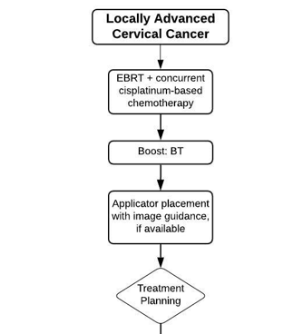
Locally advanced cervical cancer algorithm

Slide 28
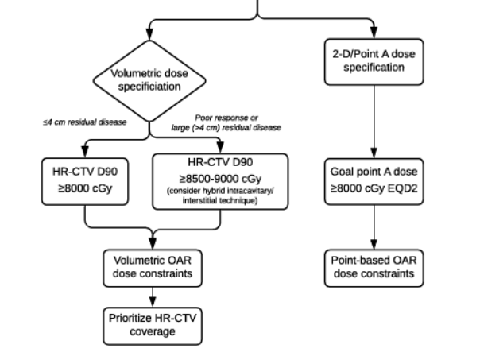
Locally advanced cervical cancer algorithm

Slide 29
Key Take Away Messages
RT remains a critical component of the curative management of all stages of cervical cancer
In early stages, initial radical hysterectomy is preferred, with risk adapted use of adjuvant RT or RT with cisplatin based chemotherapy
With locally advanced disease (≥stage IB3), RT with concurrent cisplatin based chemotherapy, followed by high-quality brachytherapy is the standard of care
Induction chemotherapy has not been shown to be superior to this approach
Additional adjuvant chemotherapy is understudy, but is not recommended at this time
IMRT is indicated to reduce the acute and late effects of RT
Special care must be undertaken to avoid under-treatment of target tissues
Consideration of target motion and regular imaging on treatment are essential
If these techniques are not available 3D conformal treatment remains an acceptable alternative

Slide 30
Key Take Away Messages (con’t)
Brachytherapy remains an essential part of the curative treatment of intact cervical cancer
SBRT and IMRT boosts have not been demonstrated to be noninferior
These techniques run the risk of increased local recurrences and toxicity
Image-guided brachytherapy is indicated to improve local control in the pelvis, and to reduce late toxicity
MRI is preferred, but CT is an acceptable alternative
If unavailable, point A based planning remains an alternative.
In advanced disease, trials using immunotherapy agents and other new therapeutic classes are ongoing
ASTRO will evaluate the need to update these guidelines on a regular schedule

