Slide 1
Instructions for Use of These Slides
The purpose of these slides is to serve as a resource that any radiation oncologist can use when speaking about the role of radiation therapy in treating GI cancers or managing GI toxicity from radiation therapy. The content of this lecture is long and may work best as a 2-part series rather than a single presentation.
The target audience could include residents/fellows, staff physicians, or mid-level providers in the field of Gastroenterology. Some aspects are also relevant to Internal Medicine, Medical Oncology and Surgical Oncology, though the section on curative use of RT is likely overly simplistic for other oncologists. Any user is welcome to format the slides as needed to fit their target audience.
Please ask attendees to complete either the pre-test or post-test so that we can assess the effectiveness of the slides. If you make significant changes to the content of the slides for your presentation, we prefer that you use the pre-test only.
Pre-test link: https://redcap.link/gi_pre1
Post-test link: https://redcap.link/gi_post1
Primary Author(s): Malcolm Mattes
Peer Reviewer(s): Anupama Chundury, Salma Jabbour, Bailey Nelson, Noam VanderWalde, Jennifer Y. Wo
Additional Support: ASTRO communications committee
Last updated in October 2022 – newer data may impact the accuracy of the content of these slides

Slide 2
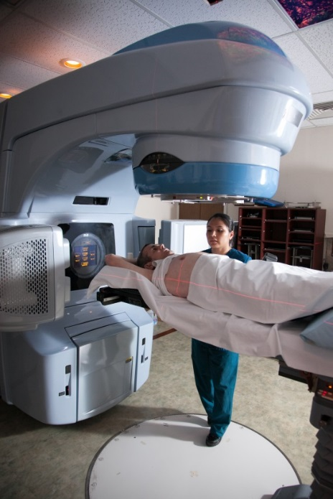
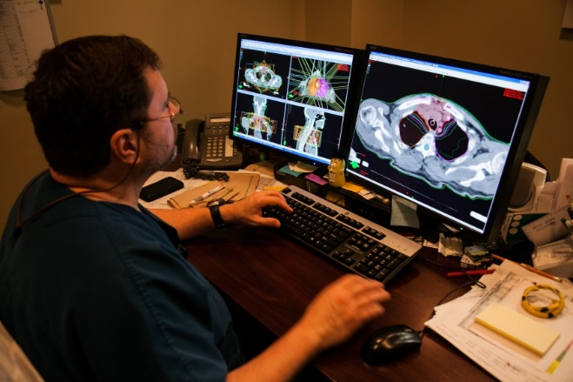
Introduction to Radiation Therapy for Gastroenterologists

Slide 3
Learning Objectives
Understand basic principles of radiation therapy
Discuss indications for curative and palliative radiation therapy in the context of multidisciplinary management of gastrointestinal malignancies
Learn radiation-induced acute and late toxicity, including management of common radiation-induced gastrointestinal complications

Slide 4
Principles of Radiotherapy for Gastrointestinal Malignancies

Slide 5
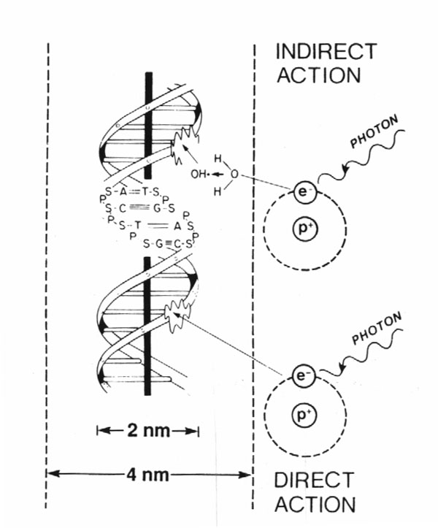
How Does Radiation Work?
80%
X-rays interact with water
radiolysis
free radicals
bind to and damage DNA
cell death
(by mitotic catastrophe)
20%
Cancer cells are more susceptible to RT
due to impaired DNA repair pathways

Slide 6
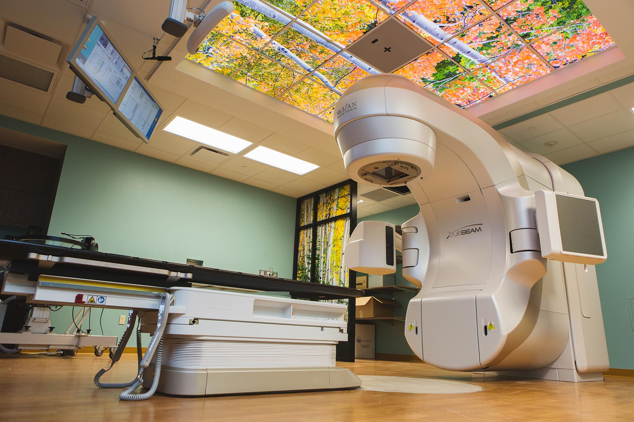
Approaches to Radiation Delivery
External Beam Radiation (majority)
Photons vs. Electrons vs. Protons
3-D CRT vs. IMRT vs. VMAT
vs. SBRT vs. IORT
Brachytherapy
Implant vs. Intracavitary
vs. Surface Molds
Radiopharmaceuticals
I-131, Y-90, Ra-223, etc.

Slide 7
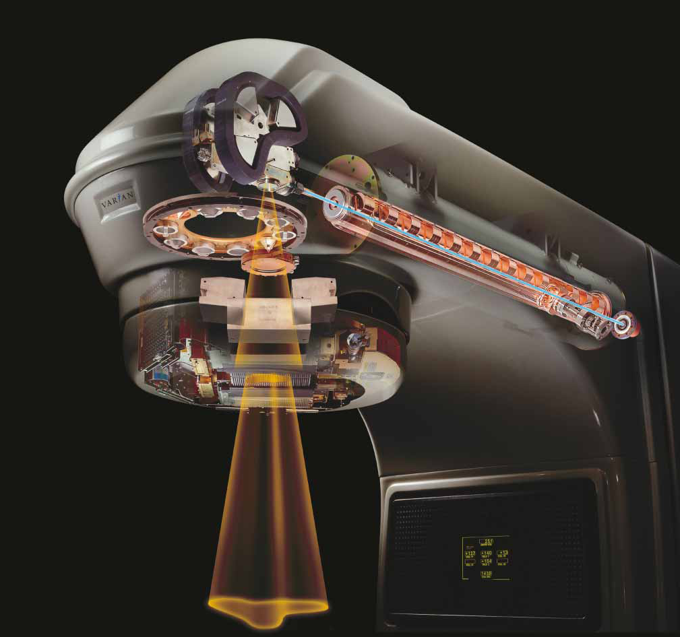
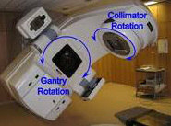
Linear Accelerator (Linac)
Delivers high energy X-rays (photons) or electrons
Non-invasive
Rapid treatment delivery, in minutes
Notes:
Explain how the machine actually works: Electricity → powers electron gun → generates high energy electrons → accelerated along waveguide → strike a Tungsten target → bremsstrahlung generates high energy photons (X-rays) → pass over a filter to generate uniform field → shaped by jaws and collimators → enter patient

Slide 8
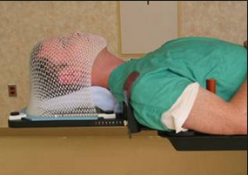
Simulation
Step 1: Position patient and design immobilization device
Goals = comfort and reproducibility
Alpha-cradle:
Foam ingredients mixed → exothermic reaction → foam rises to conform to patient
Aqua-plast:
Plastic “mesh” heated until soft → shaped to conform while warm → cools to rigid form

Slide 9
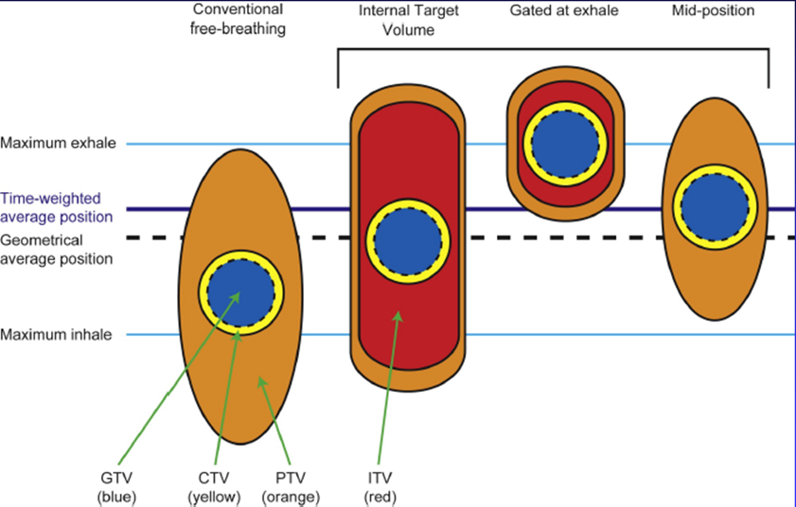
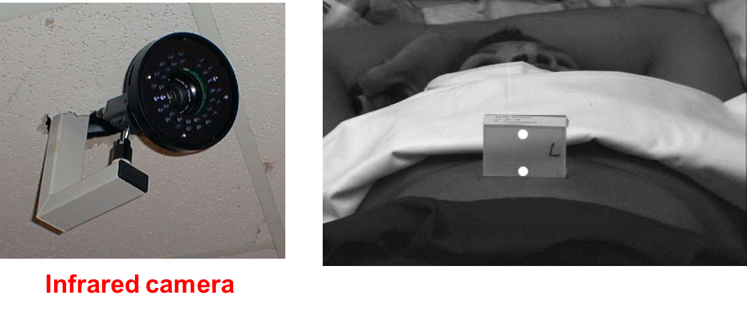
Managing Internal Organ Motion During Planning and Treatment
For upper GI malignancies:
4-D CT enables visualization of tumor motion
Deep Inspiration Breath Hold (DIBH) or respiratory gated treatments → less motion

Slide 10
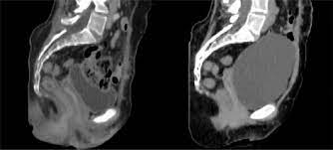
Managing Internal Organ Motion During Planning and Treatment
For lower GI malignancies:
Can displace bowel away from treated area with full bladder or prone positioning
Oral contrast enables more accurate delineation of bowel or stomach

Slide 11
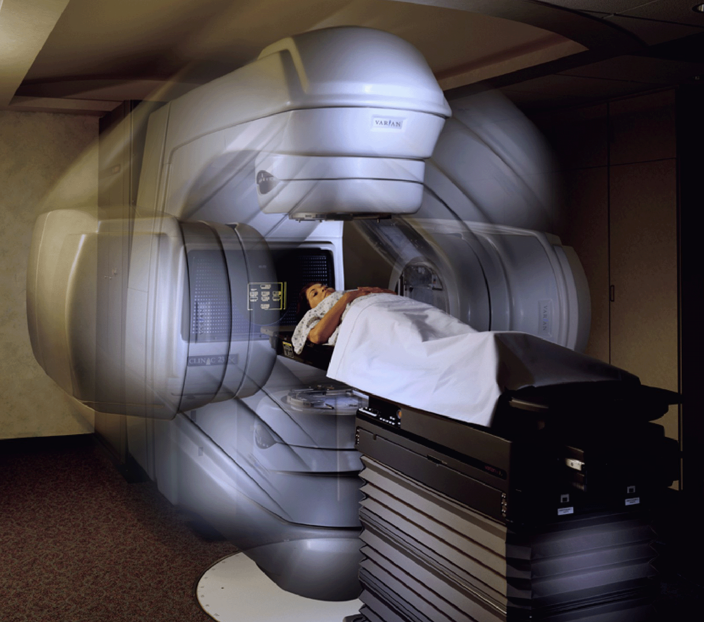
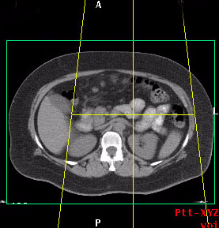
Simulation
Step 2: CT scan → tattoo/mark patient
Isocenter

Slide 12
Target-Volume Delineation
Step 3: Draw the target(s) on the planning CT (+/- with image “fusion” with PET or MRI)
GTV (Gross Tumor Volume)
Visible disease
CTV (Clinical Target Volume)
GTV + margin for clinical uncertainty/microscopic spread
PTV (Planning Target Volume)
CTV + margin for physical uncertainties (e.g. positioning, respiratory motion)
PTV
CTV
GTV
TUMOR
Notes:
Not going to talk about ITV

Slide 13
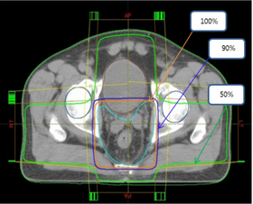
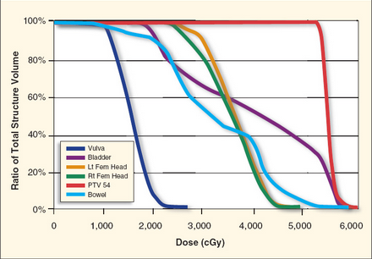
Treatment Planning
Step 4: MD provides planning directives, and dosimetrist uses sophisticated computer software to add RT field(s). “Quality” of plan evaluated by calculating dose to tumor and normal organs.
Isodose Curve:
A line passing through points of equal dose
Dose-Volume Histogram: Relates RT dose to volume of all contoured structures

Slide 14
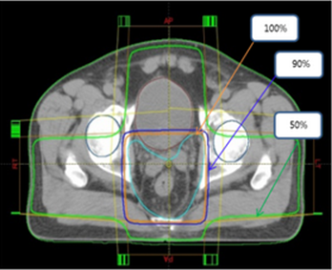
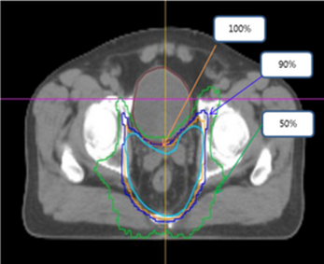
Intensity-Modulated Radiation Therapy (IMRT)
MLCs can dynamically modulate the dose intensity around a curved target volume
Improves conformality to complex target volumes
Enables dose escalation or reduction in toxicity
3DCRT
IMRT
Valuable in curative and reirradiation settings​
Rectal Cancer

Slide 15
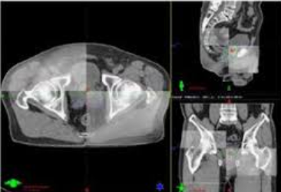
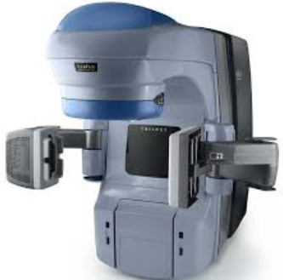
Image-Guided Treatment Delivery
Critically important to ensure accuracy of highly conformal RT plans
Accounts for daily shifts in soft tissue anatomy or patient setup
Enables reduced margin around tumor → less risk of toxicity

Slide 16
Fiducials for CT-Based Image Guidance
CT-based image guidance for abdominal tumors has relatively poor image quality, and is inadequate when delivering high dose/fraction (e.g., SBRT)
Fiducials placed within a tumor improve accuracy of delivery
Disadvantages:
Invasive procedure
Migration
Inability to place due to difficult tumor location

Slide 17
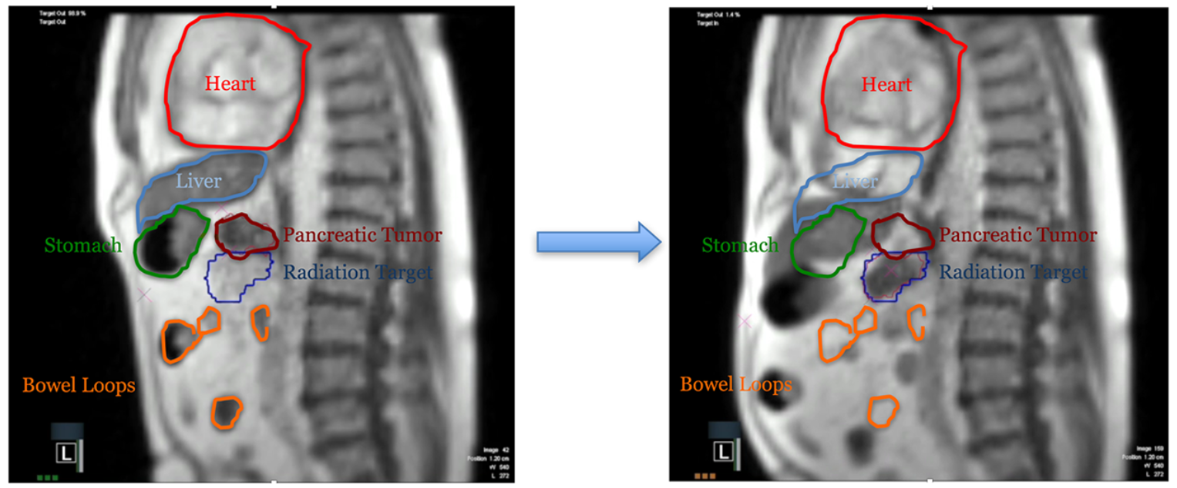
MRI-Guided Linear Accelerators
Better soft tissue characterization
No reliance on motion surrogates
CINE MRI imaging for real-time target tracking and gating
No additional radiation exposure

Slide 18
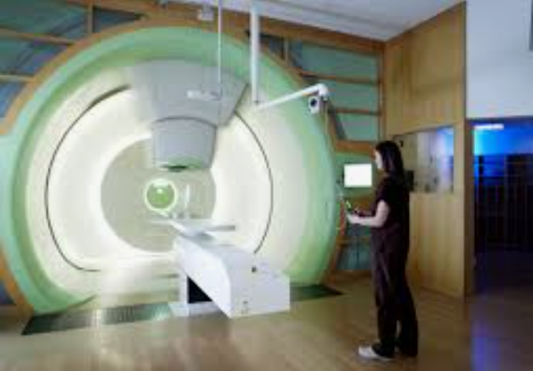
Proton Beam Therapy (PBT)

Slide 19
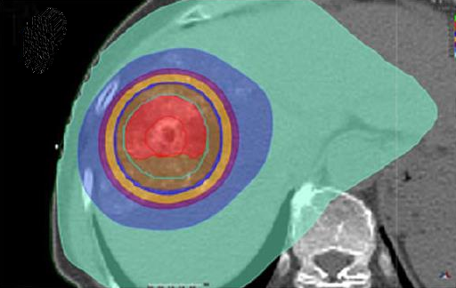
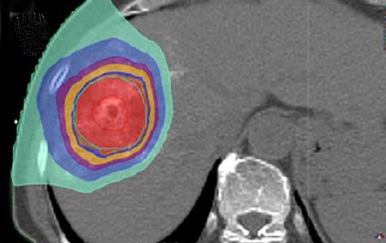
IMRT vs. PBT for Hepatobiliary Cancers
Advantage over photon IMRT in dose distribution; less low-intermediate dose to surrounding tissues.
Potential benefit for patients with cirrhosis
IMRT
PBT

Slide 20
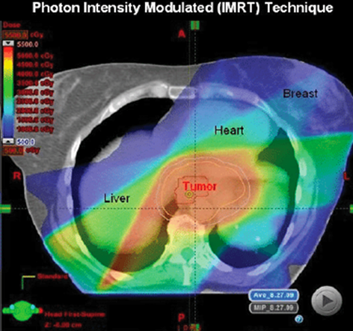
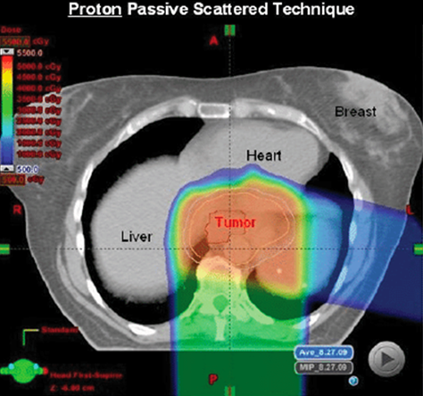
IMRT vs. PBT for Esophageal/GE Junction Cancers
Disadvantage of protons is high cost, and still to be determined benefit in clinical outcomes

Slide 21
Radiation Dosing
Gray (Gy) is the unit of RT dose
1 Gy = 100 centiGray (cGy)
The dose from 1 cGy roughly equals 1 CT scan
Dose prescription depends on:
Goal of treatment (curative > palliative)
Amount of disease (gross > microscopic)
RT sensitivity of tumor
RT sensitivity of surrounding normal tissue

Slide 22
The Total Dose is Delivered in a Series of Daily Fractions
Most patients receive multiple fractions during their treatment course
RT typically delivered once-daily, 5 days/week (30-45 min/visit)
Fractionation decreases risk of toxicity by allowing for DNA repair in normal tissue
The potency, or Biologically Effective Dose of a RT course depends not only on total dose, but how that dose is fractionated, and the tissue irradiated.

Slide 23
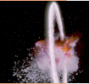
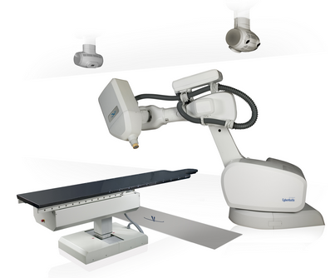
Stereotactic Body Radiation Therapy
Use of a high dose/fraction of RT in a very focused way
High probability of local control (>90%)
Can be done safely for well defined, small-medium sized targets, using our most advanced treatment technologies to deliver this very potent dose safely

Slide 24
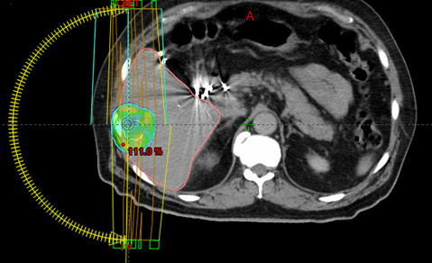
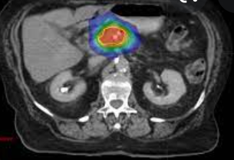
Common GI Indications for SBRT
Liver Mets or HCC
Pancreatic Cancer

Slide 25
Radiation Therapy in the Curative Management of GI Malignancies (a brief overview)

Slide 26
Conceptual Framework
Definitive surgical resection is the primary curative modality for most GI malignancies
Neoadjuvant (pre-op) radiation is commonly used for more locally advanced/borderline resectable tumors.
Adjuvant (post-op) radiation is sometimes used, if high risk pathologic features for recurrence like positive margin +/- positive LNs.
Definitive radiation for “organ preservation” is typically used for anal cancer, select rectal cancers, and other surgically unresectable tumors or medically inoperable patients

Slide 27
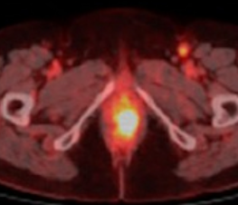
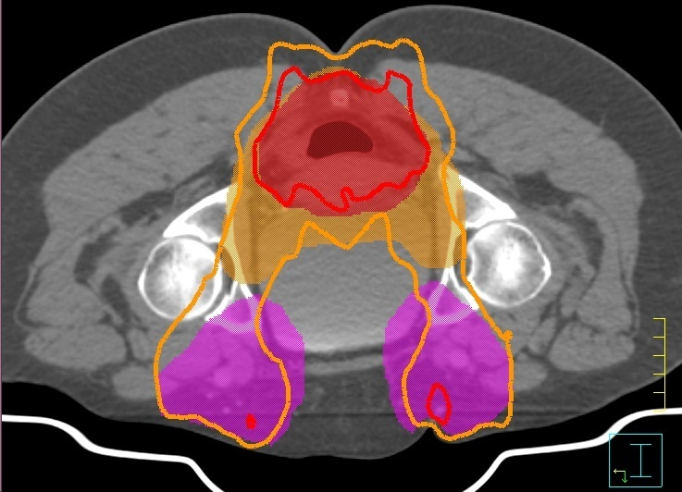
Anal Cancer
HPV+ SCC is often highly responsive to chemo-RT
Surgical resection would result in permanent colostomy
All patients undergo definitive chemo-RT to primary tumor + LNs
Persistent disease may continue to regress even at 6 months from start of chemo-RT. DO NOT BIOPSY unless evidence of growth/progression

Slide 28
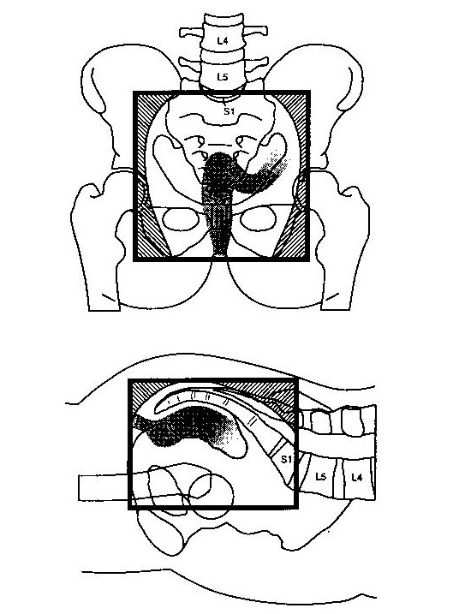
Rectal Cancer
Neoadjuvant chemo and chemo-RT commonly used for locoregionally advanced disease
Patients with a cCR based on DRE, MRI, and endoscopy may consider “watch and wait” without surgery
Alternative neoadjuvant approach is “short course” RT (5Gy x 5 fraction)
Adjuvant RT is less commonly used, but can be indicated if no neoadj RT given, & high recurrence risk (e.g., positive margin or LNs)

Slide 29
Colon Cancer
Adjuvant RT is rarely used
Considered for T4 primary tumor with extension into a fixed structure or positive margin
Neoadjuvant chemo-RT is rarely used
Considered for unresectable disease that does not respond to chemotherapy

Slide 30
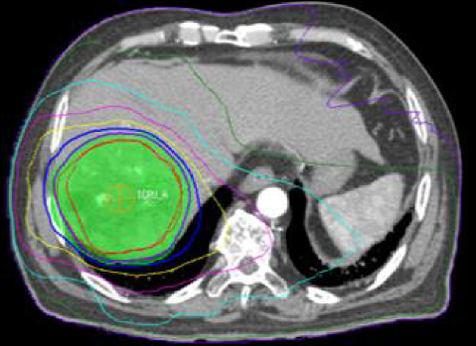
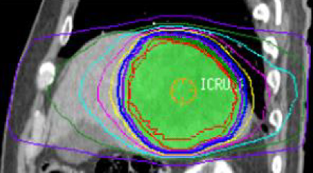
Hepatocellular Carcinoma
IMRT, SBRT or PBT commonly used in conjunction with TACE as local treatment for non-surgical or transplant candidates
Radiation can also used for bridging therapy to transplant
Y-90 radioembolization for unresectable larger volume or multifocal tumors and life expectancy >3 months

Slide 31
Biliary Cancers
Adjuvant RT is typically used for positive margin, positive LNs, or other locally advanced disease
Neoadjuvant chemo-RT may be used as a bridge to transplant for hilar cholangiocarcinoma
Definitive chemo-RT for unresectable disease
Notes:
May also mention brachytherapy for hilar cases

Slide 32
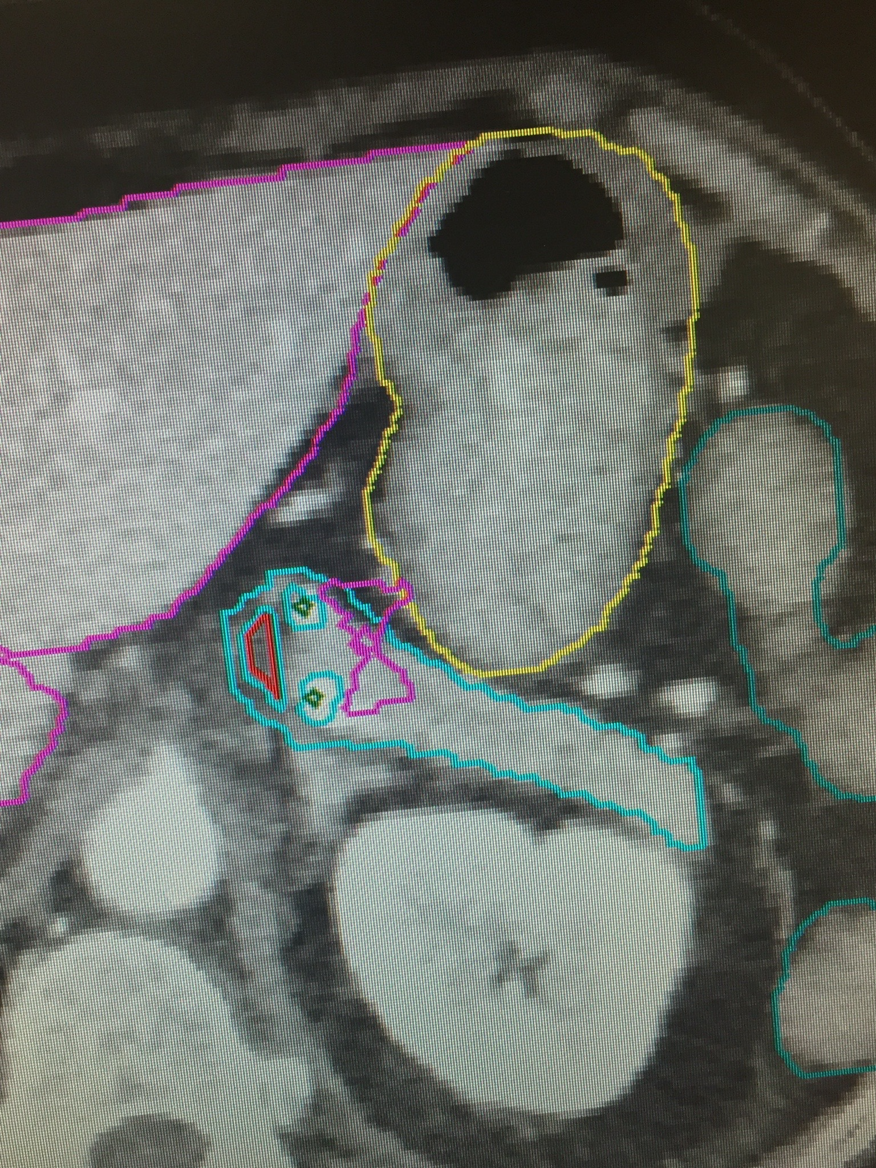
Pancreatic Cancer
Potentially curable patients undergo definitive surgery, often with neoadjuvant or adjuvant chemotherapy.
Adjuvant RT is used for positive/close surgical margins & in some cases positive LNs
Neoadjuvant RT is an option for borderline resectable tumors
Chemo-RT or SBRT is an option for unresectable, non-metastatic tumors (following induction chemotherapy)

Slide 33
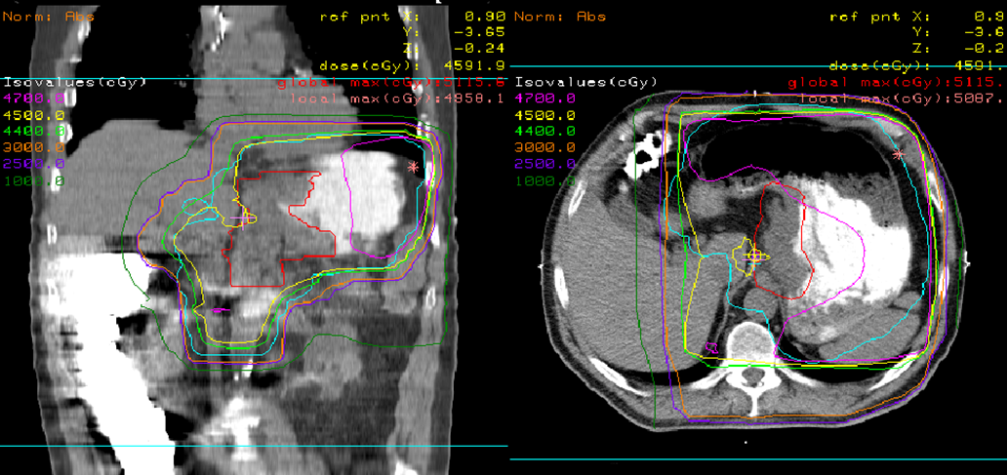
Gastric Cancer
Most patients undergo definitive surgery and peri-op chemo
Adjuvant RT can be considered if positive surgical margins, no neoadjuvant chemotherapy, or inadequate nodal dissection
Definitive RT can be considered if not a surgical candidate

Slide 34
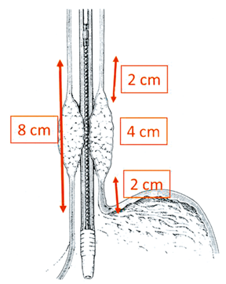
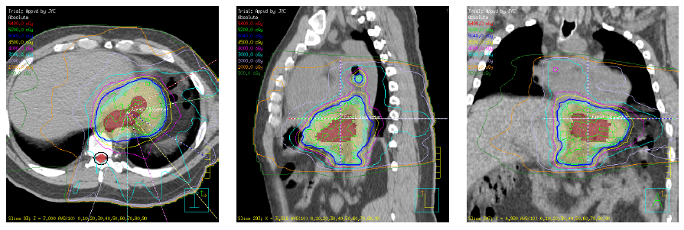
Esophageal Cancer
Neoadjuvant chemo-RT is common
More technically feasible than adjuvant RT
Definitive chemo-RT if not surgical candidate
EGD/EUS helpful for staging and defining length of involved esophagus

Slide 35
Palliative Radiation for GI Indications

Slide 36
Why Not Systemic Therapy Alone?
For any Stage IV solid tumor, systemic therapy is the primary palliative (and potentially life-prolonging) treatment modality
However, response rates to first line systemic therapy are generally <50% for most GI malignancies (and even lower for 2nd/3rd line)
Responses are also generally not immediate after start of treatment
Unless patient’s symptoms are mild, generally need to address symptomatic sites of disease with a local therapy to improve quality of life in a patient population that will not be cured.

Slide 37
What Does Palliative RT Offer?
External beam RT is non-invasive
Brachytherapy is minimally invasive
Most patients experience symptomatic relief
Relatively low doses used
Usually with minimal short-term toxicity that is readily controlled with supportive medications
Usually with no clinically significant long-term toxicity (brain RT is one notable exception)
Reirradiation may be feasible in some patients
However, usually some delay in treatment effect
Stenting or surgical palliation can provide immediate palliation, though with greater invasiveness and usually more short- and long-term morbidity

Slide 38
General Approach to Palliative/Supportive Care
All cancer symptoms exist on a spectrum
Mild symptoms
Relatively controlled
Moderate symptoms
Impacting quality of life
Severe/life threatening symptoms or refractory to other treatments
Immediate relief needed
Systemic Therapy Alone
no local side effects
+ Radiation Therapy
mild-mod potential for short or long term local side effects
+ Surgery/Invasive Procedure
higher potential for short or long term local side effects
Since these patients are incurable, before any intervention goals of care should always be evaluated and hospice considered, depending on patient’s values and wishes

Slide 39
Indications for Palliative RT are Sometimes Confused with Toxicities from Curative RT
The same symptoms that radiation can effectively alleviate, it can also cause as late toxicity.
However, this does not mean that radiation will make a cancer-induced symptom worse.
Most tumors respond to RT
By design, the incidence of severe late toxicities is generally low (<5%) in the curative setting, and very low in the palliative setting.
Notes:
Somehow the toxicities are remembered more

Slide 40
Common GI Indications for Palliative RT
 | Examples | Usual Dose & Fractions Needed | Time To Response
Bleeding | esophagus, stomach, rectum | Relatively low (8-20 Gy in 1-5 fractions) | days
Obstruction | esophagus, stomach, colon, rectum, biliary | Somewhat higher (30-50 Gy in 10-20 fractions) (+/- concurrent chemo) | days - weeks
Pain | celiac nerve, bone mets, liver mets | Depends on tumor site and extent of disease | days - weeks
Neurologic Symptoms | brain mets, spinal cord compression | Depends on tumor site and extent of disease | days - weeks
A general rule of thumb is that ~75% of patients who live long enough to respond to palliative RT will have improvement in their symptoms (though in practice, a number of factors can affect this rate)
Notes:
May be higher or lower depending on a variety of factors

Slide 41
Evaluation for Palliative RT
Identify the source of the symptoms
H&P, imaging, endoscopy
Define specific goals
e.g., pain relief, ↓ mass effect, bleeding control
↓ requirements for supportive meds (e.g. opioids, steroids)
Estimate patient’s life expectancy
Impacts treatment modalities offered; also dose of RT given
Ideally >1 month so patient alive long enough to benefit
Goal is ↓ symptom for duration of life, with least morbidity possible

Slide 42
When To Consult Radiation Oncology?
Immediately upon diagnosis of any cancer-related symptom that may benefit from radiation
Optimize multidisciplinary decision making
Important since usually lacking randomized evidence to guide management in palliative setting
You do not need to wait for pathologic confirmation of disease
Expedite treatment
Important in a symptomatic patient
Greater likelihood patients will live long enough to benefit from palliative RT if initiated earlier in course

Slide 43
Scenario 1: Malignant Dysphagia
68M presents with 6 months dysphagia and 20 lbs weight loss. He is diagnosed with a distal esophageal AdenoCA with metastases to celiac nodes and liver.
How do you manage his dysphagia?
First, grade its severity
Dysphagia | Symptom
Grade 0 | Able to swallow all solid foods without difficulty
Grade 1 | Able to swallow solid foods with some difficulty
Grade 2 | Able to swallow soft or semi-solid foods only
Grade 3 | Able to swallow liquefied foods and liquids only
Grade 4 | Unable to swallow liquids/saliva

Slide 44
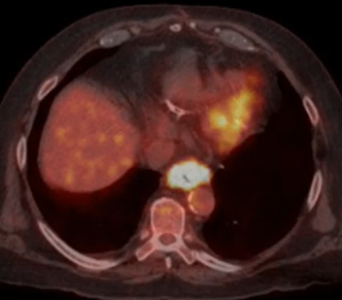
Potential Treatment Modalities
Chemotherapy Alone
Endoscopic Approaches
Dilation, injection therapies, PDT, APC, cryospray ablation, stenting
Radiation Therapy
External beam (+/- chemotherapy) or brachytherapy

Slide 45
Palliative RT for Malignant Dysphagia
RT is generally effective:
70-90% dysphagia relief within 2 weeks of starting RT
50-70% dysphagia-free until death
Max benefit ~ 4 weeks (longer for AdenoCA than SCC)
Duration of response, and expected complications of RT, depend on dose of RT prescribed
Transient worsening of dysphagia in 30% due to esophagitis
Strictures are uncommon at palliative doses, but can occur with higher doses
TE fistulas are uncommon, but patients with SCC near airways who had prior stent are at some risk
Hayter CR. Radiother Oncol, 2000
Homs MY. Lancet, 2003
Steyerberg ES. Gastrointest Endosc, 2005
Stahl M. Ann Oncol, 2013
Spaander MCW. Endocopy, 2016
Fuccio L. Radiother Oncol, 2017
Penniment MG. Lancet Gastroent Hepatol, 2018

Slide 46
Stents for Malignant Dysphagia
Stents provide most rapid palliation of dysphagia, but the difference gradually diminishes over time compared to RT
64% rate of stent-related adverse events within 1 year
33% rate of major adverse events
0.5-2% mortality rate, related to sedation, aspiration, stent malposition or esophageal perforation
Dai Y. Cochrane Database Syst Rev, 2014
Medeiros VS. Gastrointest Endosc, 2017

Slide 47
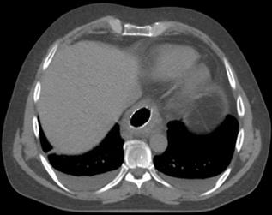
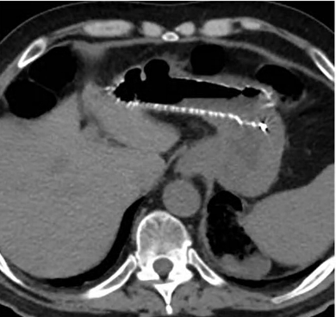
Risk Factors For Complications from Esophageal Stent
Tumor Related Factors:
Longer length stents
Advanced tumor stage
Tumor invading the aorta
Treatment Related Factors:
RT prior to stent placement
RT after stent placement
Tumor shrinkage → stent migration in 31%
2-3x increased acute toxicity from chemo-RT
Stent → larger RT target volume → higher dose to heart & lungs
Longer survival after stenting:
Stent migration or occlusion (10-50%)
Fistula formation (4-14%)
Highest risk if mid-esophageal tumor and prior RT
Stent Migration
Siddiqui AA. Dis Esophagus, 2009
Francis SR. Int J Radiat Oncol Biol Phys, 2017

Slide 48
Potential Indications for Endoscopic Intervention for Esophageal Cancer
Fistula is present (clearest indication for stent)
Patients for whom definitive management with chemo-RT is planned, but severe dysphagia at presentation requires intervention prior to therapy
Try to avoid stent unless absolutely necessary
If patients has incomplete obstruction or SCC, better to place NG tube and start RT right away since likely to respond to RT relatively quickly. If patient has complete obstruction or AdenoCA then stent may have more value up-front.
Failure to achieve adequate palliation of dysphagia with initial therapy
Recurrent dysphagia after RT due to local failure or benign stricture
Patient is a poor candidate for either chemotherapy or radiation therapy
Notes:
Stents are not for everybody, and in most cases up-front palliative RT is preferred

Slide 49
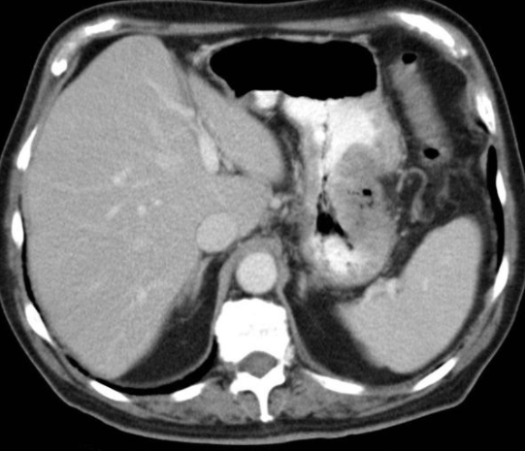
Scenario 2: Palliation of Gastric Cancer
Palliative RT is preferred to palliative surgery (gastrectomy or gastrojejunostomy) or endoscopic approaches in most cases
Expected long-term control rates with RT:
70-90% for bleeding
50-80% for dysphagia/obstruction
45-80% for pain
Endoscopic stent may be indicated for obstructive symptoms if more immediate relief is needed
Downside is shorter duration of tumor control, heartburn and dietary modifications
Tey J. Int J Radiat Oncol Biol Phys, 2007
Harvey JA. Dis Esophagus, 2004
Asakura H. Cancer Res Clin Oncol, 2011
Yuan ST. Am J Clin Oncol, 2015

Slide 50
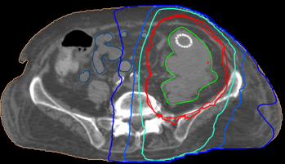
Scenario 3: Bowel Obstruction
Distinguish benign from malignant bowel obstruction
In cancer patients, large bowel obstruction much more common than small bowel obstruction
Bowel obstruction often requires more immediate relief than RT can provide, so surgical exploration or stenting are generally preferred up-front management if obstruction does not resolve with conservative management
Myint AS. Eur J Gastroenterol Hepatol 2000;12:381
Crane CH. Int J Radiat Oncol Biol Phys 2001;49(1):107
Willet CG. J Gastrointest Surg 2004;8(3):277
Cameron MG. BMC Res Notes 2011;4:252
Bae SH. Radiation Oncology 2011;6:52
Cameron MG. Acta Oncologica 2014;53:164

Slide 51
Scenario 4: GI Bleeding
As Indicated:
Stabilize emergent bleeding/major hemorrhage
Blood transfusion
Endoscopy to identify source + hemostasis
Palliative RT generally stops slower bleeds from a tumor within days, regardless of the tumor site

Slide 52
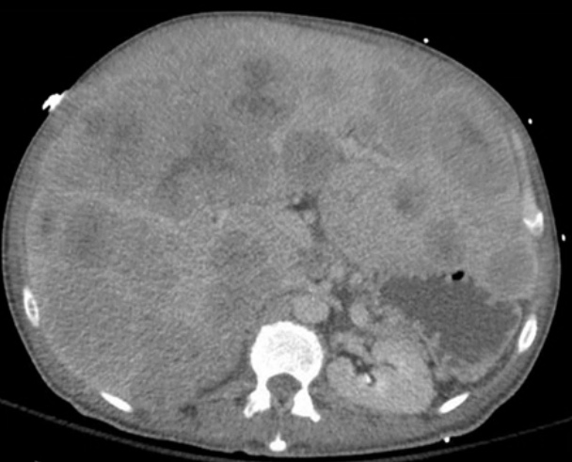
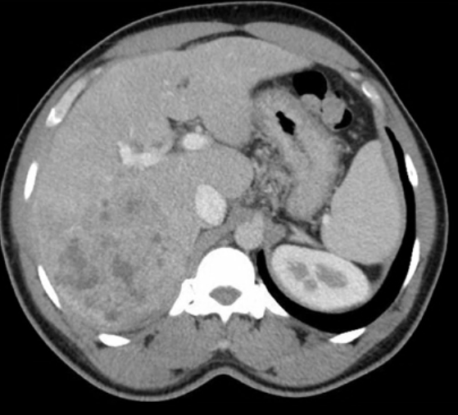
Scenario 5: Painful Liver Tumor (Primary or Metastasis)
Can cause pain by several mechanisms:
Capsule stretch and inflammation
Chest/abdominal wall invasion
Duct dilation and obstruction
Initial medical management:
Trial of opioids or low dose Decadron (2-4mg)

Slide 53
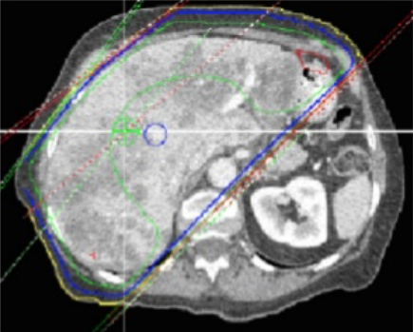
Palliative RT for Painful Liver Tumors
Can treat whole liver or focal area
Usually 8-21 Gy in 1-7 fractions
Minimal toxicity
Transient fatigue, nausea, diarrhea or pain flare
Partial pain response in 50-80%
Latency to pain response ~2 weeks
Duration of pain response ~13 weeks
Bydder S. Australasian Radiology 2003
Hoyer M. Int J Radiat Oncol Biol Phys 2012
Soliman H. J Clin Oncol 2013

Slide 54
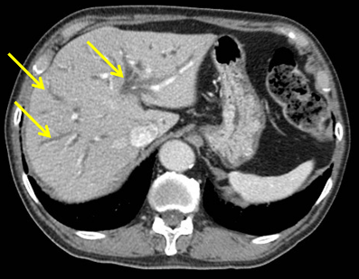
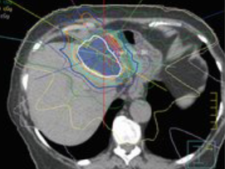
Scenario 6: Biliary Obstruction
For distal unresectable malignant biliary obstruction, stenting is favored over surgical bypass or percutaneous drainage
Stent patency typically 60-200 days
EBRT should be considered if jaundice is refractory to the above interventions
Response rate varies depending on etiology (extrinsic compression vs. longitudinal tumor infiltration in duct)
Brachytherapy can be considered based on institutional expertise
Moss AC, Cancer Treat Rev, 2007 Saito H. J Hepatobiliary Pancreat Surg, 2008

Slide 55
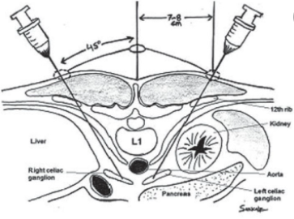
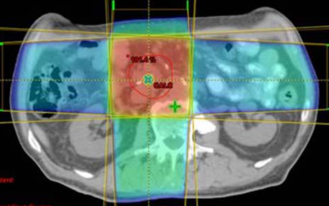
Scenario 7: Pancreatic Cancer With Celiac Nerve Pain
Celiac plexus neurolysis (nerve block) is more effective than pharmacologic therapy alone
Pain relief in 50-90% at 3 months across various studies
RT should be considered if incomplete response (or refractory pain) to nerve block
Pain relief in 50-75%, though maximal effect takes several weeks
Eisenberg E, Anesth Analg, 1995
Ceha HM, Cancer, 2000

Slide 56
Understanding and Managing Radiation-Induced GI Toxicity

Slide 57
Case Study: Radiation Proctitis
A 64-year-old male is diagnosed with prostate cancer
He sees a urologist and radiation oncologist and is informed that radiation and radical prostatectomy have relatively equal curative potential
He chooses to proceed with RT over surgery, since RT is less likely to cause long term ED and urinary incontinence. He is aware of the risk of chronic radiation proctitis

Slide 58
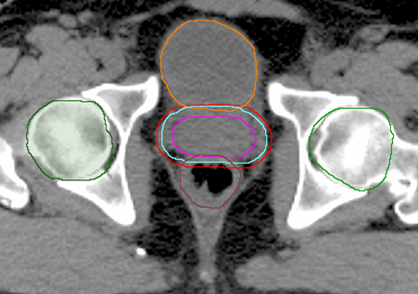
Case Study: Why Does Proctitis Happen?
Most prostate cancer is in the peripheral zone (postero-lateral prostate), which directly abuts the anterior rectal wall
In order to effectively cure the cancer, the anterior rectal wall must get a relatively high RT dose
The same principle applies to any organ in close proximity to tumor
Contoured Target Volumes and Avoidance Structures
RT Dose Distribution

Slide 59
Case Study: Ways to Prevent Proctitis
Implantable hydrogel spacer to physically separate rectum from prostate and decrease rectal dose
Cone Beam CT
Assessment of probability of toxicity based on planning “constraints”
Daily image guidance to safely reduce margin around prostate
Despite our best efforts, long-term toxicities still happen for some patients
Notes:
We’ll come back to this case study in a minute.

Slide 60
Factors That Impact the Probability of Radiation Toxicity in a Given Organ
Type of organ irradiated
Some organs are more sensitive than others
Parallel vs. serial organs
Dose/volume vs. max point dose
Total dose and dose/fraction to that organ
Technique of radiation delivery
Use of concurrent radiosensitizer (e.g., chemotherapy)
Underlying vascular, inflammatory or autoimmune conditions

Slide 61
Acute vs. Late Radiation Toxicities
Early (acute) toxicity occurs during or shortly after RT
Generally due to death of normal cells involved with cell turnover, leading to thinning or denudation
Usually readily treatable with supportive medications, or occasionally treatment break if severe (avoid invasive endoscopic procedures)
Full recovery within weeks of completing RT
Late (chronic) toxicity occurs 3 months – years after RT
Generally due to scarring/fibrosis in irradiated organs and their vascular supply
Usually irreversible and more difficult to treat
Minimizing risk of severe late toxicity is generally what limits RT prescription (“acceptable” amount of risk varies)

Slide 62
Diagnosing Radiation Toxicity
Step 1: Make sure the patient underwent radiation therapy
Step 2: Find out what part of the body received radiation
Only irradiated organs develop radiation toxicity
Step 3: Ask a radiation oncologist if they think a given sign or symptom is radiation toxicity
This will help you narrow your differential diagnosis and treat the patient appropriately
Each of these steps is important before biopsy or other invasive procedure is considered.

Slide 63
Acute GI Radiation Toxicities
Esophagitis
Sx: dysphagia, odynophagia, substernal discomfort
Ddx: esophageal thrush (consider empiric Nystatin)
Tx: viscous lidocaine, antacid or mucosal coating agent (magnesium or aluminum hydroxide), analgesics, PPIs, dietary modifications
Gastritis
Sx: Nausea/vomiting, dyspepsia, anorexia, abdominal pain
Tx: anti-emetics (45 min before RT and prn), PPI

Slide 64
Acute GI Radiation Toxicities
Enteritis
Sx: diarrhea, abdominal pain, nausea, anorexia, malaise
Imaging: Thickened loops of bowel correlating with RT dose
Ddx: rule out infection if diarrhea
Tx: Immodium or Lomotil for diarrhea, dietary modifications
Proctitis
Sx: Diarrhea, mucus discharge, urgency, tenesmus, bleeding
Tx: Dietary modifications, antidiarrheal agent or topical anti-inflammatory

Slide 65
Chronic GI Radiation Toxicities
Esophageal stricture, altered motility, ulceration, perforation or fistula
Dilation(s) for stricture, +PPI
Stent or surgical intervention for fistula or perforation
Gastric ulceration, non-ulcer dyspepsia or antral stenosis
PPI prophylaxis reduces risk of ulcer in patients receiving high dose
Dyspepsia treated with PPI, and analgesics if severe
Esophageal Stricture

Slide 66
Chronic GI Radiation Toxicities
Capsule Endoscopy:
Small or large bowel enteritis can cause altered motility, reduced bile absorption, bacterial overgrowth, lactose malabsorption, ulceration, stricture or obstruction
Workup with endoscopy and imaging
Treat symptoms as appropriate with antidiarrheal agents, bile-acid binding sequestrants, antibiotics for bacterial overgrowth, low residue diet if obstructive symptoms
Abnormal jejunal villi and lacteals
Jejunal stricture

Slide 67
Back to the Case Study: Diagnosis of Chronic Radiation Proctitis
Typically occurs > 9 months after pelvic RT in area of high dose.
After prostate RT → mild (G1-2) in ~33% and severe (G3-4) in <5% of patients
Detailed H&P + labs as indicated to rule out other causes of colitis
MRI if concern for fistula, CT if obstructive symptoms concerning or malignancy
Endoscopic findings: mucosa is pale and noncompliant with telangiectasias (+/- strictures, ulcerations, fistulas and areas of mucosal hemorrhage)
Minimize rectal trauma or biopsies due to risk of fistula formation (or if Bx necessary, direct it at lateral or posterior wall)

Slide 68
Management of Chronic Radiation Proctitis
If symptoms mild, can monitor without intervention
Rectal urgency → fiber, cholestyramine
Stricture → stool softener → dilation as needed
Tenesmus or rectal pain → sucralfate or hydrocortisone enema
Bleeding → sucralfate enema → if no response within 4 weeks then endoscopic therapy (usually APC)
Other considerations: hyperbaric oxygen, formalin enema
After prostate RT, minimize trauma to anterior rectal wall, especially in distal 2cm of rectum
Discuss management plan with Rad Onc
Telangiectasias and hematochezia
Status post Argon Plasma Coagulation
Paquette IM, Dis Colon Rectum, 2018

Slide 69
Take Home Points
Radiation is a critical component of the multidisciplinary management of GI malignancies
Variety of neoadjuvant, adjuvant, definitive and palliative indications
Early radiation oncology consultation facilitates effective multidisciplinary care
Severe acute or chronic radiation-induced GI toxicities are best managed by gastroenterology and radiation oncology together
Trainees are welcome to come rotate with us in radiation oncology (even if just for a day) so you can get a better sense of what we do
Please complete the post-test! https://redcap.link/gi_post1

